Slide 1
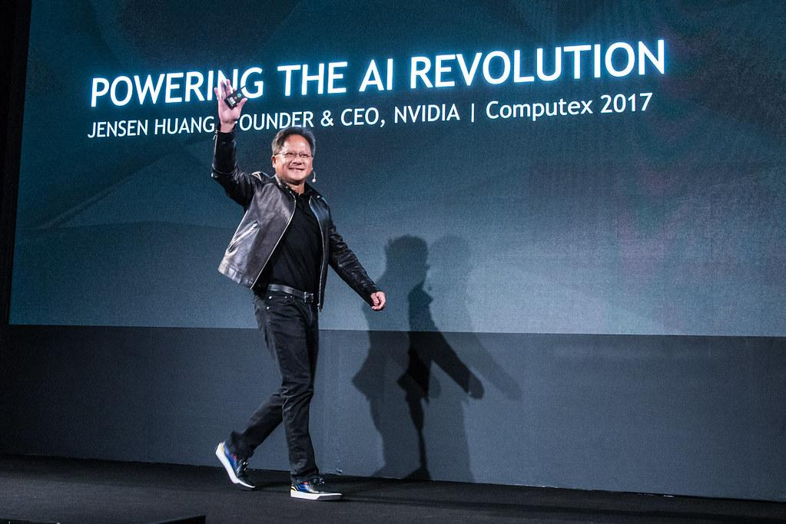
RoboReviews
By Benny Michel
Automated AI-Driven Review Synthesis

Slide 2
The Pitch
RoboReviews is an automated, AI-powered shopping assistant.
Objective: Transform over 67,000 raw customer reviews into unbiased buyer's guides.
Eliminates 'Review Fatigue': The AI reads, analyzes, and summarizes the data for you.

Slide 3
Introduction & Problem
The real-world problem: Information overload and contradictory ratings.
Standard star ratings do not detail specific product flaws.
The application: A cohesive 3-step pipeline (Classification -> Clustering -> Generation).
Methodology: Traditional Machine Learning (Scikit-Learn) combined with Generative AI.

Slide 4
Methods & Preprocessing
Dataset: 67,000+ Amazon Reviews across 6 target categories (Tablets, Smart Home, etc.).
NLP Preprocessing: Text cleaning via Regex and removal of Stopwords.
Feature Extraction: TF-IDF Vectorization.
Configuration: Retained unigrams and bigrams, capped at 5,000 maximum features.

Slide 5
Model 1 - Sentiment Classification
Objective: Classify textual reviews into Positive, Neutral, or Negative sentiments.
Model Used: Logistic Regression (via Scikit-Learn).
The Challenge: Severe class imbalance (massive overrepresentation of positive reviews).
The Solution: Applied Undersampling techniques to strictly balance the training data.

Slide 6
Model 1 - Evaluation
Result: Achieved 76% Global Accuracy on the balanced test set.
Validation: The confusion matrix proves the model's ability to isolate true negative reviews.
Critical Step: If this classification fails, the entire downstream pipeline is compromised.
it was classifying a lot of reviews

Slide 7
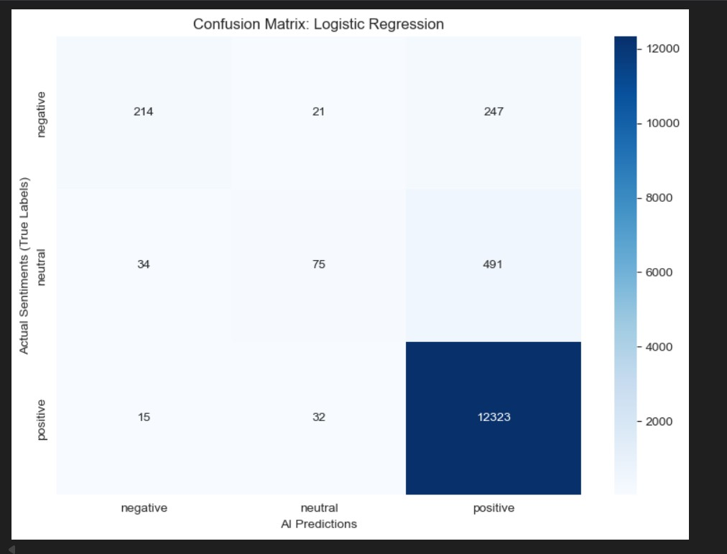

Slide 8
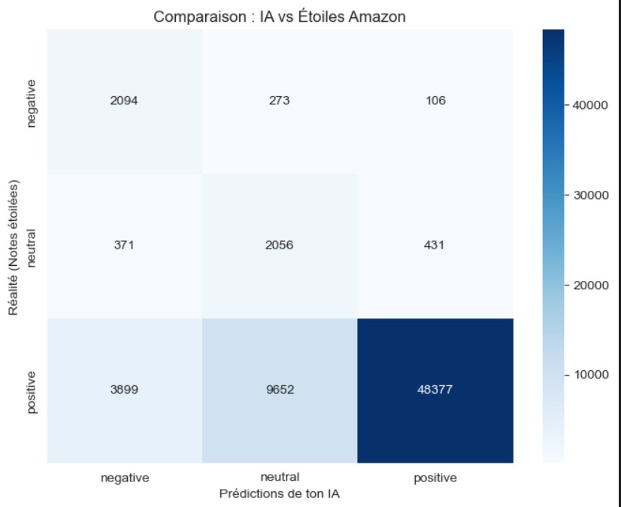

Slide 9
Model 2 - Issue Clustering
Objective: Determine the root mathematical causes of customer dissatisfaction.
Model Used: K-Means Clustering (Unsupervised Learning).
Implementation: Applied exclusively to the subset of reviews classified as 'Negative'.
Result: Extracted the top 3 specific friction points (clusters) per product category.

Slide 10
Model 3 - Generative AI
Objective: Convert mathematical clusters into a readable, natural blog article.
Models Used (Hybrid Approach): Google Gemini 2.5 Flash (Cloud) and Qwen 2.5 (Local).
Mechanism: The LLMs only receive the top 3 flaws extracted by K-Means.
Benefit: This strict constraint entirely prevents the Generative AI from hallucinating.

Slide 11
The Technical Bonus: Local GPU Inference
Highlight: Successful local deployment of the Qwen 2.5 (3 Billion Parameters) model.
Hardware: Executed completely offline on an NVIDIA RTX 5070 GPU.
Advantages: Total independence from third-party Cloud APIs and strict data privacy.
Conclusion: A perfect blend of reliable classic ML and creative Generative AI.

Slide 12
Demonstration
Launch of the Streamlit user interface.
Dynamic selection of product categories.
Real-time display of the AI's final verdict.

