Slide 1
Customer Churn System
Prediction, Prevention, and Business Impact
July 31, 2025
A comprehensive analysis of modern customer retention strategies
Presented By:
1.Mohammed Aathif Khan.A
2.Monish Meganathan
3.Mohamed Arshad.M
4.Diyanath.K

Slide 2
Agenda
1.
Introduction & Business Impact
9.
Real-World Case Studies
2.
Understanding Churn Fundamentals
10.
Tools & Technologies
3.
Data Collection & Preparation
11.
ROI & Business Value
4.
Machine Learning Models
12.
Best Practices
5.
Key Metrics & KPIs
13.
Challenges & Solutions
6.
Churn Prediction Workflow
14.
Future Trends
7.
Prevention Strategies
15.
Conclusion & Next Steps
8.
Implementation Framework
Customer Churn System
2
Made with Genspark

Slide 3
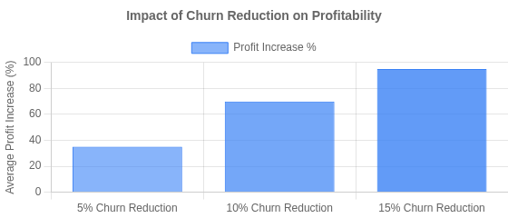
1. Introduction & Business Impact
Why Churn Matters
Financial Impact
Definition: Customer churn represents the rate at which customers stop doing business with a company over a given period
Acquisition vs Retention: Acquiring a new customer costs 5-25x more than retaining an existing one
Revenue Impact: Reducing churn by just 5% can increase profits by 25-95%
Growth Ceiling: High churn creates a "leaky bucket" effect, limiting sustainable growth
Average Churn Rates by Industry
Industry Statistics
80% vs 8%
of CEOs believe they deliver superior customer experience, but only 8% of customers agree
SaaS
5-7% monthly
Telecom
2-3% monthly
Banking
20-25% annual
E-commerce
60-80% annual
52%
of customers switched brands in the past year due to poor customer experience
Customer Churn System
3

Slide 4

Understanding Customer Churn Fundamentals
What is Customer Churn?
Key Drivers of Churn
Customer churn refers to when customers stop doing business with a company or service. In subscription-based models, it's measured as the percentage of customers who cancel or don't renew within a given period.
Customer Dissatisfaction
Poor product experience, unmet expectations, or service quality issues
Low Engagement
Infrequent product usage, declining feature adoption, or low perceived
Types of Churn
value
Competitive Offers
Voluntary Churn
Customer makes a conscious decision to leave due to dissatisfaction, better alternatives, or changing needs
Better pricing, features, or service from competitors pulling customers
away
Pricing Issues
Involuntary Churn
Customer leaves due to external factors like payment failures, expired cards, or technical issues
Value not aligning with cost, unexpected price increases, or billing
problems
Silent Churn
Customer disengages but doesn't formally cancel, often still paying but "mentally checked out"
Business Impact
A 5% reduction in churn can increase profits by 25-95%, making churn prediction and prevention critical for sustainable business growth and
valuation.
Customer Churn System
4
Made with Genspark

Slide 5








Data Collection & Preparation
Critical Data Sources
Preprocessing Best Practices
Behavioral Data: Product usage, feature adoption, login frequency, session duration
Transactional Data: Purchase history, subscription changes, payment records
Demographic Data: User role, company size, industry, geographical location
Support Interactions: Ticket frequency, resolution time, satisfaction scores
Missing Data: Imputation strategies (mean/median), removal when appropriate
Scaling: Normalize numerical features to prevent algorithm bias
Encoding: One-hot encoding for categorical data, target encoding for high-cardinality features
Handling Imbalanced Data
Feature Engineering
SMOTE: Synthetic Minority Over-sampling Technique to generate synthetic churned examples
Class Weights: Adjust model weights to give more importance to minority class
Undersampling: Reduce majority class samples for balanced training
Lag Features: Time since last login, purchase, or support contact
Rolling Aggregates: Average activity over 7, 30, or 90-day periods
Ratio Metrics: Usage relative to plan limits, engagement vs. industry benchmarks
Key Insight: 80% of successful churn prediction models depend on quality data preparation. The most predictive features are often derived from raw data through careful feature engineering.
Customer Churn System
5

Slide 6

Machine Learning Models for Churn Prediction
Top Models for Churn Prediction
Model Comparison
Logistic Regression
Simple, interpretable, fast to implement. Good baseline model that provides clear coefficients for feature importance.
Model Accuracy Interpretability Complexity Data Size
Logistic Regression
●●○○○ ●●●●● ●○○○○
Small- Medium
Random Forests
Handles non-linear relationships well. Robust to outliers and less prone to overfitting. Provides feature importance metrics.
Random Forests
Medium
●●●○○
●●●○○
●●○○○
GBMs
(XGBoost)
●●●●○
●●○○○
●●●○○
Medium- Large
Gradient Boosting Machines
XGBoost, LightGBM, CatBoost - High accuracy for complex data. Sequential learning from previous models' errors.
Neural Networks
●●●●●
●○○○○
●●●●●
Large
Neural Networks
Deep learning for complex patterns. Best with large datasets, but less interpretable and more complex to tune.
Model Selection Guidance:
Start with simple models (logistic regression) as a baseline
When interpretability matters, use tree-based models with SHAP values For highest accuracy with adequate data, use ensemble methods
(XGBoost)
Consider model combinations for improved performance
Always cross-validate and evaluate using business-relevant metrics
Key takeaway: Model selection depends on your business context, available data, and need for interpretability vs. accuracy
Customer Churn System
Machine Learning Models
6

Slide 7
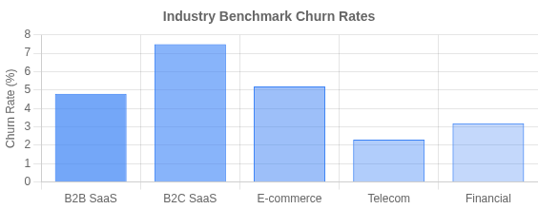
Key Metrics & KPIs
Customer Churn Rate
Percentage of customers lost during a specific period. Formula: (Lost Customers ÷ Total Customers at Start) × 100
Additional Key Metrics
Customer Effort Score (CES): Measures ease of customer
Customer Retention Rate
Percentage of customers retained over time. Formula: ((End Customers
- New Customers) ÷ Starting Customers) × 100
interactions
Customer Satisfaction (CSAT): Direct measure of satisfaction
with service/product
Customer Lifetime Value (CLV)
Total revenue expected from a customer during their relationship with your business
DAU/MAU Ratio: Engagement metric showing daily to monthly
active user ratio
Revenue Churn Rate: Revenue lost from existing customers
over time
Net Promoter Score (NPS)
Measures customer loyalty based on likelihood to recommend. Formula: % Promoters - % Detractors
Expansion Revenue: Additional revenue from existing
customers
Key Insights
5% monthly churn rate = ~46% annual customer loss Reducing churn by just 5% can increase profits by 25-95%
Customer acquisition costs 5-25x more than retention Loyal customers are 5x more likely to repurchase
Customer Churn System
7

Slide 8
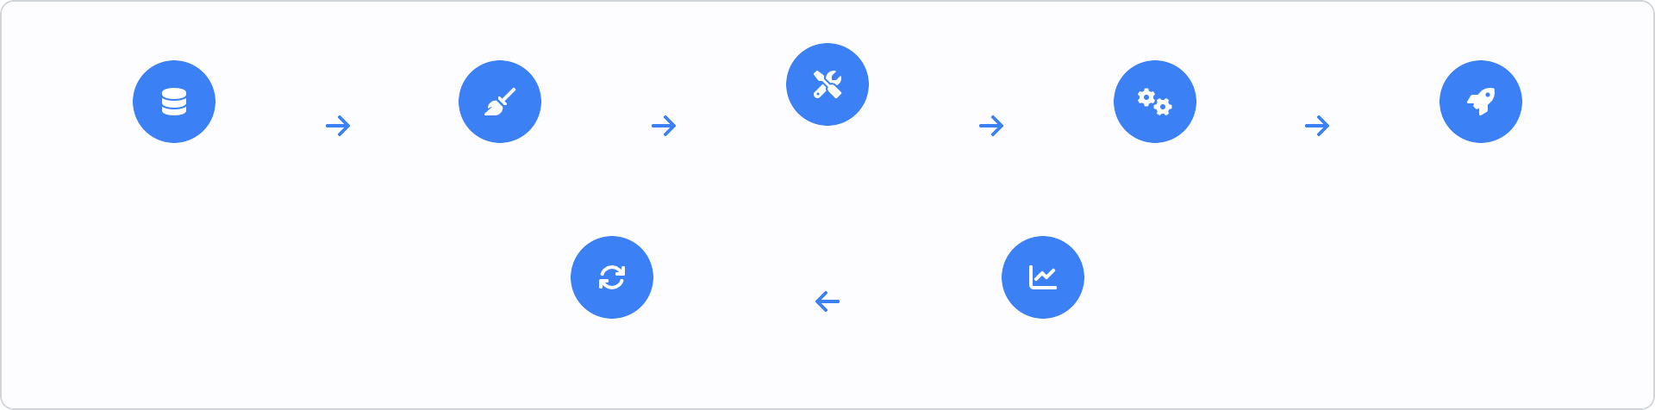




Churn Prediction Workflow
Data Ingestion
Preprocessing
Feature Engineering
Model Training
Deployment
Retraining
Monitoring
Data Collection & Ingestion Customer interaction data, transactional logs, support interactions, demographic data
Data Preprocessing Cleaning, handling missing values, addressing data imbalance, normalization
Feature Engineering Creating lag features, rolling aggregates, categorical encoding, time- based features
Model Training & Selection Logistic regression, Random Forests, Gradient Boosting, hyperparameter tuning
Deployment & Action Real-time or batch prediction, integration with CRM, targeted interventions
Monitoring & Retraining Tracking model performance, data drift detection, periodic model updates
1
4
2
5
3
6
Customer Churn System
8

Slide 9





Prevention Strategies
Proactive approaches to retain customers before they churn
Personalized Onboarding
Health Scoring System
Tailor user journeys based on role, behavior, and needs. Guide users to their first value moment with interactive walkthroughs.
Implement scoring models that flag at-risk customers based on engagement, support tickets, and feature adoption metrics.
Proactive Outreach
Loyalty Programs
Intervene before users churn with personalized offers, check-ins, and support from customer success teams triggered by risk signals.
Reward long-term customers with exclusive benefits, tiered rewards, and recognition to increase switching costs and emotional connection.
Root Cause Analysis
Value-Based Pricing
Systematically analyze why customers leave through exit interviews, offboarding surveys, and mapping churn drivers to product gaps.
Align pricing with customer value perception through tiered plans, usage- based options, and strategic discounting for at-risk segments.
Key Success Factors:
Cross-functional ownership
Continuous feedback loops
Data-driven interventions
Measuring prevention ROI
Customer Churn System
9

Slide 10










Implementation Framework
Structuring Your Churn Prevention System
A successful implementation requires strategic planning, resource allocation, and a phased approach with clear milestones.
Phase 1: Foundation & Alignment
Phase 2: System Development
Stakeholder Alignment
Secure executive sponsorship and align cross-functional teams on objectives
Model Development
Build, test, and validate prediction models
Integration Framework
Data Infrastructure Setup
Establish data collection points, storage, and governance
Connect with CRM, BI tools, and customer communication systems
Testing & Validation
Success Metrics Definition
Define KPIs and establish baseline measurements
Verify system accuracy and end-to-end functionality
Phase 3: Deployment & Adoption
Phase 4: Continuous Improvement
Change Management
Train teams and establish new workflows
Performance Monitoring
Track model accuracy and business impact
Pilot Program
Start with specific segments before full deployment
Model Retraining
Refresh models with new data regularly
Communication Plan
Establish protocols for acting on predictions
Roadmap Updates
Evolve the system based on business needs
Critical Success Factors: Cross-functional ownership, executive sponsorship, and iterative development approach
Customer Churn System
10

Slide 11
Real-World Case Studies
SmartReach: 35% Churn Reduction in 12 Months
Starting point: 27% churn (above industry benchmark of 20-25%)
35%
Churn Reduction
Implemented customer health score system with risk-based alerts
17.5% Final
Restructured sales compensation to incentivize retention
Rate
Enhanced email authentication & deliverability (23% churn decrease)
Netflix
Telecom Provider
Reduced churn by 25% using content recommendation algorithm
Implemented ML model to predict churn 45 days in advance
Targeted retention offers resulted in 18% churn reduction
Personalized email campaigns based on viewing patterns
SaaS Company
Banking Sector
Identified product friction points through usage analytics
Random Forest model achieved 89% accuracy in predicting
Reduced churn by 30% with proactive customer success outreach
attrition
Personalized retention strategy led to 15% churn reduction
Key Learnings Across Cases:
Leadership involvement is critical for success
Data-driven interventions outperform intuition-based ones
Customer Churn System
11

Slide 12






Tools & Technologies
Machine Learning Platforms
Survey & Feedback Platforms
AutoML platforms (DataRobot, H2O.ai)
Qualtrics XM (Experience management)
Databricks (Unified Analytics)
SurveyMonkey (Voice of customer)
AWS SageMaker (Model training & deployment)
Userpilot (In-app feedback & NPS)
Pecan AI (No-code predictive analytics)
ContentSquare (Customer journey analytics)
Integr_{C}a_{R}ti_{M}on&B_{B}e_{u}s_{s}t_{i}P_{n}r_{e}a_{s}c_{s}t_{I}ic_{n}e_{te}s_{lligence}
Salesforce (Customer 360 platform)
Specialized Retention Tools
ChurnZero (Customer success platform)
Unified Data Layer Predictive Engine
Action System
Measurement
HubSpot (Marketing & customer service)
Gainsight (Customer success management)
Your CoMmicpraonsyoNftaDmyenamics (Business applications)
Customer CMhiuxrPnaSnyestle(mProduct analytics)
12
Tableau & Power BI (Visualization)
Totango (Customer engagement)

Slide 13


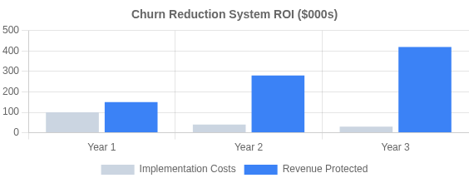
ROI & Business Value
Financial Impact of Churn Reduction
Measuring ROI of Churn Systems
5-25%
Profit increase from 5% churn reduction
Revenue Protected: Value of customers who would have churned but stayed due to interventions
Extended Customer Lifetime Value: Increased LTV from longer
customer relationships
3-5x
Lower cost than new customer acquisition
Cross-Sell/Upsell Opportunities: Revenue from expanded business with retained customers
Cost Savings: Reduced acquisition spend to replace churned
customers
67%
Higher spend from long-term customers
"Reducing churn by just 5% can increase profits by 25% to 95%."
— Harvard Business Review
SmartReach Case Study
35% churn reduction → $1.2M additional annual recurring revenue → 780% ROI on churn system implementation within 12 months
Customer Churn System
13

Slide 14

Best Practices
Ensure Clean, Quality Data
Prioritize data hygiene and integration from multiple sources. Handle missing values appropriately and create meaningful features that reflect customer behavior patterns.
Balance Model Complexity & Interpretability
Choose algorithms that balance accuracy with explainability. For stakeholder buy-in, ensure you can explain why predictions are made, not just what the predictions are.
Implement Agile, Iterative Approach
Start simple and improve incrementally. Test models frequently against real-world outcomes and refine based on performance data and changing customer behaviors.
Monitor Model Performance Continuously
Implement monitoring systems that detect model drift and performance degradation. Retrain models regularly with fresh data to maintain prediction accuracy.
Connect Prediction to Action
Develop clear intervention protocols for different churn risk segments. Create feedback loops between customer-facing teams and data scientists to continuously refine both predictions and interventions.
Key Insight: The most successful churn prediction systems prioritize cross-functional ownership with regular communication between data teams and business units that act on the predictions.
Customer Churn System
14

Slide 15

13. Common Challenges & Solutions
Data Quality Issues
Solution
Missing values, inconsistent formats, and outdated customer records can compromise model accuracy
Implement automated data validation pipelines, regular data audits, and standardized collection procedures
Class Imbalance
Solution
Churners typically represent a small minority of customers (5-20%), making predictive modeling difficult
Apply SMOTE, class weighting, or ensemble methods specifically designed
for imbalanced datasets
Model Drift
Solution
Customer behavior changes over time, causing models to become less accurate without regular updates
Implement automated model monitoring and retraining processes on a regular cadence (monthly/quarterly)
Leadership Buy-in
Solution
Executives often view churn as a CS issue rather than a company-wide strategic priority
Quantify revenue impact of churn, create executive dashboards, and tie
churn metrics to company OKRs
Key Insight
Successful churn prediction requires cross-functional collaboration between data science, product, marketing, and customer success teams to convert insights into action.
Customer Churn System
15

Slide 16




14. Future Trends
Emerging Technologies & Innovations in Customer Churn Prediction
Advanced AI & Deep Learning
Emerging Data Sources
Next-gen neural networks and transformer models capable of identifying subtle behavioral patterns that indicate early churn risk, far beyond today's capabilities.
Incorporation of unstructured data (social media sentiment, voice analysis), IoT signals, and cross-platform behavioral patterns to create 360° churn
prediction.
Explainable AI (XAI)
Omnichannel Retention Strategies
Moving beyond black-box predictions to models that explain the "why" behind churn forecasts, building trust and enabling targeted action.
Unified cross-channel retention systems that coordinate interventions across email, app, web, call centers, and in-person touchpoints.
Real-time Prediction & Intervention
Predictive Customer Journey Optimization
Zero-latency systems that detect and address churn signals during active customer interactions, creating immediate intervention opportunities.
AI systems that continuously redesign customer journeys based on real- time churn prediction data, creating personalized paths to loyalty.
Industry Adoption Timeline
Now
Basic ML Models
1-2 Years
Advanced AI & XAI
3-4 Years
Real-time Systems
5+ Years
Fully Autonomous
Customer Churn System
16

Slide 17
Conclusion & Next Steps
Key Takeaways
Customer churn prediction is a business-critical capability, not just a technical exercise
A 5% reduction in churn can increase profits by 25-95%, making it one of your highest-ROI initiatives
Success requires cross-functional alignment between data science, product, marketing, and executive leadership Both prediction and prevention must work together in a continuous feedback loop
Recommended Next Steps
1 Audit existing data sources & establish unified customer view
3 Implement churn risk scoring in your CRM within 90 days
2 Form cross-functional churn reduction task force
4 Test first proactive retention campaign within 120 days
Start Today:
Schedule your Customer Churn Assessment to benchmark your current performance and identify your biggest opportunities for retention improvement.
Customer Churn System
17

