Slide 1
Machine learning Stratified Kfold cross-validation
AMIT
Dr.-Ing. Mehdi Maboudi

Slide 2
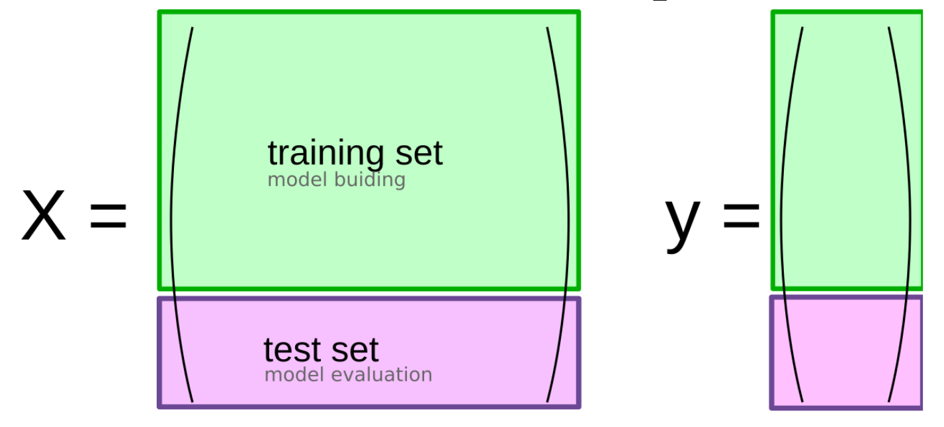
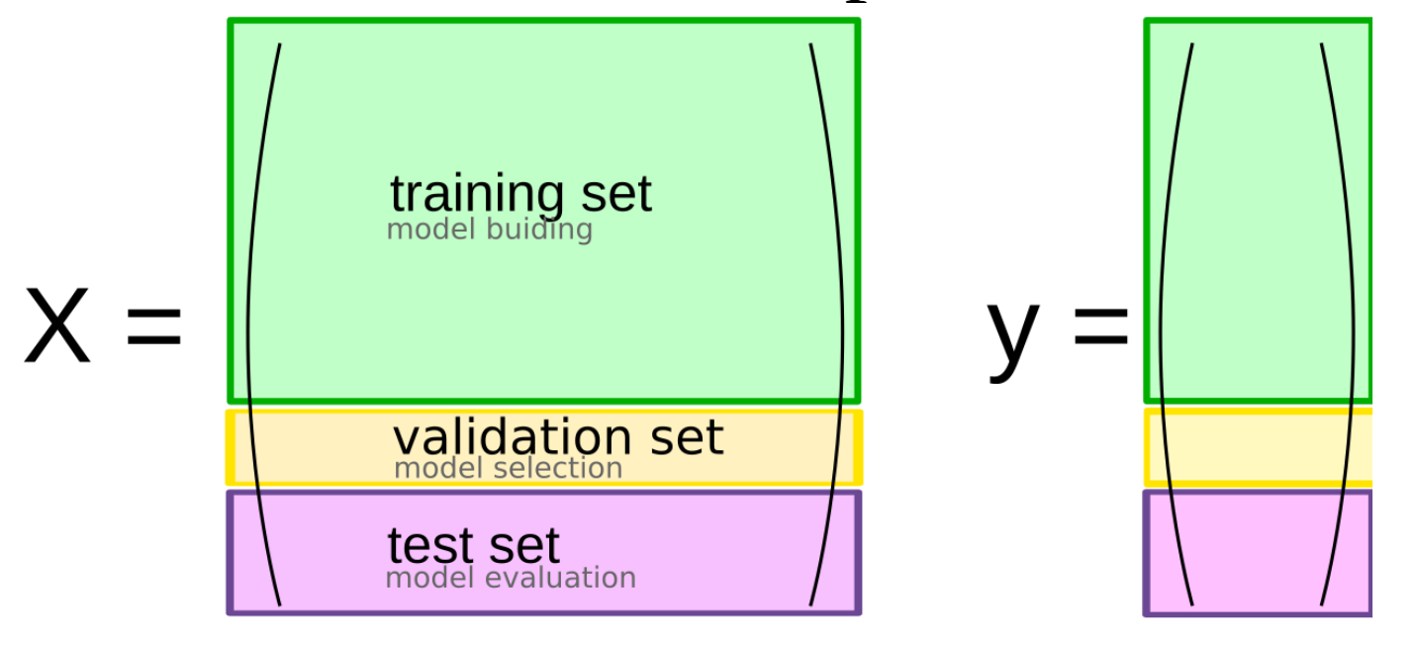
Splitting Dataset
Train-test-split
Threefold split
Source

Slide 3
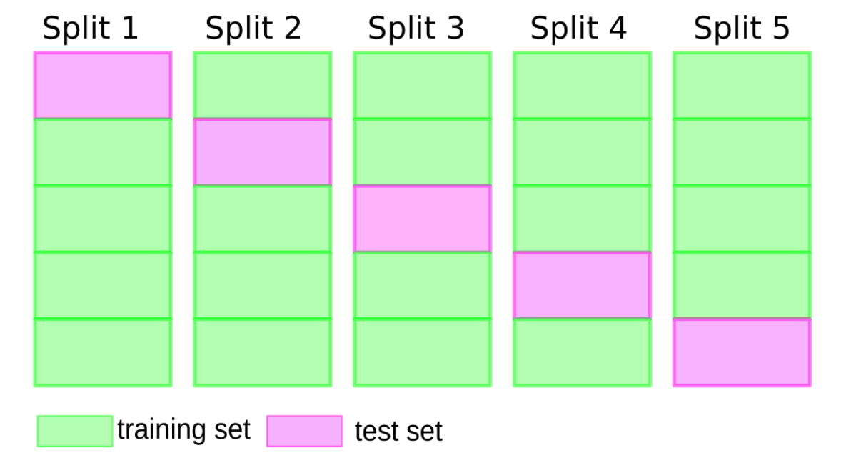
Cross-validation
Cross-validation is a resampling method that uses different portions of the data to test and train a model on different iterations.
Source

Slide 4
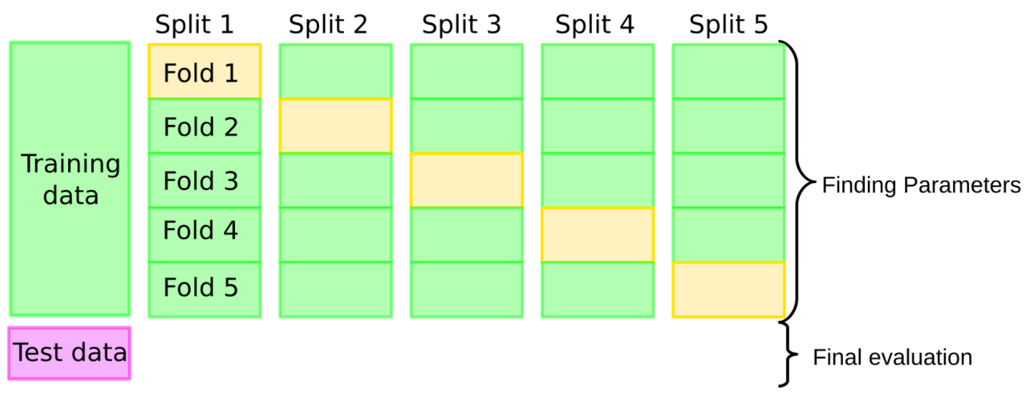
Cross-validation
Cross-validation + test set
Pro: more stable, more data
Con: slower
Source

Slide 5
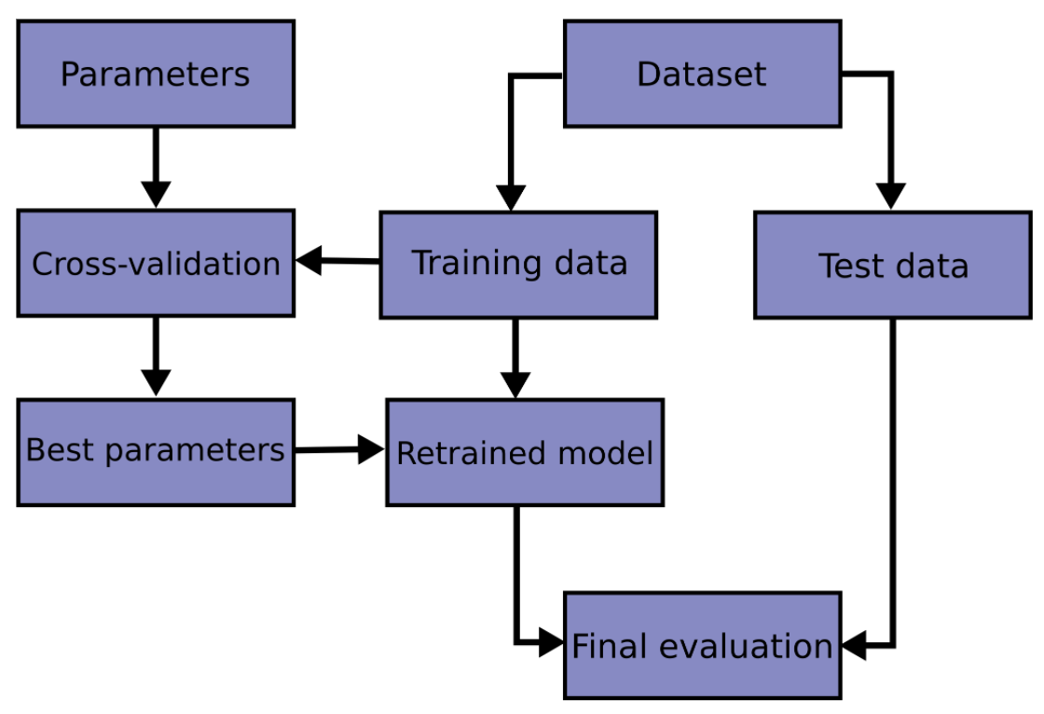
Flowchart of cross validation
Source

Slide 6
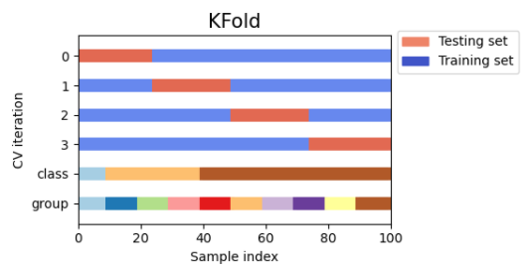
Cross-Validation Strategies ( K-Fold )
KFold divides all the samples in k groups of samples, called folds.
Source

Slide 7
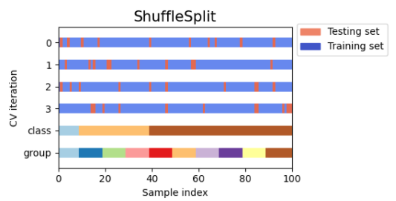
ShuffleSplit
The ShuffleSplit iterator will generate a user defined number of independent train / test dataset splits. Samples are first shuffled and then split into a pair of train and test sets.
ShuffleSplit is not affected by classes or groups
Source

Slide 8
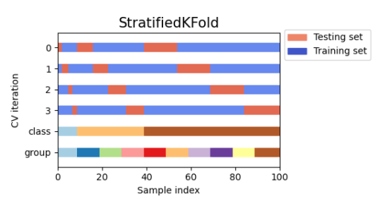
StratifiedKFold
StratifiedKFold is a variation of k-fold which returns stratified folds: each set contains approximately the same percentage of samples of each target class as the complete set.
Stratified: Ensure relative class frequencies in each fold reflect relative class frequencies on the whole dataset.
Source

Slide 9
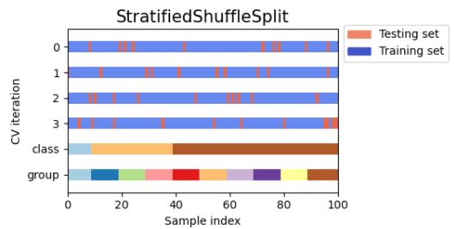
StratifiedShuffleSplit
StratifiedShuffleSplit is a variation of ShuffleSplit, which returns stratified splits, i.e which creates splits by preserving the same percentage for each target class as in the complete set.
Number of iterations and test set size independent
Source

Slide 10
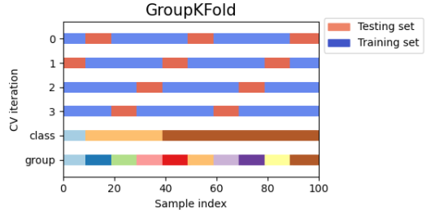
GroupKFold
GroupKFold is a variation of k-fold which ensures that the same group is not represented in both testing and training sets.
GroupKFold makes it possible to detect this kind of overfitting situations.
Source

Slide 11
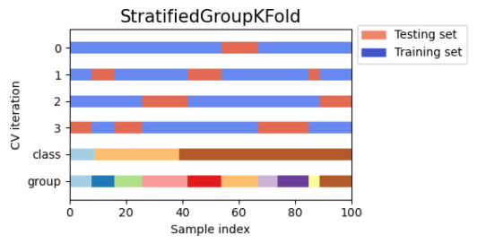
StratifiedGroupKFold
StratifiedGroupKFold is a cross-validation scheme that combines both StratifiedKFold and GroupKFold.
Useful when we have an unbalanced dataset so that using just GroupKFold might produce skewed splits.
Source

Slide 12
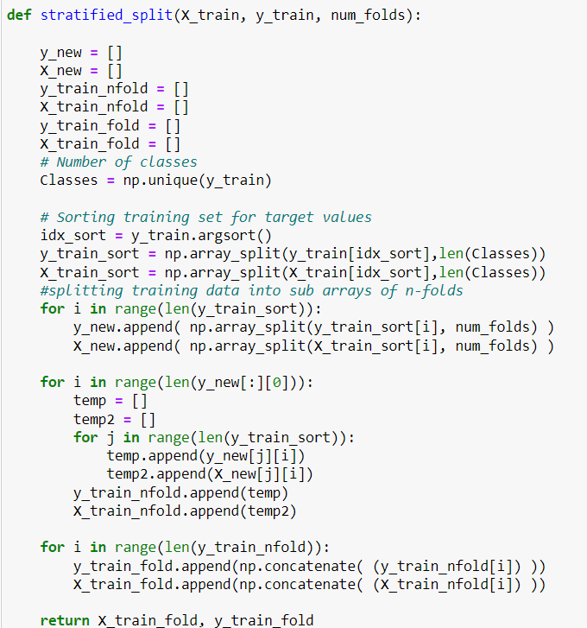
Stratified K-fold naive implementation

Slide 13
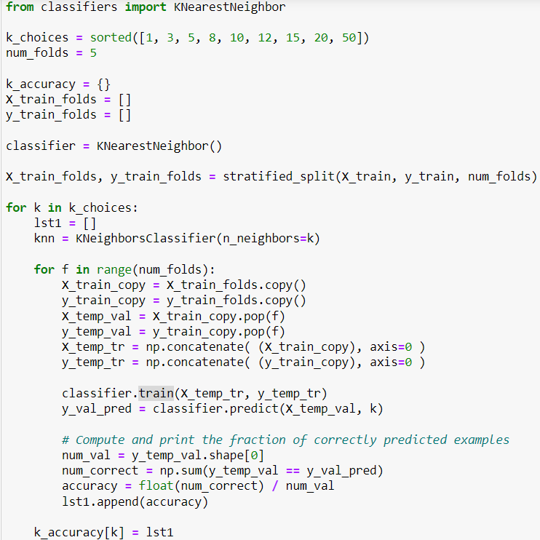
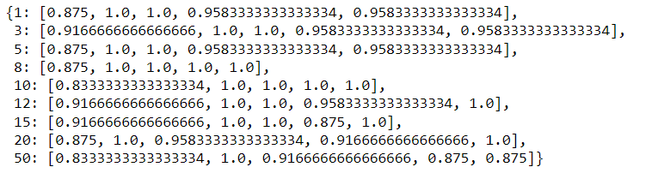
Stratified K-fold naive implementation

Slide 14
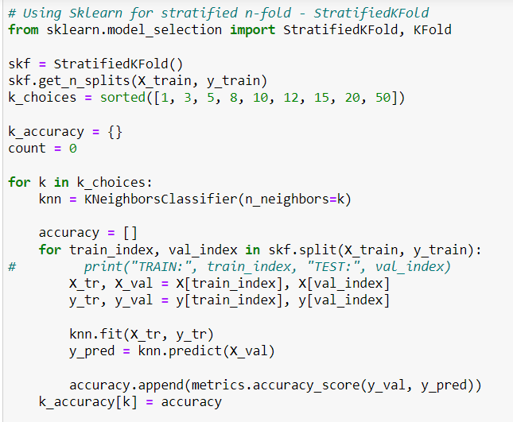
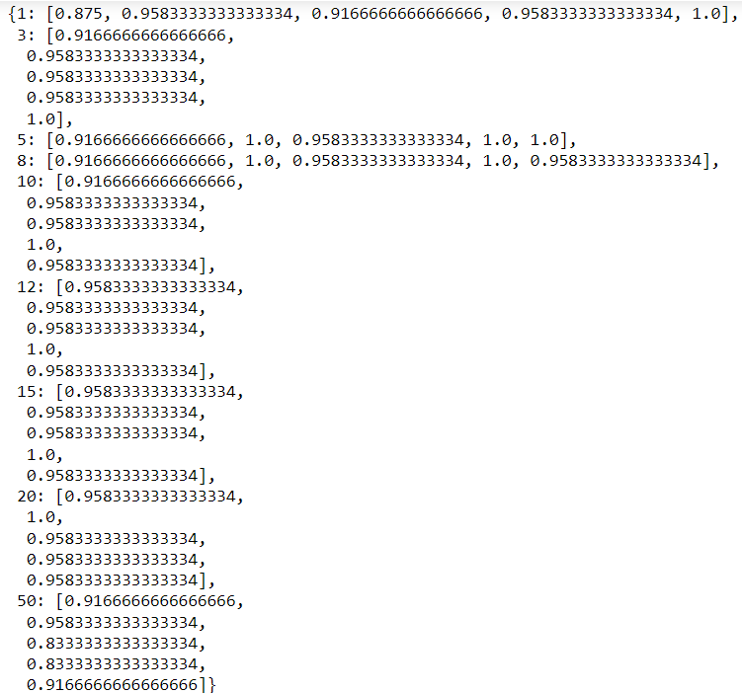
Stratified K-fold using sklearn

Slide 15
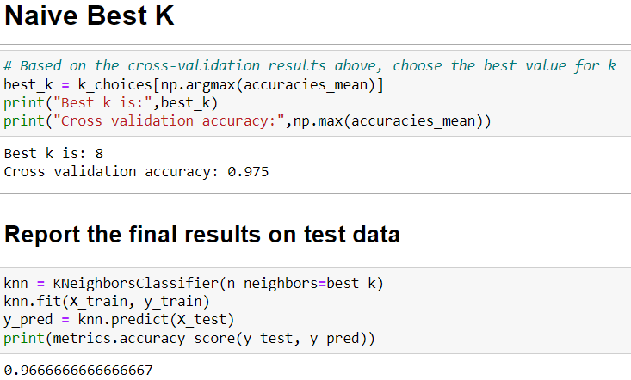
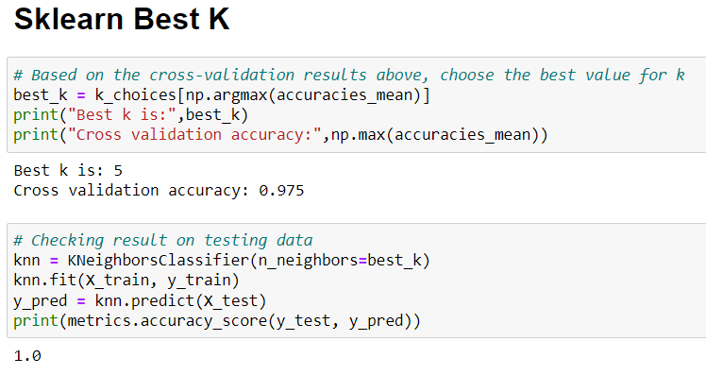
Best K using both naïve and sklearn for stratifiedkfold

Slide 16
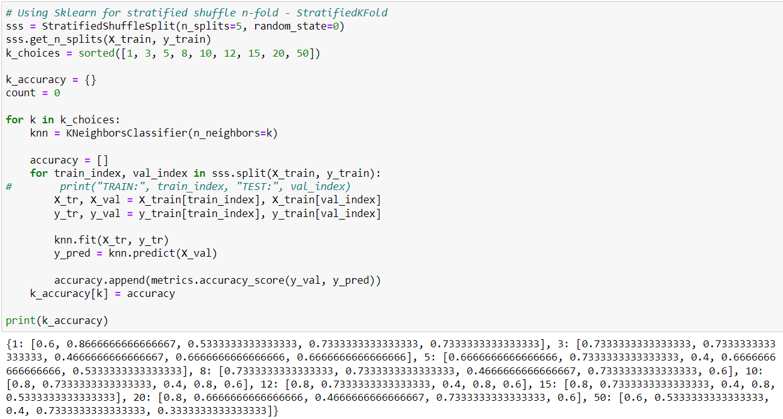
Stratified Shuffle K Fold cross-validation

Slide 17
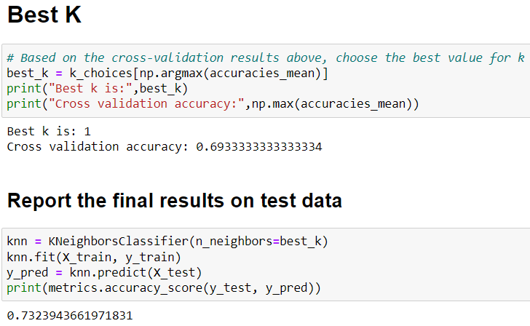
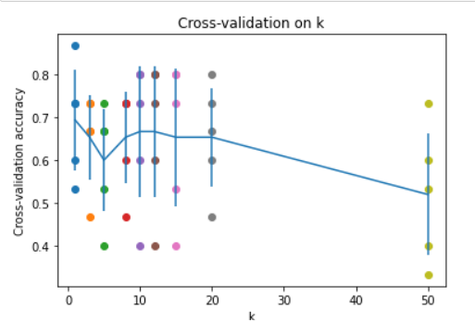
Best K on stratified shuffle

Slide 18
StratifiedKFold - Implementation
Generate test sets such that all contain the same distribution of classes, or as close as possible.
Be invariant to class label: relabelling y = ["Happy", "Sad"] to y = [1, 0] should not change the indices generated.
Preserve order dependencies in the dataset ordering, when shuffle=False: all samples from class k in some test set were contiguous in y, or separated in y by samples from classes other than k.
Generate test sets where the smallest and largest differ by at most one sample.

Slide 19
Sources:
Img: https://amueller.github.io/COMS4995-s20/slides/aml-03-supervised-learning
Cross-Validation Images: https://scikit-learn.org/stable/modules/cross_validation.html
Other Sources:
https://scikit-learn.org/stable/modules/generated/sklearn.model_selection.StratifiedKFold.html
https://www.geeksforgeeks.org/stratified-k-fold-cross-validation/
https://en.wikipedia.org/wiki/Cross-validation_(statistics)
https://scikit-learn.org/stable/modules/generated/sklearn.model_selection.StratifiedShuffleSplit.html#sklearn.model_selection.StratifiedShuffleSplit

Slide 20
.
Thank You

