Slide 1



Titel der Präsentation
Platzhalter für Bild, Bild auf Titelfolie hinter das Logo einsetzen
Machine learning
Stratified K-Fold Cross Validation
AMIT
Vorname, Nachname des Referenten, Datum

Slide 2
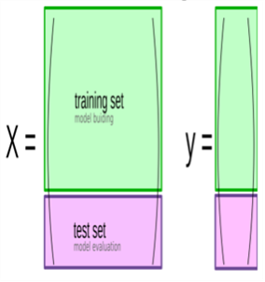
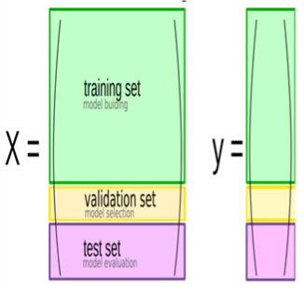


Titel der Präsentation
Splitting Dataset
Train-test-split
Threefold split
Vorname, Nachname des Referenten, Datum
Figure 1: Train test split
Machine learning,
Mini Project
| | page 2

Slide 3
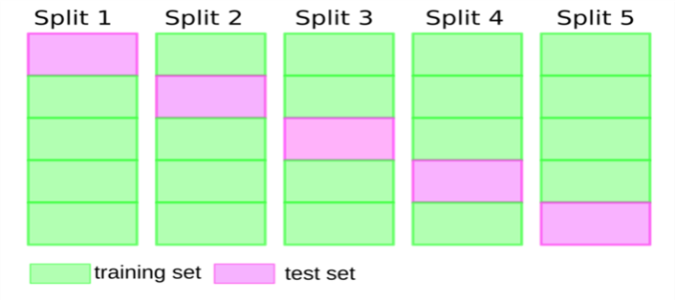
Titel der Präsentation
Cross-validation
Cross-validation is a resampling method that uses different portions of the data
to test and train a model on different iterations.
Vorname, Nachname des Referenten, Datum
Figure 2: Cross Validation
Machine learning,
Mini Project
| | page 3

Slide 4
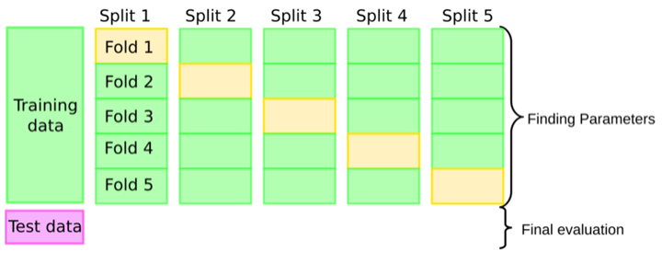
Titel der Präsentation
Cross-validation
Cross-validation + test set
Pro
: more stable, more data
Figure 3: Cross Validation + Train set
Con
: slower
Vorname, Nachname des Referenten, Datum
Machine learning,
Mini Project
| | page 4

Slide 5
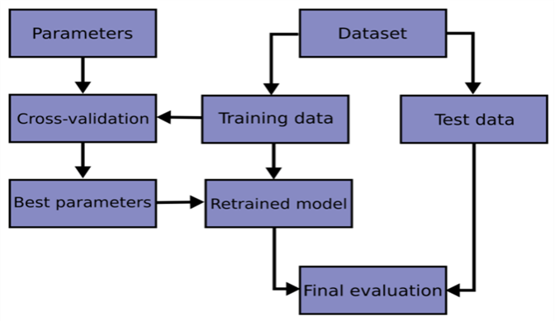
Titel der Präsentation
Flowchart of cross validation
Vorname, Nachname des Referenten, Datum
Figure 4: Flowchart Cross Validation
Machine learning,
Mini Project
| | page 5

Slide 6
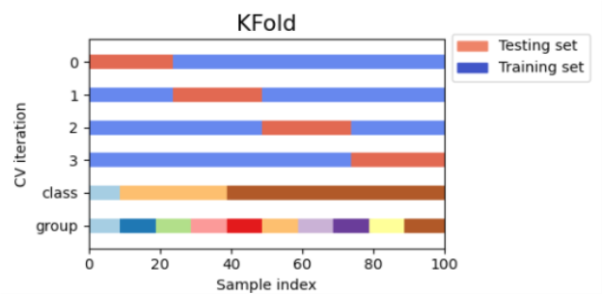
Titel der Präsentation
Cross-Validation Strategies ( K-Fold )
KFold divides all the samples in
k
groups of samples, called folds.
Figure 5: K-fold
Vorname, Nachname des Referenten, Datum
Machine learning,
Mini Project
| | page 6

Slide 7
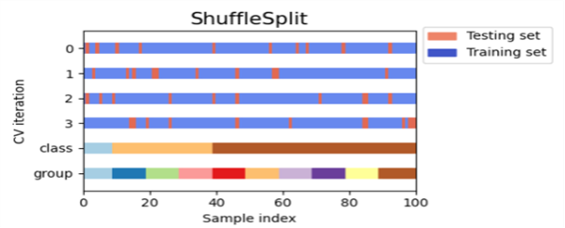
Titel der Präsentation
ShuffleSplit
The ShuffleSplit iterator will generate a user defined number of independent
train / test dataset splits. Samples are first shuffled and then split into a pair
of train and test sets.
ShuffleSplit is not affected by classes or groups
Vorname, Nachname des Referenten, Datum
Figure 6: ShuffleSplit
Machine learning,
Mini Project
| | page 7

Slide 8
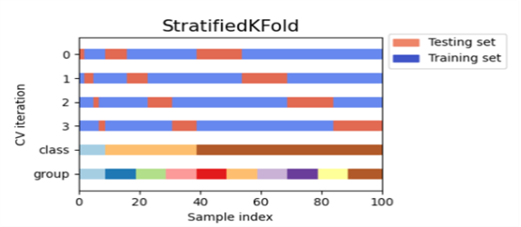
Titel der Präsentation
StratifiedKFold
StratifiedKFold is a variation of k-fold which returns stratified folds: each set
contains approximately the same percentage of samples of each target
class as the complete set.
Stratified: Ensure relative class frequencies in each fold reflect relative class
frequencies on the whole dataset.
Vorname, Nachname des Referenten, Datum
Figure 7: StratifiedKFold
Machine learning,
Mini Project
| | page 8

Slide 9
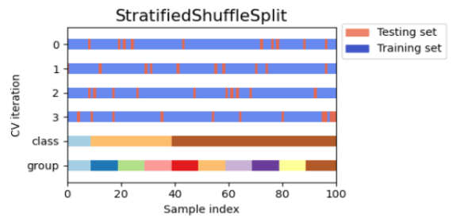
Titel der Präsentation
StratifiedShuffleSplit
StratifiedShuffleSplit is a variation of ShuffleSplit, which returns stratified
splits, i.e which creates splits by preserving the same percentage for each
target class as in the complete set.
Number of iterations and test set size independent
Vorname, Nachname des Referenten, Datum
Figure 8: StratifiedShuffleKFold
Machine learning,
Mini Project
| | page 9

Slide 10
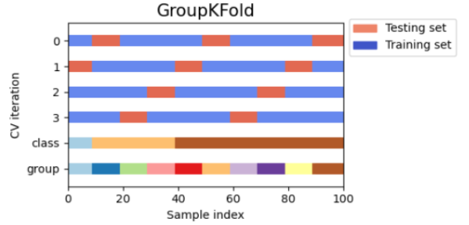
Titel der Präsentation
GroupKFold
GroupKFold is a variation of k-fold which ensures that the same group is not
represented in both testing and training sets.
GroupKFold makes it possible to detect this kind of overfitting situations.
Vorname, Nachname des Referenten, Datum
Figure 9: GroupKFold
Machine learning,
Mini Project
| | page 10

Slide 11
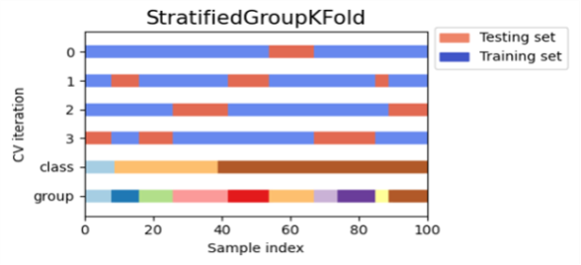
Titel der Präsentation
StratifiedGroupKFold
StratifiedGroupKFold is a cross-validation scheme that combines both
StratifiedKFold and GroupKFold.
Useful when we have an unbalanced dataset so that using just GroupKFold
might produce skewed splits.
Vorname, Nachname des Referenten, Datum
Figure 10: StratifiedGroupKFold
Machine learning,
Mini Project
| | page 11

Slide 12
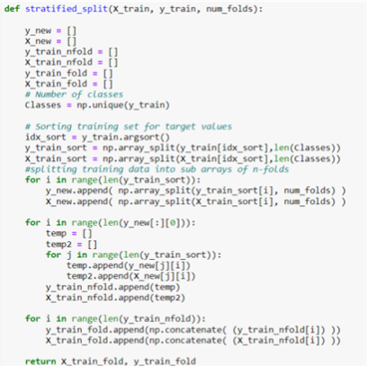
Titel der Präsentation
Stratified K-fold naive implementation
Vorname, Nachname des Referenten, Datum
Machine learning,
Mini Project
| | page 12

Slide 13
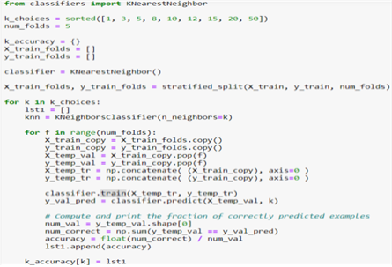
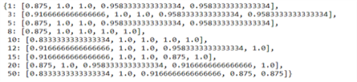
Titel der Präsentation
Stratified K-fold naive implementation
Vorname, Nachname des Referenten, Datum
Machine learning,
Mini Project
| | page 13

Slide 14
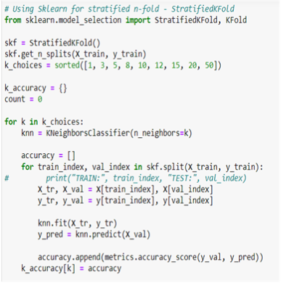
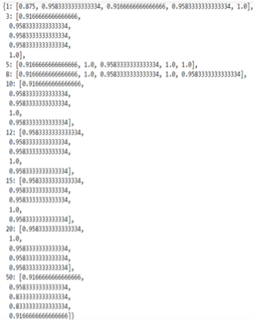
Titel der Präsentation
Stratified K-fold using sklearn
Vorname, Nachname des Referenten, Datum
Machine learning,
Mini Project
| | page 14

Slide 15
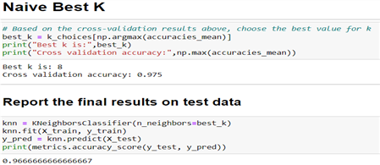
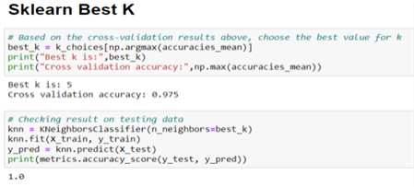
Titel der Präsentation
Best K using both naïve and sklearn for stratifiedkfold
Vorname, Nachname des Referenten, Datum
Machine learning,
Mini Project
| | page 15

Slide 16
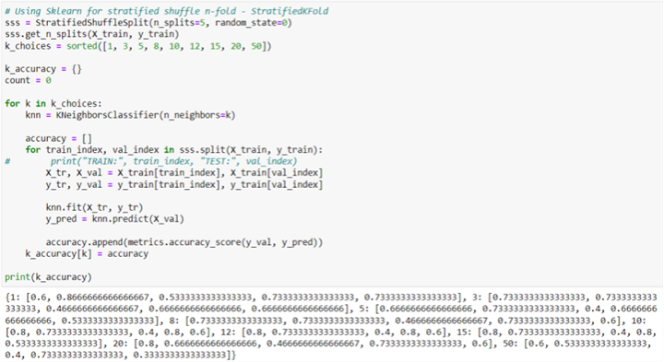
Titel der Präsentation
Stratified Shuffle K Fold cross-validation
Vorname, Nachname des Referenten, Datum
Machine learning,
Mini Project
| | page 16

Slide 17
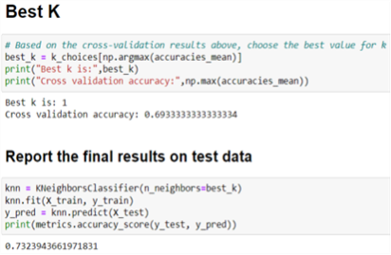
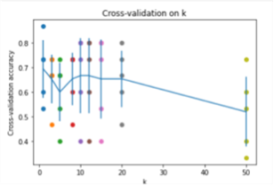
Titel der Präsentation
Best K on stratified shuffle
Vorname, Nachname des Referenten, Datum
Machine learning,
Mini Project
| | page 17

Slide 18
Titel der Präsentation
StratifiedKFold - Implementation
Generate test sets such that all contain the same distribution of classes,
or as close as possible.
Be invariant to class label: relabelling y = ["Happy", "Sad"] to y = [1, 0]
should not change the indices generated.
Preserve order dependencies in the dataset ordering, when shuffle=False:
all samples from class k in some test set were contiguous in y, or
separated in y by samples from classes other than k.
Generate test sets where the smallest and largest differ by at most one
sample.
Vorname, Nachname des Referenten, Datum
Machine learning,
Mini Project
| | page 18

Slide 19
Titel der Präsentation
Sources:
Fig
:
https://amueller.github.io/COMS4995-s20/slides/aml-03-supervised-learning
Cross-Validation Images
:
https://scikit-
learn.org/stable/modules/cross_validation.html
Other Sources:
https://scikit-
learn.org/stable/modules/generated/sklearn.model_selection.StratifiedKFold.html
https://www.geeksforgeeks.org/stratified-k-fold-cross-validation/
https://en.wikipedia.org/wiki/Cross-validation_(statistics)
https://scikit-
learn.org/stable/modules/generated/sklearn.model_selection.StratifiedShuffleSplit.html
#sklearn.model_selection.StratifiedShuffleSplit
Vorname, Nachname des Referenten, Datum
Machine learning,
Mini Project
| | page 19

Slide 20
.
Thank You

