Slide 1
Cross Validation
Ananya Kapoor | ML/AI Fundamentals | July 6, 2023

Slide 2
The Purpose of Cross Validation
Evaluating the performance of a (machine learning) model when data are limited
Model performance: how well can our model generalize to unseen data.
An extremely useful tool that can be used in ML / non-ML models
Notes:
If I were to give a one sentence summary -- cross validation is a very common method for evaluating the performance of a machine learning (or any) model. In the work we do, we are oftentimes building predictive models. For example, training a machine learning model to find biomarkers of disease in a sample of human subjects and then seeing how well that model generalizes to another sample of subjects. Cross validation allows us to assess model performance in a smart way. Moreover, it’s a general purpose tool that can be applied across traditional statistical or machine learning models.
Cross validation can also be applied for hyperparameter optimization, but I won’t touch on that today.

Slide 3
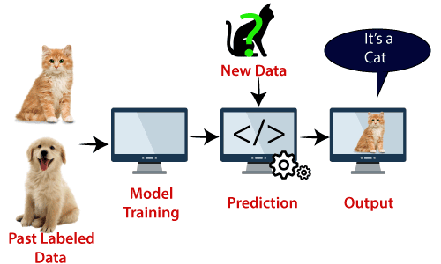
Model Building / Evaluation
Goal: Build (train) a model on a dataset and see how well it generalizes to unseen data
Example: Training a model to predict dogs from cats.
Can a ML model distinguish between cats and dogs and use that knowledge to predict unseen data?
Notes:
Typically in machine learning, we want to train a model on a set of data and then see how well it performs on never-before-seen data. One example of this is building a image classifier to distinguish between dogs and cats. We will train the classifier on a dataset of images, thereby teaching the classifier to learn the image features that makes cats cats and to learn the image features that make dogs dogs. Once our model is trained, we will then see how well it does on never-before-seen images. If the model is able to correctly classify these never-before-seen images, we have found a model that has good predictive performance. Thus, this model is properly trained to distinguish between dogs and cats.

Slide 4
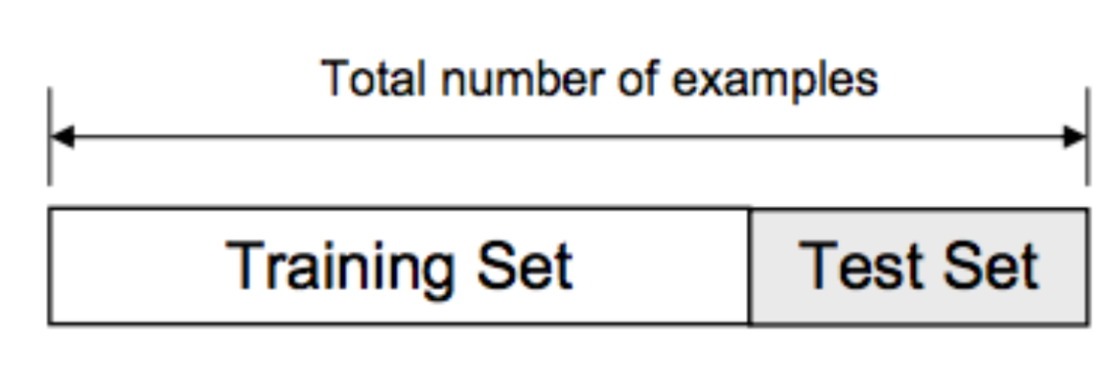
Evaluating Performance: Train/Test Split
Divide the dataset into training and testing splits
Develop a ML model on the training dataset and then evaluate performance on the testing dataset
Testing performance is key
Common train/test splits: 70/30, 80/20
70%
30%
Evaluate trained model on testing set
Train ML model on training set
Notes:
Therefore, to evaluate model performance we need a training dataset and a testing dataset. Typically these datasets are formed by splitting our total dataset, in our case a large database of cat and dog images, into a training dataset and testing dataset. We will train the model on the training dataset and then assess model performance on the testing dataset.
Some common splits are 70% training and 30% testing, or 80% training and 20% testing. Oftentimes, when you read ML papers they will often employ a train/test split method to assess model performance.

Slide 5
Issues with Train/Test Split Method
Issue #1: Small Datasets
Less data to train our ML model
Example: Total dataset of 32 cat/dog pictures
Training: 32 x 0.75 = 24 pictures
Testing: 32 x 0.25 = 8 pictures
Not enough data to learn a good ML model -> poor model performance
Issue #2: Model performance highly depends on data split
If our training dataset has too many pictures of cats, it will do a poor job at classifying dogs
Notes:
However, there are some issues with the train/test split method. Firstly, this method is not conducive to small datasets. For example, let’s say we have a dataset of 32 pictures. A 70/30 split on this total dataset will give us 24 pictures in our training dataset and 8 pictures in our testing dataset. This is not nearly enough training data to properly learn to distinguish between cats and dogs. Because our model is trained on such little data, it will give us very poor testing performance.
Another problem with the train/test split is that our model performance is highly dependent on the way we split our data. For example, let’s say our training dataset is largely cat pictures. Therefore, our model will be able to learn the cat features really well but neglect to learn the features that make dogs, dogs. The result is a model that only learns ”half” of what we want it to learn.

Slide 6
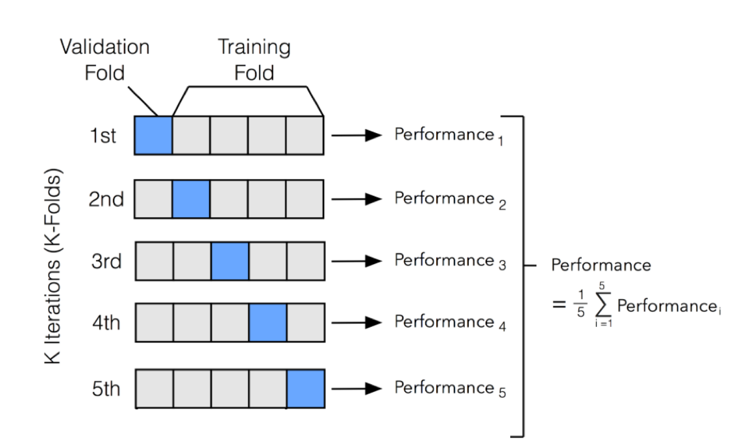
Solution: K-Fold Cross Validation
Divide your entire dataset into k partitions of equal size. One of the k partitions will be the “validation dataset” and the other k-1 partitions will be the training dataset
Build k models -- each of which tests on a new subset of the data. Evaluate the performance of each model
Build a k+1th model on all the data. This is known as our main model. This model’s cross validated performance is the average of the k performance metrics
Notes:
We can get around this problem using K-Fold cross validation. In this procedure we will divide our dataset into K distinct non-overlapping groups. For example, if we have 100 images, 5-Fold CV will yield 5 data groups, each of which has 20 images. 4 out of the 5 data groups (folds) will be used to train our ML model. Model performance will be evaluated on the left-out validation fold and then stored in performance_1. We will then rebuild the model but changing the validation fold. Therefore, we are training the model on data from folds 1, 3, 4, 5 and then evaluating model performance on fold = 2. We then store fold_2’s model performance as performance_2. We repeat this procedure for each validation fold until we have 5 validation fold performance metrics. We will then build a cross validated model on the entire dataset, which will have an overall cross validated model performance as the average performance across all 5 validation folds.

Slide 7
How is Cross Validation from the Train/Test Method?
Train/Test Split
Cross Validation
Traditional Method: Evaluating model performance on 30% of the data
K-Fold Cross Validated: Evaluating model performance on all the data
This implies that every observation is given the chance to be in the validation dataset.
Evaluating model performance on 30% of the data
Evaluating model performance on all the data
Notes:
Before I talked about how cross validation is better than the traditional train/test split on small datasets. Why is it better? In the train/test split method, we are training our model on 70% of the whole dataset and evaluating generalization performance on 30% of the dataset. In cross validation we are training the model on ALL the data and then testing the model on ALL the data. This allows our model to see all datapoints, which is very beneficial when we have small datasets.
I’ve personally used cross validation many times, one notable example being on human data. It’s very difficult to get large clinical human datasets, both behavioral but especially neural datasets. So what I ended up doing was

Slide 8
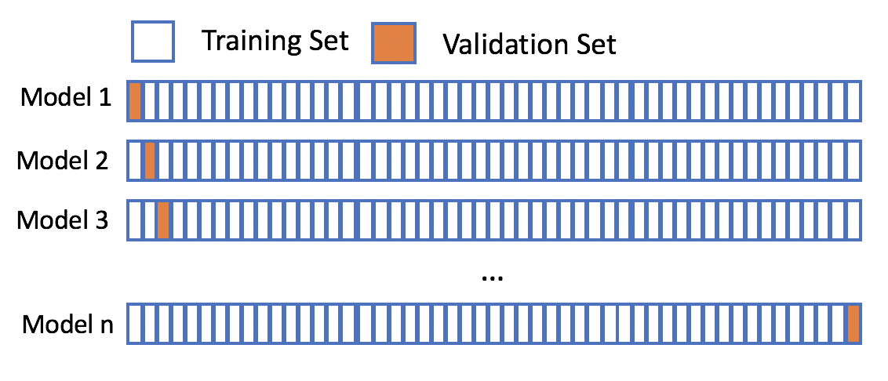
Leave-One-Out CV
Notes:
One special application of K-Fold cross validation is leave-one-out CV where we partition the dataset s.t. each fold only have 1 datapoint. For example, if we have 100 datapoints, under LOOCV we would partition the dataset into 100 folds, each with one observation. Therefore, for each iteration, we would train the ML model on data from 99 folds and then evaluate the performance on the left out fold (one observation). We repeat this process until we have 100 validation accuracies and then we average across all 100 validation accuracies.
Many people use LOOCV, especially in clinical applications. It’s especially appealing when our dataset is especially small (like 30 – 60 subjects). One potential drawback of LOOCV is that can be computationally expensive because you are building a total of 100 models if our dataset size is 100 subjects. There are also some issues of potential overfitting, which we won’t talk about today.

Slide 9
Variations of Cross Validation
Repeated K-Fold Cross Validation
Stratified K-Fold Cross Validation
Repeated Stratified K-Fold Cross Validation

Slide 10
Repeated K-Fold Cross Validation
Repeats = 3
Building a total of 5*3=15 models (one for each fold).
Cross-validated performance = average across 15 models
After obtaining the cross validated performance, discard the 15 models.
Repeat again
CV Performance: Repeat = 1
CV Performance: Repeat = 2
CV Performance: Repeat = 3
Mean CV Performance across repeats
Stdev in CV Performance across repeats

Slide 11
Stratified K-Fold Cross Validation
Previously: K-Fold cross validation randomly divided our data into k partitions.
Stratified K-Fold Cross Validation: Controlling the proportion of cat/dog pictures in each fold
More stability in our cross validated results
Within each fold: 50% cat pictures, 50% dog pictures

Slide 12
Repeated Stratified K-Fold Cross Validation
Perform Stratified K-fold Cross Validation multiple times.
We then obtain each individual model’s performance metric and average them to get the overall cross validated performance metric

Slide 13
DEMO

