Slide 1
A Machine Learning Model of Flexible, Adaptable Motor Control
Ananya Kapoor | Fall 2022 Rotation Talk | 12/07/2022
Notes:
My name is Ananya and this past quarter I had the opportunity of rotating in James Murray’s lab in the NeuroAI center. I’m excited to share the work I’ve done this past quarter on building a machine learning model of flexible, adaptable motor control.

Slide 2
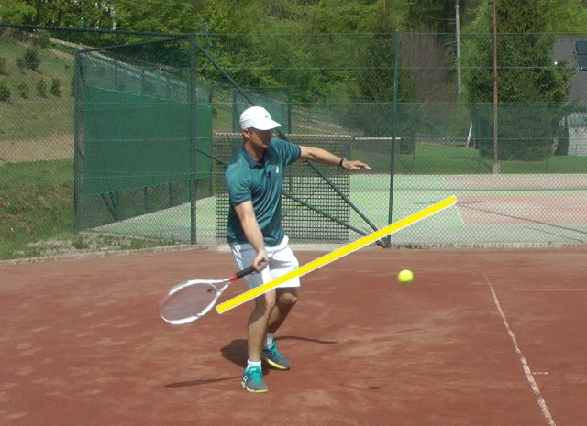
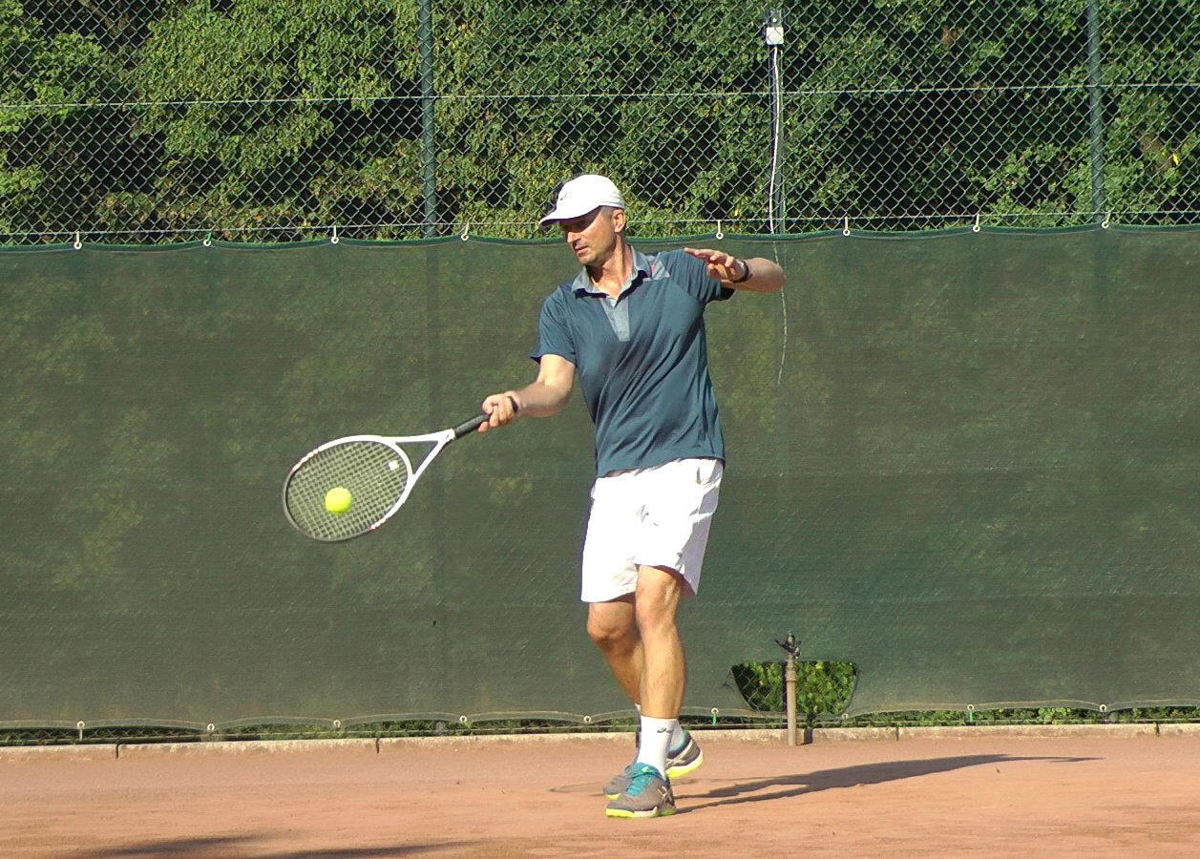
Motor Control Problem: Complexity and Stability
How can a system learn to control a motor behavior that
Is complex
Can flexibly converge to any arbitrary goal location
Robotics solutions: complex and flexible trajectories but are not biologically-plausible
Neuroscience solutions: Produce complex trajectories but do not flexibly adapt
Objective: Develop a biologically-realistic model of flexible, adaptable motor control
Notes:
My rotation project focused on one overarching question: how does the brain control movements that are both complex as well as flexibly converge to any goal state in space. For example, how can a tennis player make a complex motion to serve a tennis ball at point A and flexibly adapt that same complex motion to serve a tennis ball at point B? That is, what are the motor control mechanisms responsible for adapting your motor trajectory to flexibly reach a new goal state in space? This problem has been addressed extensively in the robotics literature through elegant modeling procedures. However, these models prioritize creating complex and flexible trajectories and thus sacrifice biological plausibility. From the neuroscience angle – this problem has been investigated through optimal feedback control. While this solution is able to produce complex trajectories, it is unable to produce motor behaviors that flexibly adapt to new goal states in task space. My objective this past term was to incorporate the best of both frameworks by developing a biologically-realistic model of flexible, adaptable motor control. Backed by tools from control theory, dynamical systems, and machine learning, our model serves as the first step in abstracting the neural mechanisms of complex yet adaptable motor behavior.

Slide 3
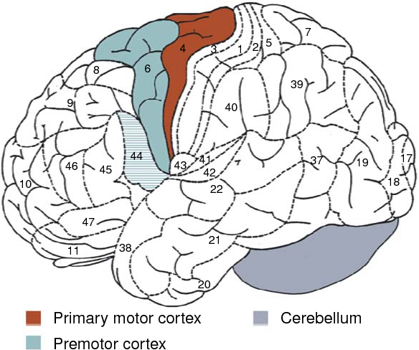
The Neural Mechanisms of Motor Control
Premotor Cortex: Generates forces necessary for the complex movement
Primary Motor Cortex: Converts forces to task space
Sent to the musculoskeletal system to be converted to physical movement
Question: How to formalize the premotor cortex system and primary motor cortex system computationally?
Adapted from Wolfensteller et. al 2009
Notes:
While there are multiple brain regions that are involved in motor control, such as the cerebellum and basal ganglia, we will focus on two critical cortical regions: the premotor and primary motor cortex. It’s thought that the premotor cortex generates the forces and torques that are necessary for complex movement. The primary motor cortex then takes these forces and torques and converts them into muscle commands. These muscle commands are then sent to the musculoskeletal system, which then results in motor output, such as a position value. These motor commands from the primary motor cortex have the additional property of converging stably to the goal state we are trying to reach. So in terms of our overall problem in creating complex and flexible motor control commands, we can conceptualize the premotor region as generating the control signals required to create complex trajectories while the primary motor region takes these control signals and converts them into motor commands that will get us to stably converge to any goal state.
Now that we understand how each system, the premotor and primary motor cortex, plays into our overall goal of complex and flexible motor control, we will now lay each system’s computational formalization. We will first do this from the robotics standpoint and then transition to our model which attempts to make these formalizations more biologically plausible.

Slide 4
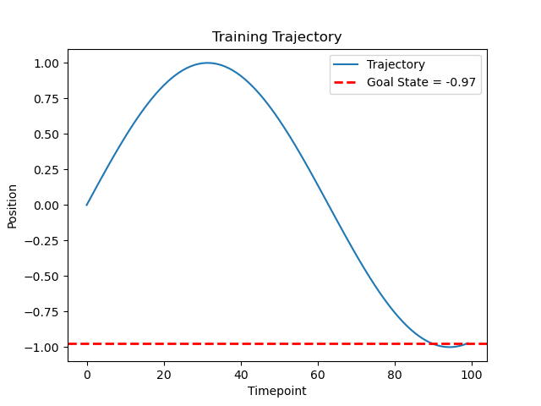
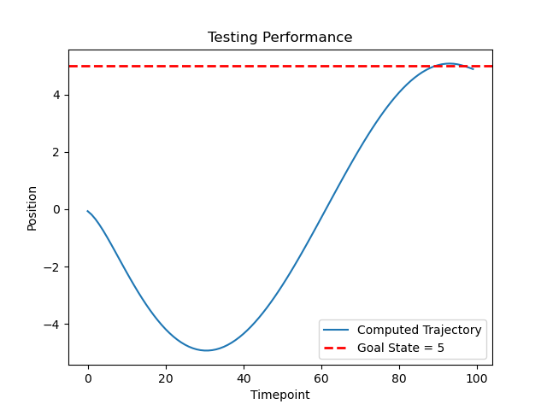
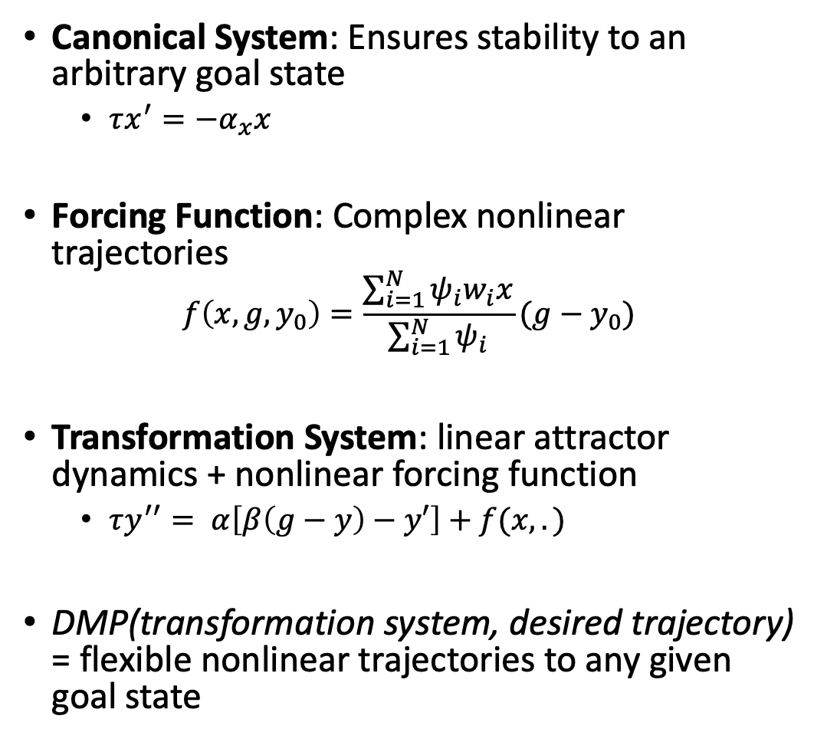
Dynamical Movement Primitives (DMPs)
Canonical System: Ensures stability to an arbitrary goal state
$τx^{′}=−α_{x}x$
Forcing Function: Complex nonlinear trajectories
$$f\left(x, g, y_{0}\right)=\frac{\sum_{i=1}^{N}{ψ_{i}w_{i}x}}{\sum_{i=1}^{N}{ψ_{i}}}(g−y_{0})$$
Transformation System: linear attractor dynamics + nonlinear forcing function
$τy^{′′}= α\left[β\left(g−y\right)−y′\right]+f(x,.)$
DMP(transformation system, desired trajectory) = flexible nonlinear trajectories to any given goal state
Forcing Function: Learns the forcing values across time that are necessary for complex motor trajectories
Nonlinear Regression Model
Transformation System: Forcing values -> Kinematic values that converge to the goal state
Mass-on-a-spring system
DMP Model has impressive performance but is biologically-implausible.
Task: Create a biologically-realistic model of motor control that retains predictive performance of the artificial DMP model
Notes:
The Dynamical Movement Primitive (DMP) model is one popular formalization of motor control. While originally from the robotics literature, this model retains our two-system framework we discussed on the last slide, just in an artificial way. For example, the artificial analog of the premotor cortex will be a nonlinear regression function which generates the forces necessary to create the motor trajectory we want to emulate. These forcing values are then fed into the artificial analog of the primary motor cortex, a mass on a spring system, that transforms the forcing values into kinematic space. This model has impressive performance – creating motor trajectories that are highly complex yet stably converge to any given goal state. For example, a DMP model trained to emulate a sine curve training trajectory ending at a goal state of -0.97 can flexibly generalize to an identical sine curve testing trajectory that ends at a goal state of +5.
However, the model’s formalizations of the premotor and primary motor system are very biologically-implausible. Therefore, how can we modify the premotor and primary motor system formalizations that (1. are more biologically realistic and (2. still retain the impressive performance this artificial motor control model has?

Slide 5
Biological Extensions of the DMP Model
Two main design changes:
Premotor System: nonlinear regression -> nonlinear RNN
Primary Motor Transformation System: mass-on-a-spring -> general state space model
Time input
Premotor Cortex
Primary Motor Cortex
Musculoskeletal System
Forcing Function RNN
Transformation System
State Space Model
Position
Prediction
Notes:
The specific changes we will make to the DMP system will be to first model the premotor cortex as a recurrently-connected network of premotor neurons instead of a nonlinear regression. The second change we will make is to model the transformation system generally, instead of a very specific mass-on-a-spring model. These two design choices, along with certain mathematical requirements, will allow us to better abstract the potential neural mechanisms of flexible and complex motor control.

Slide 6
Biological Extensions of the DMP Model
Two main design changes:
Premotor System: nonlinear regression -> nonlinear RNN
Primary Motor Transformation System: mass-on-a-spring -> general state space model
Time input
Premotor Cortex
Primary Motor Cortex
Musculoskeletal System
Forcing Function RNN
Transformation System
State Space Model
Position
Prediction
Notes:
Our first design choice is the forcing function RNN

Slide 7
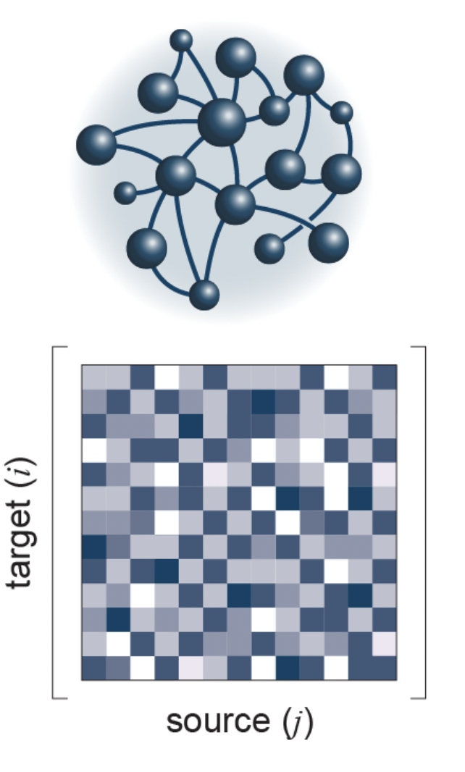
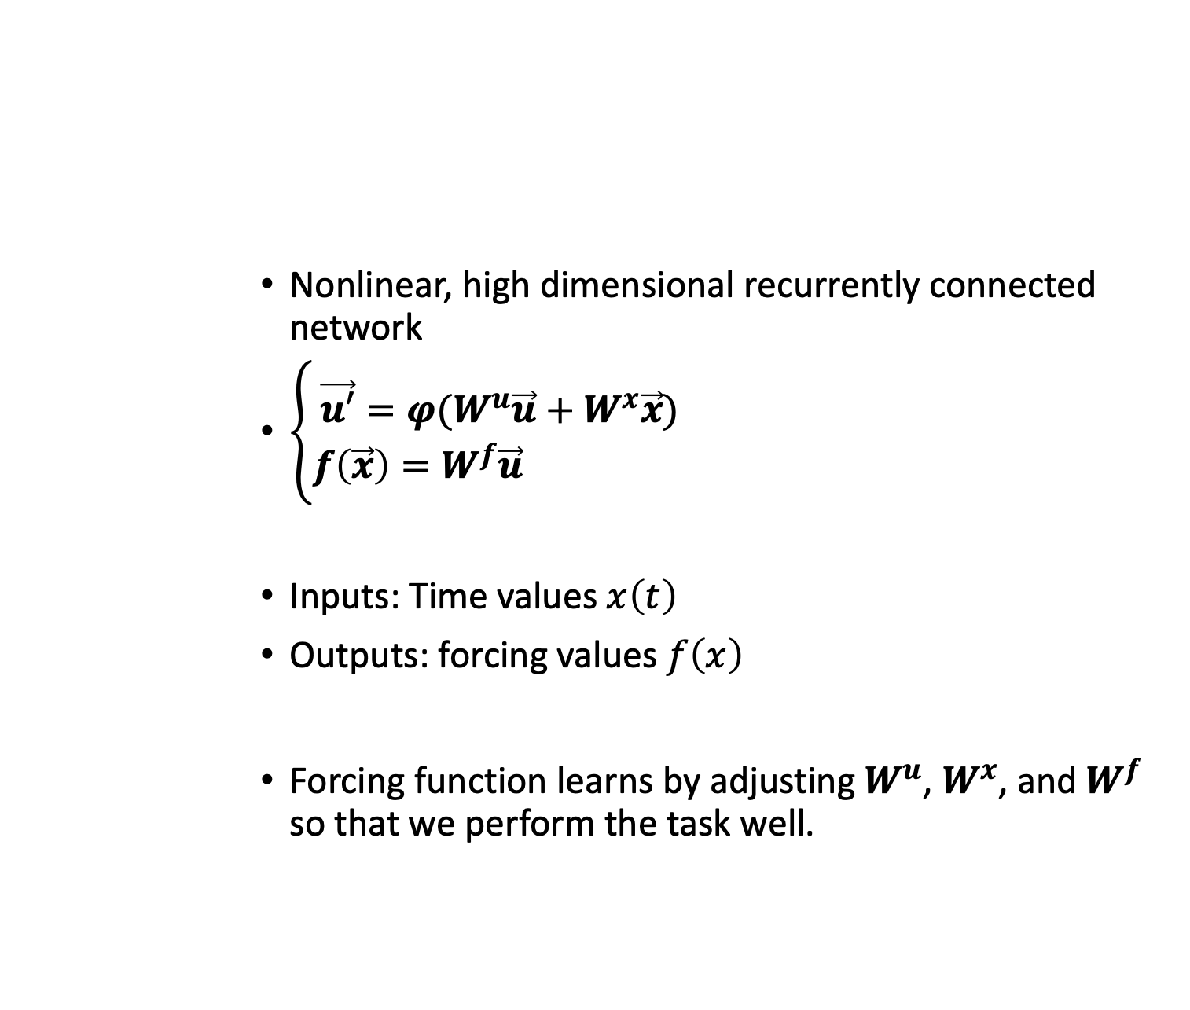


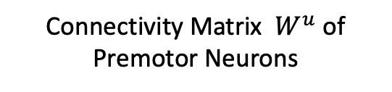
Design Choice #1: The Forcing Function RNN
Nonlinear, high dimensional recurrently connected network
$\left\{\begin{aligned}\vec{u′}={φ(W}^{u}\vec{u}+W^{x}\vec{x}) \\ f\left(\vec{x}\right)=W^{f}\vec{u} \end{aligned}\right.$
Inputs: Time values $x\left(t\right)$
Outputs: forcing values $f\left(x\right)$
Forcing function learns by adjusting $W^{u}$, $W^{x}$, and $W^{f}$ so that we perform the task well.
Connectivity Matrix $W^{u}$ of Premotor Neurons
Neuron $i$
Neuron $j$
Adapted from Perich et al 2021
Notes:
Instead of a nonlinear regression we will model the premotor system as a high dimensional nonlinear RNN – that is like a bag of neurons all interacting with each other like we see on the top cartoon. The rate of change of premotor population activity(firing rate) can be formalized as a nonlinear function phi of two components:
Premotor population activity weighted by how strongly connected the premotor neurons are to each other (the connectivity matrix you see with darker values indicating stronger connections)
the influence from our time inputs, which for technical reasons must be a nonlinear function of time x(t)
The RNN’s output will be forcing values, which are a linear combination of the premotor population activity at each point in time. The RNN learns by adjusting the weights in the W^u, W^x, and W^f matrix so that we perform the motor task well. The idea is that the RNN will learn the forces that are necessary to create the complex trajectory.

Slide 8
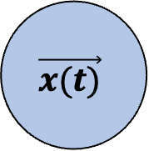
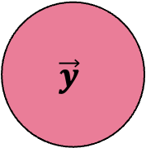
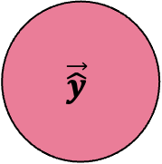
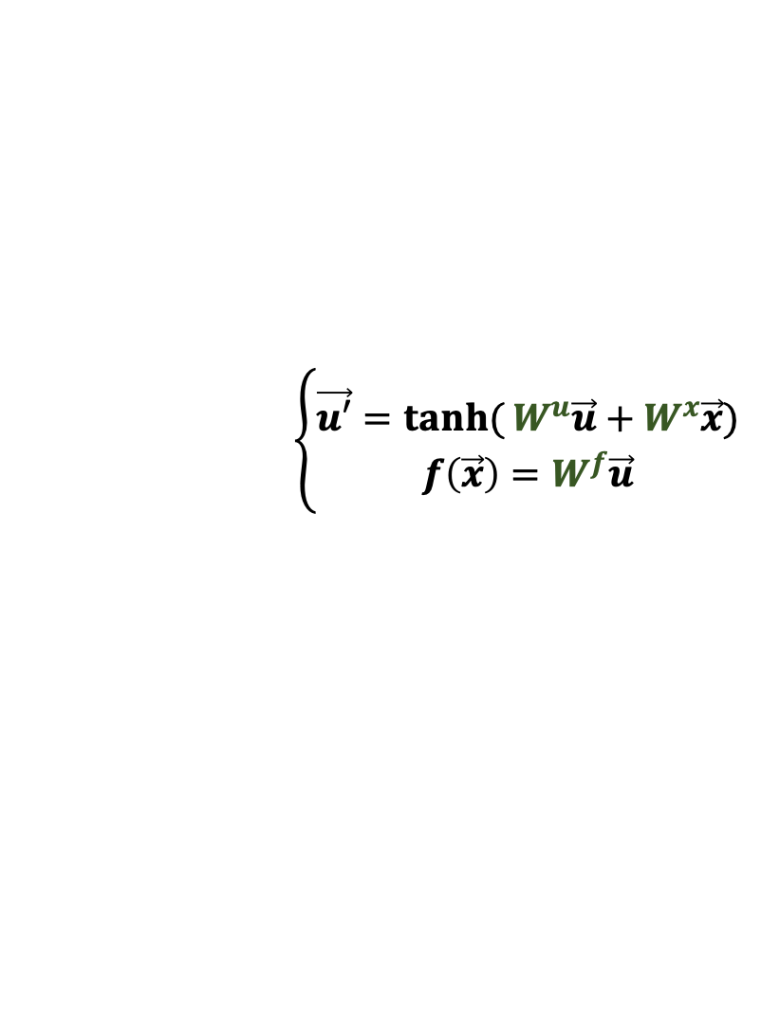
Training the Forcing Function RNN
Time Input
Forcing Function RNN
Transformation System
Position
Prediction
Desired
Position
$$\vec{x(t)}$$
$$\left\{\begin{aligned}\vec{u′}=\tanh{(}W^{u}\vec{u}+W^{x}\vec{x}) \\ f\left(\vec{x}\right)=W^{f}\vec{u}\end{aligned}\right.$$
$$\vec{\hat{y}}$$
$$\vec{y}$$
Transformation System
State Space Model
Weight Updates Through Backpropagation Through Time
Notes:
So where are we now? We have begun to formalize a motor control model that could resemble the roles of the premotor and primary motor cortex in flexible, adaptable motor control. We model the premotor cortex as an RNN and produce forcing values, which are then fed into the transformation system to produce position predictions that stably converge to our goal state. We learn the forcing function that is necessary to produce the movement by training our RNN, which involves updating our forcing function model such that we minimize the distance between the predicted position values and the actual position values across time.

Slide 9
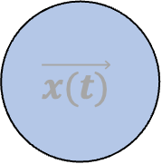
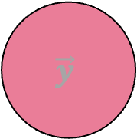
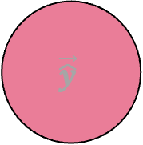
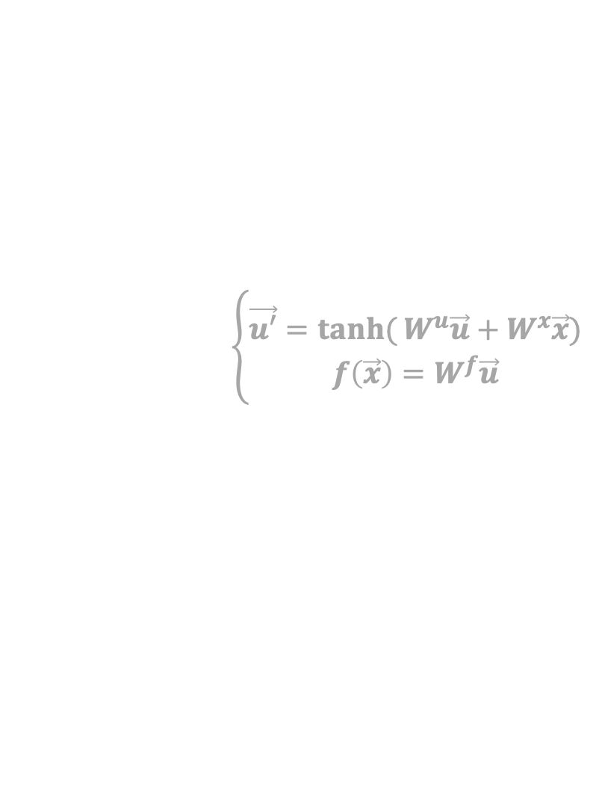
Design Choice #2: Transformation System
Time Input
Forcing Function RNN
Transformation System
Position
Prediction
Desired
Position
$$\vec{x(t)}$$
$$\left\{\begin{aligned}\vec{u′}=\tanh{(}W^{u}\vec{u}+W^{x}\vec{x}) \\ f\left(\vec{x}\right)=W^{f}\vec{u}\end{aligned}\right.$$
$$\vec{\hat{y}}$$
$$\vec{y}$$
Transformation System
State Space Model
Weight Updates Through Backpropagation Through Time
Notes:
That’s all well and good but how do we computationally formalize the primary motor cortex system, where we go from forcing values to position predictions that stably converge to our goal state?
Now we will focus in on our second design choice – the transformation system.

Slide 10
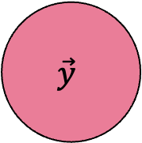
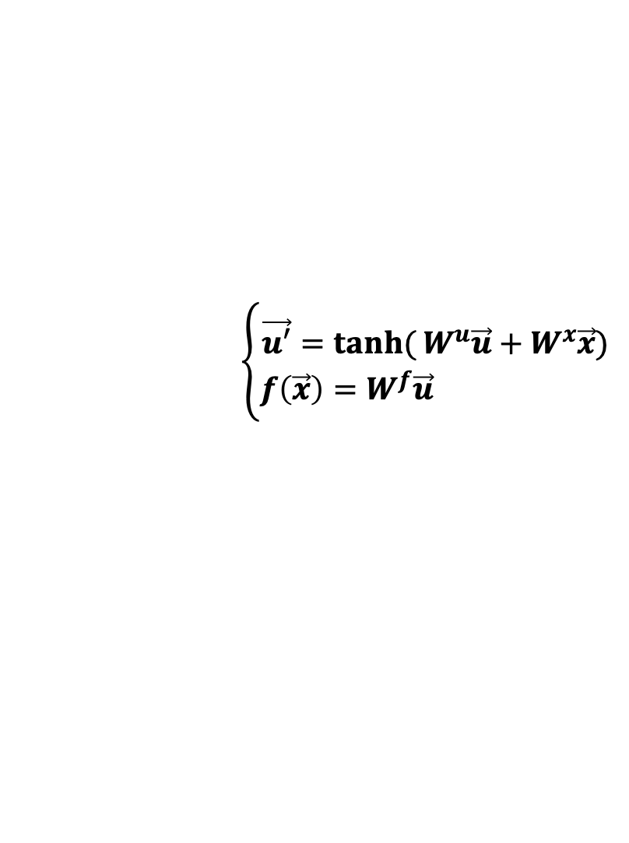
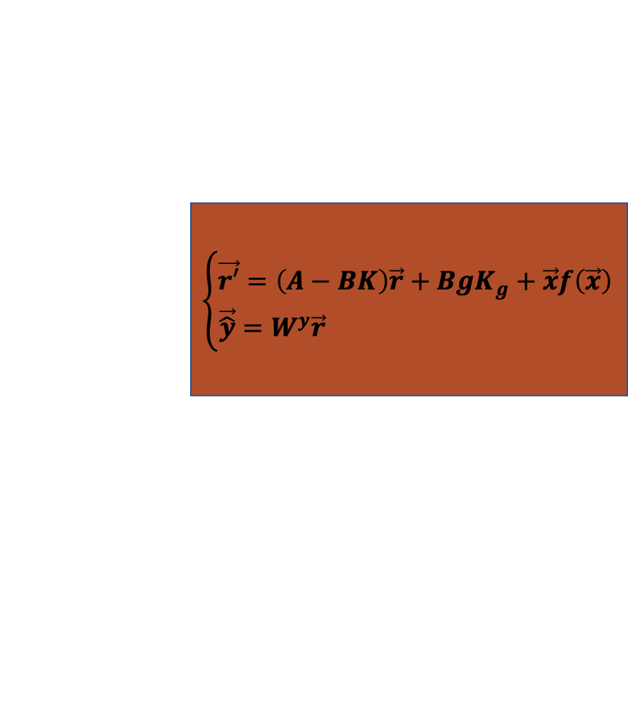
Complete Model Architecture
Time Input
Forcing Function RNN
Transformation System
Position
Prediction
Desired
Position
Linear Quadratic Regulator Control
$$\left\{\begin{aligned}\vec{r′}=\left(A−BK\right)\vec{r}+BgK_{g}+\vec{x}f\left(\vec{x}\right) \\ \vec{\hat{y}}=W^{y}\vec{r} \end{aligned}\right.$$
$$\vec{x(t)}$$
$$\left\{\begin{aligned}\vec{u′}=\tanh{(}W^{u}\vec{u}+W^{x}\vec{x}) \\ f\left(\vec{x}\right)=W^{f}\vec{u} \end{aligned}\right.$$
$$\vec{\hat{y}}$$
$$\vec{y}$$
Weight Updates Through Backpropagation Through Time
Notes:
We will generally define our transformation system as a state space model rather than a very specific mass-on-a-spring. The output of this transformation system will be a position readout. While the general state space model will allow us to abstract to a population of neurons in primary motor cortex, a general state space model will not necessarily converge to a goal state. Therefore we need to find a way to control the state space model so that it not only converges to a goal state but that it also converges to a desired set goal state. To do this we can leverage a branch of mathematics known as control theory, specifically the linear quadratic regulator. This algorithm uses optimization procedures to find the control policy that will force our state space model to converge to any arbitrary goal state g. Our resulting transformation system will have the following state space form, which will guarantees us convergence to any goal state in task space.

Slide 11
Summary of Algorithmic Steps
Training model specification:
Forcing Function
Transformation System converging to point goal_{train}
Train the forcing function on the training trajectory
Specify the transformation system converging to point goal_{test}
Evaluate the model on the testing trajectory
Notes:
We can summarize our biologically-inspired model into a set of steps. First we will define the forcing function hyperparameters and construct a general transformation system, with the specification that we converge to the training goal state. We then train the forcing function using the training trajectory, updating our forcing function weight parameters to minimize the distance between our predicted positions and actual desired positions. Now to test our model we will first need to design our transformation system to converge to the testing goal state. We then evaluate our model on the testing trajectory and get complex yet adaptable trajectories that converge to our testing goal state.

Slide 12
Model Implementation
Notes:
Now that we have an idea of how the model works, let’s now test it out on a sample training and testing trajectory.

Slide 13
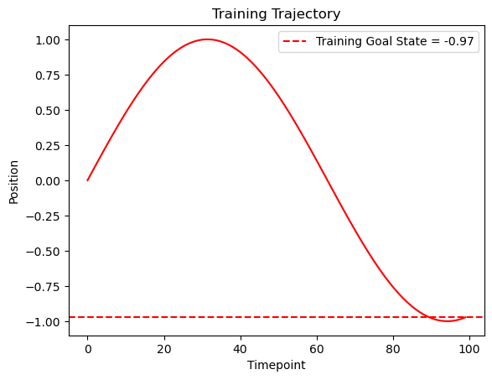
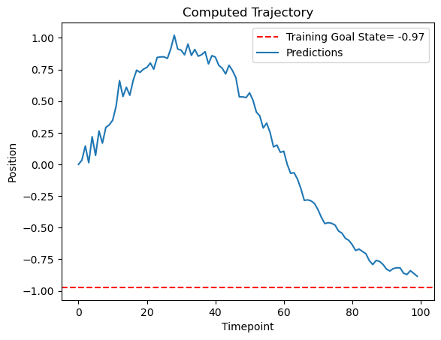
Model Training Performance
Notes:
We start with a trajectory that we want to emulate. In this case this is the red curve on the left. We provide a goal location for our training trajectory and then build our model. The predictions from our model are shown on the right – We see that the model predictions emulate the training trajectory and also reasonably converge to the goal state.
Now we want to see how our trained model generalizes to a new goal location, such as +5. As a real life example, let’s say we learned a motor trajectory to return a tennis ball at point A (-0.97) but now want to flexibly adapt our motor trajectory to return the ball at point B (+5).

Slide 14
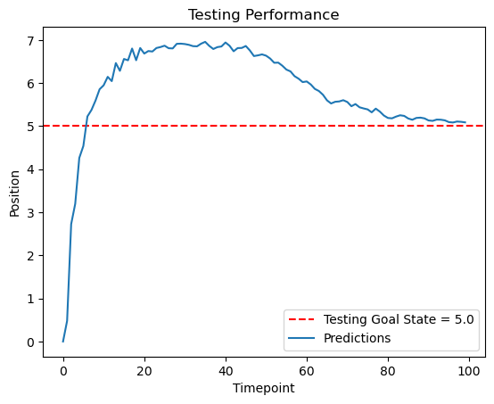
Model Testing Performance
Notes:
We see here that the testing output behaves extremely similarly to the trained sine curve but that it now flexibly converges to our new set goal position +5.

Slide 15
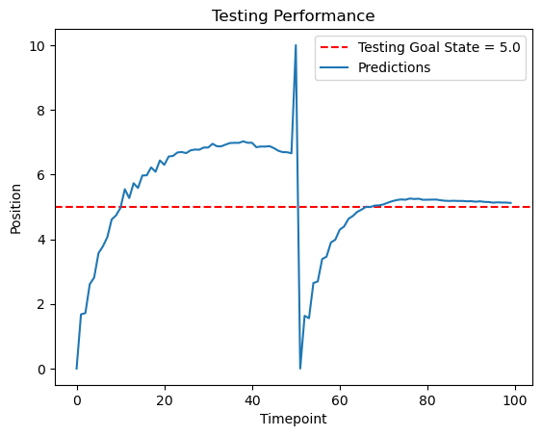
Stability to External Perturbations
Notes:
What if we kick testing predictions off course. For example, let’s say there is some online disturbance – such as accidently hitting something with your racquet as you return a ball. Would you still be able to recover from the disturbance and flexibly return to the goal location to return the ball?
To show this, let’s manually set the predicted position at time 50 to be +10 rather than the original predicted value of 6.61. Here we see that even though we’ve kicked our predictions off course, our system is still able to stably converge back to the goal state. This shows that our model is able to adapt to online disturbances and still return to baseline.

Slide 16
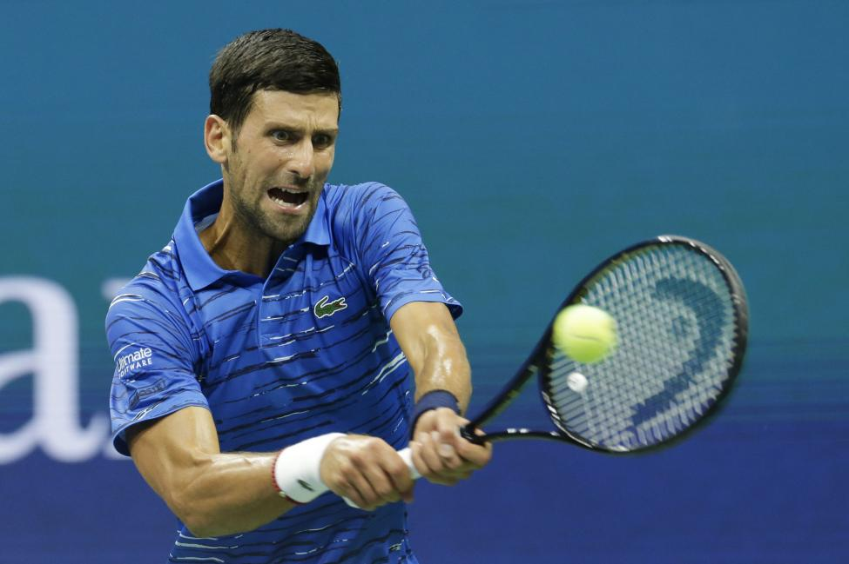
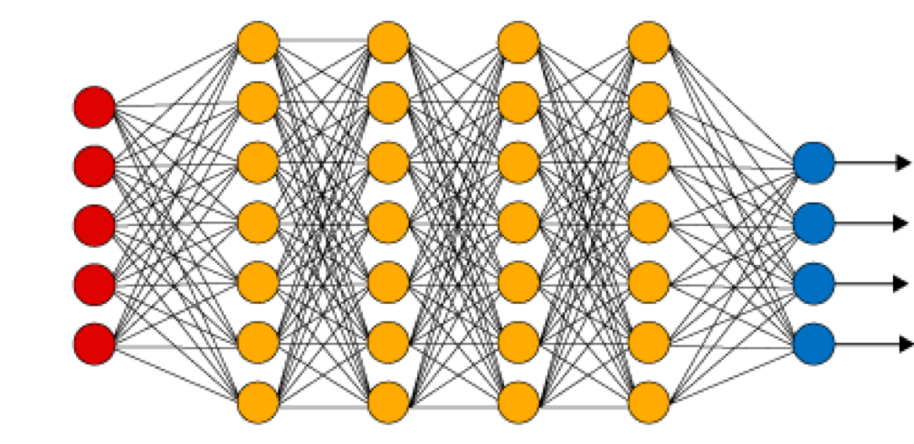
Summary + Future Directions
Our model: A biologically-realistic generalization of the DMP framework
Premotor System -> forcing values
Primary Motor Transformation System -> motor commands that create stable motor output.
Future directions:
Replacing the LQR control policy with a high-dimensional RNN
Neural Network solutions of optimal control
Modularity of motor actions
Library of simple motor behaviors -> complex, flexible motor behaviors.
Notes:
In summary, I worked on developing a biologically-plausible model of motor control – one that produces complex nonlinear trajectories but also generalizes to new goal states. This model is composed of two systems, the first being the premotor system that generates the forces necessary for complex nonlinear trajectories. Our second system, the primary motor transformation system, converts the forcing values to position output that converges stably to any goal state we provide. This model’s results show that our biological extensions and additional mathematical conditions do not require us to sacrifice predictive performance – we are able to produce nonlinear trajectories that converge to any arbitrary goal state in task space.
Additional extensions of this model include replacing the linear quadratic regulator optimization procedure to include more biologically-plausible frameworks – such as a high dimensional RNN of primary motor cortex. Moreover, investigating more biologically-realistic control theory rules the brain could be using to tame the transformation system would be a next step in investigating flexible neural motor control.
Another exciting next step would be to extend our model to incorporate modularity. Modularity of motor actions is a well-celebrated phenomena in biological systems and involves combining a library of simple motor behaviors into complex trajectories in an efficient way. We can think of it as stacking legos to create a complex lego creation. In our context, modularity could mean our model creating complex trajectories by stacking or switching between simpler motor trajectories. An extension of this model that accounts for this stacking/switching behavior will give insight into the computational mechanisms required for complex yet stable motor behavior.

Slide 17

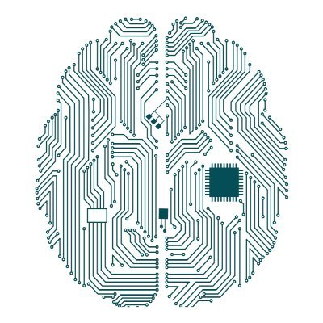
Acknowledgements
James Murray
UO NeuroAI Center Members
Notes:
I would like to thank James Murray for his guidance and mentorship as well as the all the members of the NeuroAI Institute for their helpful feedback.

