Slide 1
SIMULATION-BASED RESOURCE OPTIMIZATION OF A RETAIL BANK BRANCH
Name – Aditya
Roll No. - 2203301

Slide 2
Overview
A "Digital Twin" of a real retail bank branch.
How it Works ?
It tracks virtual customers from the moment they walk in the door until they are served or leave.
The Ultimate Goal:
Find the perfect number of Tellers and Helpdesk staff to maximize the bank's daily profit while keeping lines short.

Slide 3
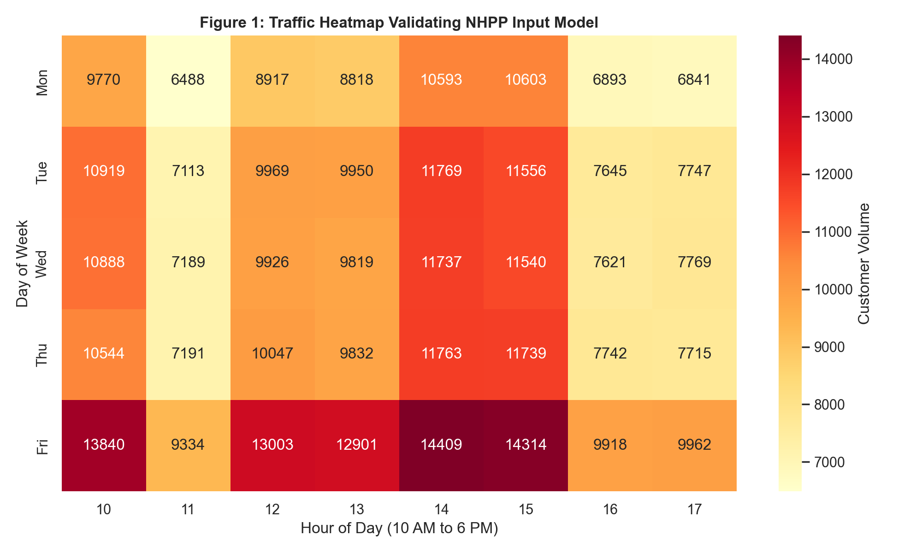
Motivation
customer foot traffic is never steady. It comes in massive, unpredictable waves
Bank branches often struggle to handle these sudden waves. When the rush hits, lines get too long, and the system breaks down.
When lines get too long, frustrated customers simply walk out the door.

Slide 4
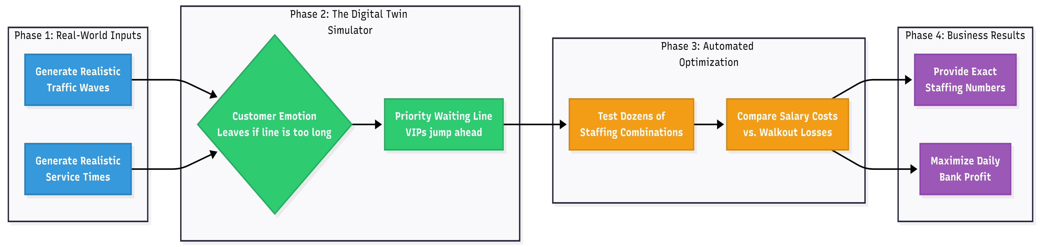
Architecture
Generating traffic y(t) = general arrival rate * specific day arrival rate * specific time arrival rate
Service time Si
S_teller , S_helpdesk = continuous distribution
S_relationship_manager = log normal distribution
Probability of leaving queue = logistic balking function (1 / (1 + exp^(sensitivity * (queue length – tolerance))

Slide 5
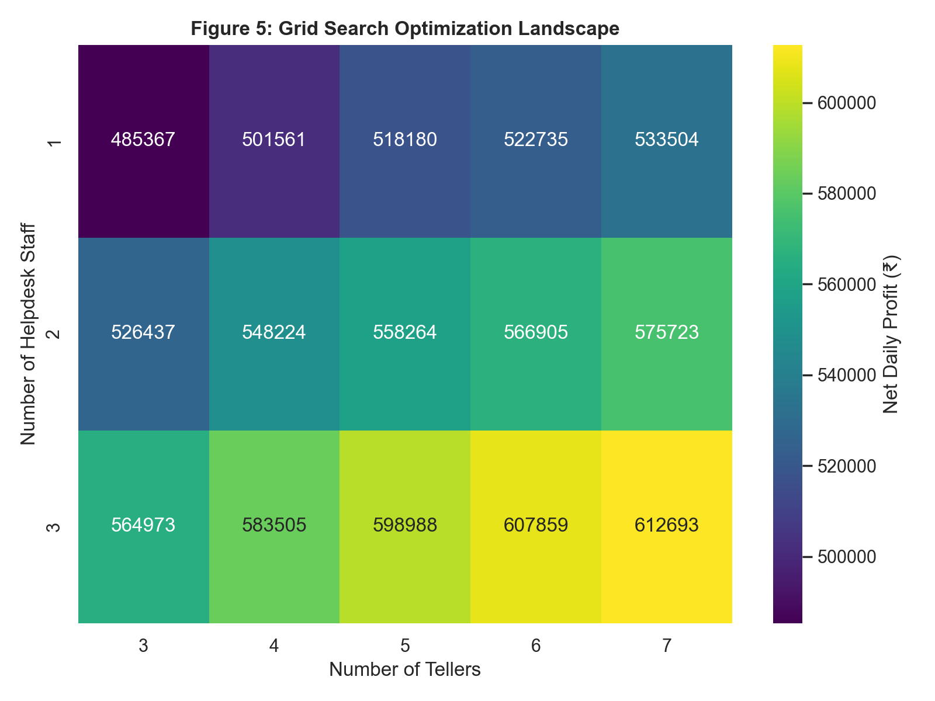
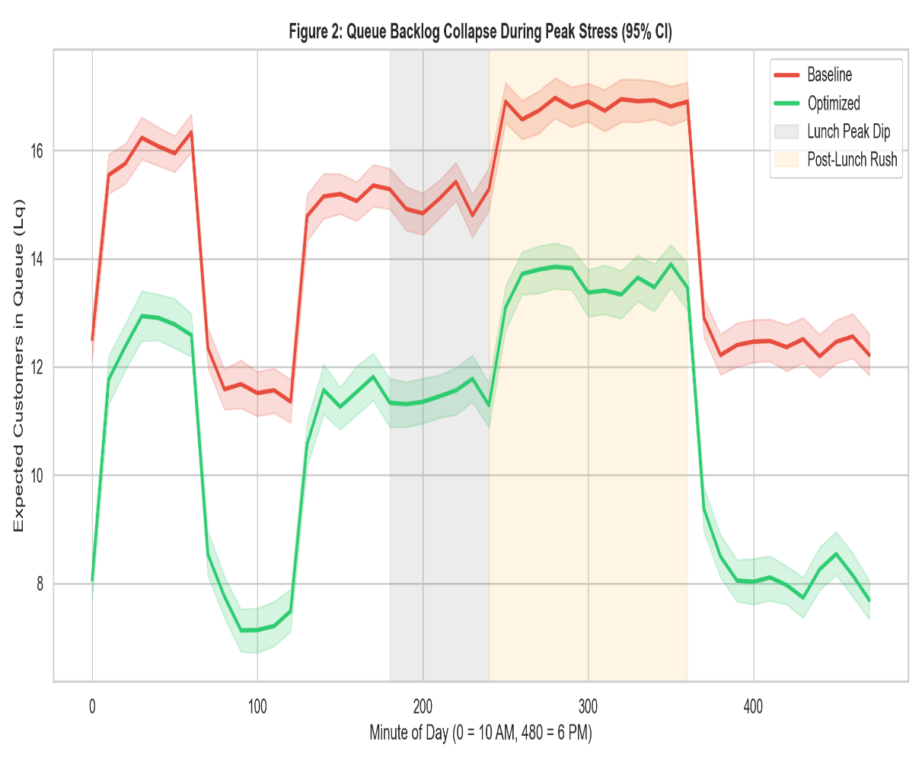
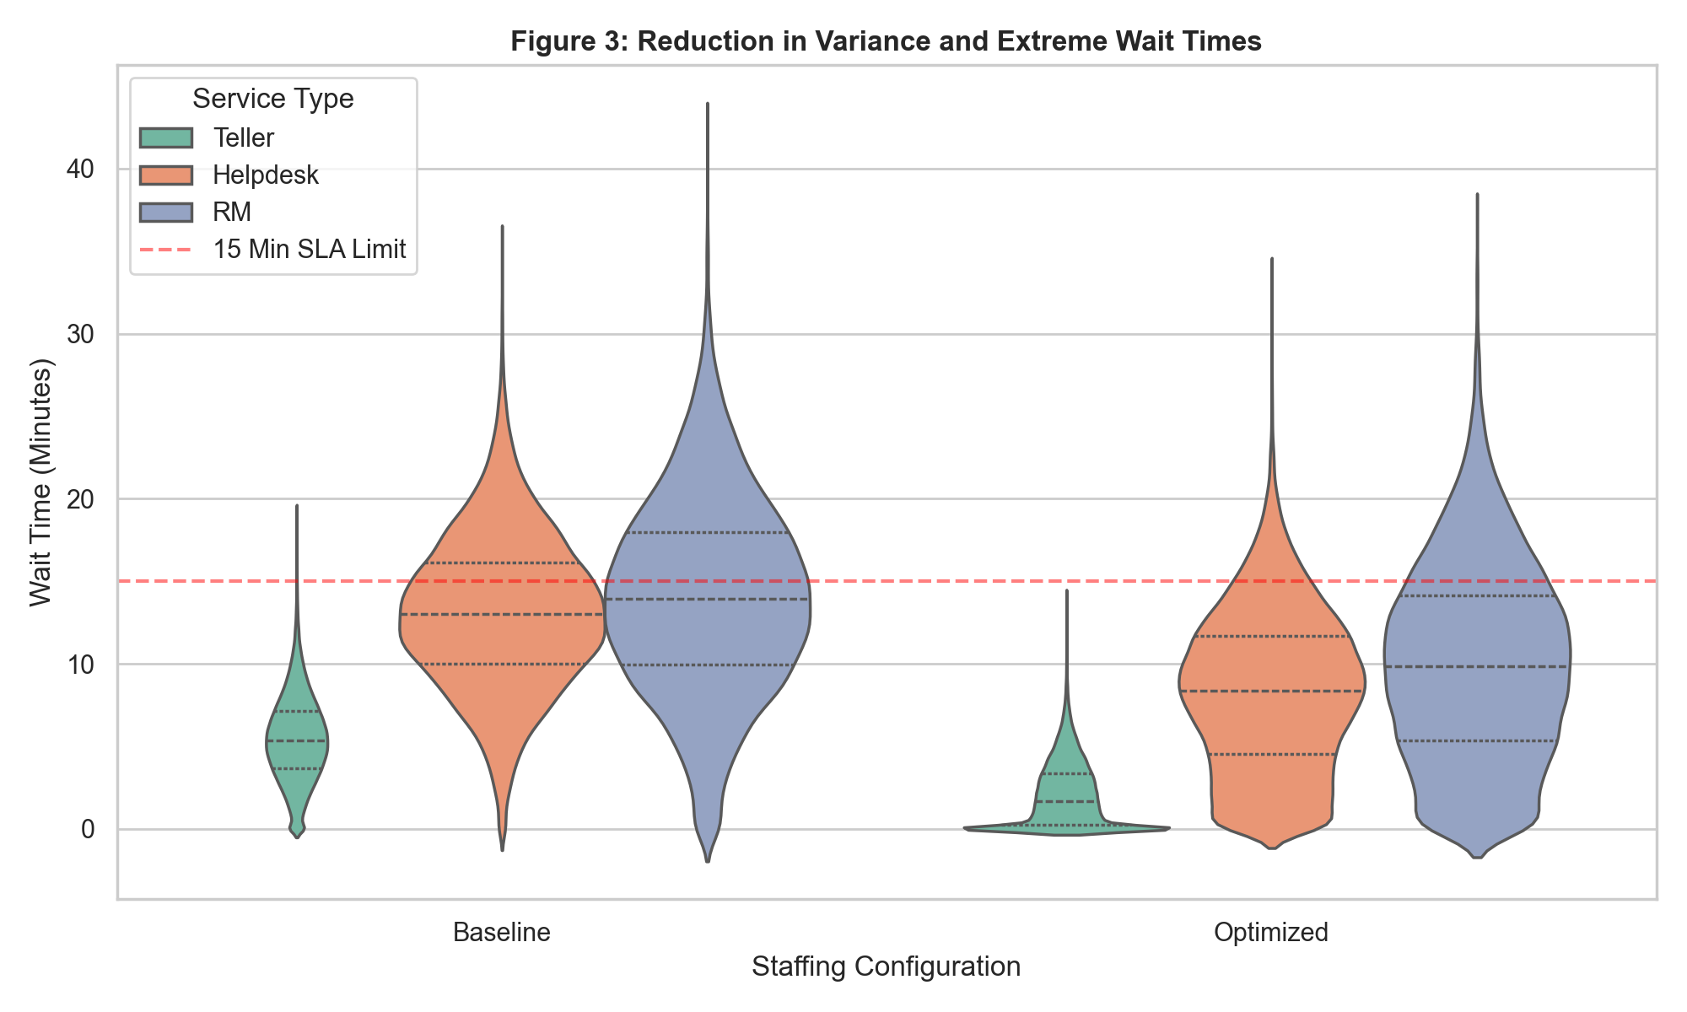
Results
The Result: The computer proved that hiring 7 Tellers and 3 Helpdesk 2 RM staff is the sweet spot for reducing the waiting queue lengths and waiting time.
SLA = service level agreement

Slide 6
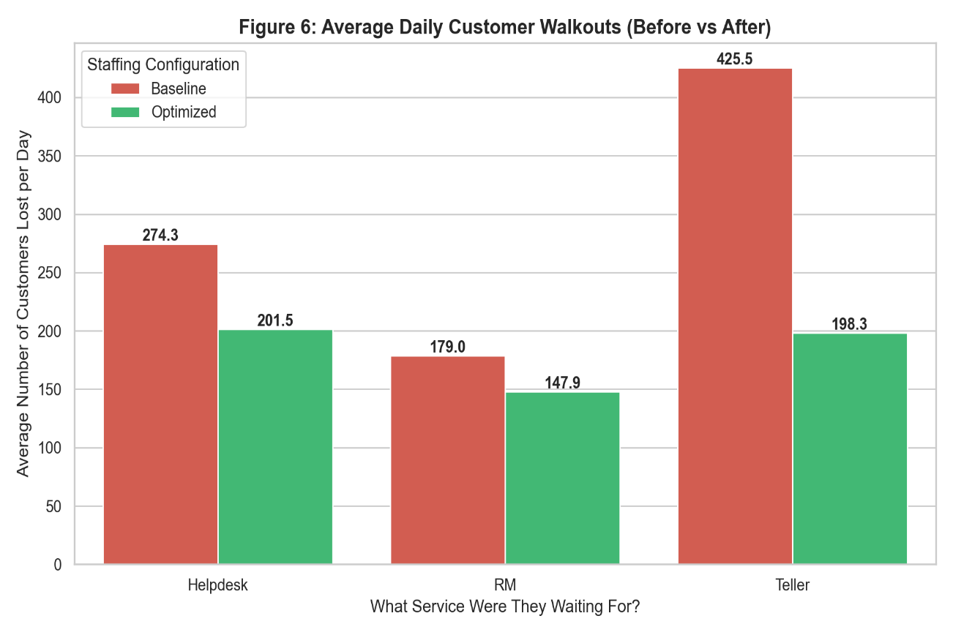
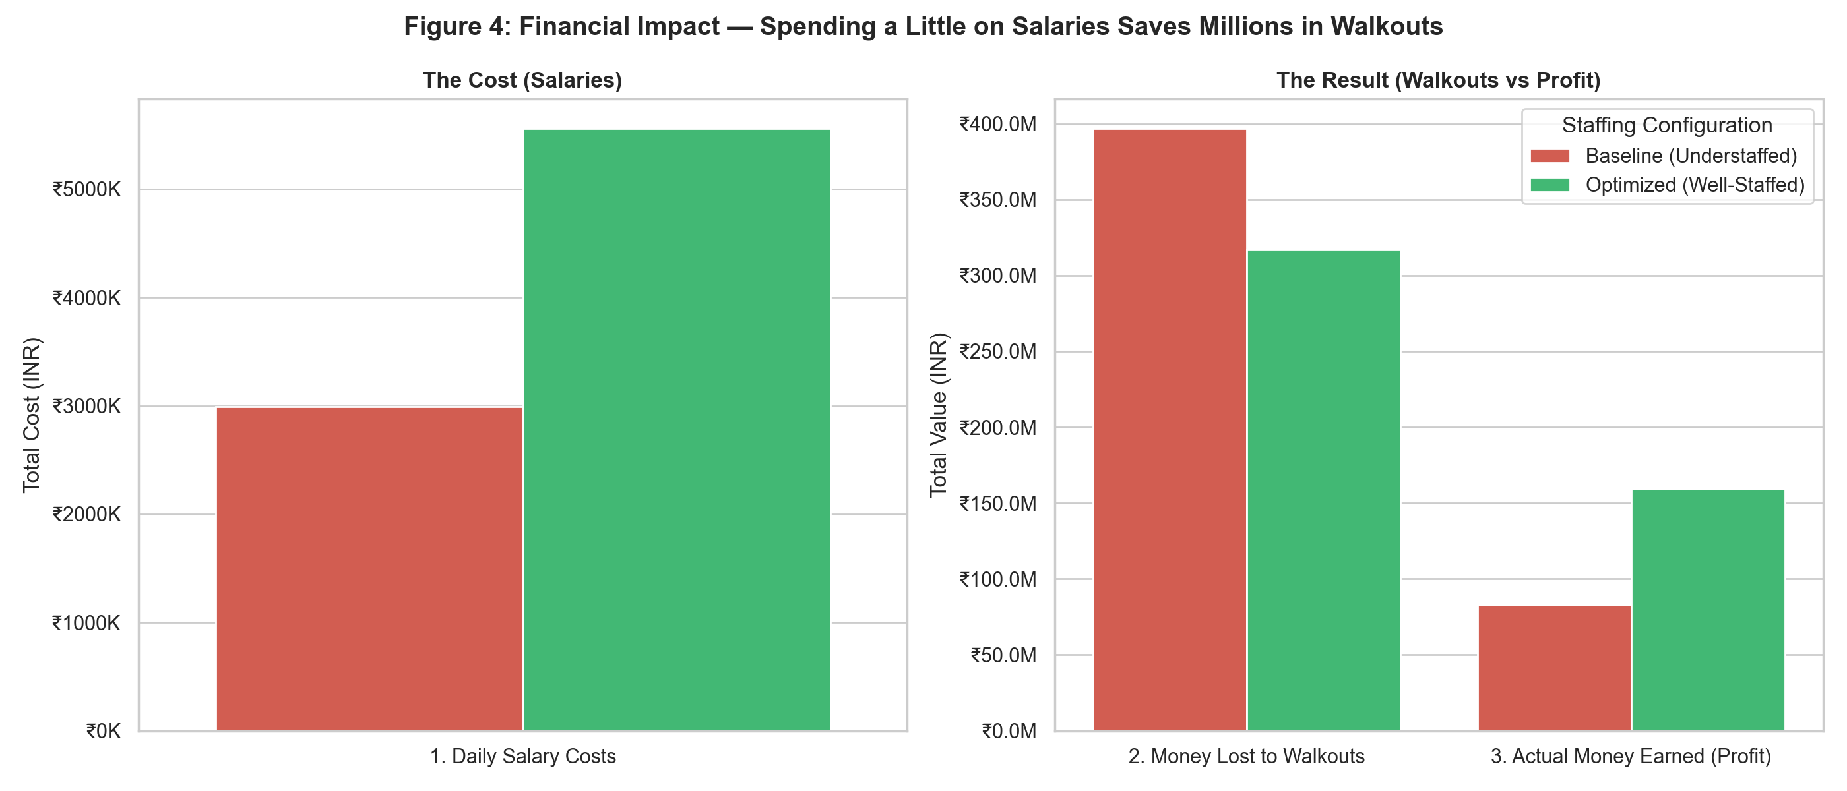
Results
The Result: The computer proved that hiring 7 Tellers and 3 Helpdesk staff is the sweet spot for maximizing profit.
The Challenge: We can’t just tell a computer "the customer gets mad and leaves..
Key Takeaway: Trying to save a few thousand rupees by understaffing is a bad business decision. It looks like you're saving money, but you are actually losing millions when long lines force valuable customers to leave.
Bank Cost = cost from served costumer – employee salary – cost from unserved costumers

Slide 7
Demo

Slide 8
THANK YOU

