Slide 1
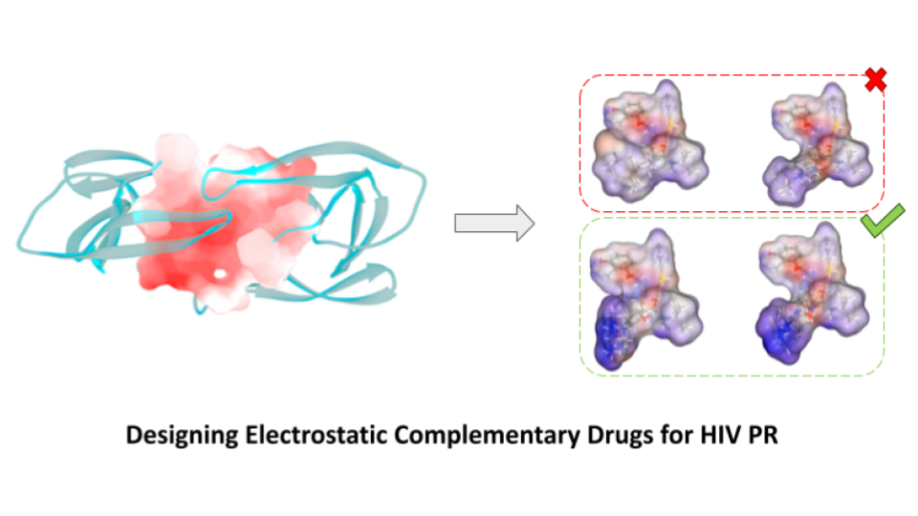
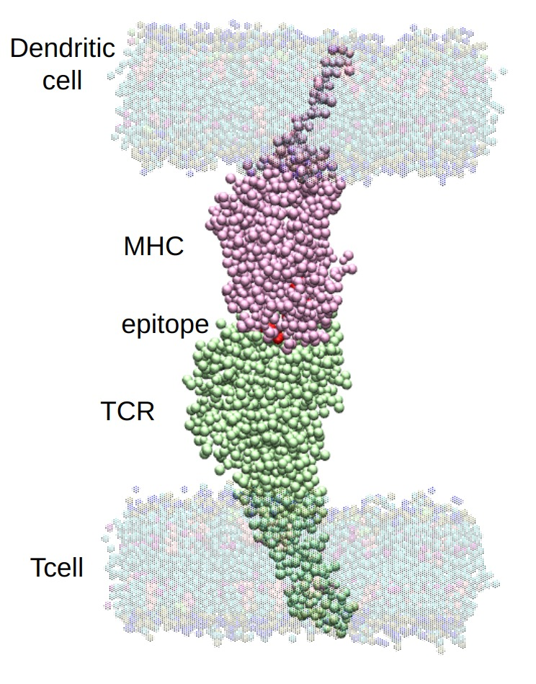
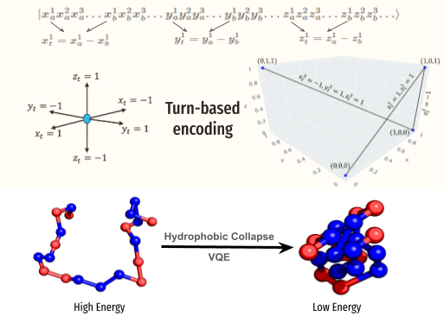
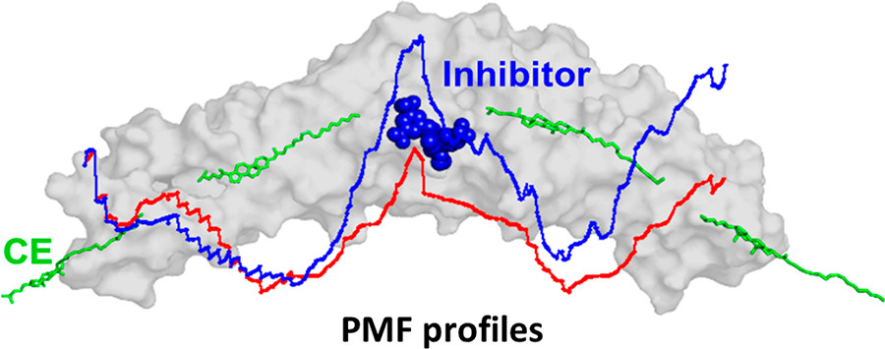
Protein Dynamics
COMPUTATIONAL BIOPHYSICS LAB
Prof. Sanjib Senapati
Developing algorithms to solve Protein Folding problem using Quantum Computing
Screening viral epitopes by targetting MHC-TCR complexation
PMF profile of CETP

Slide 2
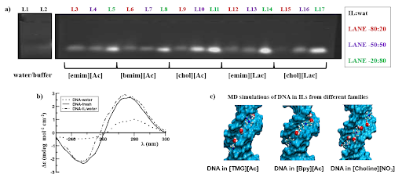
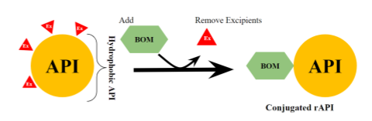
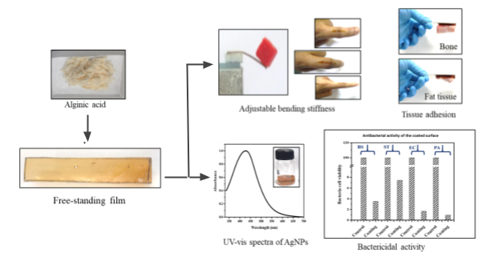
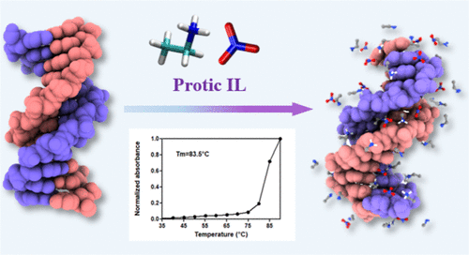
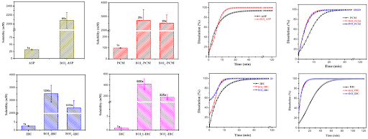

Ionic Liquids
COMPUTATIONAL BIOPHYSICS LAB
Prof. Sanjib Senapati
Reformulation of APIs for improving the bioavailability of drugs
Bio-ionic Liquid based Soft and Adhesive Film for Therapeutic Applications
visit our lab website to explore more
Long-term stability of nucleic acids at room temperature

Slide 3
Ionic Liquids
COMPUTATIONAL BIOPHYSICS LAB
Prof. Sanjib Senapati
Reformulation of APIs for improving the bioavailability of drugs
Bio-ionic Liquid based Soft and Adhesive Film for Therapeutic Applications
visit our lab website to explore more
Long-term stability of nucleic acids at room temperature

Slide 6
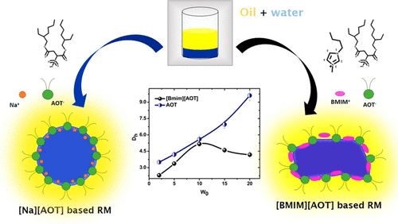

Slide 7
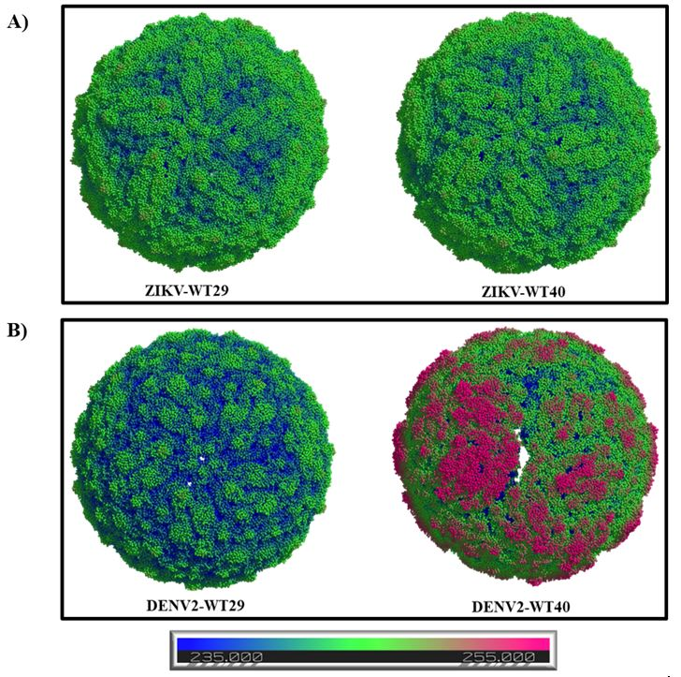

Slide 8
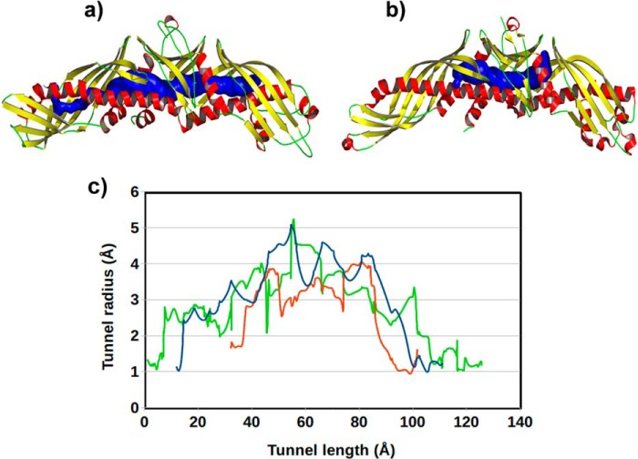

Slide 9
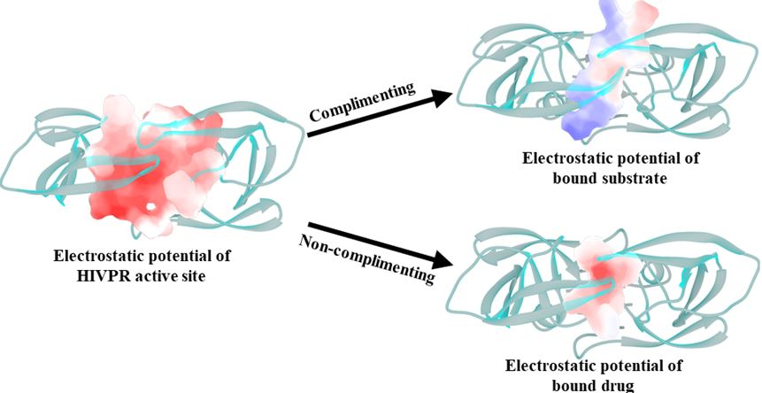

Slide 10
