Slide 1

QUESTPOND
OAuth 2.0 Authentication using MSAL in Angular
A Practical Demo of Secure Authentication with Microsoft Identity Platform
Presented by: Alisha Mugale
Technology: Angular + ASP.NET Core + Microsoft Entra ID
Demo: Login → Access Token → Secured API

Slide 2
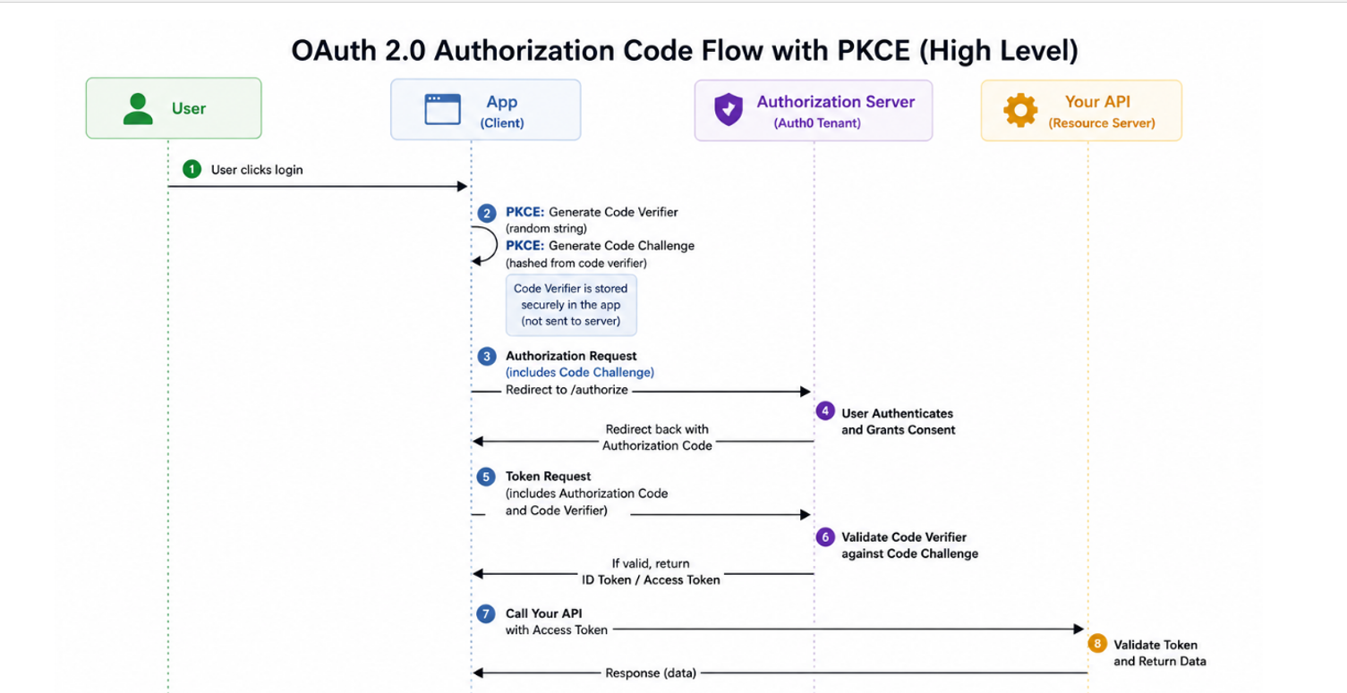
Microsoft Authentication Library
Proof Key for Code Exchange

Slide 3
Proof Key for Code Exchange
App creates:
  code verifier (secret)
  code challenge (derived from verifier)
Login request (authorization call):
Send → code challenge
After login success:
You receive → authorization code
Token request:
Send → authorization code + original code verifier
Server checks:
  It recalculates challenge from verifier
  If it matches → token is issued

Slide 4
01
npm install @azure/msal-browser @azure/msal-angular

Slide 5
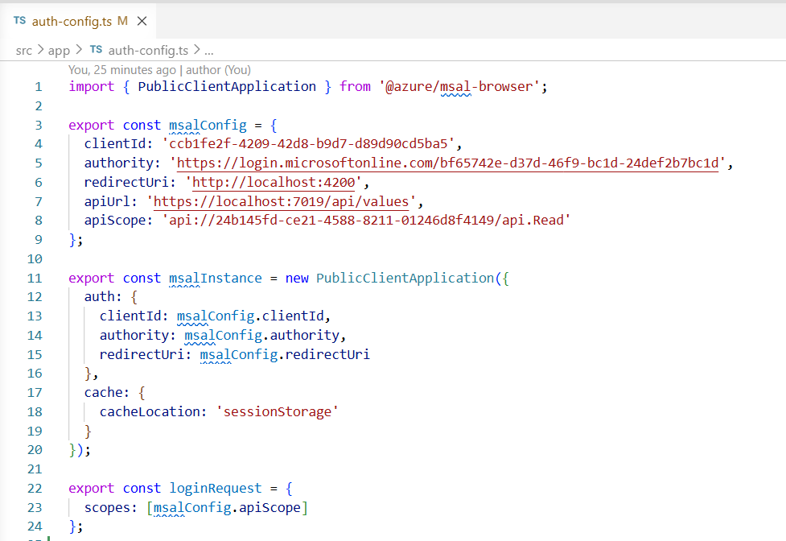
02
It contains the core MSAL-Microsoft Authentication Library settings

Slide 6
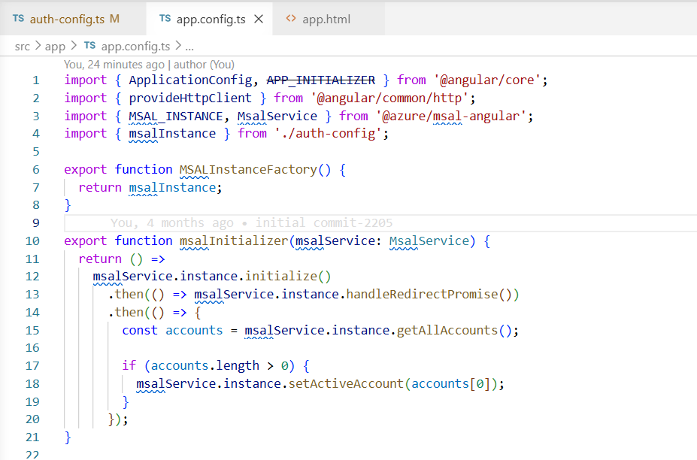
Integrates MSAL into the Angular application.
03

Slide 7

Questpond.com
Thank You
https://github.com/ak2943/MSAL-OAuth2.0

