Slide 1
Update Model

Slide 2
Overview
OceanStore employs an update model based on conflict resolution
This reduces number of aborts normally seen in detection-based schemes
Updates can be performed on encrypted data

Slide 3
Update Format
Updates are formatted as a list of predicates associated with actions
A predicate is a TRUE or FALSE statement
To apply an update, a replica evaluates all of the update’s predicates in order
If any predicates are true an update commits, otherwise it aborts

Slide 4
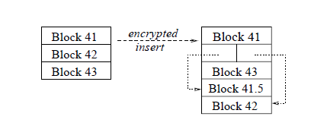
Working with Ciphertext
The following operations can be applied to ciphertext: replace-block, insert-block, delete-block, and append
Block insertion on ciphertext

Slide 5
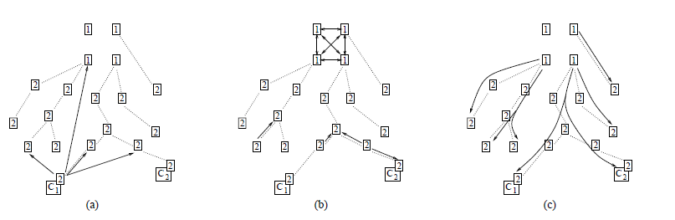
The Path of an Update
All updates pass through primary and secondary tiers of replicas
The primary tier consists of a small number of replicas in high-bandwidth, high connectivity areas
The secondary tier is organized into multicast trees of replicas

Slide 6
Deep Archival Storage

Slide 7
Erasure Codes
The archival mechanism of OceanStore employs erasure codes
Input data is treated as a series of fragments (say n) and is transformed into a greater number of fragments (say 4n)
Any n of the coded fragments are sufficient to construct the original data
If fragments are spread widely, it is very likely the data will be recoverable

Slide 8
Survivability
These procedures maximize survivability of archival copies:
Administrative domains are ranked by their reliability and trustworthiness
Most fragments are not dispersed to locations with a high probability of failure
The number of fragments is determined on a per-object basis

