Slide 1
Ocean Store!

Slide 2
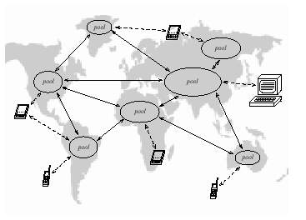
Introduction
Inspiration of technology is to achieve more Transparency
Persistent information
permits the behavior of devices to be independent of the devices themselves.
Requirements
Connectivity
Security
Durability
Information divorced from location
Geographically distribute the servers

Slide 3
Two Unique Goals
Untrusted Infrastracture
Encryption
Distributed consitency management
Nomadic Data
Locality
Promiscuous Caching

Slide 4
System Overview
Fundamental unit: “Persistent Object”
GUID
Replicated and stored on multiple services
Probabilistic algorithm to locate
Slower deterministic algorithm
Updates
versioning
Forms
Archival
Active

Slide 5
Application
Problems
Consistency, security, privacy, wide-scale data dissemination, dynbamic optimization, durable storage, and disconnected operation.
Groupware
Emails
Digital libraries and repositories

