Slide 1
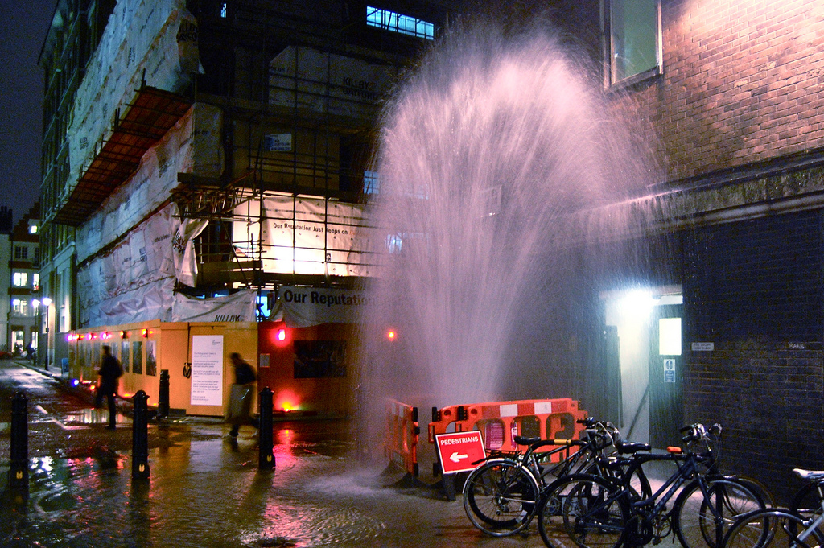


RRPAMWDS
Funded by:
Risk-based decision making and life cycle cost analysis of water pipes
Assela Pathirana
assela@Pathirana.net

