Slide 1
Python project
Topic:- Words Unscramble
Submitted By:-
Ashish Kumar-11717701
Jitendra Verma-11717900
Aniket Kushwaha-11700117
Submitted To:-
Mrs. Vishu

Slide 2
Project Description
A Puzzle Game in which , various letters will be shown in a table and he/she can select any random letter from the grid in order to make meaningful words.

Slide 3
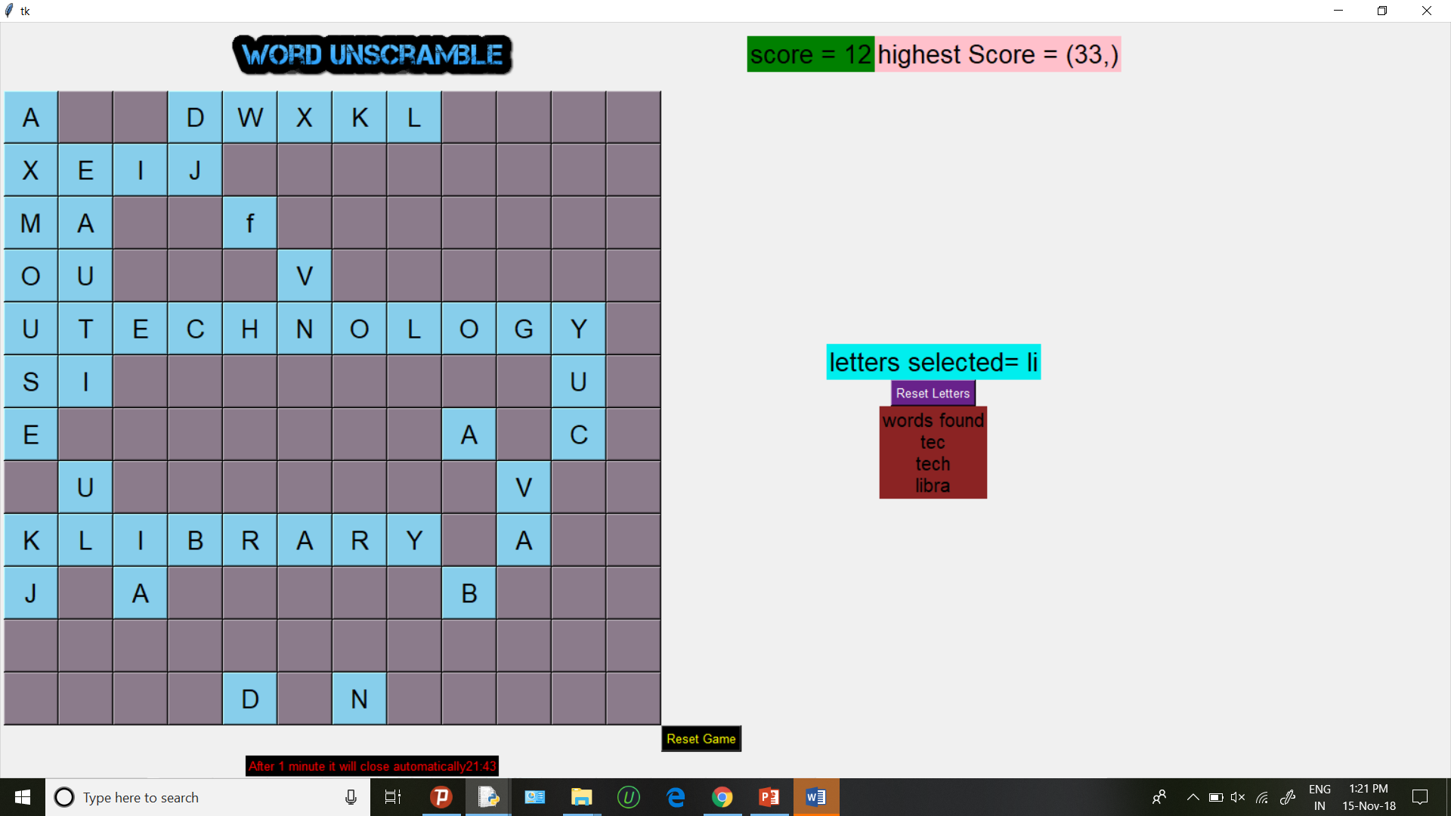
Main Game Screens

Slide 4
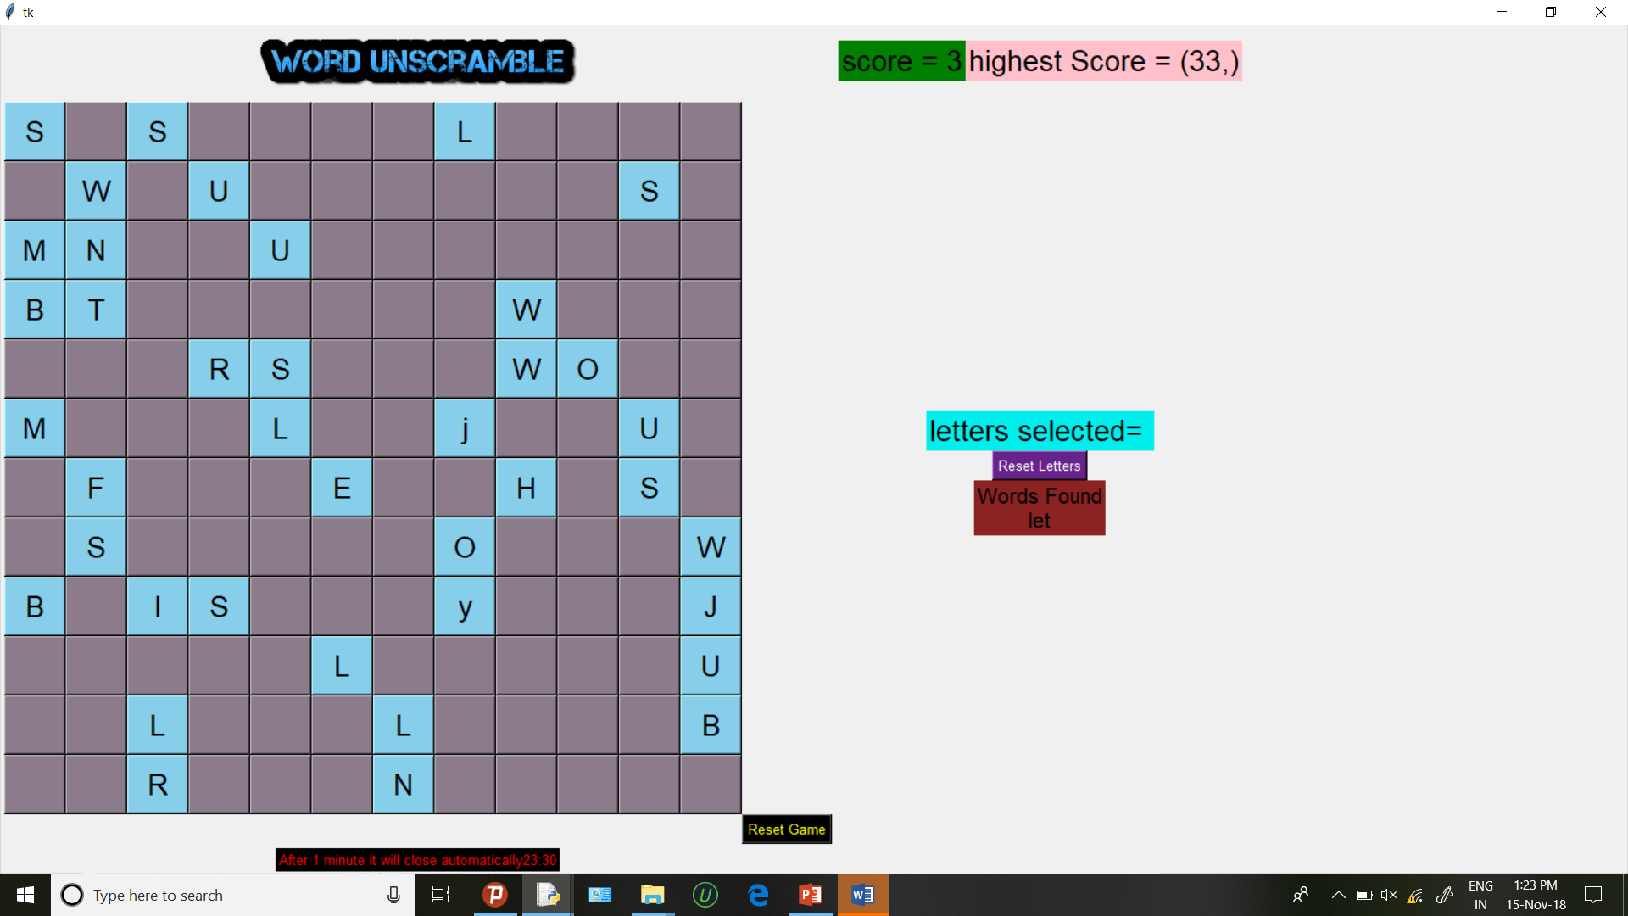

Slide 5
Methodology
We have used Python 3 for the coding part .
GUI part is designed using Tkinter .
We also used NLTK(Natural Language Toolkit). It is used to enable python programs to work with human language data.
We have used ‘Sqlite 3’ for database storage.
Other modules used are ‘time’ and ‘random’.

Slide 6
Game-play Tips
User is expected to find meaningful words from the given matrix by selecting letter one by one.
He/she will have to find as many words as possible
within the specified time.
Selected letters will be displayed in a separate column labelled as ‘letters selected’ in the game screen.
A separate ‘Reset game’ button is provided at the bottom in case user wants to start a new game from beginning.

Slide 7
Conclusion
The game ‘Word Scramble’ has been designed in a way that user find it interesting to play.
By the addition of timer in the game we tried to make it even more interesting .
Overall designing the game was a real challenge for us and we think that we delivered it pretty well.

