Slide 1

POLARITY ANALYSIS OF TWEETS
Department of Computer Science and Engineering
(Supervisor: Mr Surya Prakash )
Group Members
Name of Member | Roll Number | Role
Amit Kumar | 1513310042 | Hadoop administrator, cloud administrator.
Ankur Choudhary | 1513310049 | Python and machine learning implementer, documentation.
Ravi Sahitya | 1513310167 | Twitter api management, tweets retriever, documentation.
Shanu Kumar Singh | 1513310167 | Python and machine learning implementer.

Slide 2

Index
Introduction
literature Survey
Problem Statement
Proposed Methodology
Brief Module details
Hardware /Software Requirement
Module Progress
Live Demo of implemented part
Conclusion
References

Slide 3
Introduction
Twitter is a micro-blogging website that has become increasingly popular with the network community. Users update short messages, also known as Tweets, which are limited to 140 characters. Users update their personal opinions on many subjects, discuss current topics and write about life events through tweets. This platform is favored by many users because it has no political and economic restrictions and is easily available to large number of people. As the amount of users increase, micro-blogging platforms are becoming a place to find strong viewpoints and sentiment. People use twitter to forecast and analyze in a lot of different areas. For example, people have already forecasted the stock market success by using data from Twitter. People use Twitter to forecast popularity and sales revenue of electronic products. From these case studies, we can know that Twitter is really useful for predicting products, services, or markets. It is one important reason why Twitter is taken into consideration to predict how people think about the popularity of day to day products. Another reason is because Twitter serves as a worthy platform for sentiment analysis due to its large user base with people across the world having different perspective. Twitter contains enormous amount of tweets, with millions being added every day. This can be easily collected through its APIs, which makes it easy to build a training set.

Slide 4
What is polarity analysis?
Polarity Analysis is the process of ‘computationally’ determining whether a piece of writing is positive, negative or neutral. It’s also known as opinion mining, deriving the opinion or attitude of a speaker.

Slide 5
Literature Survey
Background work
Sentiment analysis deals with identifying and classifying opinions or sentiments which are present in source text. Social media is generating a huge amount of sentiment rich data in the form of tweets, status updates, reviews and blog posts etc. Sentiment analysis of this user generated data is very useful in knowing the opinion of the crowd. Twitter sentiment analysis is arduous as compared to basic sentiment analysis due to the presence of slang words and misspellings. The maximum limit of characters that are allowed in Twitter is 140. Machine learning approach can be used for analyzing sentiments from the text.
Some sentiment analysis are performed by analyzing the twitter posts about electronic products like cell phones, computers etc. using Machine Learning approach. By performing sentiment analysis in a specific domain, it is possible to identify the effect of domain information in sentiment classification. They presented a new feature vector for classifying the tweets as positive, negative or neutral and extract people’s opinion about products.
Another research tried to pre-processed the dataset, after that extracted the adjective from the dataset that have substantial meaning which is called feature vector, then selected the feature vector list and thereafter applied machine learning algorithms such as Naïve-Bayes, Maximum Entropy and SVM along with the Semantic Orientation based Word-Net which extracts synonyms and relation for the content feature. At the end, they measured the performance of classifier in terms of recall, precision and accuracy.

Slide 6
Some researchers had an approach where posted tweets from the Twitter micro-blogging site are subjected to preprocessing and classified based on their emotional content as positive, negative and neutral or irrelevant; and compares the performance of various classifying algorithms based on their precision and recall in such cases. Further, the paper also discusses the applications of this research and its limitations [3]. A number of machine learning like Naïve Bayes and Random Forest models performed sentiment analysis on product review data [8]. Some work in this field included experiments with mood classification on blog posts. One of the researches also deals with review of aspect-based opinion polling from unlabelled free-form textual customer reviews without requiring customers to answer any questions [10]. The tweet retrieval process needs access tokens from the twitter developer site and a piece of code which perform the operation of retrieving those tweets.

Slide 7
Existing System
The existing system works only on the dataset which is constrained to a particular topic. The existing systems also do not determine the measure of impact the results determined can have on the particular field taken into consideration and it does not allow retrieval of data based on the query entered by the user i.e. it has constrained scope. In simple words, it works on static data rather than dynamic data. Unsupervised algorithms like Vector Quantization, are used for data compression, pattern recognition, facial and speech recognition, etc. and therefore cannot be used in determining sentiment in twitter data. Apriori algorithm fails to handle large datasets and as a result can generate faulty results.

Slide 8
Proposed System
In proposed system we will retrieve tweets from twitter using twitter API based on the query and will store it in cloud. The collected tweets will be subjected to preprocessing. We will then apply the supervised algorithm on the stored data. The supervised algorithm used in our system is Naïve Baye’s. The results of the algorithms i.e. the sentiment will be represented in graphical manner(pie charts/bar charts). The proposed system is more effective than the existing one. This is because we will be working on cloud rather than local system and will be able to know how the statistics determined from the representation of the result.

Slide 9
Comparison
S.NO. | Existing System | Proposed System
1. | Existing system takes a stored dataset on a particular topic into consideration. | Proposed system will gives you the freedom to choose the data of any topic
2. | Proposed system will gives you the freedom to choose the data of any topic. | Here, it gives you the impact the results and statistics will have on the respective field.
3. | Existing system does not allow the retrieval of data based on the query entered by user. | Proposed system allows retrieval of data based on the query entered by the user.
4. | Existing system works on local system. | Proposed system will also work on cloud.

Slide 10
Why polarity analysis?
Business: In marketing field companies use it to develop their strategies, to understand customers’ feelings towards products or brand, how people respond to their campaigns or product launches and why consumers don’t buy some products.
Politics: In political field, it is used to keep track of political view, to detect consistency and inconsistency between statements and actions at the government level. It can be used to predict election results as well!
Public Actions: Sentiment analysis also is used to monitor and analyze social phenomena, for the spotting of potentially dangerous situations and determining the general mood of the blogosphere.

Slide 11
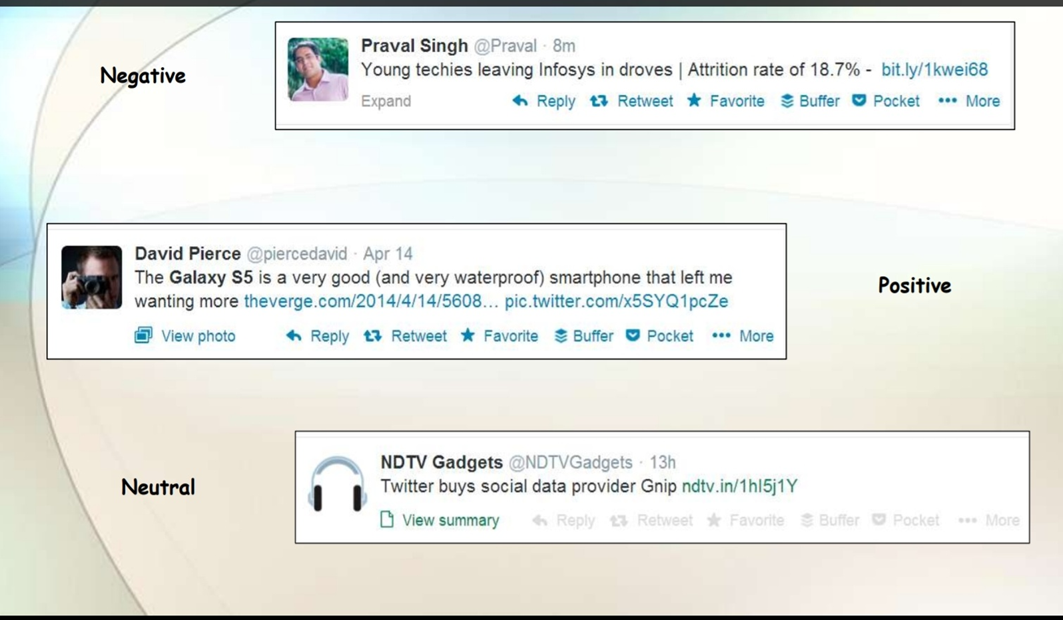

Slide 12
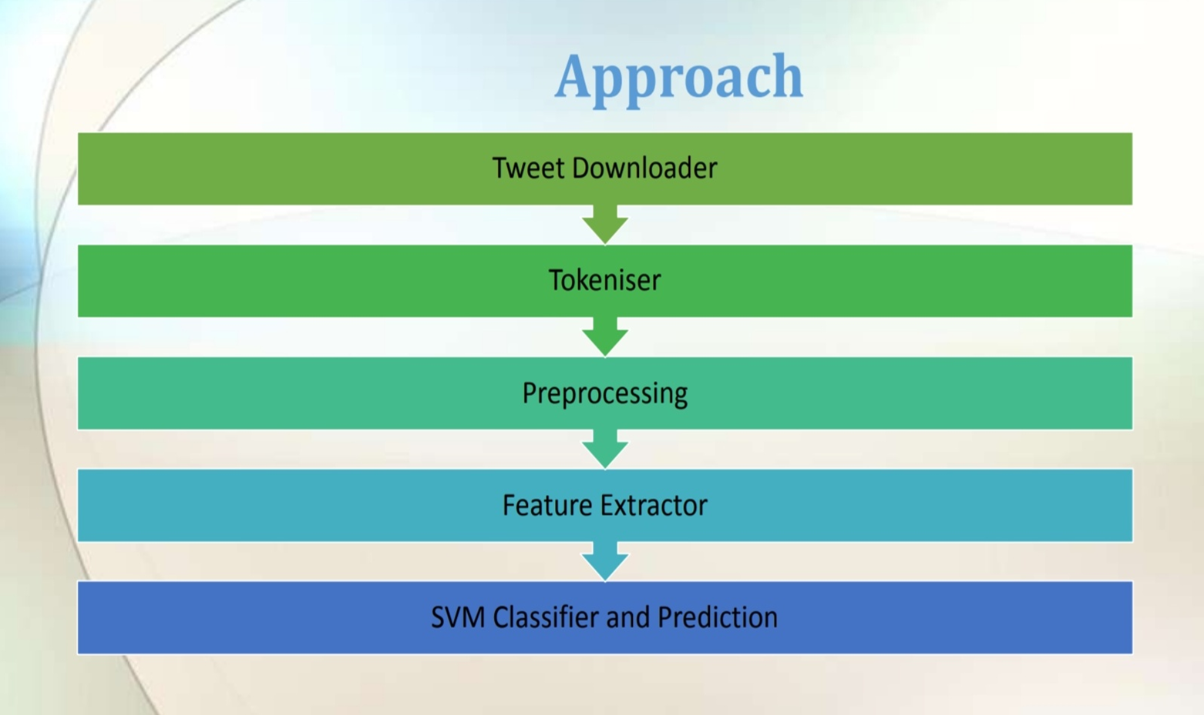

Slide 13
Modules Summary
Cloud account setup.
Environment setup.
Twitter data retrieval.
Polarity analysis.

Slide 14
Module Details
Cloud account setup
In this module we’ll create our cloud account with required OS service on amazon ec2 cloud and set up private key for restricting it’s access.
Environment setup
In this module we’ll install the tools required to do our project. We’ll install
Hadoop
Hive
Python
Twitter data retrieval
In this module we’ll perform steps to retrieve twitter data from twitter api. First we’ll create account and then create twitter application and use it’s url to retrieve tweets in our Hadoop(hdfs) storage.

Slide 15
Polarity analysis
In this module we’ll run our python code on retrieved twitter data to perform polarity analysis which will give us idea about sentiments of people towards a particular topic.

Slide 16
Hardware Requirements
(Local System)
RAM: 8GB
Processor: Intel corei5 or more
Hard Disk: 512GB
Speed: 2GHZ
(Cloud)
Amazon Ec2 or Emr cluster(minimum 1 system)
Ram : 1GB
Storage: 8GB

Slide 17
Software Requirements
Ubuntu 10 Os/Cent Os
Hadoop 2.0
Hive /Imphala
Python 2.7

Slide 18
Module Progress
Cloud account setup

Slide 19
Environment Setup

Slide 20
Twitter data retrieval

Slide 21
Polarity analysis

Slide 22
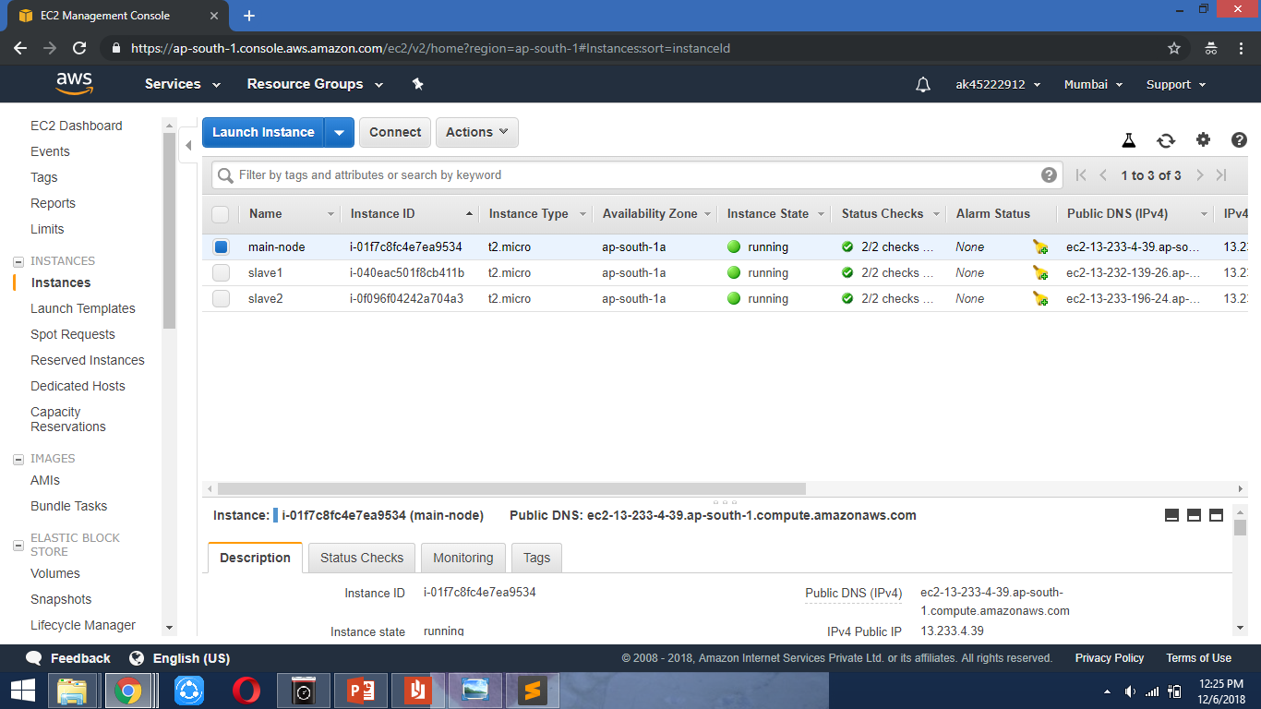
Live Demo of Implemented part
Amazon ec2 management console

Slide 23
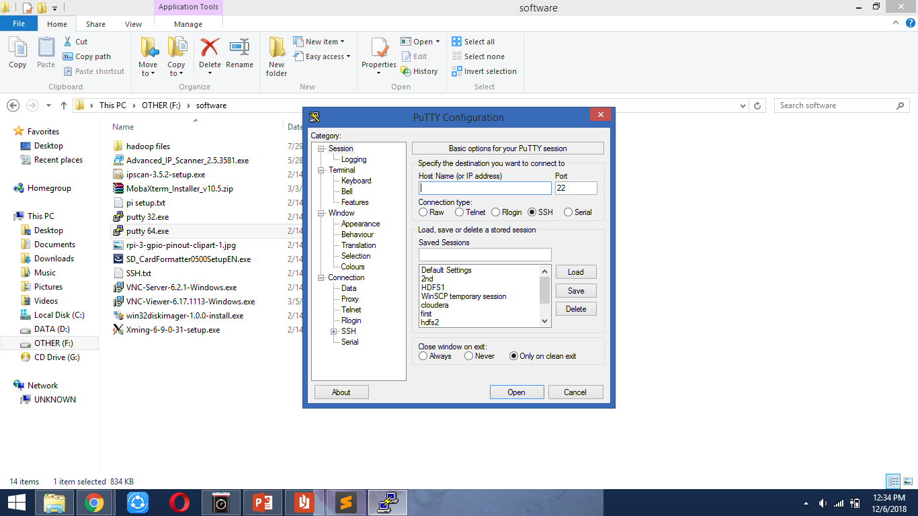
Putty window

Slide 24
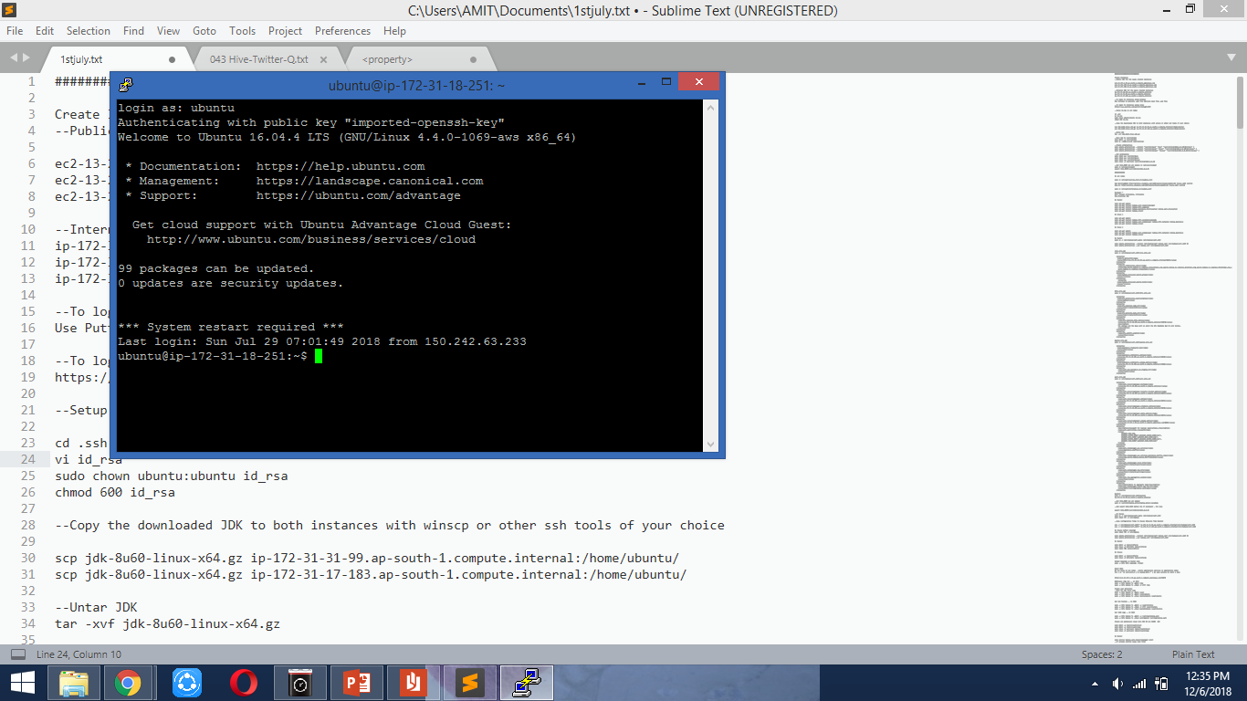
Connection to cloud server through SSH

Slide 25
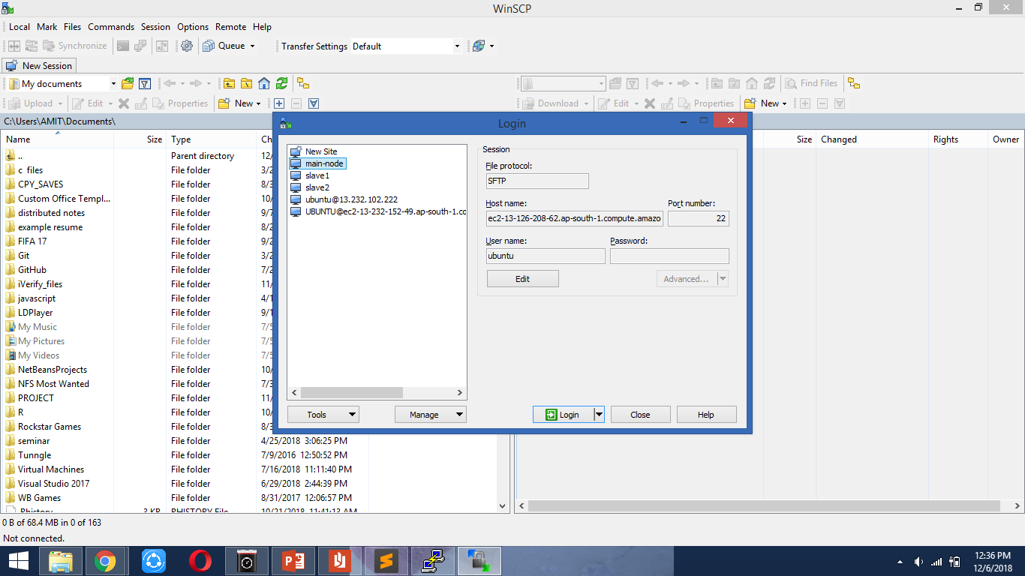
WinSCP window(used to exchange files between local system and cloud server

Slide 26
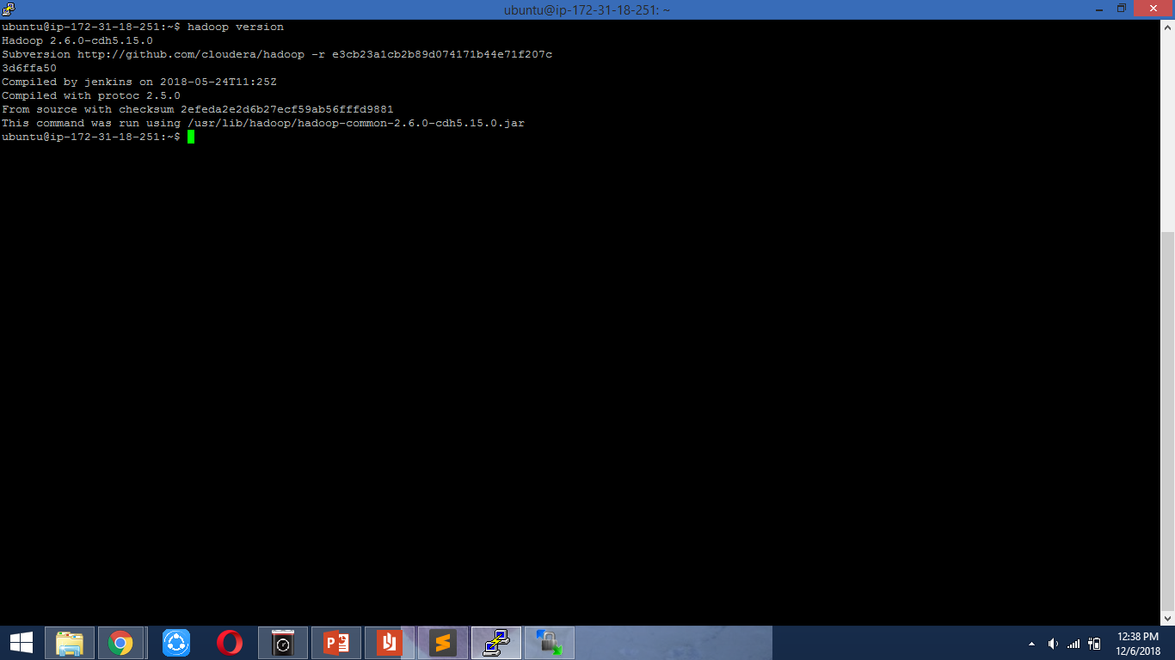
Hadoop version information

Slide 27
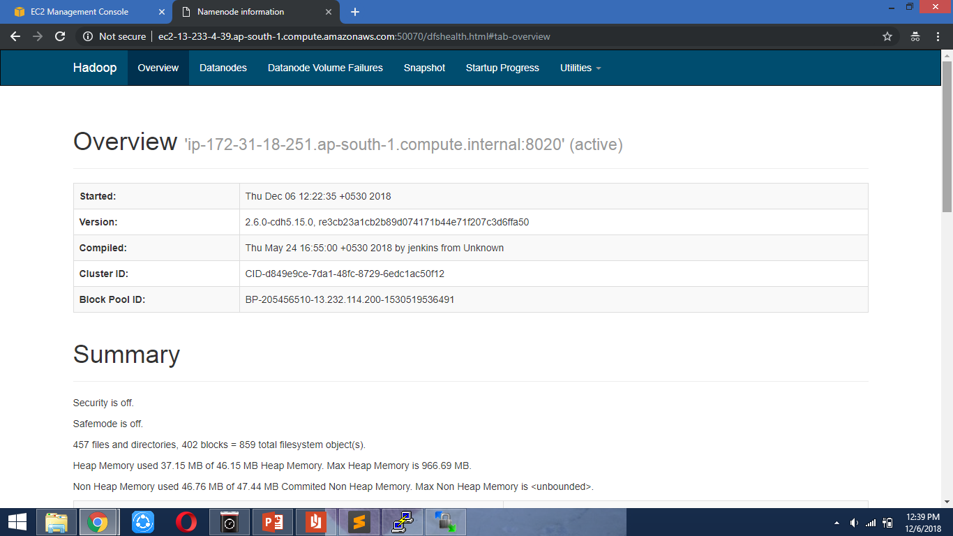
Hadoop window

Slide 28
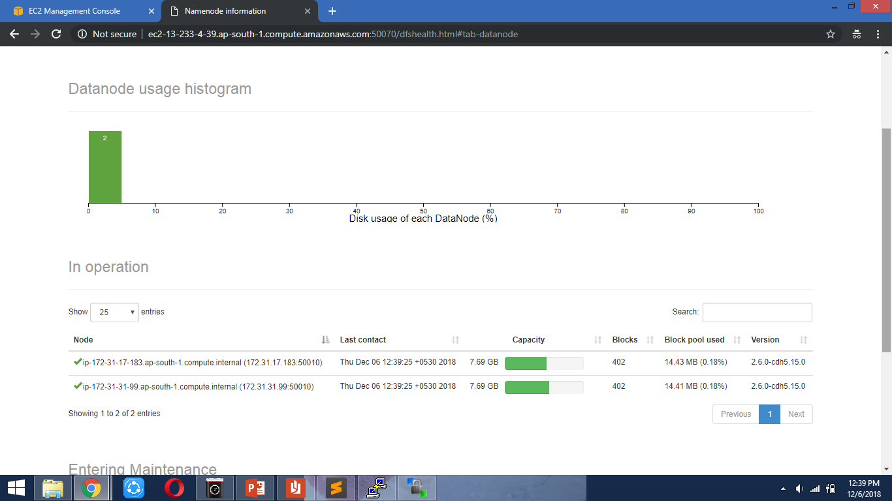
Datanode information

Slide 29
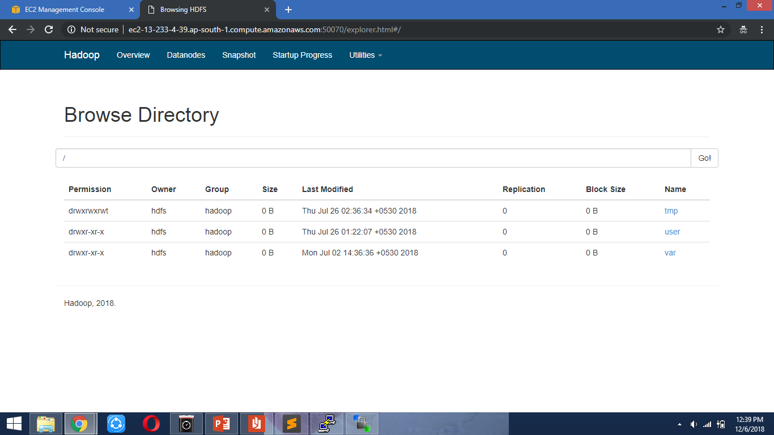
Hadoop file system

Slide 30
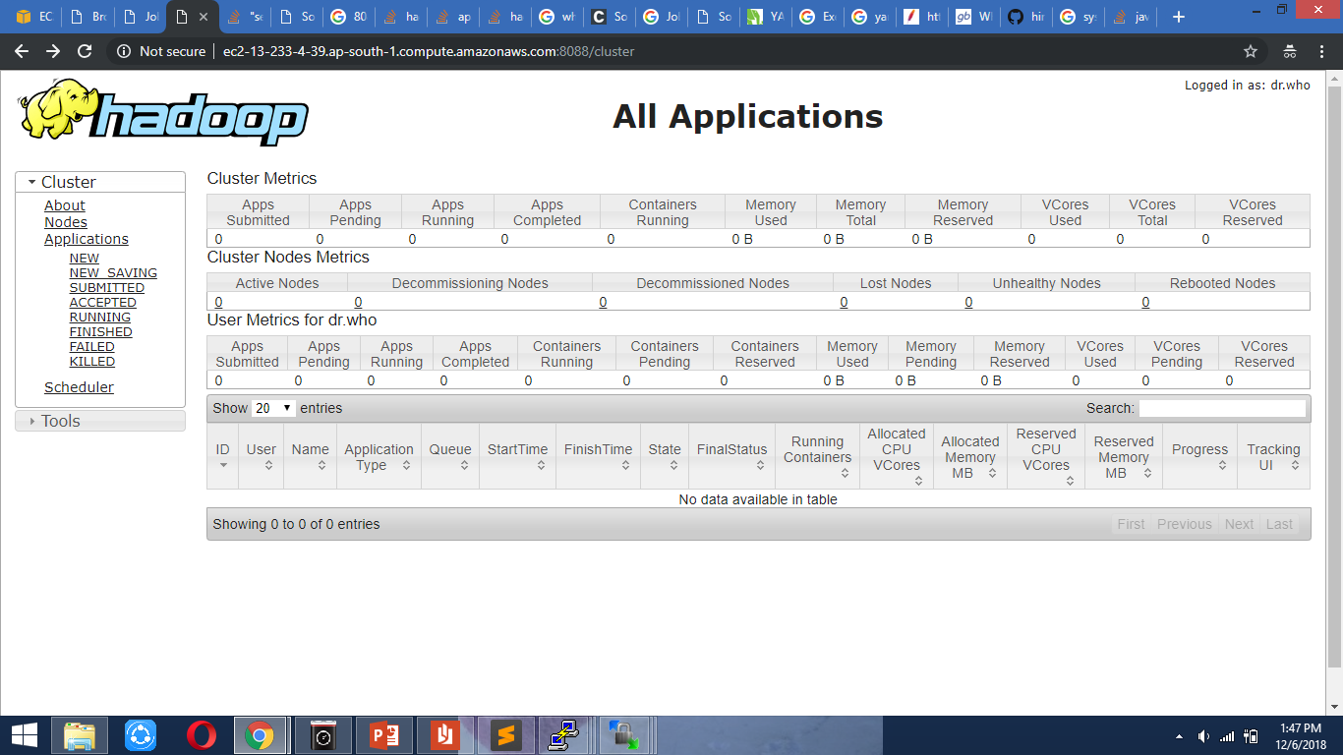
Hadoop job management window

Slide 31
Conclusion
We investigated two kinds of models: Baseline and Feature based models and demonstrate that combination of both these models perform the best.
For our feature based approach, feature analysis reveals that the most important features are those that combine the prior polarity of words and their parts-of-speech tags.

Slide 32
References
1] Geetika Gautam, Divakar Yadav, “Sentiment Analysis of Twitter Data Using Machine Learning Approaches and Semantic Analysis”. IEEE 2014.
[2] Neethu M S, Rajasree R, “Sentiment Analysis in Twitter using Machine Learning Techniques”. IEEE 2013.
[3] B. Gokulkrishnan, P. Priyanthan, T. Ragavan, N. Prasath and A. Perera, “Opinion Mining and Sentiment Analysis on a Twitter Data Stream”. IEEE 2012.
[4] http://twitter4j.org/en/
[5] https://en.wikipedia.org/wiki/Vector_quantization

Slide 33
Thank You

