Slide 1


Final Project Challenge - Microscopy Cell Segmentation
Ben Gurion University of the Negev
Electrical Engineering Department
Deep Learning for Signal and Image Processing and Analysis
361-2-1120

Slide 2
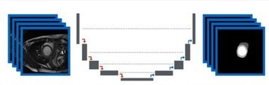
Final Project Challenge - Microscopy Cell Segmentation
This presentation contain two different architecture for microscopy cell segmentation
Both the architecture based of U-net combined ResNet

Slide 3
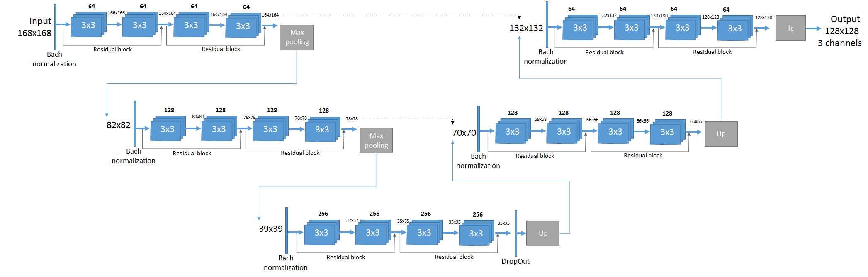
Architecture 1
Unet with resNet blocks
Non zero padding
Bottle neck
Input: resized image +40 pixels
Xavier
L2 regularization

Slide 4
Architecture 1 - Params:
Bath Normalization : at the beginning of each layer
Drop-out : In the bottom of the U layers
Learning rate: 0.0001
Weights for segmentation : (0.14 , 0.16 , 0.7)
Crop size: 128x128 , 10 crops per image
Stride: 1 in each Convolution
Batch size: 18

Slide 5
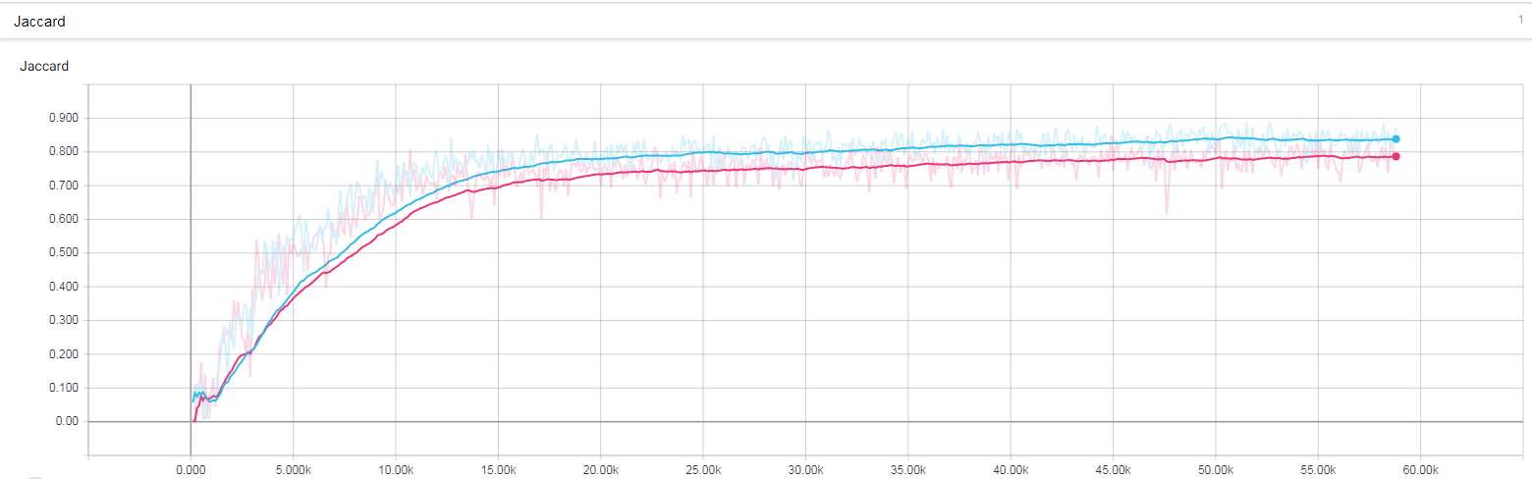
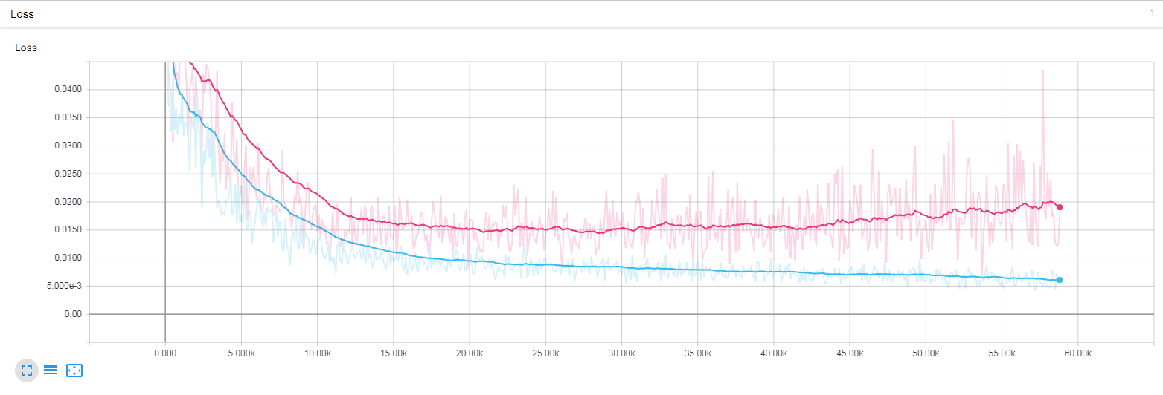
Architecture 1 - Results:
Loss train: 0.0065
Loss Val: 0.018
Jaccard train : 0.89
Jaccard Val: 0.79

Slide 6
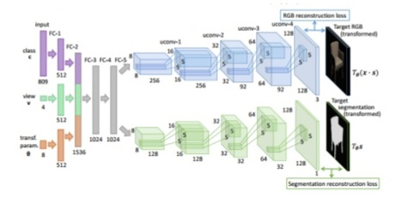
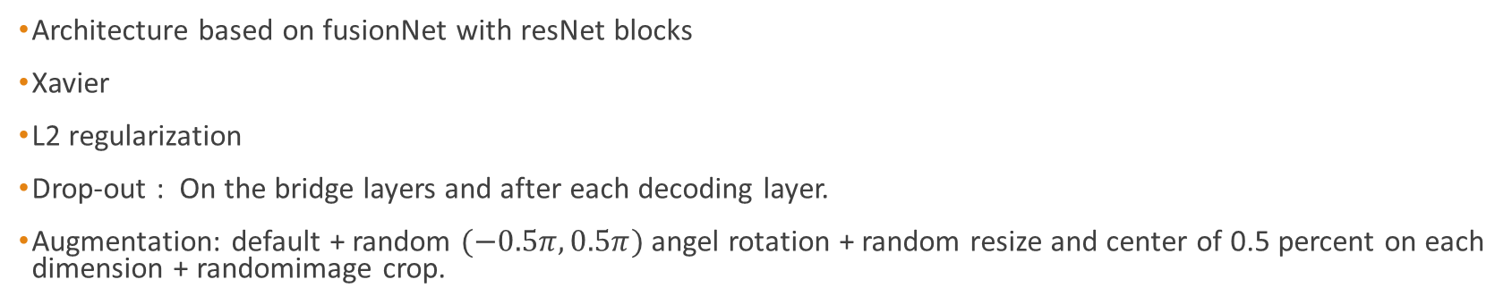
Architecture 2
Architecture based on fusionNet with resNet blocks
Xavier
L2 regularization
Drop-out : On the bridge layers and after each decoding layer.
Augmentation: default + random $(−0.5π, 0.5π)$ angel rotation + random resize and center of 0.5 percent on each dimension + randomimage crop.

Slide 7
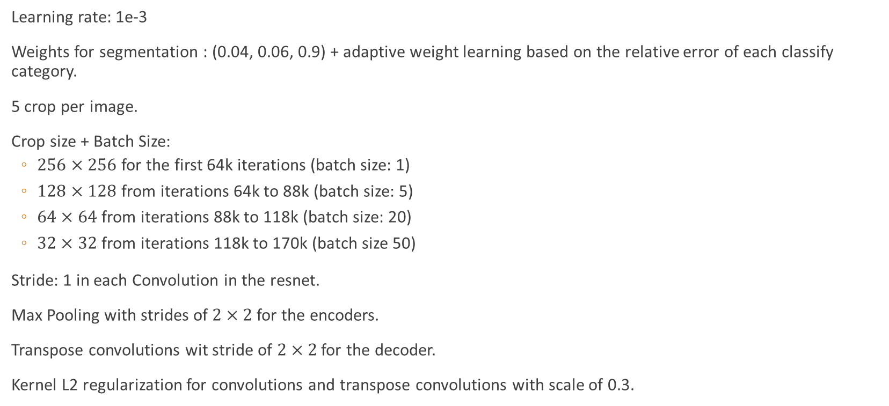
Architecture 2 - Params
Learning rate: 1e-3
Weights for segmentation : (0.04, 0.06, 0.9) + adaptive weight learning based on the relative error of each classify category.
5 crop per image.
Crop size + Batch Size:
$256×256$ for the first 64k iterations (batch size: 1)
$128×128$ from iterations 64k to 88k (batch size: 5)
$64×64$ from iterations 88k to 118k (batch size: 20)
$32×32$ from iterations 118k to 170k (batch size 50)
Stride: 1 in each Convolution in the resnet.
Max Pooling with strides of $2×2$ for the encoders.
Transpose convolutions wit stride of $2×2$ for the decoder.
Kernel L2 regularization for convolutions and transpose convolutions with scale of 0.3.

Slide 8
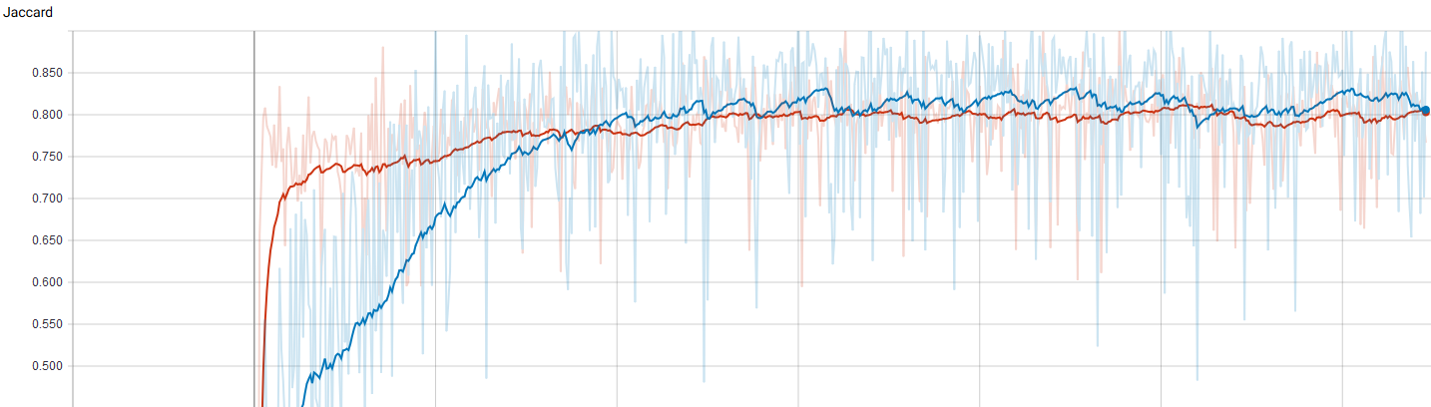
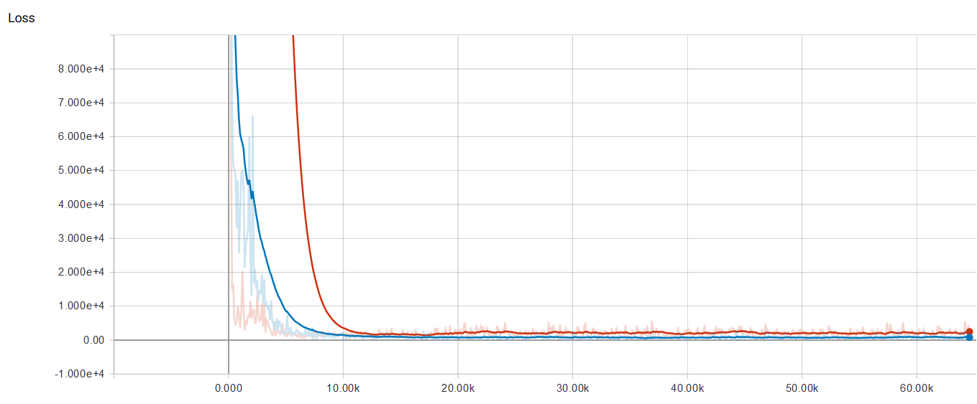
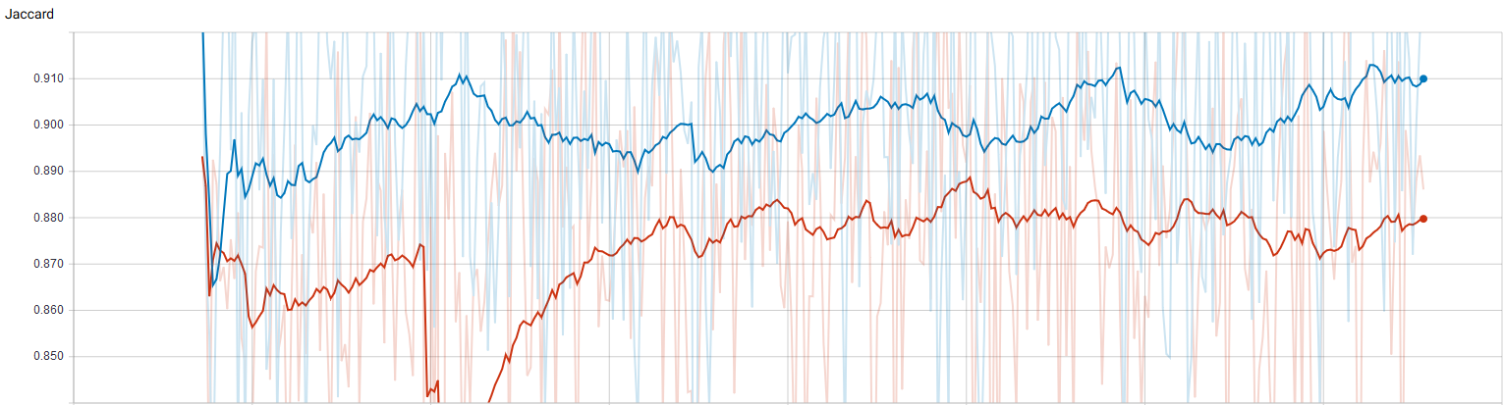
Architecture 2 - Results
Jaccard train : 0.93
Jaccard Val: 0.89

Slide 9
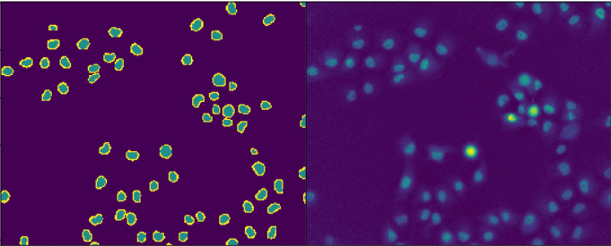
Architecture 2 - Results
We used Sobel filters for edge detection in order to improve our segmentation

Slide 10
Architecture 2 - Conclusion
To much layers – add noise to the output
In this case 2/3 down and up sampling provides the best results
Dealing with overfitting
While the kernel size increases, the number of the parameters increases
Using dropout, L2 regularization, multiple res-net layers
Using augmentation
A better result achieved by gradually increasing the batch size rather than increasing the learning rate, since we are limited to 2 GB gpu memory, we at the same time we were decreasing the crop size
We have examined several different loss functions, eventually we have returned to cross-entropy with some changes
We found that it is better the batch norm just before the activation-layer
We used Parametric ReLU

