Slide 1
Genetic Algorithms Final Project An Implementation for Combining Neural Networks and Genetic Algorithms
Reporter: Tzu-Jui Huang
Date: 2018/06/26

Slide 2
Outline
Problem
Source of Data
Neural Network Architecture
Genetic Algorithm
Simulation results
Conclusion

Slide 3
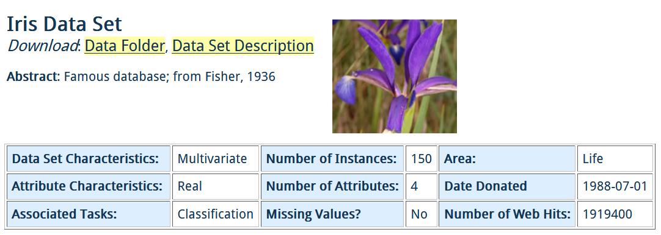
Problem
Classification problem
Fig. 1. Iris data set.

Slide 4
Source of Data
Attribute
Sepal length in cm
Sepal width in cm
Petal length in cm
Petal width in cm
Class
Iris Setosa
Iris Versicolour
Iris Virginica
http://archive.ics.uci.edu/ml/datasets/Iris
5.3, 3.7, 1.5, 0.2, Iris-setosa
5.0, 3.3, 1.4, 0.2, Iris-setosa
7.0, 3.2, 4.7, 1.4, Iris-versicolor
6.4, 3.2, 4.5, 1.5, Iris-versicolor
6.3, 3.3, 6.0, 2.5, Iris-virginica
5.8, 2.7, 5.1, 1.9, Iris-virginica
Fig. 2. Numerical data set.

Slide 5
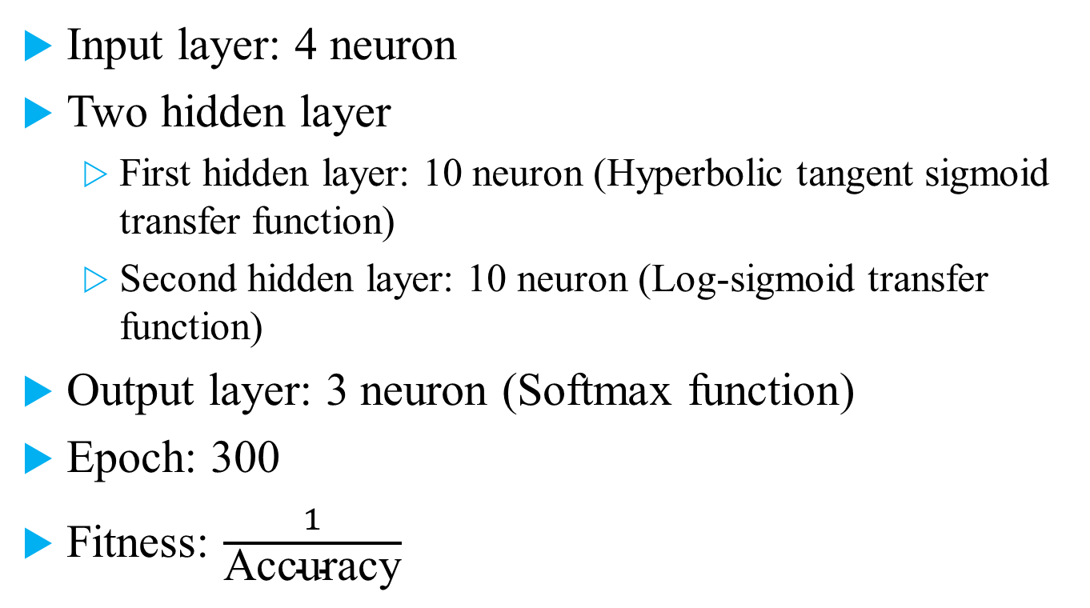
Neural Network Architecture
Input layer: 4 neuron
Two hidden layer
First hidden layer: 10 neuron (Hyperbolic tangent sigmoid transfer function)
Second hidden layer: 10 neuron (Log-sigmoid transfer function)
Output layer: 3 neuron (Softmax function)
Epoch: 300
Fitness: $\frac{1}{\text{Accuracy}}$

Slide 6
Genetic Algorithm
Genetic representation: real number
Population size = 100
Crossover: one-point crossover, rate = 0.8
Mutation: uniform mutation, rate = 0.1
Selection: roulette wheel
Elitism: 1 individual

Slide 7
Simulation results
Initialization
Uniform distribution on the interval [-2, 2].
Number of instances: 150
Training data: 90
Testing data: 60

Slide 8
Simulation results
First result
Fig. 3. First result of the convergence figure.
Fig. 4. First result of classification problem with 85% accuracy.

Slide 9
Simulation results
Second result
Fig. 5. Second result of the convergence figure.
Fig. 6. Second result of classification problem with 91.7% accuracy.

Slide 10
Simulation results
Third result
Fig. 7. Third result of the convergence figure.
Fig. 8. Third result of classification problem with 91.7% accuracy.

Slide 11
Conclusion
From the experimental results show that GANN (combining genetic algorithms with neural networks) has good classification ability.
Better results can be obtained by combining modified genetic algorithm.

Slide 12
Thanks for Your Attendance!

