Slide 1
Genetic Algorithms Homework#1
Reporter: Tzu-Jui Huang
Date: 2018/04/10

Slide 2
Outline
Problem
Genetic algorithm
Experimental Results
Conclusion

Slide 3

Problem
Question
Minimize the function
$$G\left(x_{1},x_{2}\right)=a{(x_{2}−bx_{1}^{ 2}+cx_{1}−d)}^{2}+e\left(1−f\right)\cos\left(x_{1}\right)+e$$
where
$$a=1, b=\frac{5.1}{{4π}^{2}}, c=\frac{5}{π}, d=6, e=10, f=\frac{1}{8π}$$
$$−5≤x_{1}≤10, 0≤x_{2}≤15$$

Slide 4
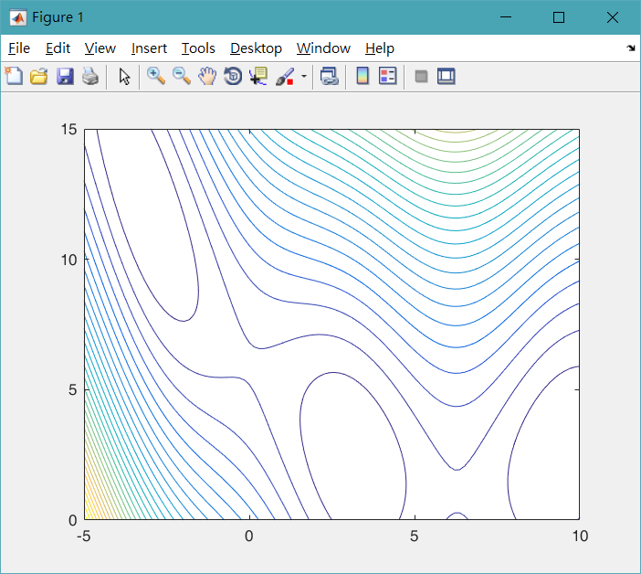
Problem
Contour

Slide 5
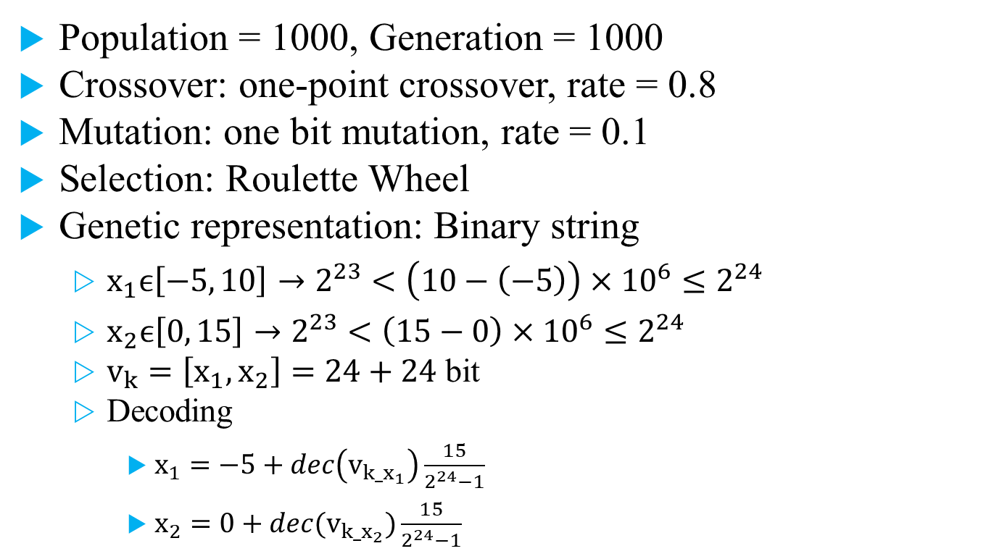
Genetic algorithm
Population = 1000, Generation = 1000
Crossover: one-point crossover, rate = 0.8
Mutation: one bit mutation, rate = 0.1
Selection: Roulette Wheel
Genetic representation: Binary string
$x_{1}ϵ\left[−5, 10\right]→2^{23}<\left(10−\left(−5\right)\right)×{10}^{6}≤2^{24}$
$x_{2}ϵ\left[0, 15\right]→2^{23}<\left(15−0\right)×{10}^{6}≤2^{24}$
$v_{k}=\left[x_{1},x_{2}\right]=24+24$ bit
Decoding
$x_{1}=−5+dec\left(v_{k_x_{1}}\right)\frac{15}{2^{24}−1}$
$x_{2}=0+dec(v_{k_x_{2}})\frac{15}{2^{24}−1}$

Slide 6
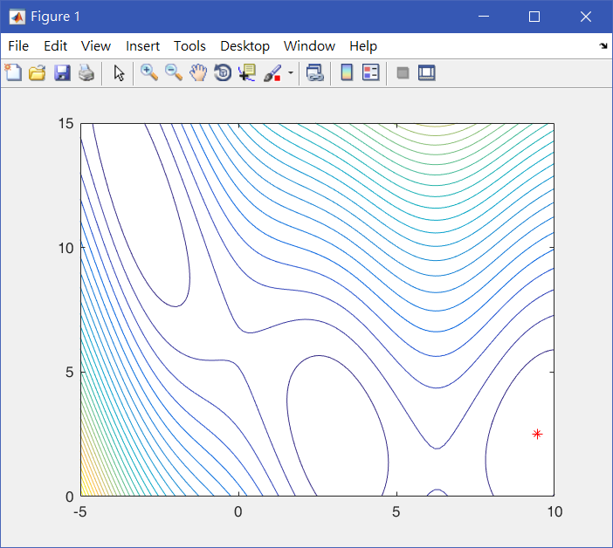
Experimental Results
Generation = 1

Slide 7
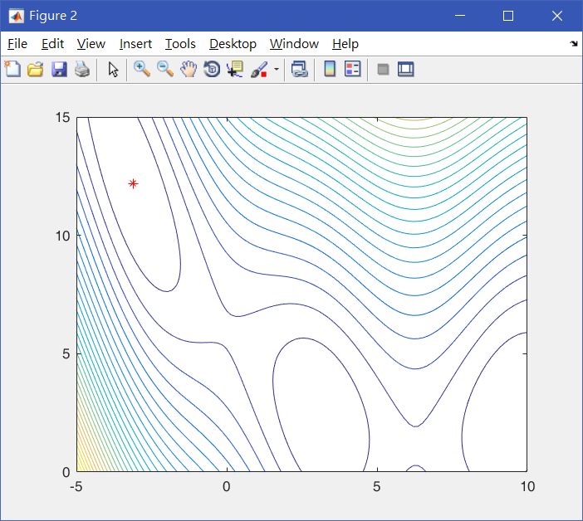
Experimental Results
Generation = 50

Slide 8

Experimental Results
Generation = 100

Slide 9

Experimental Results
Generation = 200

Slide 10
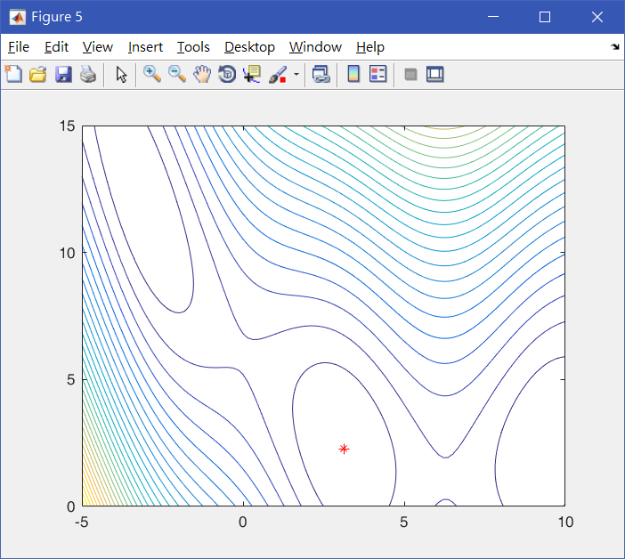
Experimental Results
Generation = 1000

Slide 11
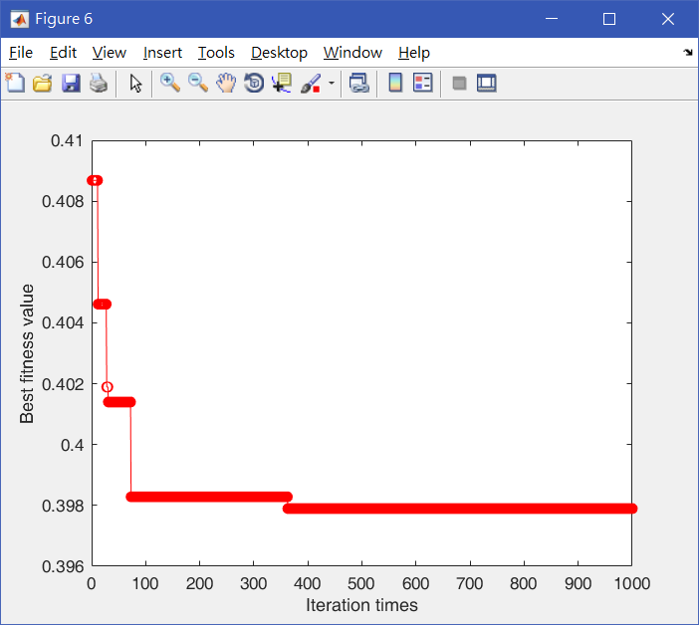
Experimental Results

Slide 12
Experimental Results
Population = 300, Generation = 300
Times | 1 | 2 | 3 | 4 | 5
(x1, x2) | (-3.197563, 12.423274) | (-3.146020, 12.237021) | (-3.191715, 12.429792) | (9.418526, 2.400294) | (3.130434, 2.295314)
Optimal solution | 0.413102 | 0.400346 | 0.411103 | 0.402897 | 0.398620
CPU time | 12.267 | 12.260 | 12.110 | 12.425 | 12.298
Population = 1000, Generation = 1000
Times | 1 | 2 | 3 | 4 | 5
(x1, x2) | (3.142863, 2.275443) | (3.143457, 2.280967) | (3.146121, 2.279586) | (-3.140931, 12.265170) | (3.146080, 2.272316)
Optimal solution | 0.397897 | 0.397959 | 0.398052 | 0.397957 | 0.397985
CPU time | 137.334 | 131.153 | 135.347 | 146.735 | 137.337

Slide 13
Conclusion
Genetic algorithm solution is stable.
The performance results will be related to the initial conditions.

Slide 14
Thanks for Your Attendance!

