Slide 1
Genetic Algorithms Homework#2
Reporter: Tzu-Jui Huang
Date: 2018/04/10

Slide 2
Outline
Problem
Hillclimbing
Simulated Annealing
Comparison
Conclusion

Slide 3

Problem
Question
Minimize the function
$$G\left(x_{1},x_{2}\right)=a{(x_{2}−bx_{1}^{ 2}+cx_{1}−d)}^{2}+e\left(1−f\right)\cos\left(x_{1}\right)+e$$
where
$$a=1, b=\frac{5.1}{{4π}^{2}}, c=\frac{5}{π}, d=6, e=10, f=\frac{1}{8π}$$
$$−5≤x_{1}≤10, 0≤x_{2}≤15$$

Slide 4
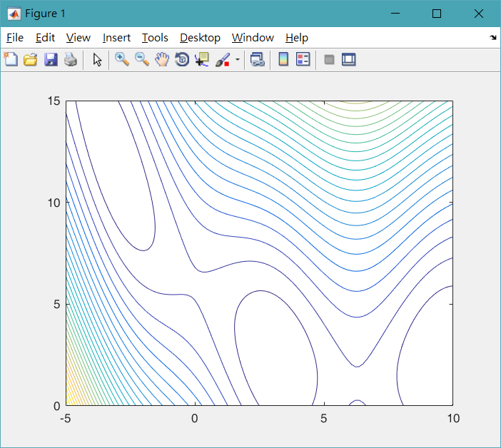
Problem
Contour

Slide 5
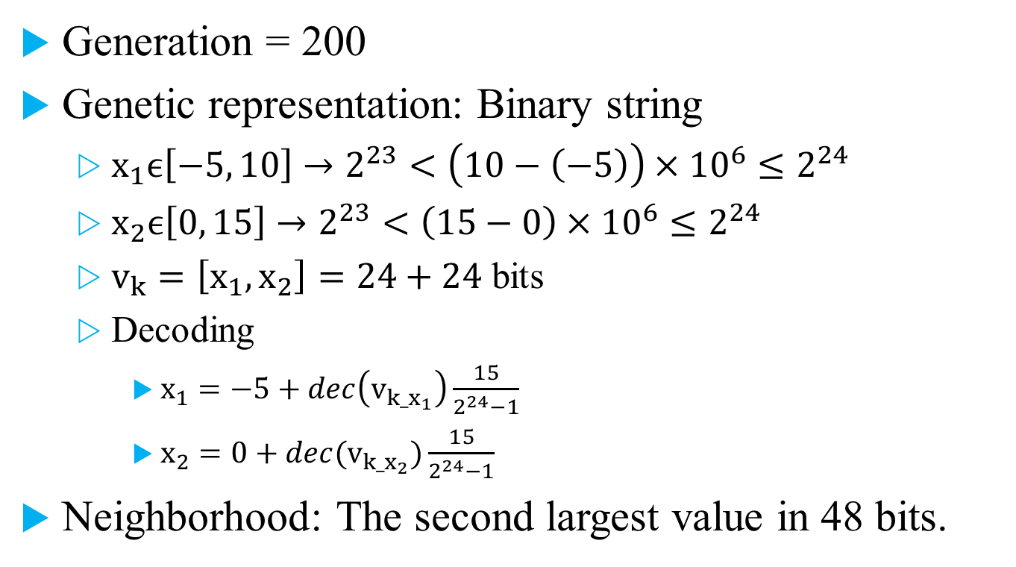
Hillclimbing
Generation = 200
Genetic representation: Binary string
$x_{1}ϵ\left[−5, 10\right]→2^{23}<\left(10−\left(−5\right)\right)×{10}^{6}≤2^{24}$
$x_{2}ϵ\left[0, 15\right]→2^{23}<\left(15−0\right)×{10}^{6}≤2^{24}$
$v_{k}=\left[x_{1},x_{2}\right]=24+24$ bits
Decoding
$x_{1}=−5+dec\left(v_{k_x_{1}}\right)\frac{15}{2^{24}−1}$
$x_{2}=0+dec(v_{k_x_{2}})\frac{15}{2^{24}−1}$
Neighborhood: The second largest value in 48 bits.

Slide 6
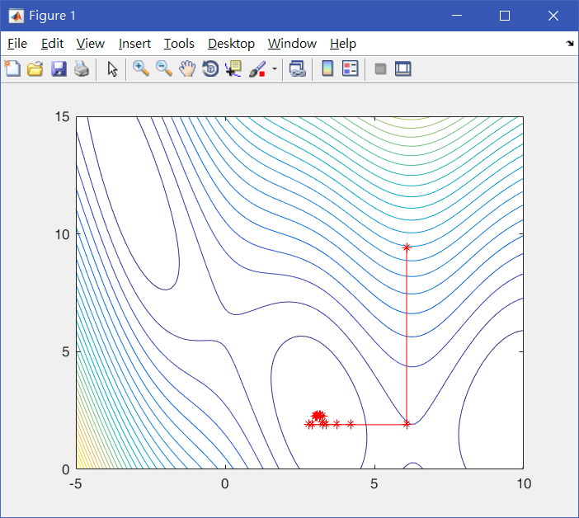
Hillclimbing

Slide 7
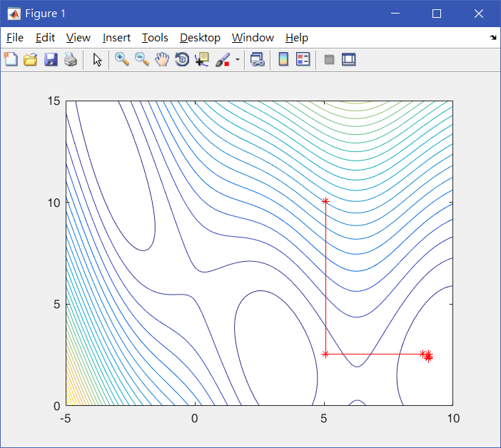
Hillclimbing

Slide 8
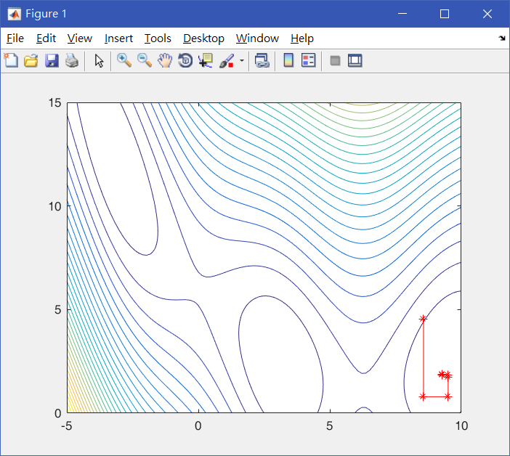
Hillclimbing

Slide 9
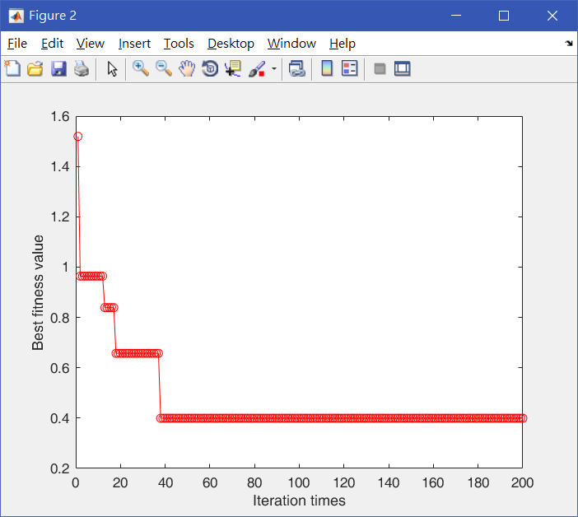
Hillclimbing

Slide 10
Hillclimbing
Times | 1 | 2 | 3 | 4 | 5
(x1, x2) | (3.159180, 2.255859) | (9.395924, 2.285155) | (9.399414, 2.453689) | (-3.125000, 12.421876) | (3.232422, 2.343750)
Optimal solution | 0.399402 | 0.429312 | 0.400976 | 0.434072 | 0.456656
CPU time | 23.589 | 24.030 | 24.381 | 24.271 | 24.603

Slide 11

Simulated Annealing
Generation = 200
Temperature $T=1$
Cooling every 50 generations
$T=T×0.1$
Temperature T_end = ${10}^{−6}$
Notes:
K_iter=10

Slide 12
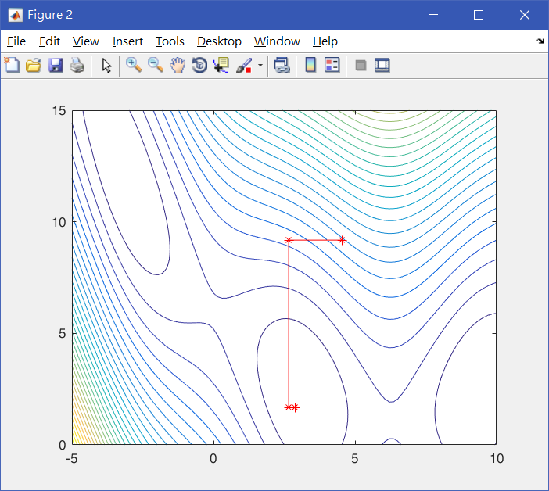
Simulated Annealing

Slide 13
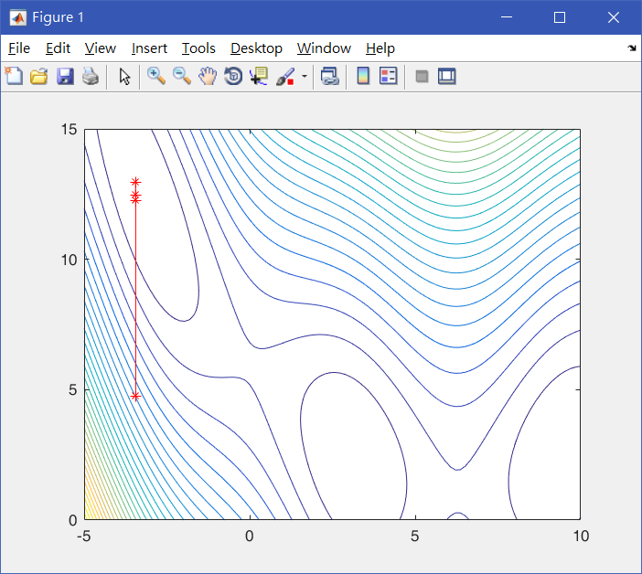
Simulated Annealing

Slide 14
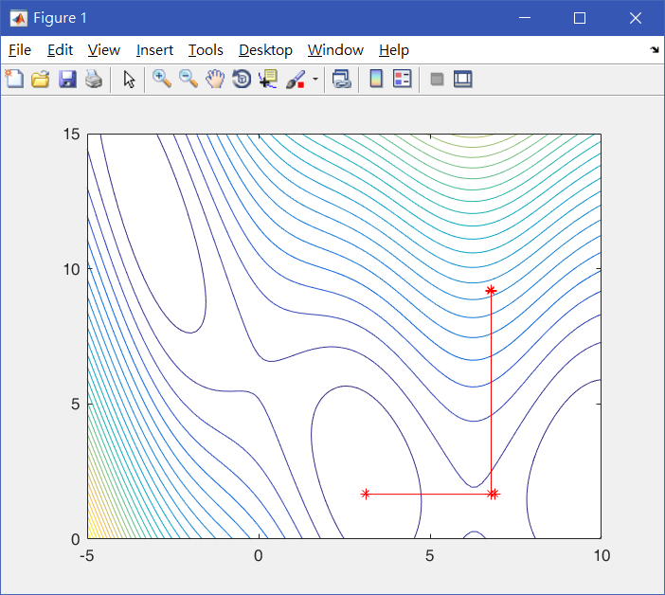
Simulated Annealing

Slide 15
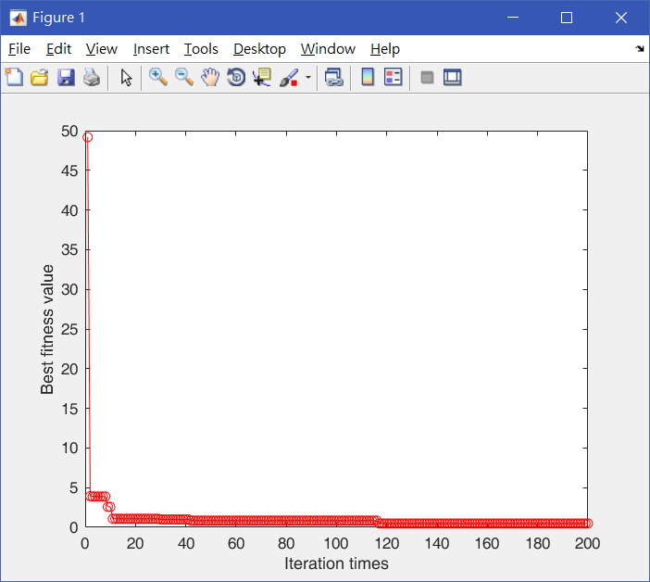
Simulated Annealing

Slide 16
Simulated Annealing
Times | 1 | 2 | 3 | 4 | 5
(x1, x2) | (-3.096546, 11.885665) | (-3.195999, 12.805043) | (9.402449, 2.467975) | (9.244634, 2.286507) | (-3.126043, 11.985221)
Optimal solution | 0.486780 | 0.571224 | 0.400419 | 0.554928 | 0.462775
CPU time | 10.515 | 10.382 | 10.276 | 11.026 | 11.289

Slide 17
Comparison
Genetic algorithm
Times | 1 | 2 | 3 | 4 | 5
(x1, x2) | (3.142863, 2.275443) | (3.143457, 2.280967) | (3.146121, 2.279586) | (-3.140931, 12.265170) | (3.146080, 2.272316)
Optimal solution | 0.397897 | 0.397959 | 0.398052 | 0.397957 | 0.397985
CPU time | 137.334 | 131.153 | 135.347 | 146.735 | 137.337
Hillclimbing
Times | 1 | 2 | 3 | 4 | 5
(x1, x2) | (3.159180, 2.255859) | (9.395924, 2.285155) | (9.399414, 2.453689) | (-3.125000, 12.421876) | (3.232422, 2.343750)
Optimal solution | 0.399402 | 0.429312 | 0.400976 | 0.434072 | 0.456656
CPU time | 23.589 | 24.030 | 24.381 | 24.271 | 24.603
Simulated Annealing
Times | 1 | 2 | 3 | 4 | 5
(x1, x2) | (-3.096546, 11.885665) | (-3.195999, 12.805043) | (9.402449, 2.467975) | (9.244634, 2.286507) | (-3.126043, 11.985221)
Optimal solution | 0.486780 | 0.571224 | 0.400419 | 0.554928 | 0.462775
CPU time | 10.515 | 10.382 | 10.276 | 11.026 | 11.289

Slide 18
Conclusion
Genetic algorithm is the best method to find the optimal solution.
Hillclimbing is fast but inaccurate.
The convergence of Simulated Annealing is slower than Hillclimbing.

Slide 19
Thanks for Your Attendance!

