Slide 1
Genetic Algorithms Homework#3
Reporter: Tzu-Jui Huang
Date: 2018/05/22

Slide 2
Outline
Problem
Genetic algorithm
Genetic algorithm + Hillclimbing
Comparison
Conclusion

Slide 3
Problem
Question
Minimize the function
Subject to

Slide 4
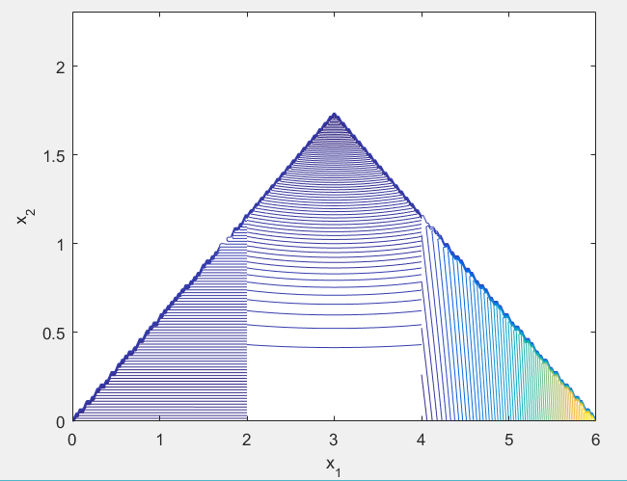
Problem
Contour

Slide 5
Genetic algorithm
Population = 10, Generation = 200
Crossover: one-point crossover, rate = 0.8
Mutation: one bit mutation, rate = 0.1
Selection: Roulette Wheel
Genetic representation: Real number
Handling constraints and repair

Slide 6

Genetic algorithm

Slide 7

Genetic algorithm

Slide 8
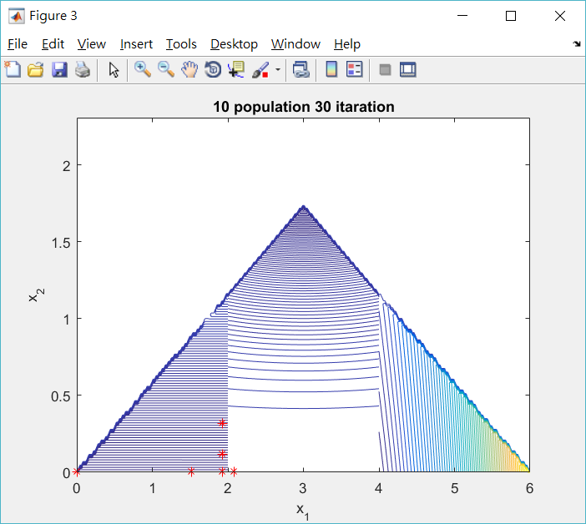
Genetic algorithm

Slide 9

Genetic algorithm

Slide 10

Genetic algorithm

Slide 11
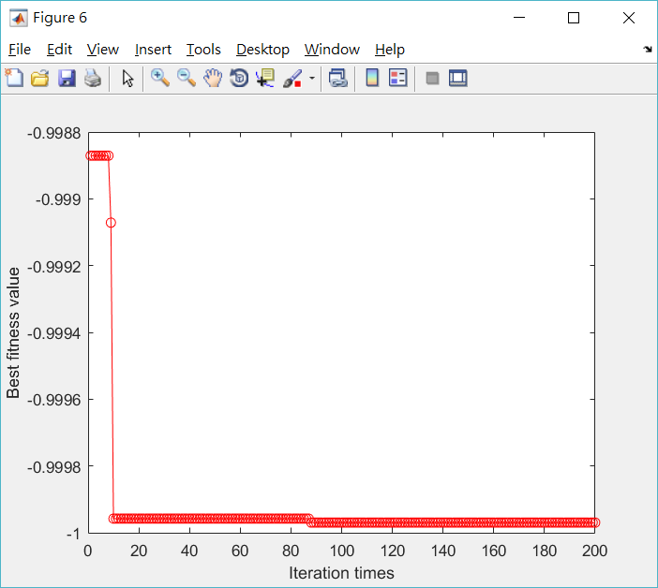
Genetic algorithm

Slide 12
Genetic algorithm + Hillclimbing
Neighborhood
Offset size 0.01 for each of the four adjacent directions of the current coordinates.
Discard the violated coordinates.

Slide 13

Genetic algorithm + Hillclimbing

Slide 14

Genetic algorithm + Hillclimbing

Slide 15

Genetic algorithm + Hillclimbing

Slide 16

Genetic algorithm + Hillclimbing

Slide 17

Genetic algorithm + Hillclimbing

Slide 18
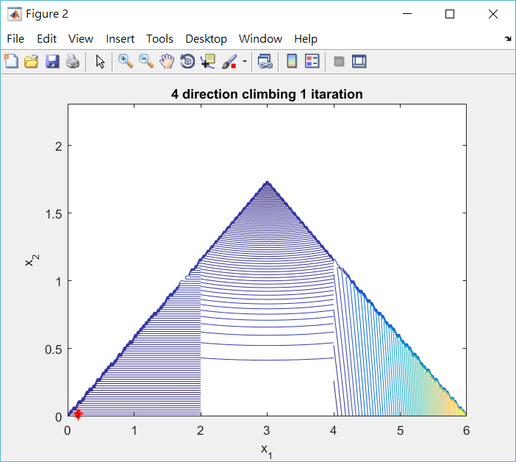
Genetic algorithm + Hillclimbing

Slide 19

Genetic algorithm + Hillclimbing

Slide 20

Genetic algorithm + Hillclimbing

Slide 21

Genetic algorithm + Hillclimbing

Slide 22
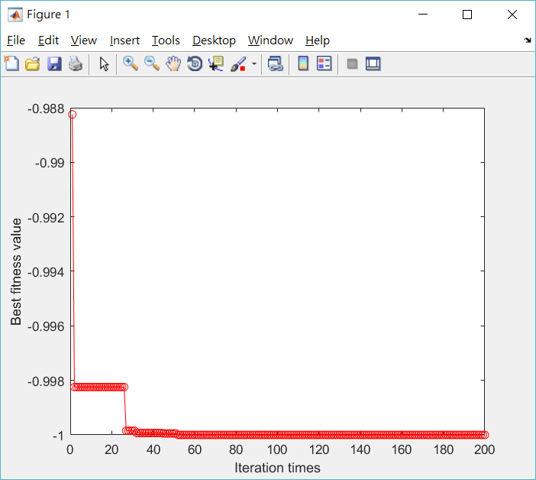
Genetic algorithm + Hillclimbing

Slide 23
Comparison
Genetic algorithm
Times | 1 | 2 | 3 | 4 | 5
(x1, x2) | (0.021409, 0.000014) | (0.051878, 0.000034) | (0.011022, 0.000055) | (0.045163, 0.000532) | (0.000902, 0.000015)
Optimal solution | -0.999986 | -0.999966 | -0.999945 | -0.999468 | -0.999985
Genetic algorithm + Hillclimbing
Times | 1 | 2 | 3 | 4 | 5
(x1, x2) | (0.009381, 0.000001) | (0.003087, 0.000030) | (0.005578, 0.000007) | (0.006288, 0.000004) | (0.005816, 0.000014)
Optimal solution | -0.999999 | -0.999970 | -0.999993 | -0.999996 | -0.999986

Slide 24
Conclusion
The results of Genetic algorithm + Hillclimbing are more stable and accurate than Genetic algorithm.
Better results can be obtained by combining different algorithm features.

Slide 25
Thanks for Your Attendance!

