Slide 1
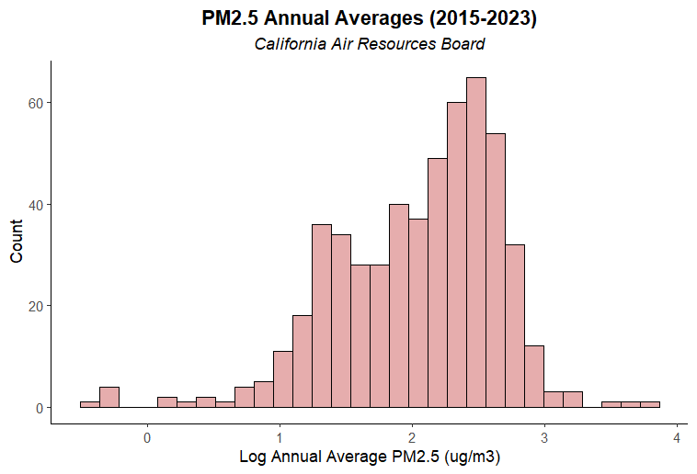
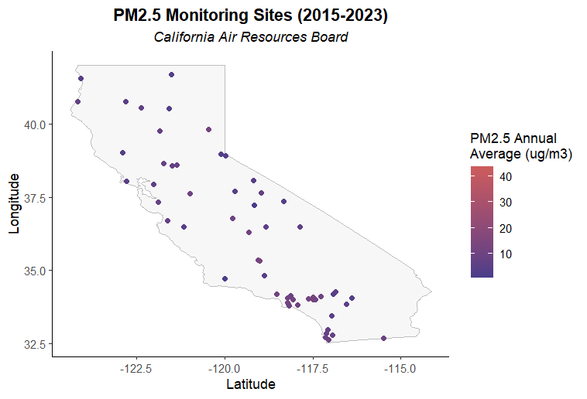
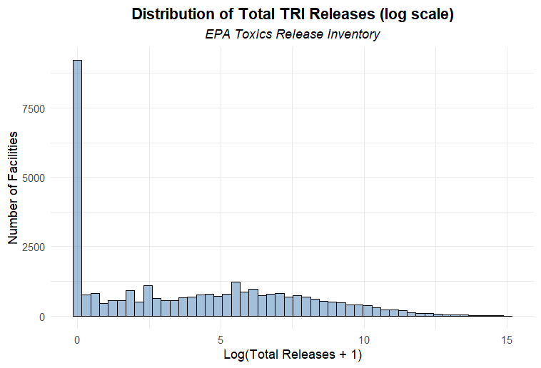
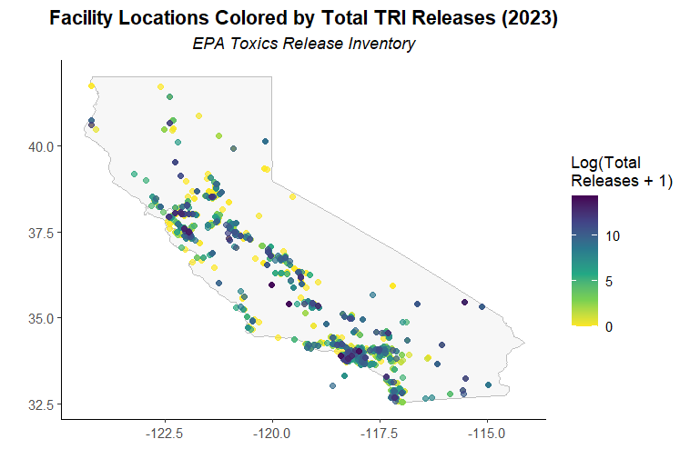
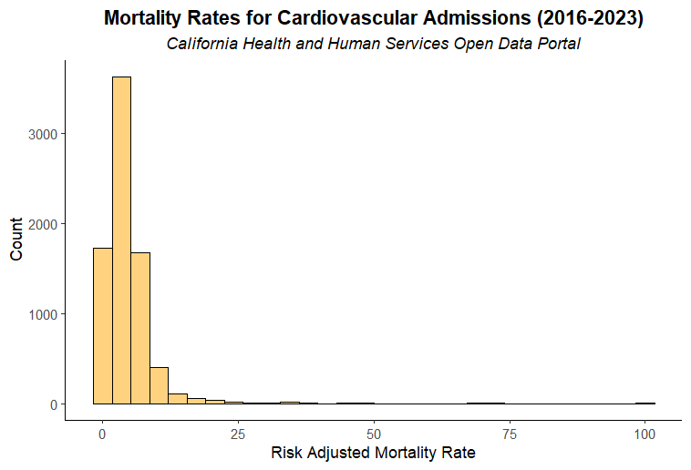
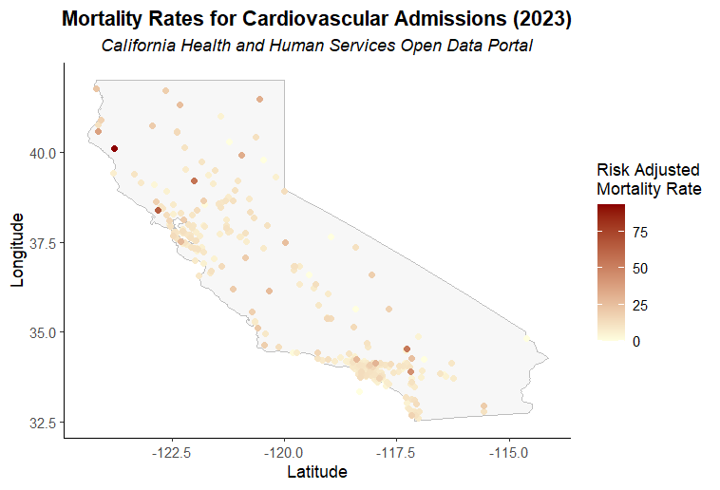
Spatiotemporal Associations Between PM2.5 Exposure and Cardiovascular Hospitalizations in CA (2016–2023)
Arghya Kannadaguli | 04-23-2025
Data Sources
CA ARB: Air Quality Data (PST) Query Tool (2015-2023) 407 weekly DAVG datasets | 58/204 sites with lat/long
EPA: Toxic Release Inventory Basic Data Files for California Statewide (2015-2023) 1524 facilities
CHHS: California Hospital Inpatient Mortality Rates and Quality Ratings (2016-2023) 554 hospitals
Progress
Consolidating datasets (if separated by year, site, week)
Exploratory data analysis
GIS Goals
Inter/Extrapolate PM2.5 data to generate annual average raster surfaces for 2015-2023.
Scope may not allow for including NO2 and SO2
Spatial lag model for outcomes, PM2.5 concentration, and TRI emission types/amounts, + covariates potentially
Calculate annual “densities” of TRI facilities per hospital catchment area
Other ideas
Use distributed lag model to assess delayed health effects from long-term exposure
Use GEE marginal model to account for within-hospital correlation over time
Bring in additional covariates (e.g. census level socio-demographics from CalEnviro4.0)

