Slide 1
Multi-focus Image Fusion
Using Singular Value Decomposition(SVD) in DCT Domain
Akshay Dobariya (16JE001934)
Faculty Mentor: Dr. Arup Kumar Pal
Department Of Computer Science And Engineering
INDIAN INSTITUTE OF TECHNOLOGY (INDIAN SCHOOL OF MINES) DHANBAD

Slide 2
INTRODUCTION
Image fusion:
The image fusion process is defined as gathering all the important information from multiple images, and their inclusion into fewer images, usually a single one. This single image is more informative and accurate than any single source image, and it consists of all the necessary information.
Multi-focus Image Fusion:
Multi-focus image fusion is a process that fuses several images from a scene with different focal lengths into a whole image in which all areas are focused on.
Advantages:
1. It reduces the amount of space needed.
2. It construct images that are more appropriate and understandable for the human and machine perception.

Slide 3
BACKGROUND
With reference of the research paper Multi-focus image fusion using Singular Value Decomposition in DCT domain published in 10th Iranian Conference on Machine Vision and Image Processing. I used the method mentioned in the paper and done some modifications in it’s consistency verification post-processing step to get more accurate and with less artefacts In the resulting image.
For deep understanding of mathematical concepts used I used some Wikipedia Articles here are some of them.
https://en.wikipedia.org/wiki/Image_fusion
https://en.wikipedia.org/wiki/Digital_image
https://en.wikipedia.org/wiki/Vector_graphics
https://en.wikipedia.org/wiki/Raster_graphics
https://en.wikipedia.org/wiki/Singular-value_decomposition

Slide 4
SEVERAL OTHER METHODS OF MULTI-FOCUS IMAGE FUSION
Multi-scale transforms include gradient, Laplacian, and morphological pyramid transform, Discrete Wavelet Transform (DWT), Shift-Invariant Wavelet Transform (SIDWT) and Discrete Cosine Harmonic Wavelet Transform (DCHWT).
Recently, several methods have been proposed for fusing images by the properties and attributes of Singular Value Decomposition (SVD) such as Multiresolution Singular Value Decomposition (MSVD) and Higher Order Singular Value Decomposition (HOSVD).
These all methods including our ones should take care of complexity in computation, making it not only unsuitable considering time consumption, but also inappropriate because of the ringing artefacts. Ringing artefacts at the edge of the images decrease the quality of the output image.

Slide 5
QUESTION???
How two images with same scene but having different focus area can be merged to give a single resultant image which resembles both the source images and give more appropriate visual perception on whole scene.

Slide 6
OUR PROPOSED METHOD

Slide 7
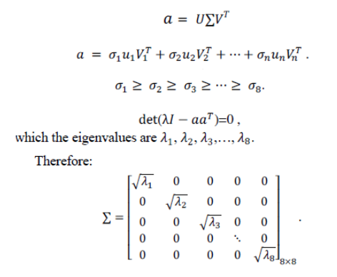
1. How to find singular values

Slide 8
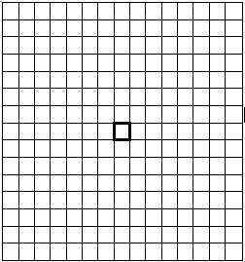
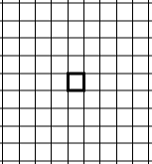

2. Detailed Consistency Verification Post-Processing Step
2.1: Method 1: Majority Filter
Bold block is desired block of which value should change
BLOCK OF 3×3
BLOCK OF 9×9
BLOCK OF 15×15
Method 1, method 5, method 6, method 7, method 8, method 9, method 10 and method 11, have majority filter as 3×3 15×15, 35×35, 23×23, 10×10, 33×33, 37×37, 39×39 respectively.

Slide 9
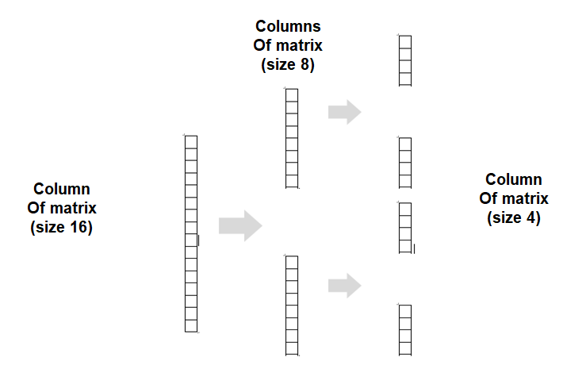
2.2: Method 2: Column Transform

Slide 10
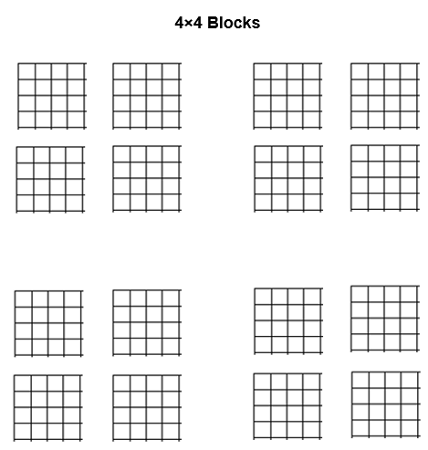
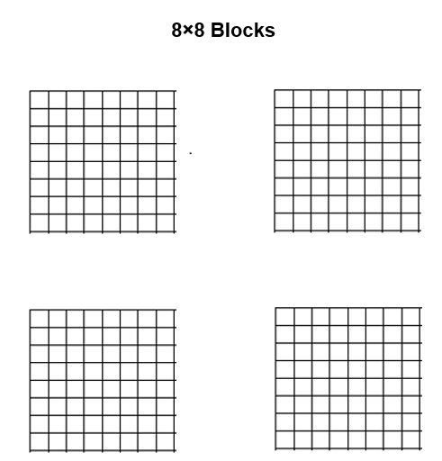
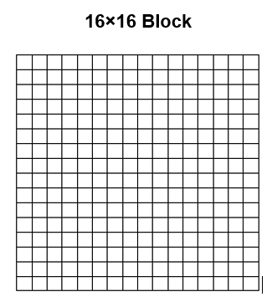
2.3: Method 3: Rectangular Transform

Slide 11
Comparison Between Different methods using PSNR VALUES

Slide 12
Comparison Between Different methods using SSIM VALUES

Slide 13
CONCLUSION

Slide 14
ACKNOWLEDGEMENTS:
Heartiest Thanks to Dr. Arup Kr. Pal sir {Assistant Professor of Computer Science & Engineering , Indian Institute of Technology (ISM) Dhanbad.}
Thanks to Jitesh Pradhan sir {JRF(CSE),Department of Computer Science & Engineering, Indian Institute of Technology (ISM) Dhanbad.}
THANK YOU

