Slide 1


HR Attrition Dashboard Analysis
Insights and Strategies for Workforce Retention
Presented by : Karan Bharale

Slide 2
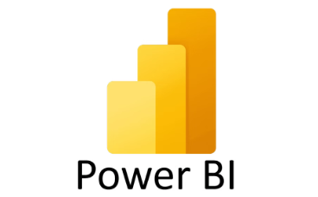

Introduction
HR analytics empowers us to make informed decisions by uncovering patterns in employee data. We'll be using powerful tools like PowerBI and Excel to analyze the data.
Data-Driven Insights
Informed Decision-Making
Actionable Strategies
HR analytics leverages data and statistical methods to uncover workforce trends and relationships.
It enables us to make informed decisions about employee retention and engagement strategies.
By analyzing data, we can identify the root causes of attrition and address them proactively.
PowerBI allows us to create interactive dashboards to visualize and explore the data.
Excel provides a flexible platform for data manipulation, analysis, and reporting.

Slide 3
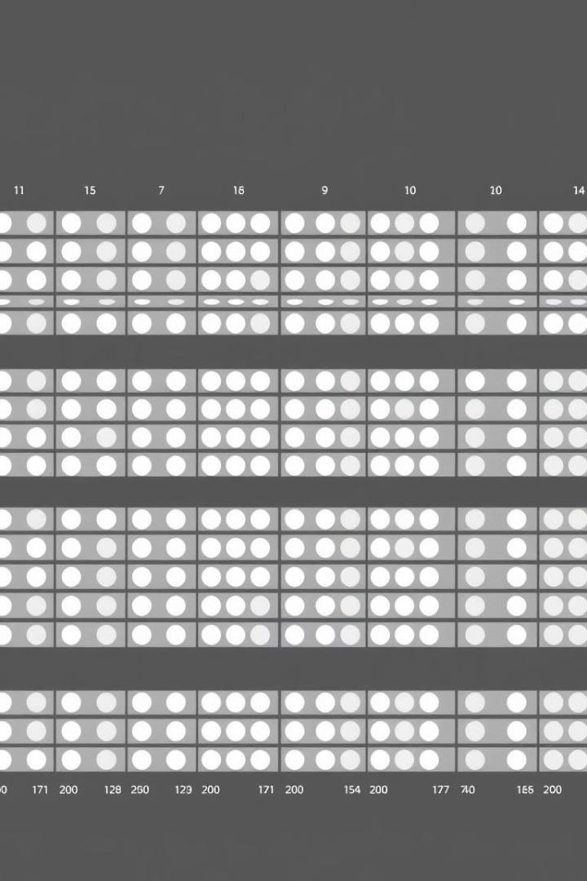
Dataset Overview: Understanding the Data
Our dataset comprises 1,470 employee records with 38 attributes.
Attrition
Indicates employee departures
Demographics
Age, Gender, Marital Status, Education, Job Role
Work Metrics
Income, Work Years, Company Tenure, Travel Frequency
Feedback Metrics
Job Satisfaction, Work-Life Balance, Performance Rating

Slide 4
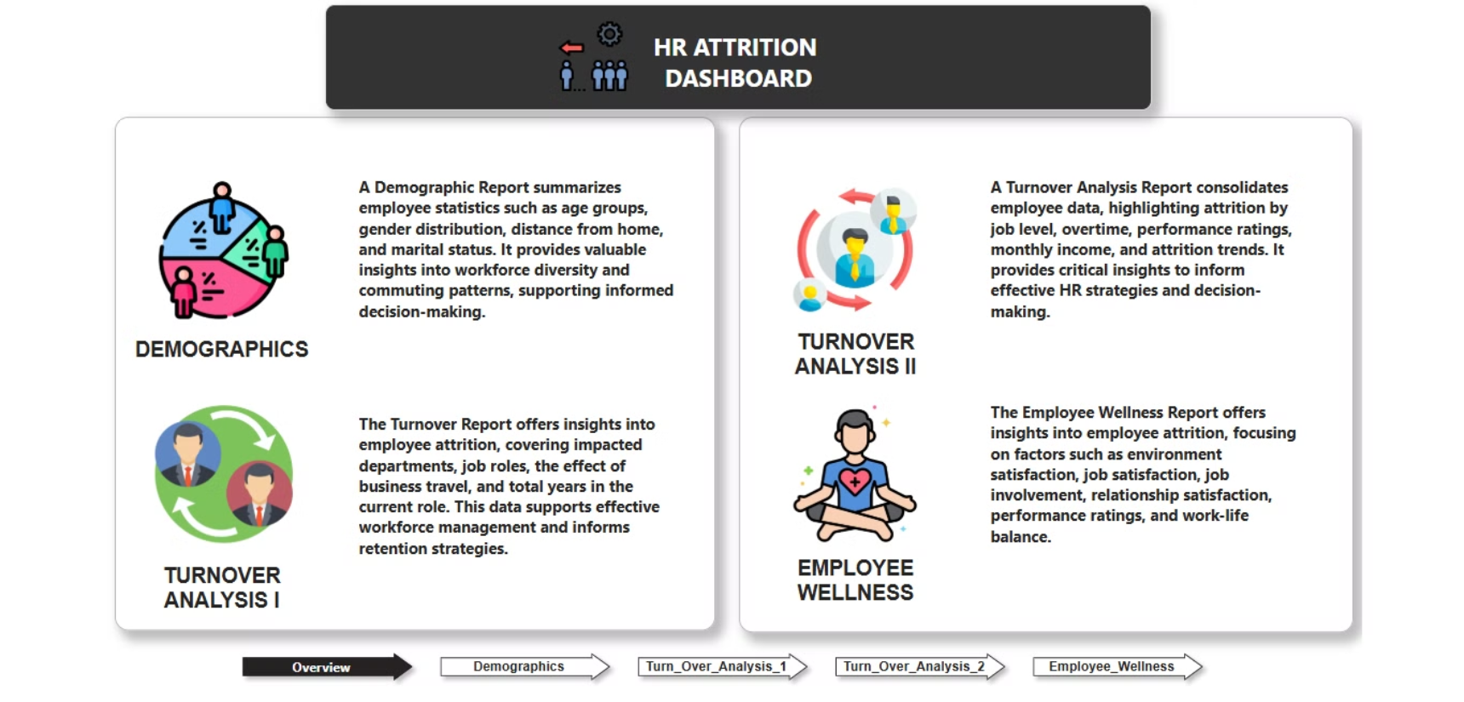

Slide 5
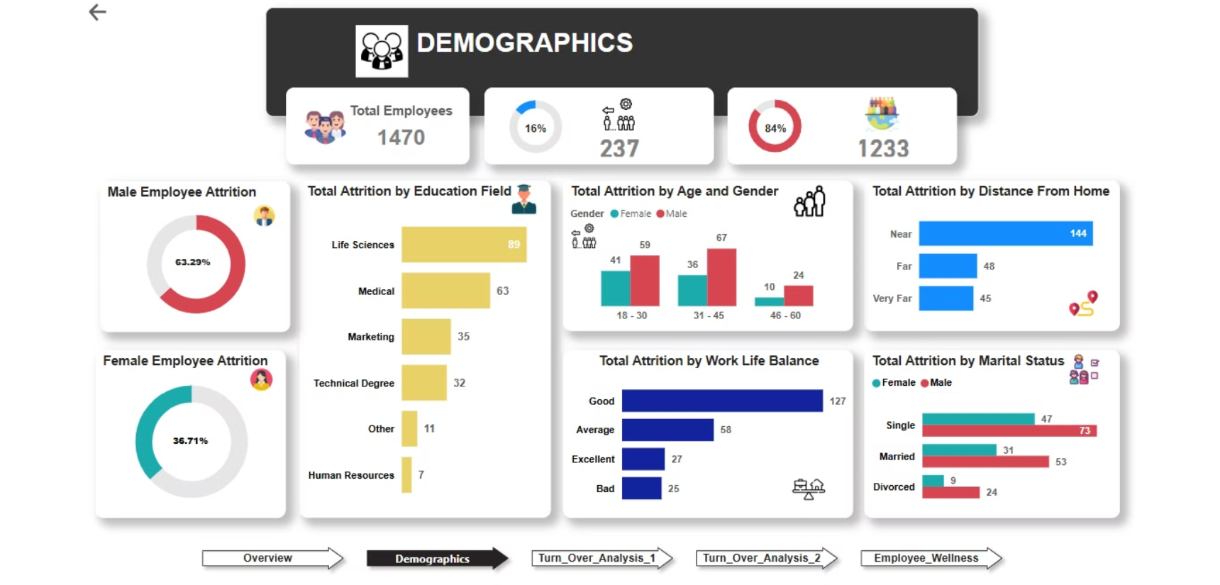

Slide 6
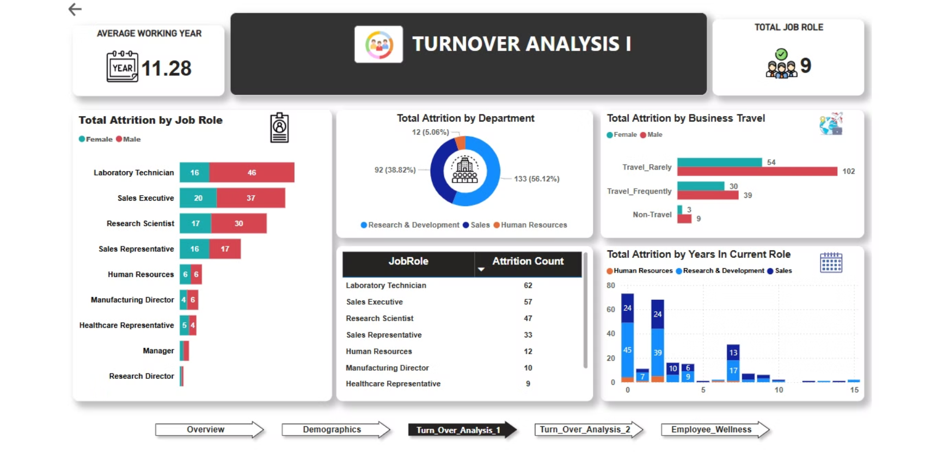

Slide 7
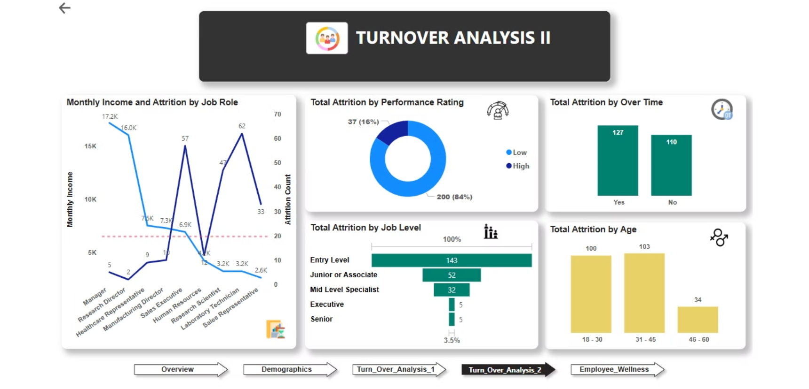

Slide 8
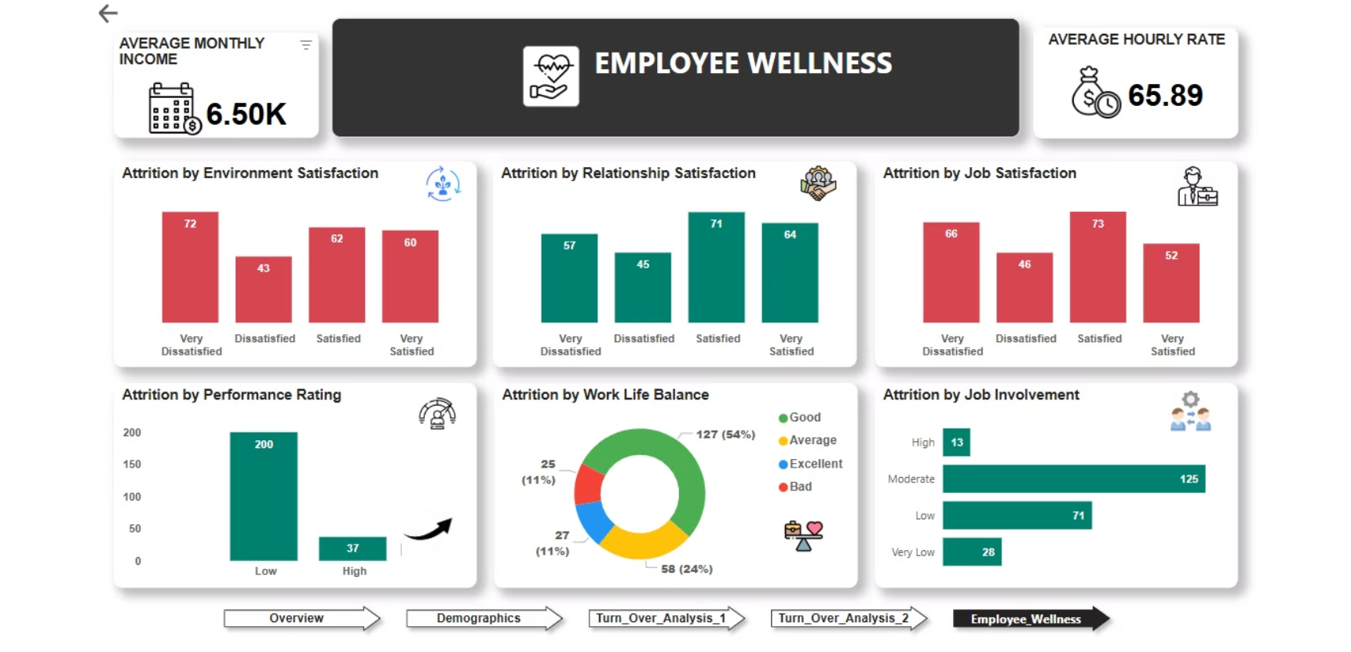

Slide 9
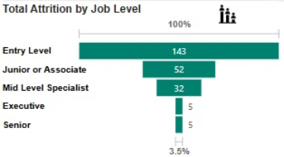
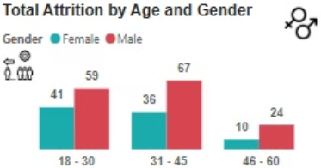
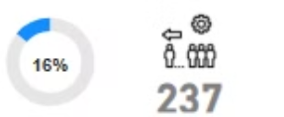
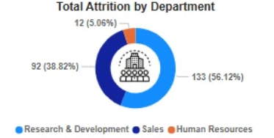
Key Metrics and Visualizations: Unveiling Trends
The dashboard reveals key metrics and patterns in attrition.
Attrition Rate
Attrition by Department
Attrition by Job Role
Demographics
The overall percentage of employees leaving the organization.
Specific roles most affected by attrition.
Age group distribution and gender breakdown.
Departments with the highest turnover rates.

Slide 10
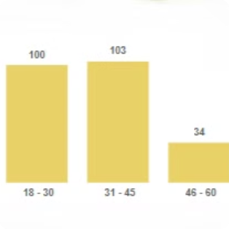
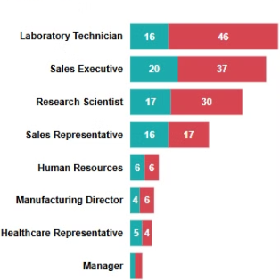
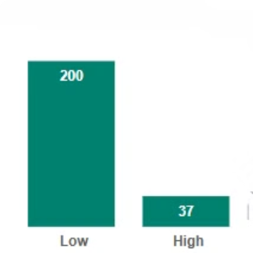
Attrition Trends: Uncovering Patterns
Analyzing the data reveals key trends influencing attrition.
Age Group Trends
Job Roles
Performance and Satisfaction
Individuals between 18-30 and 31-45 years old exhibit the highest attrition rates, potentially driven by career advancement or work-life balance concerns.
Laboratory Technicians are experiencing high attrition rates, suggesting possible factors like limited growth opportunities or dissatisfaction.
Lower satisfaction and performance ratings demonstrate a strong correlation with higher attrition rates.

Slide 11
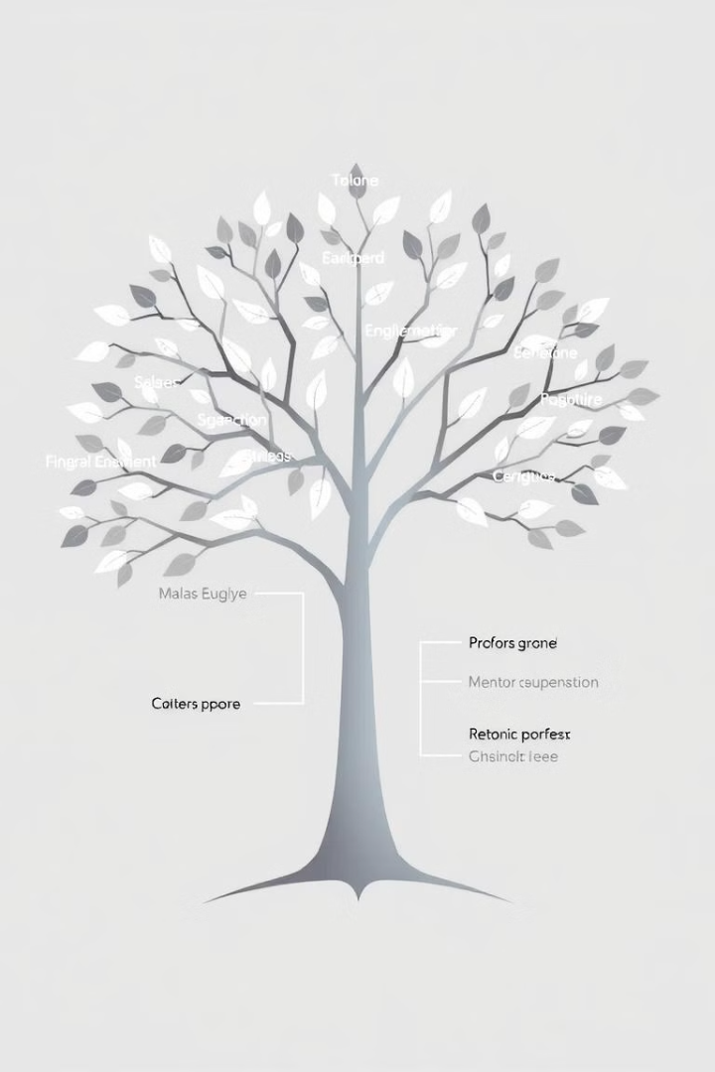

Strategies to Reduce Attrition: Actionable Insights
The dashboard provides insights to inform our attrition reduction strategies.
Age Group (25–34 years):
Job Roles (e.g., Laboratory Technicians):
Offer flexible working options and career advancement opportunities.
Design tailored career development programs and provide frequent feedback and recognition.
New Employees:
Implement comprehensive onboarding processes and provide regular mentorship and performance feedback.

Slide 12
Conclusion
Key Insights
High attrition rates are driven by specific roles, age groups, and factors like job satisfaction and work-life balance.
Addressing these areas can significantly improve retention and employee engagement.
1
2
Next Steps
Focus on targeted strategies such as better onboarding, career development programs, and flexible work options.
Continue using data to drive HR decisions and refine strategies over time.
1
2
"Retention isn’t just about reducing attrition; it’s about creating a workplace where employees want to stay and grow."

Slide 13

Thank You
Thank you for your attention. I welcome any questions and feedback you may have.

