Slide 1
ECLIPSE IDE
Name: Anil Kumar
Topic: Introduction to Eclipse IDE
Lab Tutorial : 1

Slide 2
What is an ide ?
Integrated Development Environment or Interactive Development Environment.
A software application that is used for Software Development.
E.g. : CodeLite for C/C++, Android Studio for building Android apps, Xcode for OS X and iOS and many more
Has inbuilt compiler, interpreter or both.
Some special functionalities like Version Control System, Graphical User Interface etc.
Open source IDEs with free distribution
E.g. : IDLE (Python GUI), Android Studio, NetBeans etc.
Cross-Platform IDEs
E.g. : NetBeans C/C++ Development pack, CodeLite, Eclipse etc.

Slide 3
ECLIPSE IDE - Introduction
One of the mostly used IDEs available for programming in different languages.
E.g. : JAVA, HTML, PYTHON, PERL, COBOL etc.
Eclipse SDK is open source software and freely available online.
https://www.eclipse.org/downloads/
Eclipse Foundation is developing and producing different versions of Eclipse IDE.
Most recent version is Eclipse Oxygen 4.7.
Older versions released are Austin 3.0, Bravo 3.1, Indigo 3.7, Kepler 4.3 etc.
Further release are Mars, Neon, Oxygen

Slide 4

Eclipse Workbench Loading

Slide 5
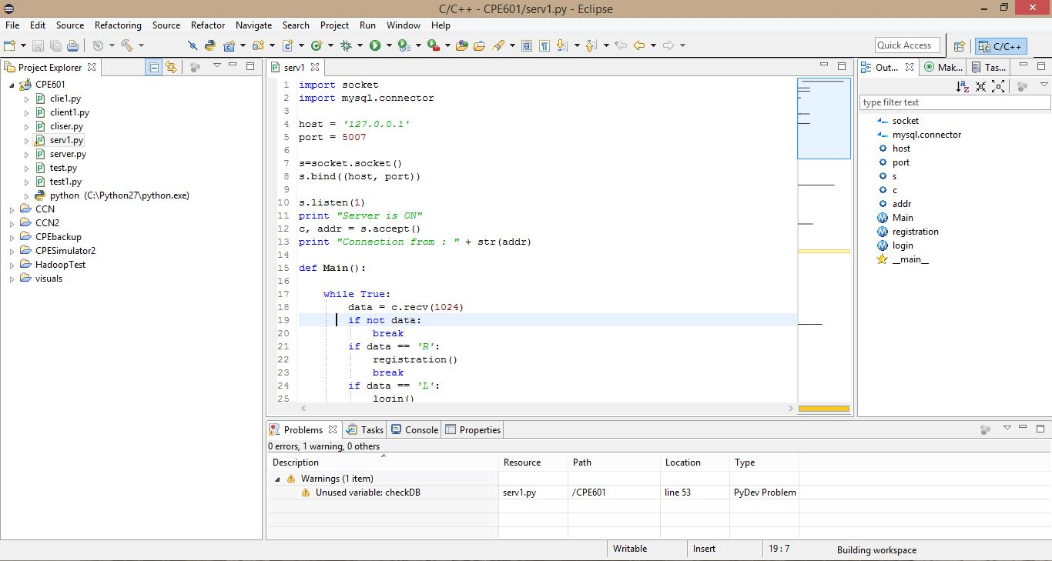
Eclipse IDE

Slide 6
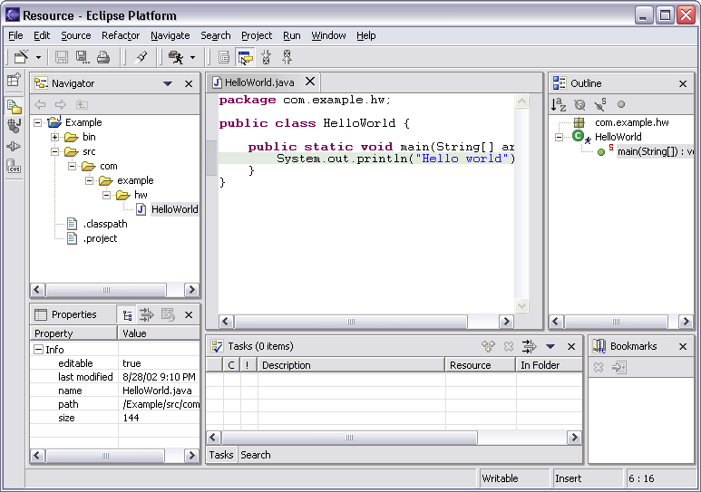
Workbench Terminology
Menu bar
Text
editor
Tool bar
Perspective
and
Fast View
bar
Outline
view
Resource
Navigator
view
Bookmarks
view
Properties
view
Message
area
Editor
Status
area
Stacked
views
Tasks
view
Notes:
[Contains animated elements]

Slide 7
Workbench Terminology
Menu bar
Text
editor
Tool bar
Perspective
and
Fast View
bar
Outline
view
Resource
Navigator
view
Bookmarks
view
Properties
view
Message
area
Editor
Status
area
Stacked
views
Tasks
view
Notes:
[Contains animated elements]

Slide 8
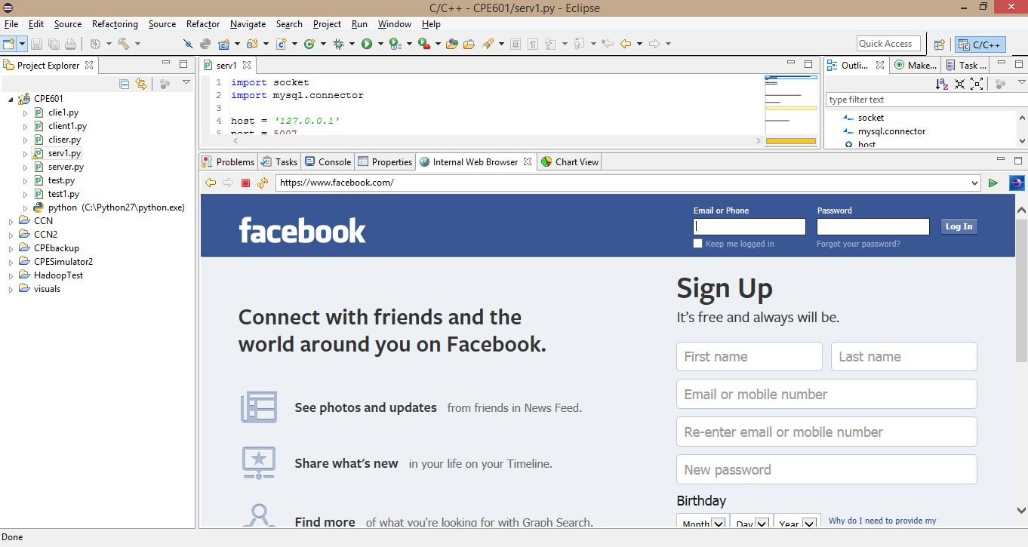
Internal Web Browser

Slide 9
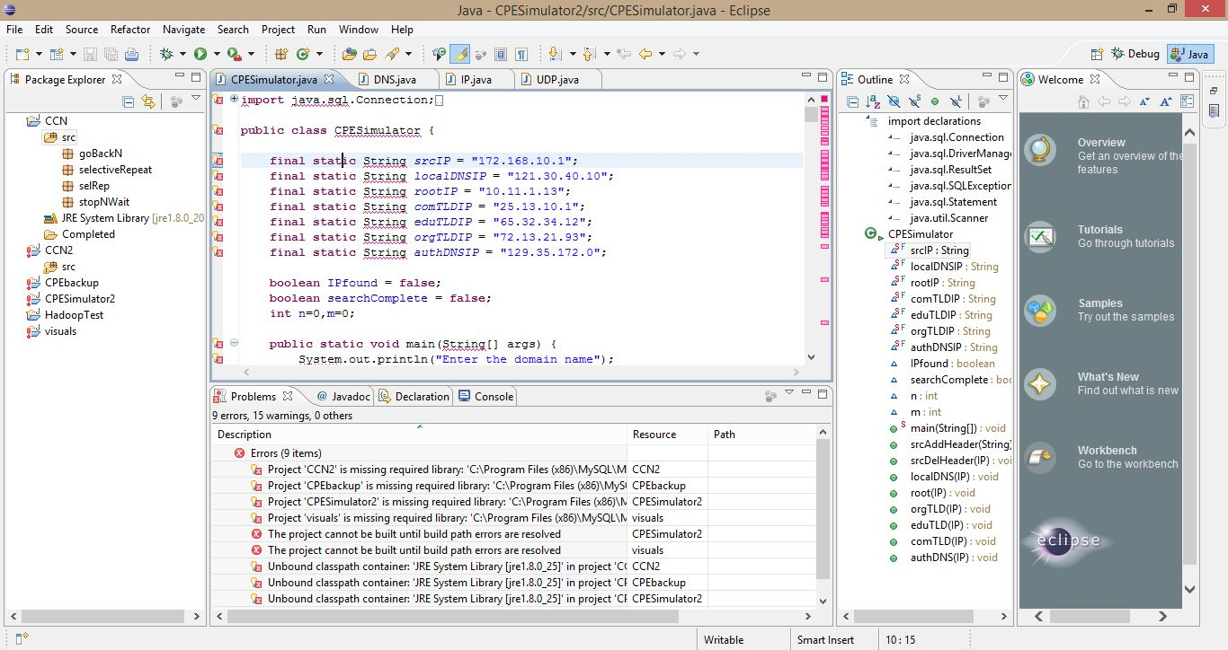
Syntax checking, Spell checking

Slide 10
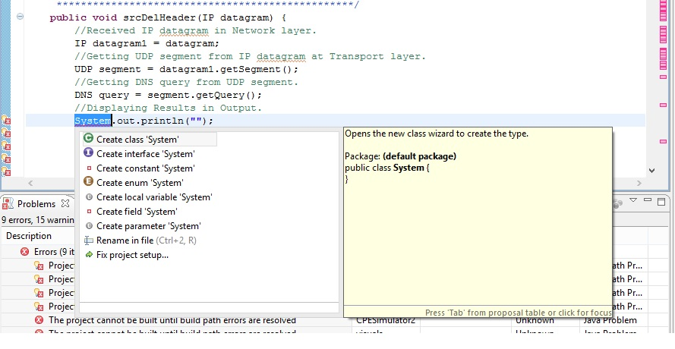
Auto formatter

Slide 11
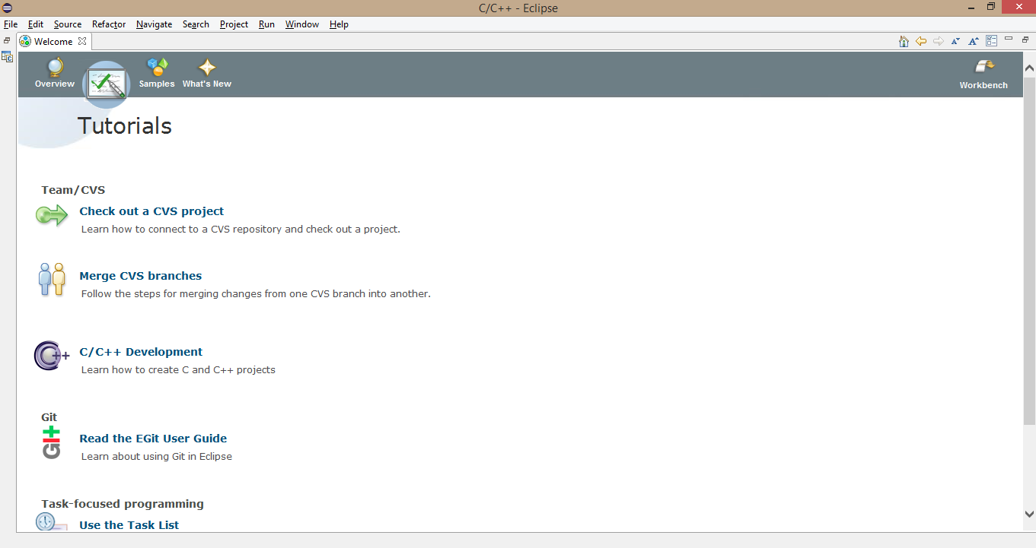
Tutorials

Slide 12
Thank you
Questions ?

