Slide 1
Workshop on Database Application Development using PHP
Organized by the department CSE and ISE
Venue: Industry Competence Lab

Slide 2
Keynote Speaker
Prof. Anil Kumar G
HOD(I/C), Dept. of CSE
CIT, Gubbi

Slide 3
Workshop on Database Application Development using PHP
By,
Anil Kumar
Asst. Prof.
Dept. of ISE
CIT, Gubbi.

Slide 4
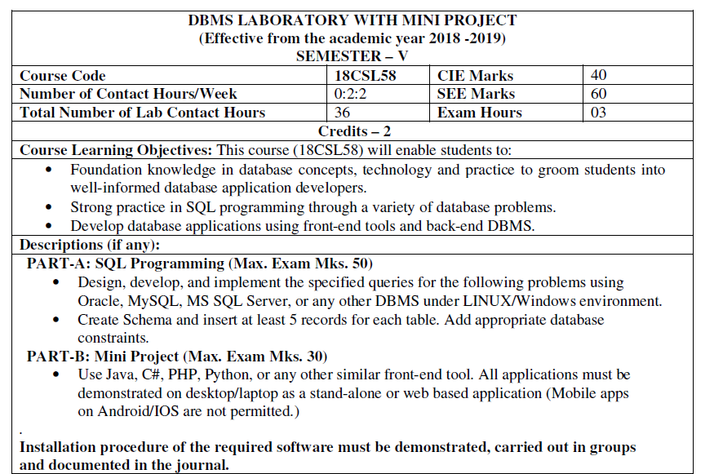
why we are here today

Slide 5
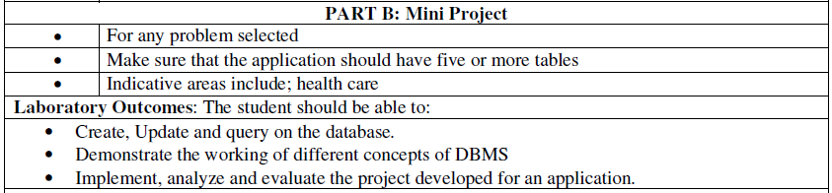
why we are here today

Slide 6

ignition

Slide 7
Contents
Live projects Demonstration
HTML
HTML Forms
Installation of XAMPP software
PHP
Database Connection
Stored Procedure
Triggers

