Slide 1
Mobile Application Development
By,
Anil Kumar
Assistant Professor,
Dept. of ISE, CIT, Gubbi

Slide 2
About Android
Android is a complete set of software for mobile devices such as tablet computers, notebooks, smartphones, electronic book readers, set-top boxes etc.
It can be thought of as a mobile operating system. But it is not limited to mobile only. It is currently used in various devices such as mobiles, tablets, televisions etc.
To learn Android Studio, you must have the basic knowledge of Java programming language.

Slide 3
What is Android?
Android is a software package and Linux based operating system for mobile devices such as tablet computers and smartphones.
It is developed by Google and later the OHA (Open Handset Alliance). Java language is mainly used to write the android code even though other languages can be used.
The goal of android project is to create a successful real-world product that improves the mobile experience for end users.

Slide 4
Features of android
After learning what is android, let's see the features of android. The important features of android are given below:
1) It is open-source.
2) Anyone can customize the Android Platform.
3) There are a lot of mobile applications that can be chosen by the consumer.
4) It provides many interesting features like weather details, opening screen, live RSS (Really Simple Syndication) feeds etc.

Slide 5
Categories of android application
There are many android applications in the market. The top categories are:
Entertainment
Tools
Communication
Productivity
Personalization
Music and Audio
Social
Media and Video
Travel and Local etc.

Slide 6
History of android
The history and versions of android are interesting to know. The code names of android ranges from A to J currently, such as Aestro, Blender, Cupcake, Donut, Eclair, Froyo, Gingerbread, Honeycomb, Ice Cream Sandwitch, Jelly Bean, KitKat and Lollipop. Let's understand the android history in a sequence.
1) Initially, Andy Rubin founded Android Incorporation in Palo Alto, California, United States in October, 2003.
2) In 17th August 2005, Google acquired android Incorporation. Since then, it is in the subsidiary of Google Incorporation.
3) The key employees of Android Incorporation are Andy Rubin, Rich Miner, Chris White and Nick Sears.

Slide 7
History of android
4) Originally intended for camera but shifted to smart phones later because of low market for camera only.
5) Android is the nick name of Andy Rubin given by coworkers because of his love to robots.
6) In 2007, Google announces the development of android OS.
7) In 2008, HTC launched the first android mobile.

Slide 8
Android Versions, Codename and API
Version | Code name | API Level
1.5 | Cupcake | 3
1.6 | Donut | 4
2.1 | Eclair | 7
2.2 | Froyo | 8
2.3 | Gingerbread | 9 and 10
3.1 and 3.3 | Honeycomb | 12 and 13
4.0 | Ice Cream Sandwitch | 15
4.1, 4.2 and 4.3 | Jelly Bean | 16, 17 and 18
4.4 | KitKat | 19
5.0 | Lollipop | 21
6.0 | Marshmallow | 23
7.0 | Nougat | 24-25
8.0 | Oreo | 26-27

Slide 9
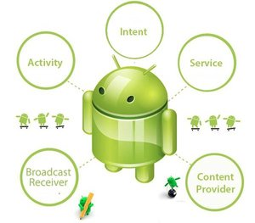
Android Core Building Blocks

Slide 10
Android Core Building Blocks
Activity
An activity is a class that represents a single screen. It is like a Frame in AWT.
View
A view is the UI element such as button, label, text field etc. Anything that you see is a view.
Intent
Intent is used to invoke components. It is mainly used to:
Start the service
Launch an activity
Display a web page
Display a list of contacts

Slide 11
Android Core Building Blocks
Service
Service is a background process that can run for a long time.
There are two types of services local and remote. Local service is accessed from within the application whereas remote service is accessed remotely from other applications running on the same device.
Content Provider
Content Providers are used to share data between the applications.
Fragment
Fragments are like parts of activity. An activity can display one or more fragments on the screen at the same time.

Slide 12
Android Core Building Blocks
AndroidManifest.xml
It contains informations about activities, content providers, permissions etc. It is like the web.xml file in Java EE.
Android Virtual Device (AVD)
It is used to test the android application without the need for mobile or tablet etc. It can be created in different configurations to emulate different types of real devices.

Slide 13
Android Emulator
The Android emulator is an Android Virtual Device (AVD), which represents a specific Android device.
We can use the Android emulator as a target device to execute and test our Android application on our PC.
The Android emulator provides almost all the functionality of a real device. We can get the incoming phone calls and text messages.
It also gives the location of the device and simulates different network speeds. Android emulator simulates rotation and other hardware sensors. It accesses the Google Play store, and much more

Slide 14
Install Android
Android supports java, c++, c# etc. language to develop android applications. Java is the officially supported language for android. All the android examples of this site is developed using Java language and Eclipse IDE.
Here, we are going to tell you, the required softwares to develop android applications using Eclipse IDE.
There are two ways to install android.
By ADT Bundle
By Setup Eclipse Manually

Slide 15
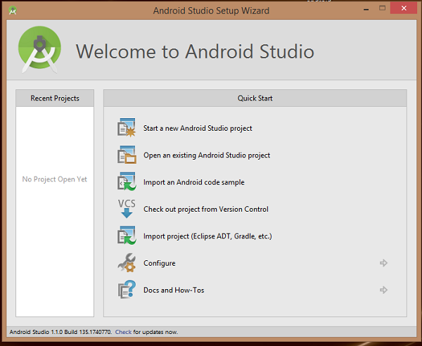
How to make android apps
The first step is to create a simple Android Application using Android studio. When you click on Android studio icon, it will show screen as shown below

Slide 16
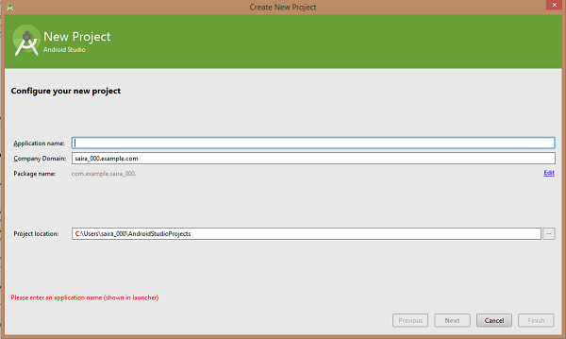
How to make android apps
You can start your application development by calling start a new android studio project. in a new installation frame should ask Application name, package information and location of the project.−

Slide 17
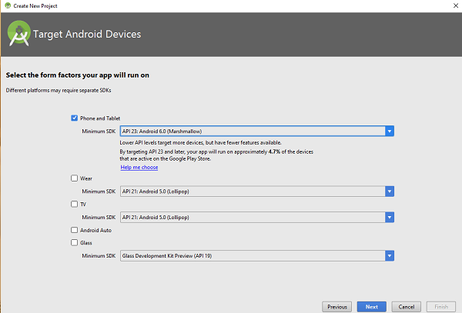
How to make android apps
After entered application name, it going to be called select the form factors your application runs on, here need to specify Minimum SDK, in our tutorial, I have declared as API23: Android 6.0(Mashmallow) −

Slide 18
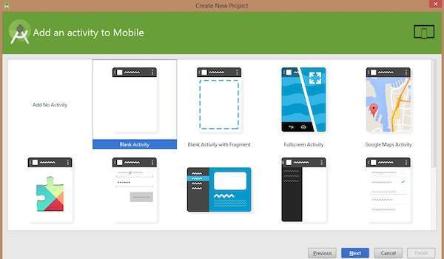
How to make android apps
The next level of installation should contain selecting the activity to mobile, it specifies the default layout for Applications.

Slide 19
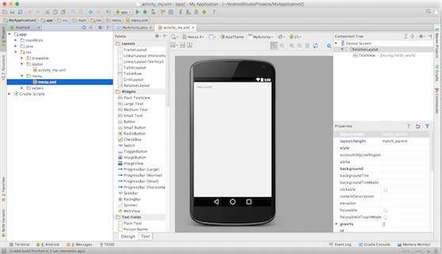
How to make android apps
At the final stage it going to be open development tool to write the application code.

Slide 20
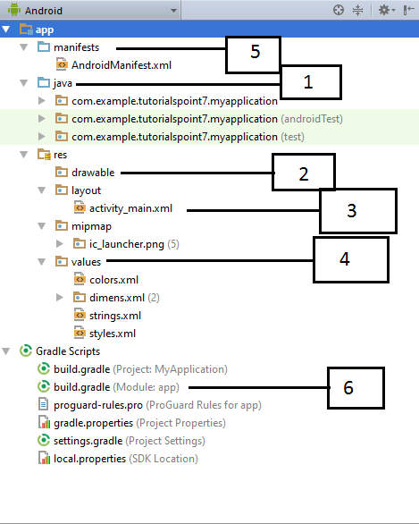
Anatomy of Android Application
Before you run your app, you should be aware of a few directories and files in the Android project −

Slide 21
Anatomy of Android Application
Java
This contains the .java source files for your project. By default, it includes an MainActivity.java source file having an activity class that runs when your app is launched using the app icon.
res/drawable-hdpi
This is a directory for drawable objects that are designed for high-density screens.
res/layout
This is a directory for files that define your app's user interface.

Slide 22
Anatomy of Android Application
res/values
This is a directory for other various XML files that contain a collection of resources, such as strings and colours definitions.
AndroidManifest.xml
This is the manifest file which describes the fundamental characteristics of the app and defines each of its components.
Build.gradle
This is an auto generated file which contains compileSdkVersion, buildToolsVersion, applicationId, minSdkVersion, targetSdkVersion, versionCode and versionName

Slide 23
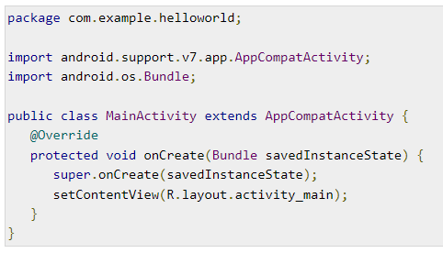
Following section will give a brief overview of the important application files.
The Main Activity File
The main activity code is a Java file MainActivity.java. This is the actual application file which ultimately gets converted to a Dalvik executable and runs your application. Following is the default code generated by the application wizard for Hello World! application −

Slide 24
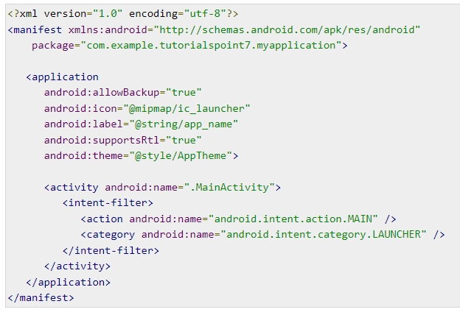
The Manifest File
Whatever component you develop as a part of your application, you must declare all its components in a manifest.xml which resides at the root of the application project directory. This file works as an interface between Android OS and your application, so if you do not declare your component in this file, then it will not be considered by the OS. For example, a default manifest file will look like as following file −

Slide 25
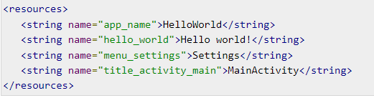
The Strings File
The strings.xml file is located in the res/values folder and it contains all the text that your application uses. For example, the names of buttons, labels, default text, and similar types of strings go into this file. This file is responsible for their textual content. For example, a default strings file will look like as following file −

Slide 26
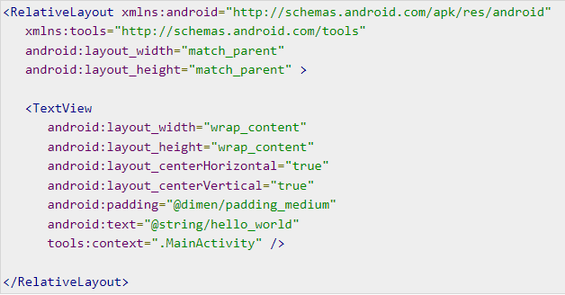
The Layout File
The activity_main.xml is a layout file available in res/layout directory, that is referenced by your application when building its interface. You will modify this file very frequently to change the layout of your application. For your "Hello World!" application, this file will have following content related to default layout −

Slide 27
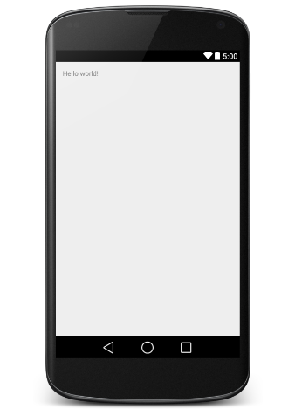
Running the Application
Let's try to run our Hello World! application we just created. I assume you had created your AVD while doing environment set-up. To run the app from Android studio, open one of your project's activity files and click Run icon from the tool bar. Android studio installs the app on your AVD and starts it and if everything is fine with your set-up and application, it will display following Emulator window −

Slide 28
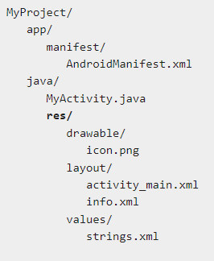
Organize resource in Android Studio

Slide 29
Directory & Resource Type
anim/
XML files that define property animations. They are saved in res/anim/ folder and accessed from the R.anim class.
color/
XML files that define a state list of colors. They are saved in res/color/ and accessed from the R.color class.
drawable/
Image files like .png, .jpg, .gif or XML files that are compiled into bitmaps, state lists, shapes, animation drawable. They are saved in res/drawable/ and accessed from the R.drawable class.

Slide 30
Directory & Resource Type
layout/
XML files that define a user interface layout. They are saved in res/layout/ and accessed from the R.layout class.
menu/
XML files that define application menus, such as an Options Menu, Context Menu, or Sub Menu. They are saved in res/menu/ and accessed from the R.menu class.
raw/
Arbitrary files to save in their raw form. You need to call Resources.openRawResource() with the resource ID, which is R.raw.filename to open such raw files.

Slide 31
Directory & Resource Type
values/
XML files that contain simple values, such as strings, integers, and colors. For example, here are some filename conventions for resources you can create in this directory −
arrays.xml for resource arrays, and accessed from the R.array class.
integers.xml for resource integers, and accessed from the R.integer class.
bools.xml for resource boolean, and accessed from the R.bool class.
colors.xml for color values, and accessed from the R.color class.
dimens.xml for dimension values, and accessed from the R.dimen class.
strings.xml for string values, and accessed from the R.string class.
styles.xml for styles, and accessed from the R.style class.

Slide 32
Directory & Resource Type
xml/
Arbitrary XML files that can be read at runtime by calling Resources.getXML(). You can save various configuration files here which will be used at run time.

Slide 33
Accessing Resources
During your application development you will need to access defined resources either in your code, or in your layout XML files. Following section explains how to access your resources in both the scenarios −
1. Accessing Resources in Code
2. Accessing Resources in XML

Slide 34
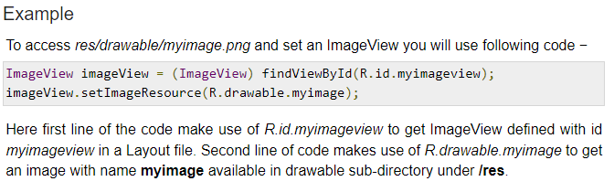
Accessing Resources in Code
When your Android application is compiled, a R class gets generated, which contains resource IDs for all the resources available in your res/ directory. You can use R class to access that resource using sub-directory and resource name or directly resource ID.

Slide 35
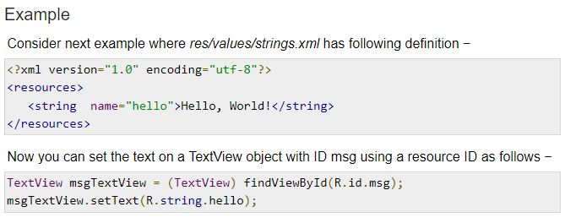

Slide 36
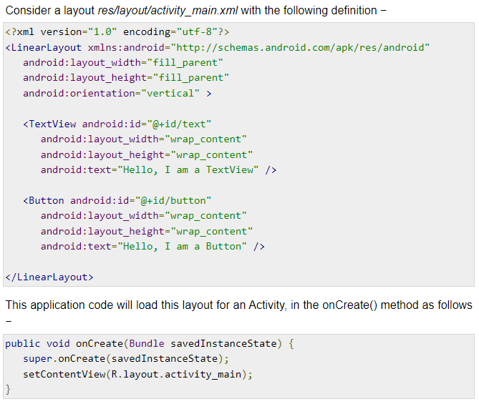

Slide 37
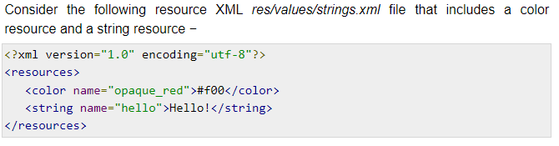
Accessing Resources in XML

Slide 38
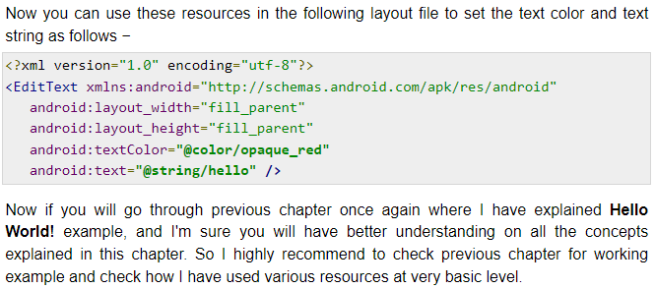

Slide 39
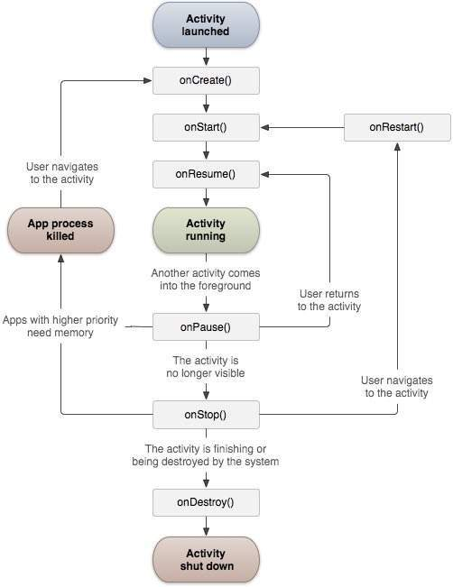
Android - Activities

Slide 40
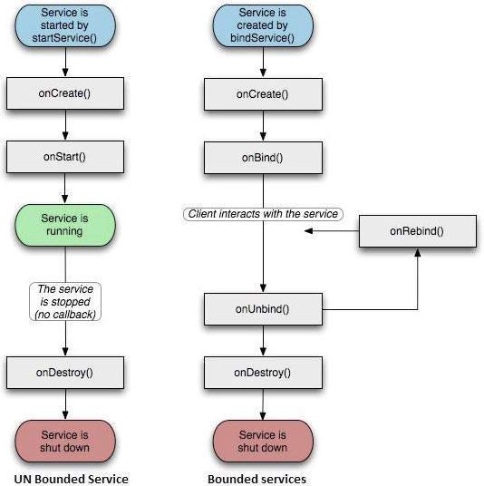
Android - Services

