Slide 1
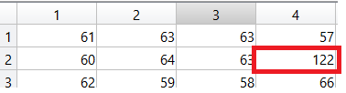
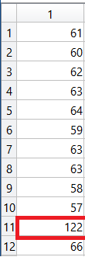
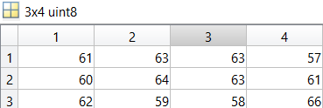
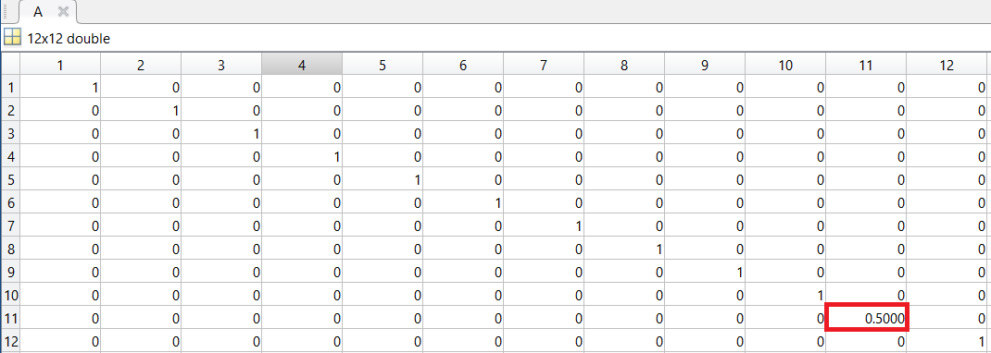
1 – initial image
2 – make column – failed pixel at [11,1]
4 – get fixed image
3 – generate A matrix. Index [11,11] is 0.5

Slide 2
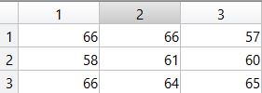
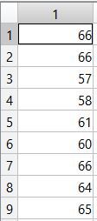
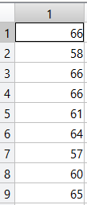
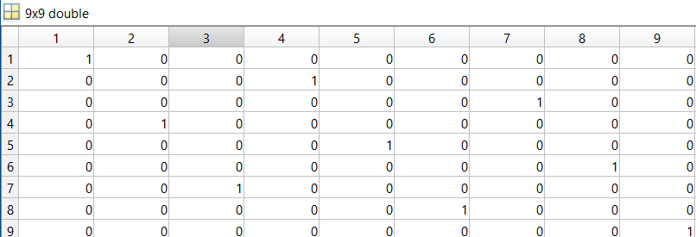
1 – initial image
2 – make row-ordered image
4 – get column ordered image
3 – generate C matrix.

Slide 3




$$(row→column)$$
$$f^{cs}$$
$$g^{cs}$$
$$k^{cs}$$
C
A
D

Slide 4
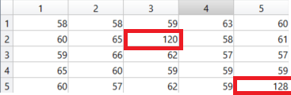
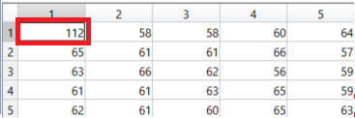
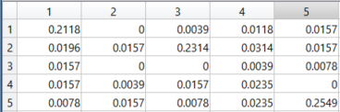
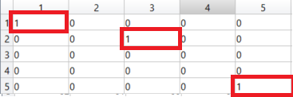
1 – initial image A
2 – initial image B
3 – differentiate 2 matrixes in ‘double’ format, take absolute value
4 – binarize the image based on the threshold

