Slide 1
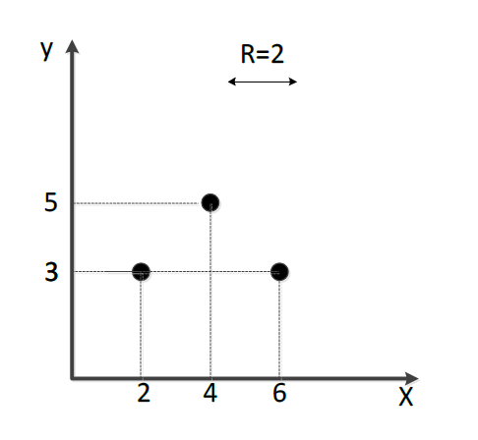
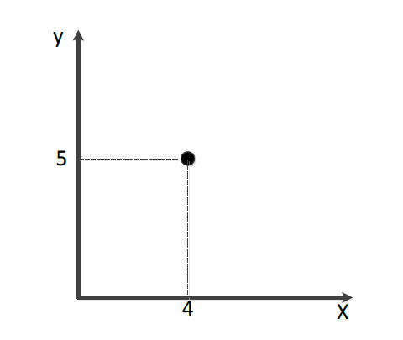

$$(a_{i},b_{i})$$
p1
B
p2
R = 4
p3
C
R = 2
A

Slide 2
B
p3
C
R = 2
A

Slide 3
