Slide 1


(1,1)
(1,101)
Length = 100
$$ρ=\frac{100}{\sqrt{2}}$$
$$θ={45}^{o}$$
(101,1)

Slide 2
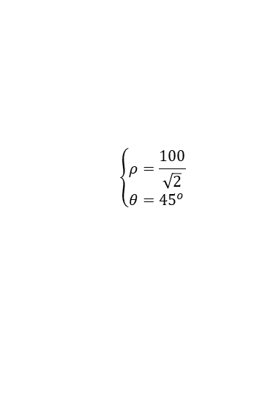
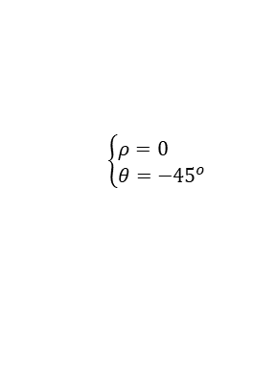

(1,1)
(1,101)
(1,1)
(1,101)
Length = 100
Length = 100
$$θ$$
$$\left\{\begin{aligned}&ρ=0 \\ &θ={−45}^{o}\end{aligned}\right.$$
$$\left\{\begin{aligned}&ρ=\frac{100}{\sqrt{2}} \\ &θ={45}^{o}\end{aligned}\right.$$
(101,1)
(101,101)
(101,1)
(101,101)

Slide 3


$$θ−$$
$$θ+$$

