Slide 1

Domain Classification based on LinkedIn Summaries
BY : Taha Zanzibarwala
Balan Dhanka
Akash Tripathi

Slide 2

Introduction
LinkedIn is home to many job seekers and employers.
LinkedIn summaries act as the first interaction between the applicant and employer.
We aim to read LinkedIn summaries of users to generalize their work domain to better suggest job openings and also be useful for further analysis..

Slide 3

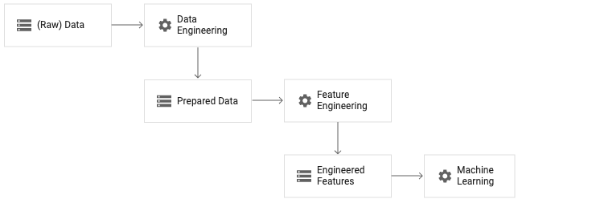
Data Preprocessing

Slide 4
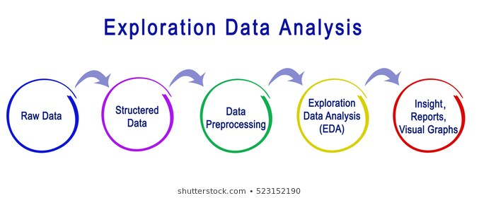
We used a Kaggle dataset (linkedin.csv) which consisted of various values of the user’s profile.
The columns include
Category, Linkedin profile picture, Description Summary, Experience, Name, Location, Skills
The dataset contained many null rows, which were dropped and the final row count came to 670.

Slide 5
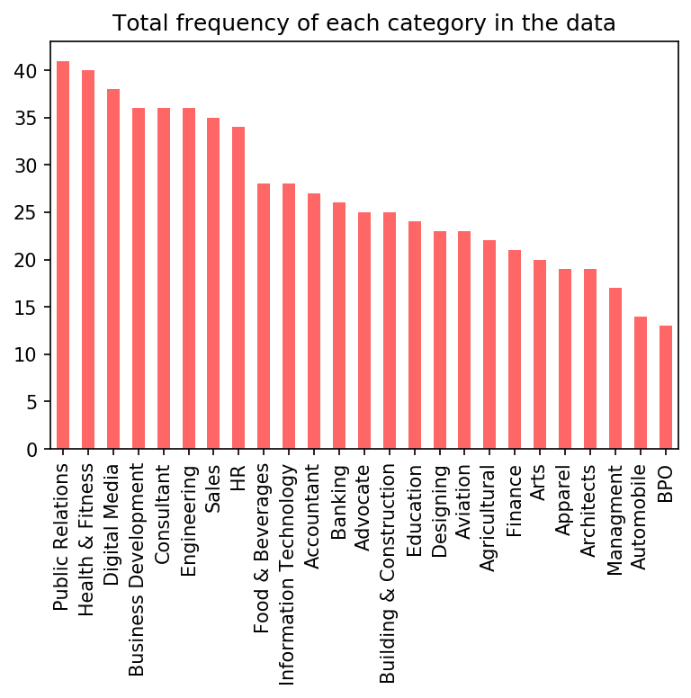
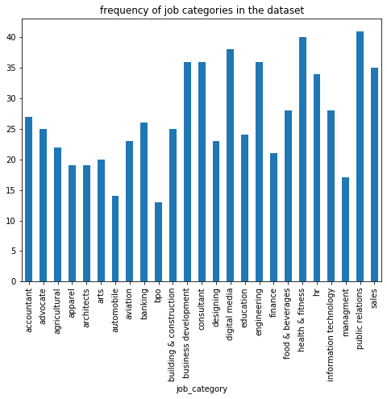

Slide 6
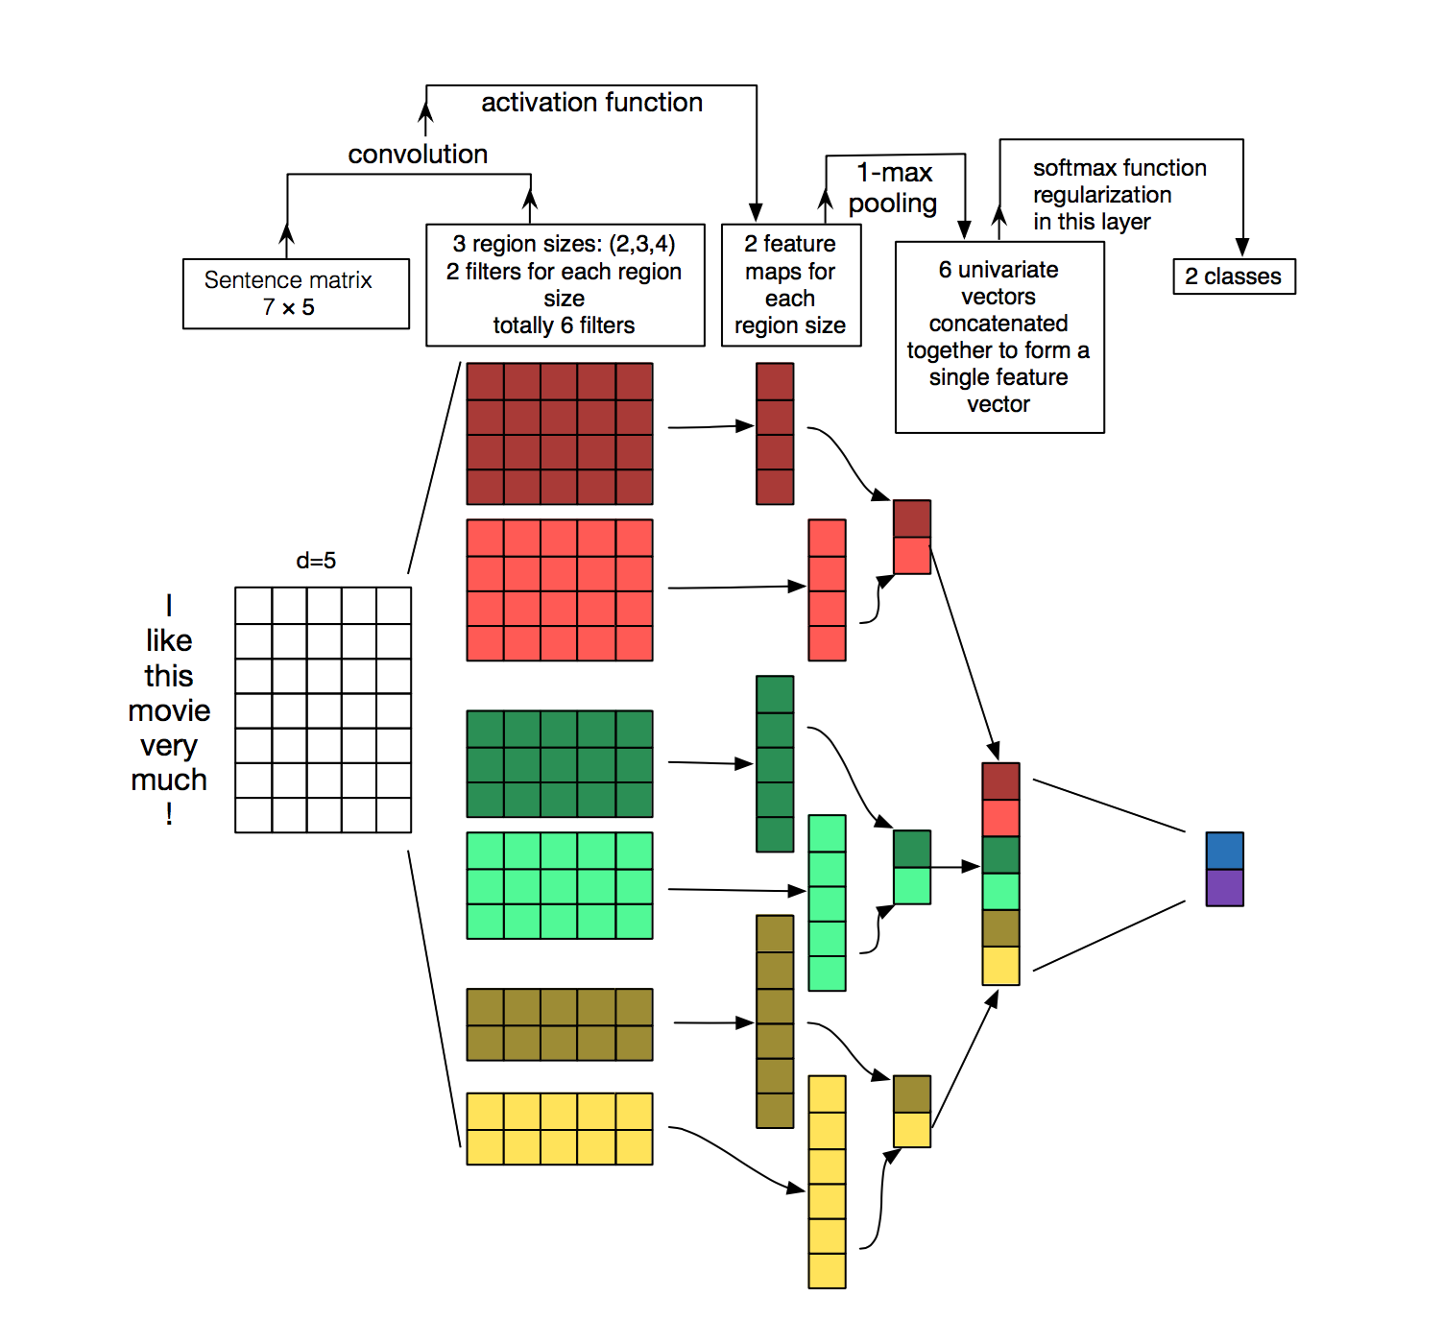
Methodology
Architecture based on Convolutional Neural Networks for Sentence Classification by Yoon Kim
Intuition is to see the text document as an image.
GloVe vectors are used to generate a sentence matrix, for input to the model.
Image Source: https://www.aclweb.org/anthology/D14-1181/

Slide 7
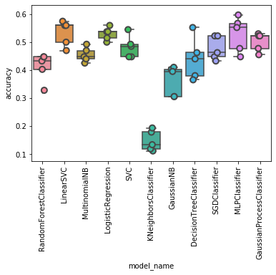
Results - Machine Learning Models

Slide 8
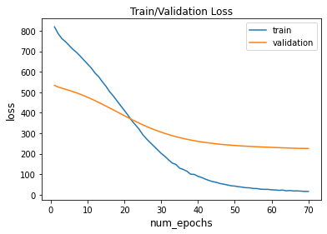
Results - CNN Model

Slide 9
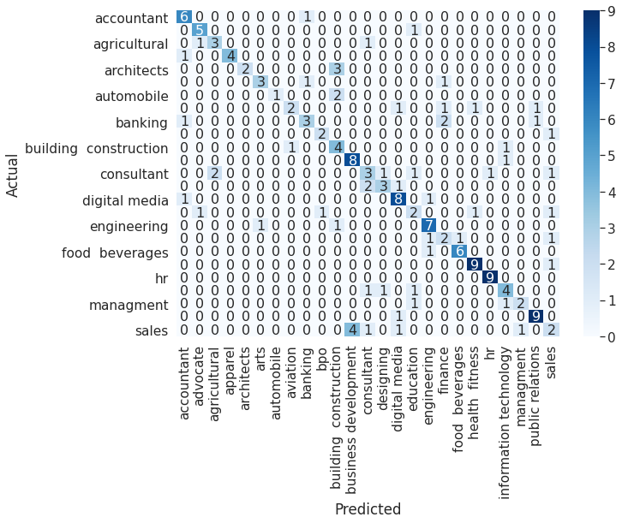
Results - Confusion Matrix

Slide 10
Future Work
We aim to use such a classifier, primarily to suggest job openings according to the predicted domain from the users LinkedIn summaries.
Furthermore, we could use the same for further analysis of LinkedIn users to find the major working domains of the users or even filter applications from resume summaries in a large organization.

