Slide 1

































Machine Learninig
Assignment 1
Notes:
1

Slide 2





THE LIBRARIES USED
Notes:
1

Slide 3
Numpy: linear algebra
Pandas: data processing, CSV file I/O (e.g. pd.read_csv)
Matplotlib
plotly.express: Plotly Express is a terse, consistent, high-level API for creating figures.
Wordcloud
seaborn: It provides a high-level interface for drawing attractive and informative statistical graphics.
Pandasql: pandasql allows you to query pandas DataFrames using SQL syntax. It works similarly to sqldf in R.
Notes:
1

Slide 4
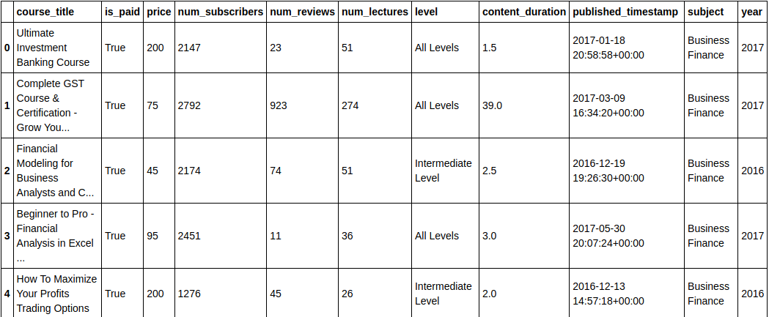
RELEVANT COLUMNS FOR EDA
Notes:
1

Slide 5
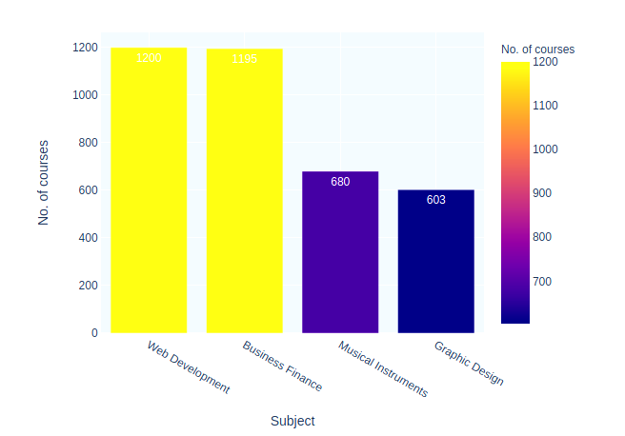
VISUALISATION OF THE NO. OF COURSES TO VARIOUS SUBJECTS
Notes:
1

Slide 6
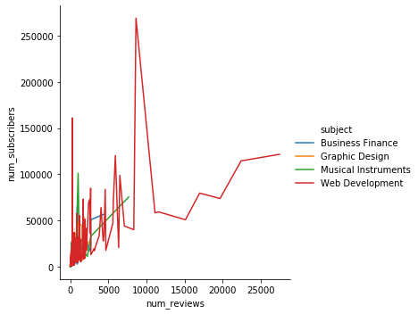
NO. OF SUBSCRIBERS VS NO OF REVIEWS
Notes:
1

Slide 7
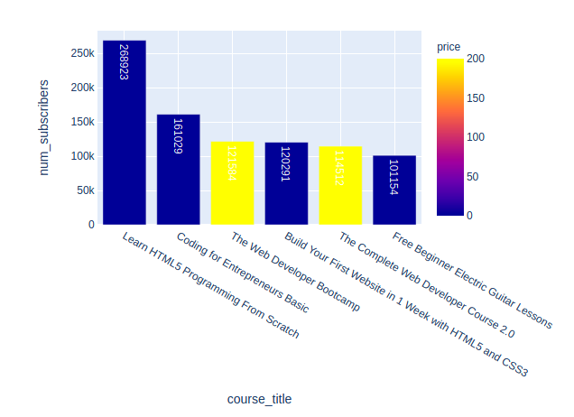
MOST ENGAGING COURSES BY SUBSCRIPTION COUNT
Notes:
1

Slide 8
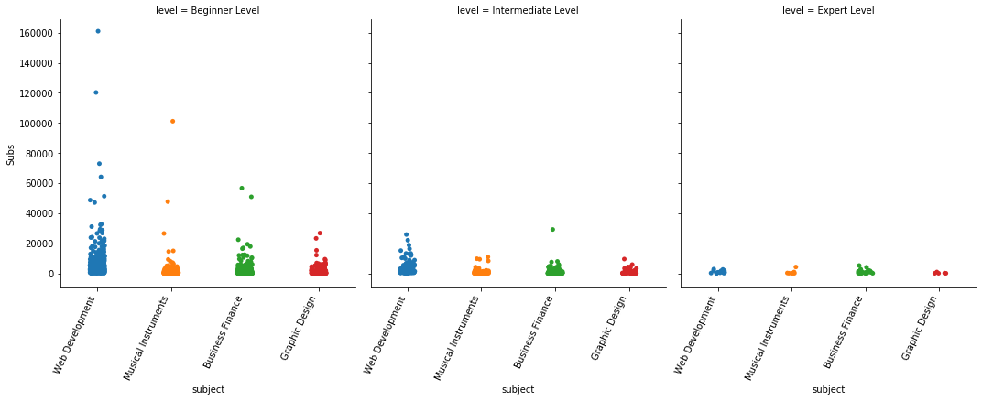
THE NUMBER OF SUBJECTS BY LEVEL
Notes:
1

Slide 9
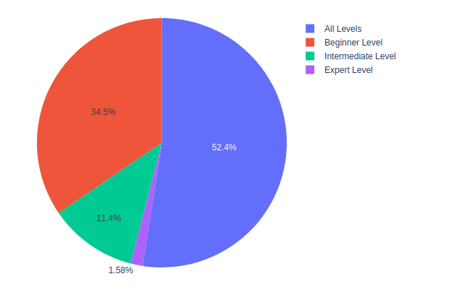
OFFERED COURSES LEVEL
Notes:
1

Slide 10
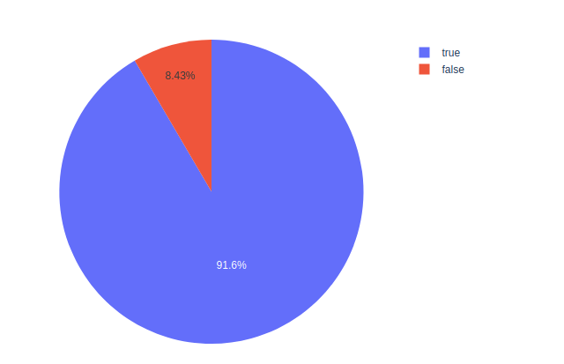
VISUALISATION OF FREE VS PAID COURSES
Notes:
1

Slide 11
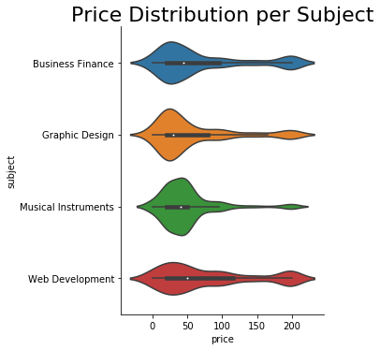
VISUALISATION OF PRICE DISTRIBUTION PER SUBJECT
Notes:
1

Slide 12
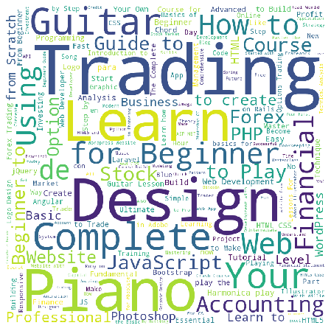
COURSE KEYWORD PER SUBJECT [BUSINESS FINANCE]
Notes:
1

Slide 13
Thank You !
Notes:
1

