Slide 1
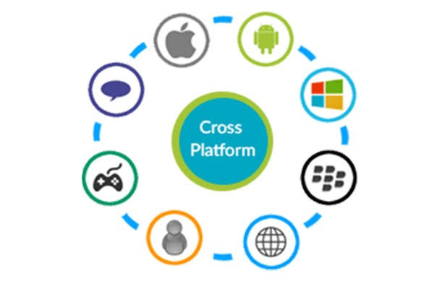
CROSS PLATFORM MOBILE APPLICATION
HTML AND CSS

Slide 2
PRESENTATION :
By: AKASH SHARMA (44620802717)
AVISHA SHARMA (35320802717)
BHAVAY SHARMA (35420802717)
Supervised by: Ms.Minakshi

Slide 3
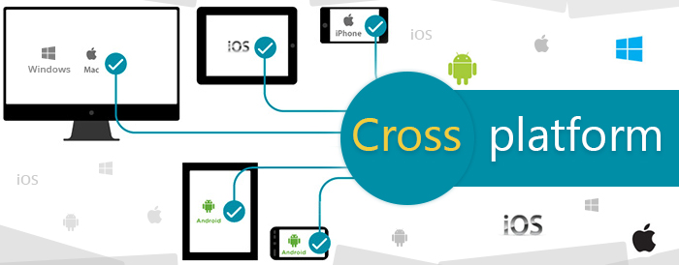
LET’S GET STARTED

Slide 4
CONTENT
Project objective
Designing
CPMA and its advantages
Cross-platform mobile development
HTML and its advantages
CSS and its advantages
Apache Cordova
PhoneGap
Fitness Application and features
Softwares used
References

Slide 5
PROJECT OBJECTIVE
To make a Cross Platform Exercise Application so that it is convenient for the user to find out the exercises for specific body parts without the help of a professional.
The application will also give you the information for performing an exercise with a correct technique. This will be a cost effective way for the user to know about the exercises without any help of a professional.

Slide 6
DESIGNING
STRUCTURE
PRESENTATION
HTML markup
Site planning
HTML is used to create the actual content of the page such as written text
CSS
IMAGERY
CSS is responsible for the design or style of the website, including the layout, visual effects and background color.

Slide 7
CROSS
PLATFORM
MOBILE
APPLICATION
(CPMA)

Slide 8
What is CPMA?
Cross-platform mobile development is the creation of software applications that are compatible with multiple mobile operating systems. Originally, the complexity of developing mobile apps was compounded by the difficulty of building out a backend that worked across multiple platforms. Although it was time-consuming and expensive, it was often easier to build native applications for each mobile operating system (OS). The problem was that the code built for one operating system could not be repurposed for another OS.

Slide 9
Advantage of CPMA
Codes can be reused. Instead of writing fresh codes for every platform, developers can reuse the same code across all platforms.
Controls Cost.
Quicker development time.
Easier Implementation.
Sameness and Uniformity.

Slide 10

What is cross-platform development?
Cross-platform development is the practice of developing software products or services for multiple platforms or software environments.
Engineers and developers use various methods to accommodate different operating systems or environments for one application or product.

Slide 11

HTML

Slide 12
What is HTML?
Hypertext Markup Language (HTML) is the standard markup language for documents designed to be displayed in a web browser. It can be assisted by technologies such as Cascading Style Sheets (CSS) and scripting languages such as JavaScript.
Web browsers receive HTML documents from a web server or from local storage and render the documents into multimedia web pages.
HTML describes the structure of a web page semantically and originally included cues for the appearance of the document.HTML elements are the building blocks of HTML pages.

Slide 13
What is HTML?
With HTML constructs, images and other objects such as interactive forms may be embedded into the rendered page. HTML provides a means to create structured documents by denoting structural semantics for text such as headings, paragraphs, lists, links, quotes and other items.
HTML elements are delineated by tags, written using angle brackets.Browsers do not display the HTML tags, but use them to interpret the content of the page.HTML can embed programs written in a scripting language such as JavaScript, which affects the behavior and content of web pages. Inclusion of CSS defines the look and layout of content.

Slide 14
Advantages of HTML
It promotes Accessibility—Creating sites that are accessible is very easy now because of semantics . The headings that come with it give screen readers the chance to access content easily.
It provides support for both Video and Audio— videos and audio clips will become truly accessible. You will not have to worry about getting media to play because the tags for audio and video treat them as if they were images.
It eliminates the need for Cut and Paste—you can now say goodbye to endless lines of unreadable codes as well as messy head tags that are filled in with your doctype attributes. All you need to do is to just type it.

Slide 15
Advantages of HTML
It presents cleaner and more attractive code—It lets us write clear and very descriptive code.We can easily separate the meaning from both content and style.
HTML is right up there with Mobile Technology—In this age where almost everyone gets their work done on mobile. Adoption grows at a rapid pace, and what you can glean from this is the continuously growing base of mobile browser users will appreciate websites or applications that are as mobile friendly as possible.

Slide 16

CSS

Slide 17
What is CSS?
Cascading Style Sheets (CSS) is a style sheet language used for describing the presentation of a document written in a markup language like HTML.CSS is a cornerstone technology of the World Wide Web, alongside HTML and JavaScript.
CSS, is a simple design language intended to simplify the process of making web pages presentable.It handles the look of a web page. Using CSS, we can control the color of the text, the style of fonts, the spacing between paragraphs, how columns are sized and laid out, what background images or colors are used, layout designs,variations in display for different devices and screen sizes as well as a variety of other effects.

Slide 18
Advantages of CSS
CSS saves time − You can write CSS once and then reuse same sheet in multiple HTML pages.
Pages load faster − If you are using CSS, you do not need to write HTML tag attributes every time. Just write one CSS rule of a tag and apply it to all the occurrences of that tag. So less code means faster download times.
Easy maintenance − To make a global change, simply change the style, and all elements in all the web pages will be updated.
Multiple Device Compatibility − CSS allow content to be optimized for more than one type of device.

Slide 19

APACHE CORDOVA

Slide 20
APACHE CORDOVA
Apache Cordova (formerly PhoneGap) is a mobile application development framework originally created by Nitobi.
It enables software programmers to build applications for mobile devices using CSS3, HTML5, and JavaScript instead of relying on platform-specific APIs like those in Android, iOS, or Windows Phone.
It enables wrapping up of CSS, HTML and JavaScript code depending upon the platform of the device.
The resulting applications are hybrid, meaning that they are neither truly native mobile application nor purely Web-based.

Slide 21
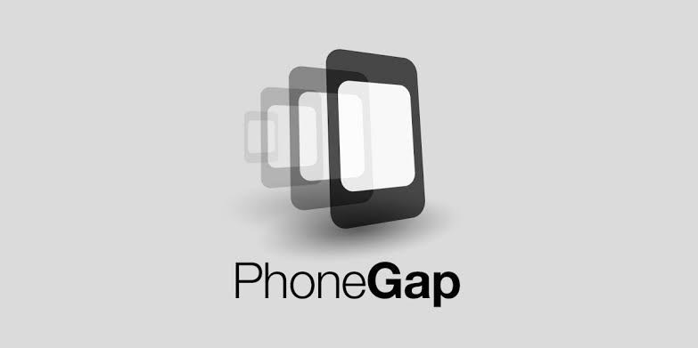
PHONEGAP

Slide 22
PHONEGAP
PhoneGap,owned by Adobe, is a cross-platform development tool that relies on web technologies to create apps for Android and iOS.
You can use HTML, CSS, and JavaScript to build a mobile app with a native look and feel, without needing to write the same code twice for different platforms.
PhoneGap gives you a unified approach with web technology that has a native look and feel. It looks like a native iOS or Android app, but it isn’t.
Tools like PhoneGap also provide unified APIs to interact with hardware such as the camera, media library, file storage, and GPS. Their underlying code may be different between platforms, but the way they work are very similar.

Slide 23
FITNESS APPLICATION
It is very important that one is both physically and mentally fit. Exercising plays a vital role in our lives.
It helps us in staying physically fit. Our human body is designed to move.
Exercise helps in improving the strength and efficiency of cardiovascular system which will improve the flow of oxygen and nutrition’s in your body.
With the proposed application, the user will easily be able to find out the exercises for specific body parts.
The application will give all the necessary details for performing an exercise.
This will be a convenient way for the user to find out which exercise triggers which muscle of the human body.

Slide 24
INTRODUCTION TO APPLICATION
The application is convenient for the user to find out the exercises for specific body parts without the help of a professional.
The proposed application will also give you the information for performing an exercise with a correct technique.
This will be a cost effective way for the user to know about the exercises without any help of a professional.

Slide 25
SALIENT FEATURES OF APPLICATION
Application is platform independent.
It is simple.
It contains proper and true information.
Its accurate
User Friendly
Cross Platform application

Slide 26
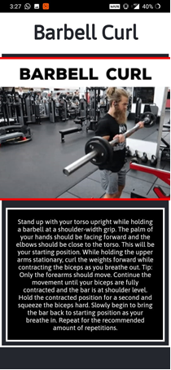
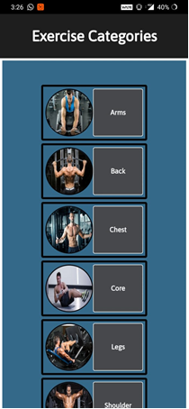
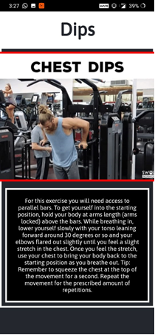
OUTPUT SCREENS

Slide 27
SOFTWARES USED
PhoneGap which allow you to access platform-specific code by using plugins.
Apache Cordova
HTML5

Slide 28
What we learnt?
Making of a cross platform mobile application
Designing a webpage using HTML and CSS
Team work

Slide 29
REFERENCES
Books:
The Essential Guide to CSS and HTML Web Design.
Smashing CSS
Head First HTML and CSS.
Websites/Links:
https://www.w3schools.com/html/html_css.asp
https://hackernoon.com/getting-started-with-cross-platform-app-development-in-2019-dd2bf7f6161b
https://www.sapho.com/glossary/cross-platform-development/

Slide 30


