Slide 1
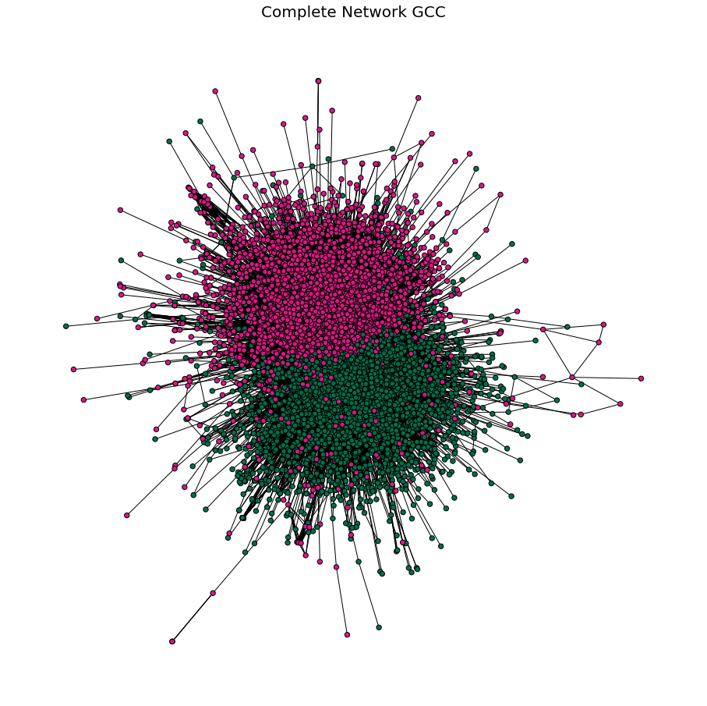
Complete Network of Starbucks & Dunkin’ Tweets, Positioned by the Spring Layout Algorithm
Dunkin’
Starbucks

Slide 2
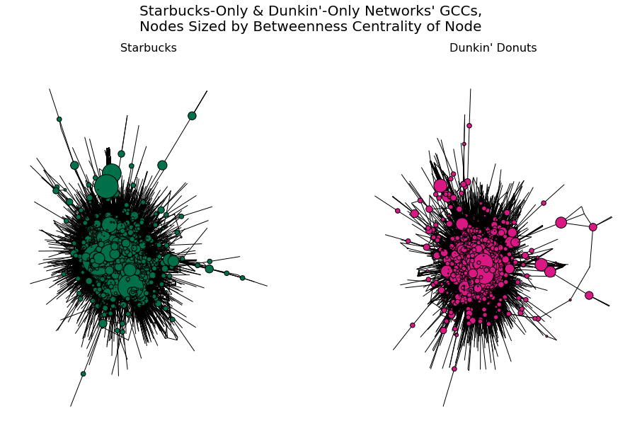
Starbucks & Dunkin’ Sub-Networks, Nodes Sized by Betweenness Centrality
Starbucks
Dunkin’
Min: 0
Max: 0.040
Min: 0
Max: 0.045

Slide 3
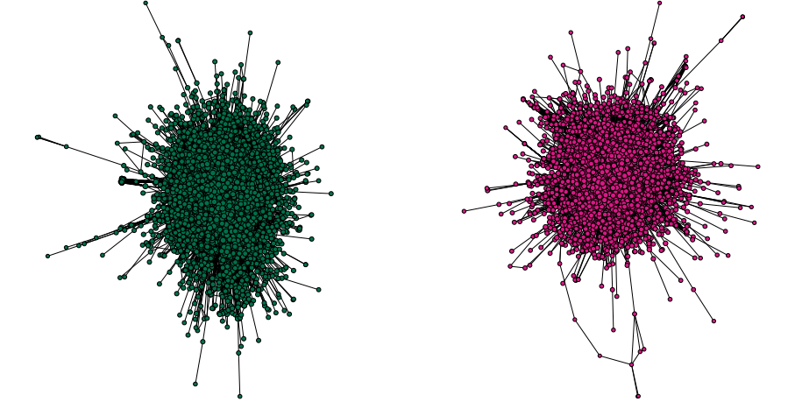
Starbucks & Dunkin’ Sub-Networks, Nodes Sized by Closeness Centrality
Starbucks
Dunkin’
Min: 0.161
Max: 0.447
Min: 0.159
Max: 0.493

Slide 4
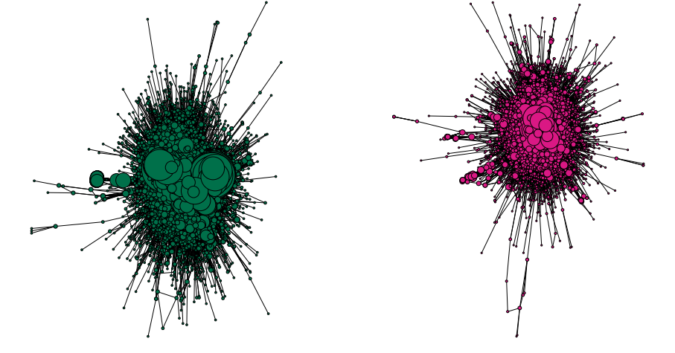
Starbucks & Dunkin’ Sub-Networks, Nodes Sized by Degree
Starbucks
Dunkin’
Min: 1
Max: 300
Min: 1
Max: 877

Slide 5
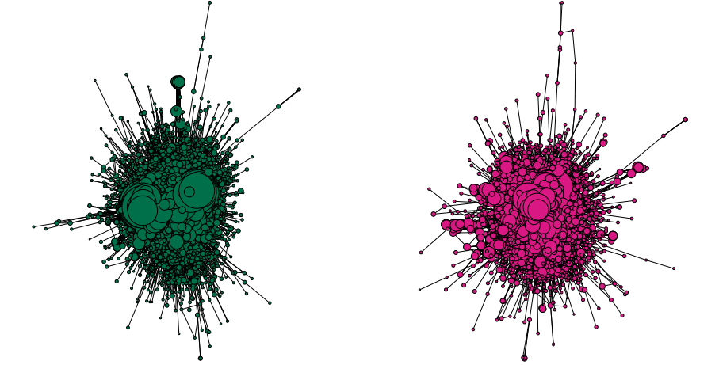
Starbucks & Dunkin’ Sub-Networks, Nodes Sized by Normalized Degree
Starbucks
Dunkin’
Min: 0.04
Max: 56.67
Min: 0.03
Max: 41.44

Slide 6
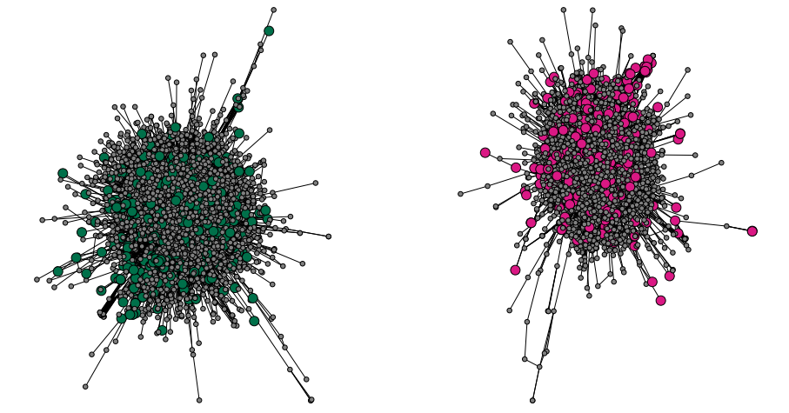
Starbucks & Dunkin’ Sub-Networks, with Influencer Nodes Identified
Starbucks
Dunkin’
Influencer
Yes
No

Slide 7
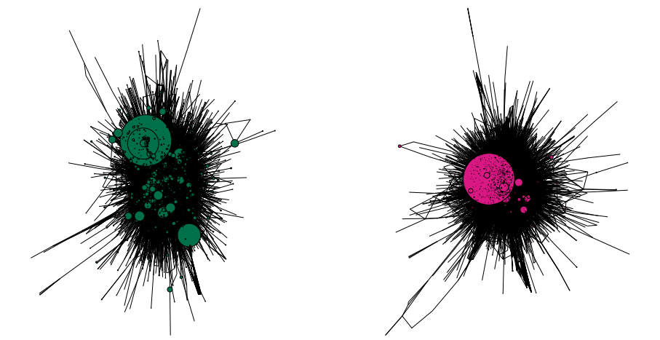
Starbucks & Dunkin’ Sub-Networks, Nodes Sized by Favorites Count
Starbucks
Dunkin’
Min: 0
Max: 13,961
Min: 0
Max: 173,566

Slide 8
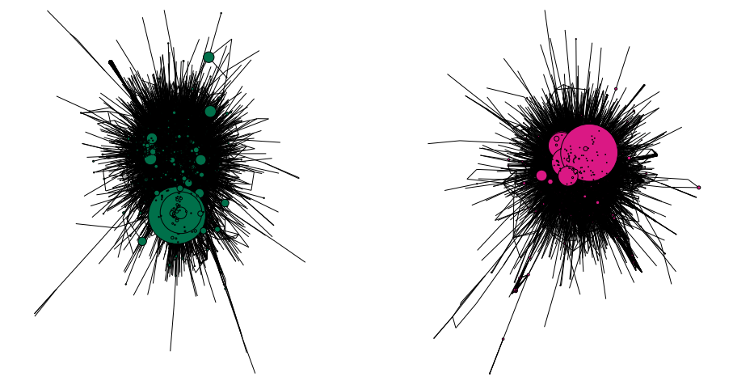
Starbucks & Dunkin’ Sub-Networks, Nodes Sized by Retweet Count
Starbucks
Dunkin’
Min: 0
Max: 2,559
Min: 0
Max: 6,761

Slide 9
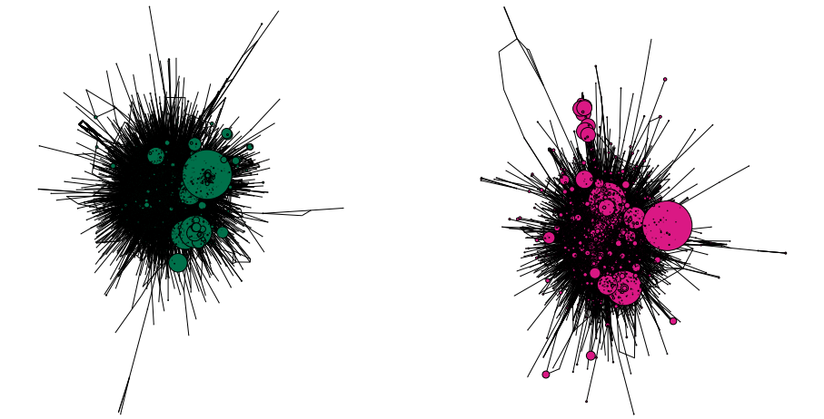
Starbucks & Dunkin’ Sub-Networks, Nodes Sized by User Follower Count
Starbucks
Dunkin’
Min: 0
Max: 19,997,565
Min: 0
Max: 3,854,868

Slide 10
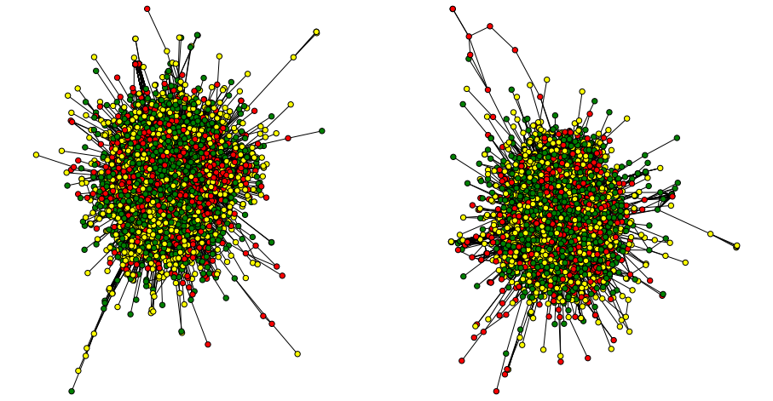
Starbucks & Dunkin’ Sub-Networks, Nodes Colored by Sentiment
Starbucks
Dunkin’
Positive
Neutral
Negative

