Slide 1


D. Y. PATIL COLLEGE OF ENGINEERING,
AKURDI, PUNE
Department of Electronics and Telecommunication
Third Year project
on
IoT-BASED DRAWER LOCKING SYSTEM
Guided by:
Mr. Manish Sharma
Group members:-
Ankur Kumar Singh(115)
Akash Singh(131)

Slide 2
Content
Introduction
System Configuration
Block diagram
Circuit Diagram
The IoT Interface
Literature Survey
Work done so far
Future scope of the Project
Results and Discussion
Conclusion
References

Slide 3
Introduction
Securing your personal drawer at your home or workplace and keeping your belongings like passport, money, important files paperwork, etc. safe is one of the jobs you have to deal with in your day to day life. Traditional drawers need keys for unlocking them which can be misplaced or misused anytime. Anybody can easily tamper it by just having the same pair of keys used for your drawer which could lead to the loss of your belongings.
At the same time, the current pandemic situation has made us skeptical about every physical contact that we make in public places. Public Places such as government hospitals, offices, police stations, etc have lots of old drawers that can only be accessed by directly using a key to open it. Now imagine that a single piece of key goes through how many places in order to achieve its end goal which is simply “locking or unlocking them”.

Slide 4
.
So, introducing a drawer locking system based on IoT, that can allow the owner to access his personal drawer through an open source platform which is directly connected to the lock in the existing wifi network of the surrounding. The open source platform also comes with security features like password protection which makes it quite hard to tamper with.
We have titled our project as IoT-based Drawer Locking System. This application-based setup is itself very straight-forward in terms of lock as either you just need to tap a single button or else, lock/unlock with a password through your Smartphone to activate the relay for unlocking the lock.
The main objective of this project is to make a secure place for all your precious belongings even while you leave the place and at the same time our aim is to make it a cost-effective and a highly reliable consumer product. And we have hopefully achieved to make the whole setup under $15 which makes the whole setup available at a fair minimum price for every sorts of places and individuals.

Slide 5
System Configuration
ESP8266 – It is a wifi module that plays an important role in the project as it connects the solenoid lock with our Smartphone app.
THE SOLENOID LOCK- It is a 12V DC lock which can be accessed with the help of ESP8266 module and a relay.
POWER SUPPLY- For a regular AC Power Source, we can simply use a 12V,1A adapter and a step down module for low voltage requirements of ESP. Or else use a 12 V, 1A DC Power supply.
RELAY- Used to control the lock.
STEP DOWN MODULE- For the ESP Module.
WIRES AND PCB- For connecting our power supply, main circuit and the lock.
SOLDERING GUN- For soldering the circuit.
DRILL MACHINE- For drilling holes in the drawer in order to attach the solenoid lock.
HOT GLUE GUN/DOUBLE SIDED TAPE- For securing the circuit inside.
THE DRAWER- For explanation on how the project is going to work.

Slide 6
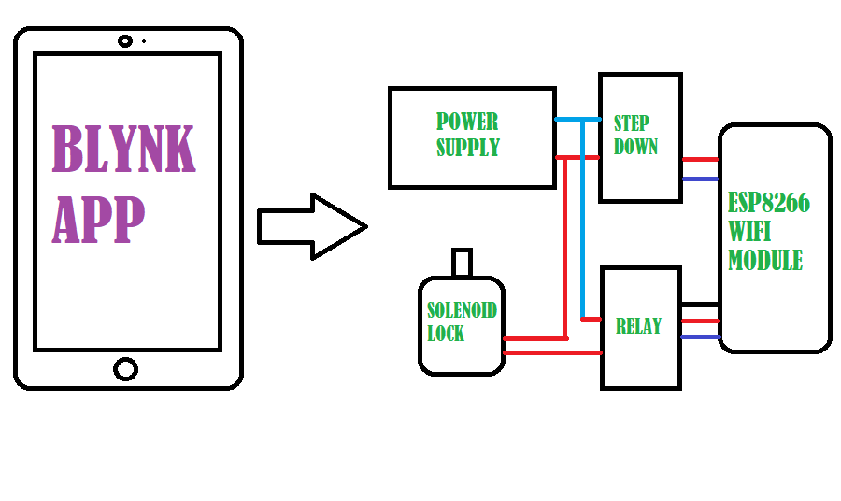
BLOCK DIAGRAM

Slide 7
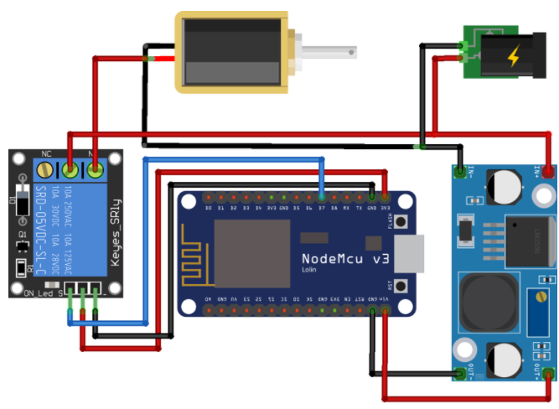
CIRCUIT DIAGRAM
5.
1.
4.
3.
2.

Slide 8
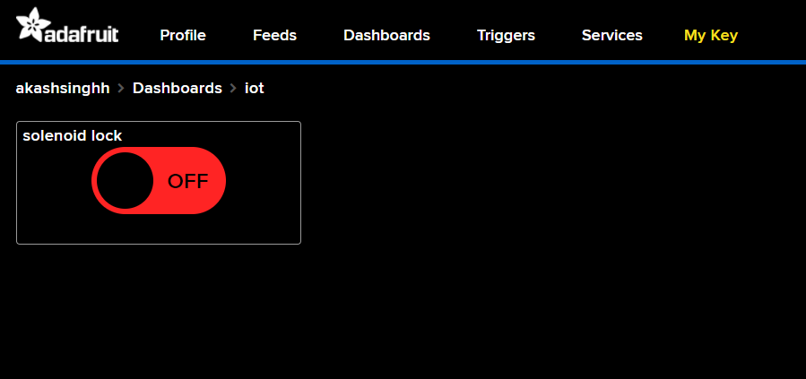
The IOT-Based Interface(Front-End)

Slide 9
Literature survey
Sr. No | Title of the Paper | Year | Abstract | Remark
1 | IOT BASED SMART LOCKER SECURITY SYSTEM | 2018 | This project focuses upon effective recognizing and controlling system for Bank locker room which is fully self determining. In cases of robberies, most commonly the banned entrance in the locker room area is tempered which can be detected by our security system. If the robbery takes place the banks are not capable recognizing the robber due to absence of proof that is due to current human operated security system. The system is designed in an effective way by recognizing and controlling illegal person to access the locker for the safety of bank locker room. | To improve the bank Security which verifies the human as well the device.

Slide 10
.
Sr. No | Title of the Paper | Year | Methodology used | Remark
2 | Improving home automation security; Integrating device fingerprinting into Smart Home. | 2016 | 1)Device finger print using JavaScript . 2) Login Credentials 3)OTP generated by sever | To improve the Home Security it verifies the user and also the device.
3 | Development of an Intelligent System for Bank Security | 2014 | 1)Motion detection. 2)messaging through GSM module. | Unauthorized image detection signal sends to microcontroller and warring message will be generated.

Slide 11
Work done so far.
Have Completely arranged and ordered all the hardware as well as the prerequisite material required to build the project.
Converted an old mobile charger into a 12v, 1A power adapter for a regulated power supply to the solenoid lock which is the physically-working component of our project.
Learned how to use arduino IDE for inserting and uploading the code in nodeMcu ESP 8266 firmware.
Have completed the first set of program for running the hardware.

Slide 12
.
Built the user interface of the lock which allows the user to lock or unlock the drawer( Using adafruit IO data platform).

Slide 13
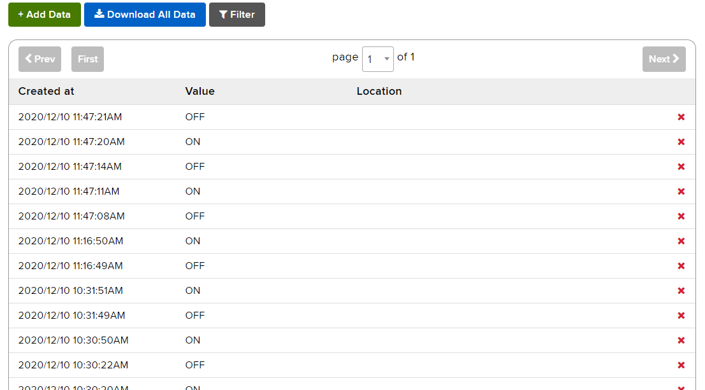
.
Built a data feed which analyses and stores the open-closing time of the lock and count the number of time it has been accessed.

Slide 14
CODE
#include <ESP8266WiFi.h>
#include "Adafruit_MQTT.h"
#include "Adafruit_MQTT_Client.h"
const char *ssid = "k"; // Enter your WiFi Name
const char *pass = “*****"; // Enter your WiFi Password
WiFiClient client;
#define MQTT_SERV "io.adafruit.com"
#define MQTT_PORT 1883
#define MQTT_NAME "akashsinghh"
#define MQTT_PASS “*******************" // Enter the API key that you copied from your adafrui IO account
#define relay D5
#define buzzer D6
Adafruit_MQTT_Client mqtt(&client, MQTT_SERV, MQTT_PORT, MQTT_NAME, MQTT_PASS);
//Set up the feed you're subscribing to
Adafruit_MQTT_Subscribe Lock = Adafruit_MQTT_Subscribe(&mqtt, MQTT_NAME "/f/Lock");

Slide 15
.
void setup()
{
Serial.begin(115200);
delay(10);
mqtt.subscribe(&Lock);
pinMode(relay, OUTPUT);
pinMode(buzzer, OUTPUT);
digitalWrite(relay, LOW); // keep motor off initally
Serial.println("Connecting to ");
Serial.println(ssid);
WiFi.begin(ssid, pass);
while (WiFi.status() != WL_CONNECTED)
{
delay(500);
Serial.print("."); // print ... till not connected
}
Serial.println("");
Serial.println("WiFi connected");
}

Slide 16
.
void loop()
{
MQTT_connect();
Adafruit_MQTT_Subscribe * subscription;
while ((subscription = mqtt.readSubscription(5000)))
{
if (subscription == &Lock)
{
//Print the new value to the serial monitor
Serial.println((char*) Lock.lastread);
if (!strcmp((char*) Lock.lastread, "Close"))
{
digitalWrite(relay, LOW);
Serial.print("Door Unlocked");
digitalWrite(buzzer, HIGH);
delay(2000);
digitalWrite(buzzer, LOW);
}

Slide 17
.
if (!strcmp((char*) Lock.lastread, "Open"))
{
digitalWrite(relay, HIGH);
Serial.print("Door Closed");
digitalWrite(buzzer, HIGH);
delay(2000);
digitalWrite(buzzer, LOW);
}
}
}
}
void MQTT_connect()
{
int8_t ret;
// Stop if already connected.
if (mqtt.connected())
{
return;
}

Slide 18
.
uint8_t retries = 3;
while ((ret = mqtt.connect()) != 0) // connect will return 0 for connected
{
mqtt.disconnect();
delay(5000); // wait 5 seconds
retries--;
if (retries == 0)
{
// basically die and wait for WDT to reset me
while (1);
}
}
}

Slide 19
Future Scope/Application of the Project:-
This drawer locking system can further be used as a safety product for all kinds of drawers/lockers in public places for high end security for the users who can get covid positive by getting in contact with a key which has been intervened by an unknown covid positive person.
This product can have a huge impact in the contactless based applications for the lock industry and can be further made for commercial use.
This locking system can function through a high quality Smartphone app which can be further researched in order to built and create a great secured product. We could add a few new features to the product further down the line such as:-
Password protection through eye scanner.
Daily notification-based GUI.
Anti-theft alarm or notification on unauthorised access etc.
Parental access control.

Slide 20
Result And Discussion
At the end of this project, we deliver a market ready circuit box that can be mounted on any drawer or locker or a door that is needed to be secured. It is operated by an application that is specifically built in order to use this device. You can password - protect it as well as give access only to the users you approve for.
We learned the basic applications of IOT and how to use an esp8266 wifi module that is operated at 3.3v.
Overall, we evaluate this project to be a great source of learning and we hope that this product fulfills all the safety requirements of its consumers.

Slide 21
Conclusion
As the project uses IOT based solution, it makes it a quicker and a better prospects in terms of existing locks in the market.
The advantages that the lock provides to the end user makes this locking system a viable option for all kind of consumers having personal belongings which they could not afford to loose.
At the same time we feel that there is no need to buy those expensive password protected vaults. Instead, using a simple and a reliable product like the contactless, automatic drawer lock can save huge amount of expenses for the consumers whose major concern is a low-cost, high-end safety solution.

Slide 22
References
[1] Arun Cyril Jose, Reza Malekian, Member, IEEE, Ning Ye “Improving Home Automation Security; Integrating Device Fingerprinting into Smart Home”DOI 10.1109/ACCESS.2016.2606478,IEEE Access.
[2] Neeraj Khera, Amit Verma “Development of an Intelligent System for Bank Securiety”2014 5th International Conference-Confluence The Next Generation Information Technology Summit(Confluence).
[3] Ashutosh Gupta, Prerna Medhi, Sujata Pandey, Pradeep Kumar, Saket Kumar, H.P.Singh “An Efficient Multistage Security System for User Authentication” International Conference on Electrical, Electronics and Optimization Techniques (ICEEOT)-2016.
[4] S.Tanwar, P.Patel, K.Patel, S.Tyagi, N.Kumar, M.S.Obaidat “An Advanced Internet of Thing Based Security Alert System for Smart Home”fellow of IEEE and Fellow of SCS.

Slide 23
.
[5] Mrutyunjaya Sahani, Chiranjiv Nanda, Abhijeet Kumar Sahu and Biswajeet Pattnaik “Web-Based Online Embedded Door Access Control and Home Security System Based on Face Recognition” 2015 International Conference on Circuit, Power and Computing Technologies [ICCPCIT].
[6] Srivatsan Sridharan “Authenticated Secure Bio-metric Based Access to the Bank Safety Lockers”ICICES2014- S.A.Engineering college, Chennai, Tamil Nadu, India, ISBN No.978-1-4799-3834-6/14
[7] https://www.instructables.com/id/Add-an-IOT-Lock-to-ANY-Drawer/
[8] https://www.instructables.com/howto/12V+power+supply/
[9] https://z-wavealliance.org/smart-lock-system-designed-safety-natural-disasters-wins-z-wave-iot-contest/

Slide 24
.
Thank You…!!!

Slide 25

A quick video on how the lock works?

