Slide 1
STUDY ON CAREER SATISFACTION AND ITS INFLUENCING DYNAMICS

Slide 2

THE MAHARAJA SAYAJIRAO UNIVERSITY OF BARODA
FACULTY OF SCIENCE
DEPARTMENT OF STATISTICS
STUDY ON CAREER SATISFACTION AND ITS INFLUENCING DYNAMICS
Presented By:
Bhagyashree Patil
Tanvi Salat
Rajeshwari Rajodia
Akash Deshmukh
Guided By:
Dr. (Mrs.) Khimiya Tinani

Slide 3
Contents
Introduction
Objectives
Questionnaire
Sampling Methodology
Data Visualization
Statistical Analysis
Conclusion
References

Slide 4
Introduction
Career is defined by the Oxford English Dictionary as an individual’s “course or progress through life (or a distinct portion of life)”. It is usually considered as pertain to remunerative work and sometimes also formal education.
Satisfaction is a feeling, emotion or a state of mind. It is experienced when a desire or a need is fulfilled. A person feels satisfied by accomplishment, recognition, invention and service.
So the term career satisfaction can be studies as
Career satisfaction = Personal fulfilment + Career progress

Slide 5
Problem Statement:
In this study the problem statement should be “To investigate the career satisfaction level with all necessary factors influencing career satisfaction based on their career selection”. If there is a failure in choosing the right career, it can lead to unhappiness and lack of productivity. Hence is important to know and be aware of what career should be chosen to lead a content life.
Rationale:
What also motivated to carry out study was the knowledge of current scenario where people face problems later in the life due to career. The motive is to carry out the study that investigates factors that lead to career satisfaction among under and post Graduate students of The Maharaja University of Baroda.
Significance:
The study may help departments of the university to develop or improve the quality of curriculum and teaching. The data collected while survey will be beneficial for another parallel study on building “Higher Education Recommendation System” to help students guide and recommend course based on the satisfaction level along with the aptitude, personality and other requirements.

Slide 6
Therefore the key information we are trying to collect in our study is about:
Demographic characteristics of an individual
Education based progress
Professional advancement
Growth within the journey of career
Satisfaction level with their career decision
Factors influencing the satisfaction
Satisfaction level with the curriculum program they acquire
Career path journey
Reasons for not working

Slide 7
CAREER SATISFACTION
Education
Skills and Utilization
Interest
Prestige
Opportunity
Social Capital
Growth
Personality

Slide 8
Objectives
To study factors influencing career satisfaction
To measure the level of career satisfaction amongst various disciplines.
To access the adequacy of curriculum in formal education and recommend (if any) to educational authority.
Comparative study of career satisfaction of working and non-working people.
To check dependency of Career Satisfaction of working and non-working over gender, marital status, year of experience etc.
Comparison of career satisfaction of working people with their working sector.

Slide 9
Limitations:
Research is limited on the ones having Physics- Chemistry-Maths group of Science in HSC.
Students from Faculty of Science & Faculty of Technology and Engineering from The Maharaja Sayajirao University of Baroda are considered under this study.
Taking pass outs of year 2014 to 2018.
Couldn’t differentiate the proportion for bachelor and masters students due to overlapping of students in master.

Slide 10
Questionnaire
Questionnaire

Slide 11
Sampling Methodology
Target population: Pass outs of Maharaja Sayajirao University from 2014 to 2018 batch.
Sampling Technique:
Two stage sampling:
Proportional Stratified Sampling department wise
Proportional Stratified Sampling year wise
Sample will be collected by SRS.

Slide 12
Total Passus of each Department(Strata)
Ni
Proportional Stratified Sampling
Sample size of each department (Strata)
ni
Proportional Stratified Sampling
2014
2015
2016
2017
2018
ni1
ni2
ni3
ni4
ni5

Slide 13
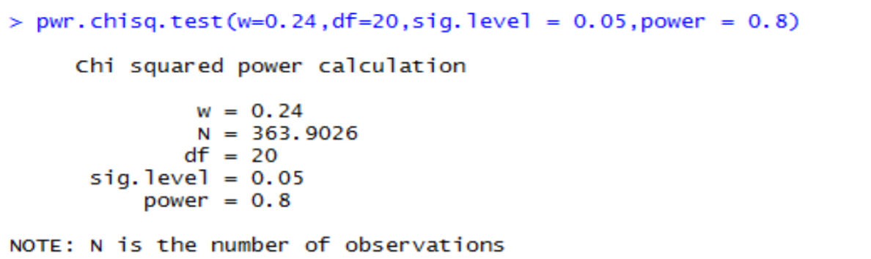
Sample size Determination:
Using Power package in R for each of the objective of our study we have determined the sample size corresponding to the appropriate statistical tool.
Example:
For determining the effective sample size in order to achieve the required accuracy in chi-square tests, we use pwr.chisq.test (w =, N = , df = , sig.level =, power = ) Where w is the effect size = 0.24 (according to Cohen’s convention of medium effect size) df is the degrees of freedom = 20, power = 0.8, ε = Margin of error = 0.05

Slide 14
Sr.no | OBJECTIVES | Tools | SAMPLE SIZE
1 | Comparison of career satisfaction between private, gov. sector and business | ANOVA | 57
2 | Comparison of career satisfaction between working and non-working people | Z-test | 274
3 | comparison of career satisfaction between male and female | Z-test | 274
4 | Comparison of career satisfaction between occupation (Self-employed and job) | Z-test | 274
5 | To check the association of career satisfaction with respect to Gender | Chi -square test | 207
6 | To check the association of career satisfaction with respect to marital status. | Chi -square test | 301
7 | To check the association of career satisfaction with respect to Grade of final education. | Chi -square test | 364
8 | To check the association of career satisfaction with respect to working experience. | Chi -square test | 335
9 | Comparison career satisfaction amongst various disciplines. (Professional and Non-professional) | Z-test | 274

Slide 15

Sample size determination by using proportional stratified sampling for each strata (department)
$n_{i}=\frac{n_{(srswor)}N_{i}}{N}$
Where,
N = Total Students Passed their final education in 2014 to 2018
Ni = Total Students Passed their final education in 2014 to 2018 in each Department
n(srswor) = Sample size of the total population
ni = Sample size of each department based on proportion

Slide 16
Department name |  | Sample Size
 | Total=Ni | 364 | Round off
Physics | 1167 | 43.2927 | 43
Chemistry | 1924 | 71.37546 | 71
Geography | 313 | 11.6115 | 12
Geology | 483 | 17.91806 | 18
Mathematics | 1859 | 68.96413 | 69
Statistics | 468 | 17.6616 | 18
Environmental Science | 530 | 19.66164 | 20
Civil Engineering | 632 | 23.44558 | 23
Mechanical Engineering | 384 | 14.24541 | 14
Electronic Engineering | 215 | 7.975948 | 8
Electric Engineering | 393 | 14.57929 | 15
Chemical Engineering | 268 | 9.942112 | 10
Computer Engineering | 401 | 14.87607 | 15
Textile Engineering | 353 | 13.09539 | 13
Metallurgical & material Engineering | 252 | 9.348553 | 9
Water Management and Irrigation | 170 | 6.306563 | 6
 | 9812 |  | 364
Based on sample size of each department and for 364 sample points using Simple Random Sampling (SRS), proportions for each dept(strata) is obtained

Slide 17
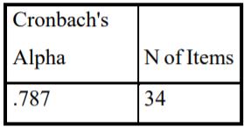
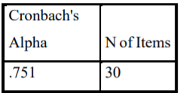
Reliability Of Questionnaire
Cronbach’s coefficient α was used to calculate the internal consistency coefficients of the items included in the questionnaire through a pilot study with working and non-working people. Cronbach’s alpha is the most common measure of internal consistency (reliability). It is widely used when you have multiple Likert questions in a survey questionnaire. It is an important indicator of the reliability of psychometric test. In the research study, the reliability of Cronbach alpha should lie between the value of 0.7 to 0.9 for consistent and reliable
Reliability Statistics (for Working):
Reliability Statistics (for Non-Working):

Slide 18
Data Visualization
Observation:
The above line diagram shows the status of career satisfaction among the various departments of Science and Technology faculty taken into study. The highest career satisfaction is observed in the Statistics from science faculty followed by Mechanical and Textile Engg. department of Technology faculty. While Metallurgy Dept shows the lowest satisfaction in their career

Slide 19
Observation:
The above bar chart shows the career satisfaction in Non -Professional courses for both working and non-working respondents. The blue bars show the working respondents and orange bar is for non-working ones. Y- axis shows the career satisfaction and x - axis contains the departments under non-professional courses. Looking on the graph it can be observed that in majority of the departments, the ratio for working and non-working has very slight difference in career satisfaction. Like career satisfaction in Geography dept. is same for working and non-working both and in Chemistry dept., Env. Science dept., Mathematics and Physics dept. career satisfaction is above average and very less difference between working and non-working ones. The lowest career satisfaction is observed in Geology category of non-working people. While in Statistics dept. there is a highest career satisfaction among all the depts. and showing no non-working respondents

Slide 20
Observation:
The above bar graph shows the career satisfaction in professional courses for Working and non-working respondents. The green bars are for working people and grey bar is showing non-working respondents.

Slide 21
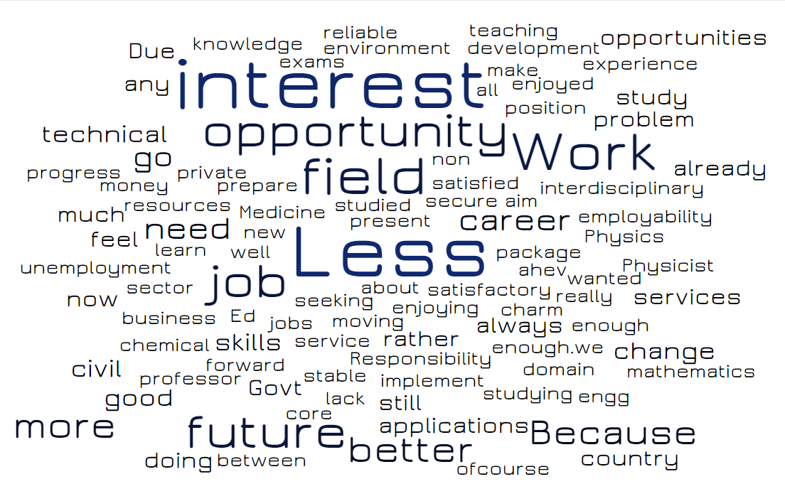
Word Cloud
1. Reasons for NOT continuing the current career:
Observation:
As you can see here is a word cloud showing the highest frequency of words by the size and colour. The words in bigger size are “interest”, “Less”, “opportunity”, “work”, “field”, “job”, “future” “better”, “change”, etc. By this we mean that the ones who don’t want to continue with their current career are may be due to the reasons that they find it less interesting, or less career opportunity, no better future, less jobs, less satisfies in this field, or a study problem, don’t find it a secure career, want to change it or go to different place.

Slide 22

2. Reasons for continuing the current career:
:
Observation:
From the above word cloud the reasons for continuing with the word cloud shows the words like “career”, “Satisfies”, “job”, “work”, “satisfies”, “yes”, “field”, “good”, “like”, “ present”, “passion”, “environment”, “opportunity”, “happy” and many such positive words. From that we can see that they are more satisfied and happier with their job. They like their work and the environment.

Slide 23

3. access the adequacy of curriculum in formal education and to educational authority.
Observation:
On asking our respondents on what they need to have better exposure to while studying, for better career performance then the words mostly used were “soft skills”, “applications”, “practical session”, “better choices”, interactive” “session”, etc. Hence, we can conclude that students while studying need more of interactive session, practical session, applications, learn Soft skills so on. Hence, we recommend were “soft skills”, “applications”, “practical session”, “better choices”, interactive” “session” to educational authority

Slide 24
Career Satisfaction Graphical Representations With Respect Others Factors
Excel Dashboard

Slide 25
Statistical Analysis
1. Z – Test
Objective: Comparative study of career satisfaction of working and non-working people.
To Test:
H0: The mean career satisfaction among working respondents and non-working is equal.
Vs
H1: The mean career satisfaction among working respondents and non-working is not equal.
Python Code:
Output:
Z = 2.771
P = 0.00557 , alpha =0.05
Observation: since |Z| >= to Z Critical (1.95) also p-value <= alpha (0.05), we have enough evidence to reject the null hypothesis.
Conclusion: Hence we conclude that mean career satisfaction among working and non-working is not same
z, p = twosampz(3.669,3.449,0,0.337,0.449,275,89)
(z, p)

Slide 26
Comparison of career satisfaction for working people
 |  | Z statistic | P value | Alpha value | Decision | Conclusion
Male | Female | 2.049 | 0.0404 | 0.05 | Reject Ho at 5% l.o.s | Mean career satisfaction among male and female is not same.
Self employed | Job | 0.654 | 0.0003 | 0.05 | Reject Ho at 5% l.o.s | Mean career satisfaction among self employed and job is not same.
Professional Course | Non- Professional Course | -0.541 | 0.5885 | 0.05 | do not Reject Ho at 5% l.o.s | Mean career satisfaction among Professional Course student and Professional student is same.
Field work | Office work | 0.24 | 0.8099 | 0.05 | do not Reject Ho at 5% l.o.s | Mean career satisfaction of respondents engaged in field work and office work is same.

Slide 27
Comparison of career satisfaction for Non working people
 |  | Z statistic | P value | Alpha value | Decision | Conclusion
Male | Female | 0.393 | 0.69373 | 0.05 | do not Reject Ho at 5% l.o.s | Mean career satisfaction among male and female is same.
Professional Course | Non- Professional Course | -2.204 | 0.0275 | 0.05 | Reject Ho at 5% l.o.s | Mean career satisfaction among Professional Course student and Professional student is not same.

Slide 28
2. Chi-square Test For Independence Of Attribute
Hypotheses:
Ho: The relative proportions of one variable are independent of the second variable
against
H1: The relative proportions of one variable are not independent of the second variable
Test statistic:
The general formula for G is
𝑮=𝟐Σ𝑶𝒊.𝐥𝐧(𝑶𝒊/𝑬𝒊)
Where, 𝑂𝑖≥0 is the observed count in a cell, 𝐸𝑖>0 is the expected count under the null hypothesis, denotes the natural logarithm, and the sum is taken over all non-empty cells. Furthermore, the total observed count should be equal to the total expected count:
𝑂𝑖= 𝐸𝑖=𝑁
Where 𝑁 is the total numbers of observations

Slide 29
Cramer's V:
In statistics, Cramer's V is a measure of association between more than two nominal variables, giving a value between 0 and +1. Close to 0 it shows little association between variables. Close to 1, it indicates a strong association.
Where, 𝜒2 = chi-square value, n = sample size, r = the number of rows, c = the number of columns. The expression “min (r-1, c-1)” means that the number of rows and columns is reduced by 1.
Python code:
data=pd.read_excel(r'C:\Users\HOME\Downloads\FULL FINAL DATA- CS.xlsx','working')
data.head()
crosstab,res,expected=rp.crosstab(data['gender'],data['round_mean'],test="g-test",expected_freqs=True)
print(crosstab)
print(res)
print(expected)

Slide 30
1) Objective: To check the dependency of career satisfaction of working people on Gender. To Test:
Ho: career satisfaction of working people is independent of gender.
Vs
H1: career satisfaction of working people is not independent of gender
Observed Frequency Expected Frequency
G-test results
Log-likelihood ratio ( 3.0) = 10.7835
p-value = 0.0130
Cramer's V = 0.1980
Conclusion: As p-value < alpha, therefore the data provide enough evident to reject H0 at 5% l.o.s. Hence, we conclude that career satisfaction of working people is not independent of gender.
Hence fore we refer Cramer’s v value. Thus, there is 19.80% association between gender and career satisfaction of working people.
G-test for working people on different attributes like gender, years of experience, marital status, percentage/CGPA in the last degree of their educational background, satisfaction on decision of choosing science stream in TABLE-1.
G-test for non-working people on different attributes like gender, marital status, percentage/CGPA in the last degree of their educational background in TABLE-2.
Gender | 2 | 3 | 4 | 5 | ALL
1 | 7 | 47 | 133 | 6 | 193
2 | 1 | 36 | 43 | 2 | 82
All | 8 | 83 | 176 | 8 | 275
Gender | 2 | 3 | 4 | 5
1 | 5.6145 | 58.251 | 123.52 | 5.6145
2 | 2.3855 | 24.749 | 52.48 | 2.3855

Slide 31
TABLE-1 Working people
Attribute | Category | VS | Attribute | Category | Log-likelihood ratio | p-value | Decision | Conclusion | Association
Career satisfaction score | 2 | VS | Gender | Male | 10.7835 | 0.013 | Reject H0 at 5% l.o.s. | not independent of gender | 19.80%
 | 3
 | 4 |  |  | Female
 | 5
Career satisfaction score | 2 | VS | years of experience | 1 | 10.0903 | 0.608 | do not reject H0 at 5% l.o.s. | independent of years of experience | No Association
 | 3 |  |  | 2
 | 4 |  |  | 3
 | 5 |  |  | 4
 |  |  |  | 5
Career satisfaction score | 2 | VS | grades | 40-49 | 11.6508 | 0.7052 | do not reject H0 at 5% l.o.s. | independent of grades | No Association
 | 3 |  |  | 50-59
 | 4 |  |  | 60-69
 | 5 |  |  | 70-79
 |  |  |  | 80-89
 |  |  |  | 90-100
Career satisfaction score | 2 | VS | marital status | Married | 4.2376 | 0.8951 | do not reject H0 at 5% l.o.s. | independent of marital status | No Association
 | 3 |  |  | Unmarried
 | 4 |  |  | divorcee
 | 5 |  |  | Widowed
Career satisfaction score | 2 | VS | decision of choosing science stream as a career | 1 | 20.9185 | 0.0516 | do not reject H0 at 5% l.o.s | independent of satisfaction on decision of choosing science stream. | No Association
 | 3 |  |  | 2
 | 4 |  |  | 3
 | 5 |  |  | 4
 |  |  |  | 5

Slide 32
TABLE-2 Non-Working people
Attribute | Category | VS | Attribute | Category | Log-likelihood ratio | p-value | Decision | Conclusion | Association
Career satisfaction score | 2 | VS | Gender | Male | 1.2082 | 0.751 | Do not reject H0 at 5% l.o.s | independent of gender | No Association
 | 3
 | 4 |  |  | Female
 | 5
Career satisfaction score | 2 | VS | marital status | Married | 7.8227 | 0.0498 | Reject H0 at 5% l.o.s | dependent of marital status | 29.65%
 | 3 |  |  | Unmarried
 | 4 |  |  | divorcee
 | 5 |  |  | Widowed
Career satisfaction score | 2 | VS | grades | 40-49 | 12.1406 | 0.6684 | Do not reject H0 at 5% l.o.s. | independent of grades | No Association
 | 3 |  |  | 50-59
 | 4 |  |  | 60-69
 | 5 |  |  | 70-79
 |  |  |  | 80-89
 |  |  |  | 90-100

Slide 33
3. One-way Anova
Objective: Determination of whether the mean of career satisfaction score for working people in government, private and business sectors are same or not? To Test: H0: μ1 = μ2= μ3 Where • μ1 is population mean score of career satisfaction of people those who are working in business sector. • μ2 is population mean score of career satisfaction of people those who are working in government sector. • μ3 is population mean score of career satisfaction of people those who are working in private sector. The alternative hypothesis (H1) is that at least one group mean significantly differs from the other group means. Levene's test is an inferential statistic used to assess the equality of variances for a variable calculated for two or more groups. To Test: Null Hypothesis: H0: σ12 = σ22 = … = σk2 Alternative Hypothesis: H1: σi2≠ σk2 for some i and k

Slide 34
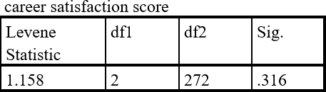
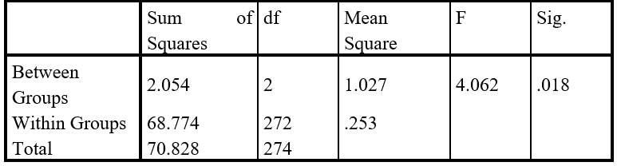
Test of Homogeneity of Variances
In the above table it is performed the Levene’s Test of Homogeneity of Variances, F (2, 272) =1.158, p = .316 With an alpha level of .05, here, p (.316) > a (.05), we do not reject H0 at 0.05 % level of significance. That means variance of all three groups are same. Assumptions of homogeneity of variance is full fill. All assumptions of one -way ANOVA is full fill. Therefor we use one-way ANOVA to compare mean of career satisfaction score for working people in government, private and business sectors.
ANOVA
career satisfaction score
F (2, 272) =4.062, p = 0.018 With an alpha level of .05, here, p (0.018) < a (.05), we reject H0 at 0.05 % level of significance. There is significance difference between mean score of career satisfaction of at least one group. That means levels of career satisfaction between people that are working in government, private and business sectors are difference.

Slide 35
4. Factor Analysis
According to data, Kaiser-Meyer-Olkin measure of sample adequacy is 0.863 which is good and acceptable.
Data is suitable for factor analysis.
Communalities Table
Total 22 variables have high extraction value between 0.40 to 0.70.
Rotated Component Matrix
Rotated component matrix minimizes the number of variables which have high loading on a factor and lead to good interpretation of factors.
Total variance explained
Six components extract 59.26% of the variance from the total information.
Scree plot
With the help of Scree plot, there are 6 components which are extracted form 23 variable and having greater than 1 eigen value
CS factor analysis (common question and working).docx

Slide 36
Conclusion
Statistics and Mechanical engineering department has the highest career satisfaction among all departments hence we can recommend students to choose their career in this field.
Statistics is only the department in our sample study that has zero unemployed individuals.
We can recommend amendment of “soft skills”, “application” “practical session”, better choices”, “interactive session” to the education authority.
Career Satisfaction of working individuals is not same as well as career satisfaction for gender and occupations is also different.
We have seen that Career Satisfaction score of male is higher than female. Therefore Career Satisfaction score of working people is dependent on gender.
People those who are working in Government sector are more satisfied than the private sector.

Slide 37

REFERNCES
Handbook of “Industrial, work & Organizational Psychology “ Edited by Neil Anderson, Deniz S.Ones,Handan kepir Snangil &Chocklingam
Career Satisfaction Survey : Assessment Originally Developed by: Larina Kase, Psy.D., M.B.A.
First Adapted and Modified by: Terry Suffredini Atkinson, PE, www.theengineerscoach.com
Further Adapted and Modified by: Doug Thorpe, MBA, www.DougThorpe.com and
www.HeadwayExec.com
https://www.careerexplorer.com/analytics/career-satisfaction
Lounsbury, J. W., Loveland, J. M., Sundstrom, E. D., Gibson, L. W., Drost, A. W. and Hamrick, F. L. 2003. “An Investigation of Personality Traits in Relation to Career Satisfaction.” Journal of Career Assessment 11:287-307.
Judge, T. A., Kammeyer-Mueller, J. and Bretz, R. D. 2004. “A Longitudinal Model of Sponsorship and Career Success: A Study of Industrial-organizational Psycho­logists.” Personnel Psychology 57:271-303.
Journal of Applied Sciences Research 1(2): 242-244, 2005© 2005, INSInet PublicationCorresponding Author: Ecevit Eyduran, Department of Animal Science, Biometry Genetics Unit, University of Yüzüncü Yil,65080 Van, Turkey.242Comparison of Chi-Square and Likelihood Ratio Chi-Square Tests: Power of Test Taner Özdemir and Ecevit Eyduran, 1 1

Slide 38
THANK YOU / IDEA / SUGGESTIONS

