Slide 1
Department of Electronics & Communication Engineering
23EXC409 MINIPROJECT I
ACADEMIC YEAR: 2025 - 2026 (EVEN)
MINIPROJECT: TITLE RESUME ANALYZER USING AI
Year / Semester: III / VI
17/04/2026
Branch / Section: EC /

Slide 2
Group Details
Name: Akaashz M Roll No : 717823L203
Name: Asishsurya Roll No : 717822L205
Name: Guna M Roll No : 717822L217

Slide 3
ABSTRACT
This project is an AI-based Resume Analyzer that evaluates resumes using Natural Language Processing (NLP) techniques. It compares resumes with job descriptions using TF-IDF and cosine similarity. The system provides a resume score, fit level, missing skills, and suggestions to improve job matching.

Slide 4
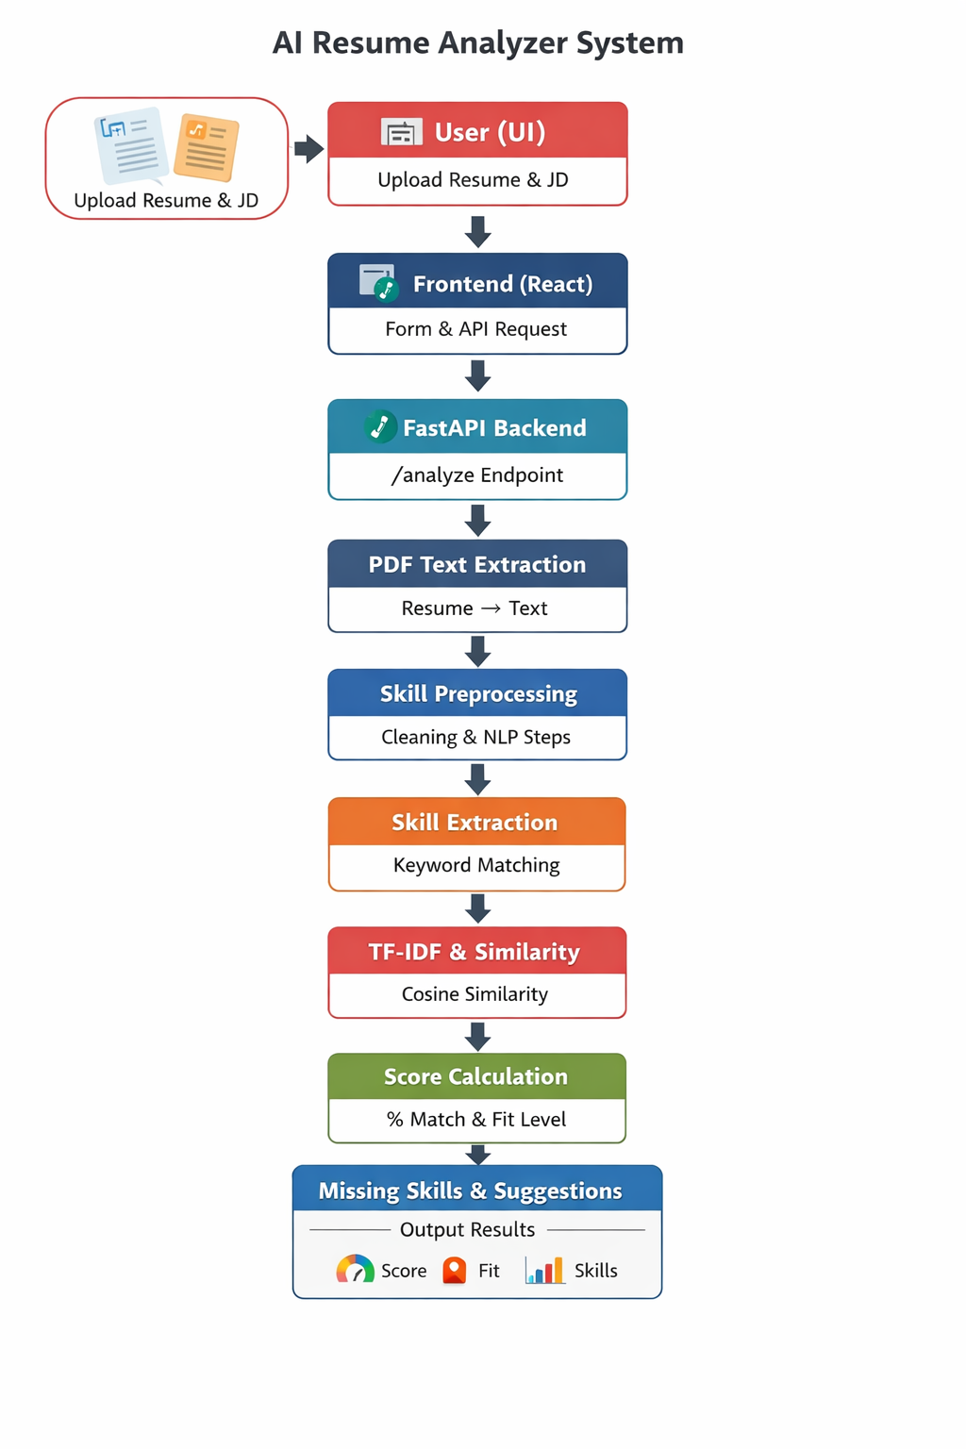
BLOCK DIAGRAM

Slide 5
COMPOENTS DETAILS
Python – Backend logic
FastAPI – API development
React – Frontend UI
Tailwind CSS – Styling
Scikit-learn – TF-IDF & similarity
NLTK – Text preprocessing

Slide 6
ABOUT THE PROJECT(Operation/Working)
Resume PDF is uploaded
Text is extracted and cleaned
Skills are identified
TF-IDF converts text into vectors
Cosine similarity calculates match
Score and suggestions are generated

Slide 7
Program Code:
Backend: FastAPI API (/analyze)
Frontend: React UI
Functions: extract_text_from_pdf()
clean_text()
calculate_similarity()

Slide 8
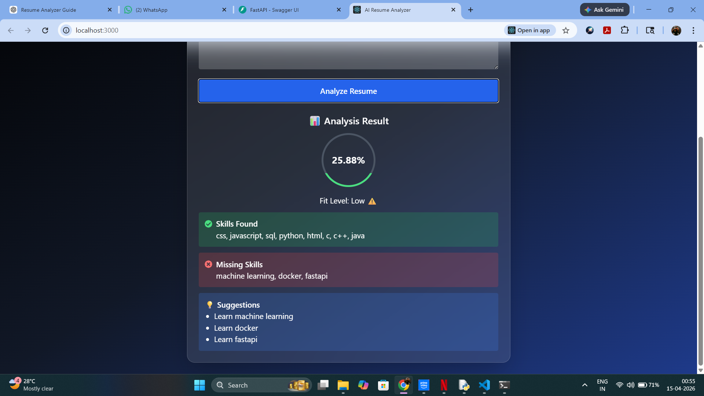
PHOTOS / VIDEOS OF THE PROJECT PROTOTYPE

Slide 9
CONCLUSION
The project successfully demonstrates an ATS-style resume analyzer using NLP and machine learning. It provides quick and efficient resume evaluation and helps improve job matching.

Slide 10
FUTURE SCOPE
Add database (MongoDB)
User login system
Deploy as web application
Improve AI model using deep learning

Slide 11
REFRENCES
Book References:
Scikit-learn Documentation
NLTK Documentation
FastAPI Documentation
Research papers on Resume Screening
Web References:
Scikit-learn Documentation 👉 https://scikit-learn.org
React Documentation 👉 https://react.dev

Slide 12
Thank you

