Slide 1
Department of Electronics & Communication Engineering
23EXC409 MINIPROJECT I
ACADEMIC YEAR: 2025 - 2026 (ODD)
SMART DESK
Year / Semester: III / V
29/10/2025
Branch / Section: EC / B

Slide 2
Group Details
Name: AKAASHZ M Roll No : 717823L203
Name: ASWIN A Roll No : 717823L206
Name: GUNA M Roll No : 717823L217
Name: RUBAN M Roll No : 717823L246

Slide 3
ABSTRACT
The Smart Desk for Students is an innovative solution designed to enhance learning efficiency, comfort, and organization in modern educational environments. This project integrates technology with traditional furniture to create an interactive and intelligent workspace for students.
The desk features components such as an automatic lighting system using LDR and IR sensors, a mobile charging station, integrated Bluetooth speaker, and temperature/humidity monitoring for a comfortable study atmosphere. It can also include features like a reminder or study timer system using an Arduino microcontroller and display unit.
By combining automation, ergonomics, and IoT-based smart features, the Smart Desk minimizes distractions, improves focus, and encourages a more productive study routine. This project demonstrates how simple electronics and microcontroller-based automation can transform conventional study setups into intelligent, student-friendly systems suitable for both classrooms and home study environments.

Slide 4
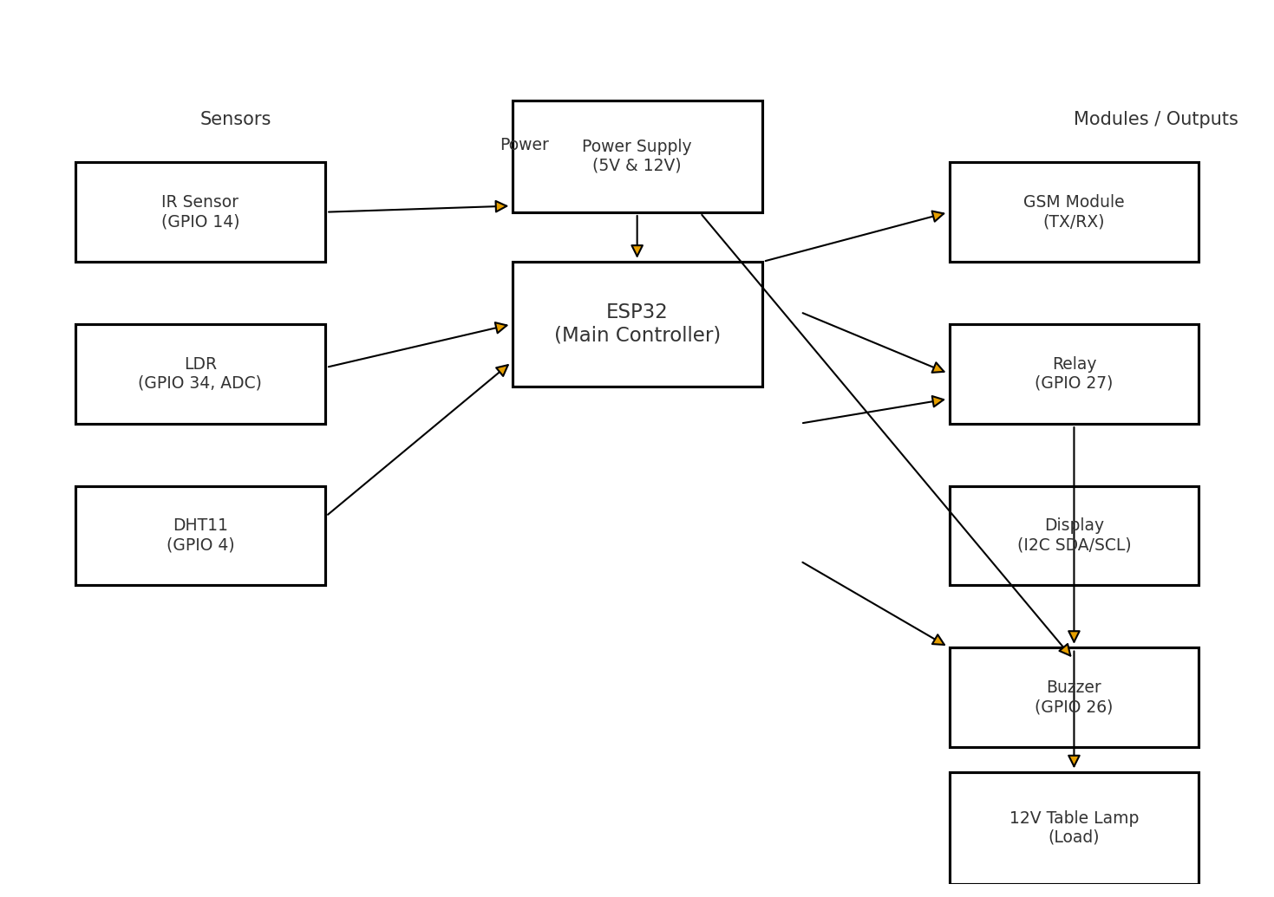
BLOCK DIAGRAM

Slide 5
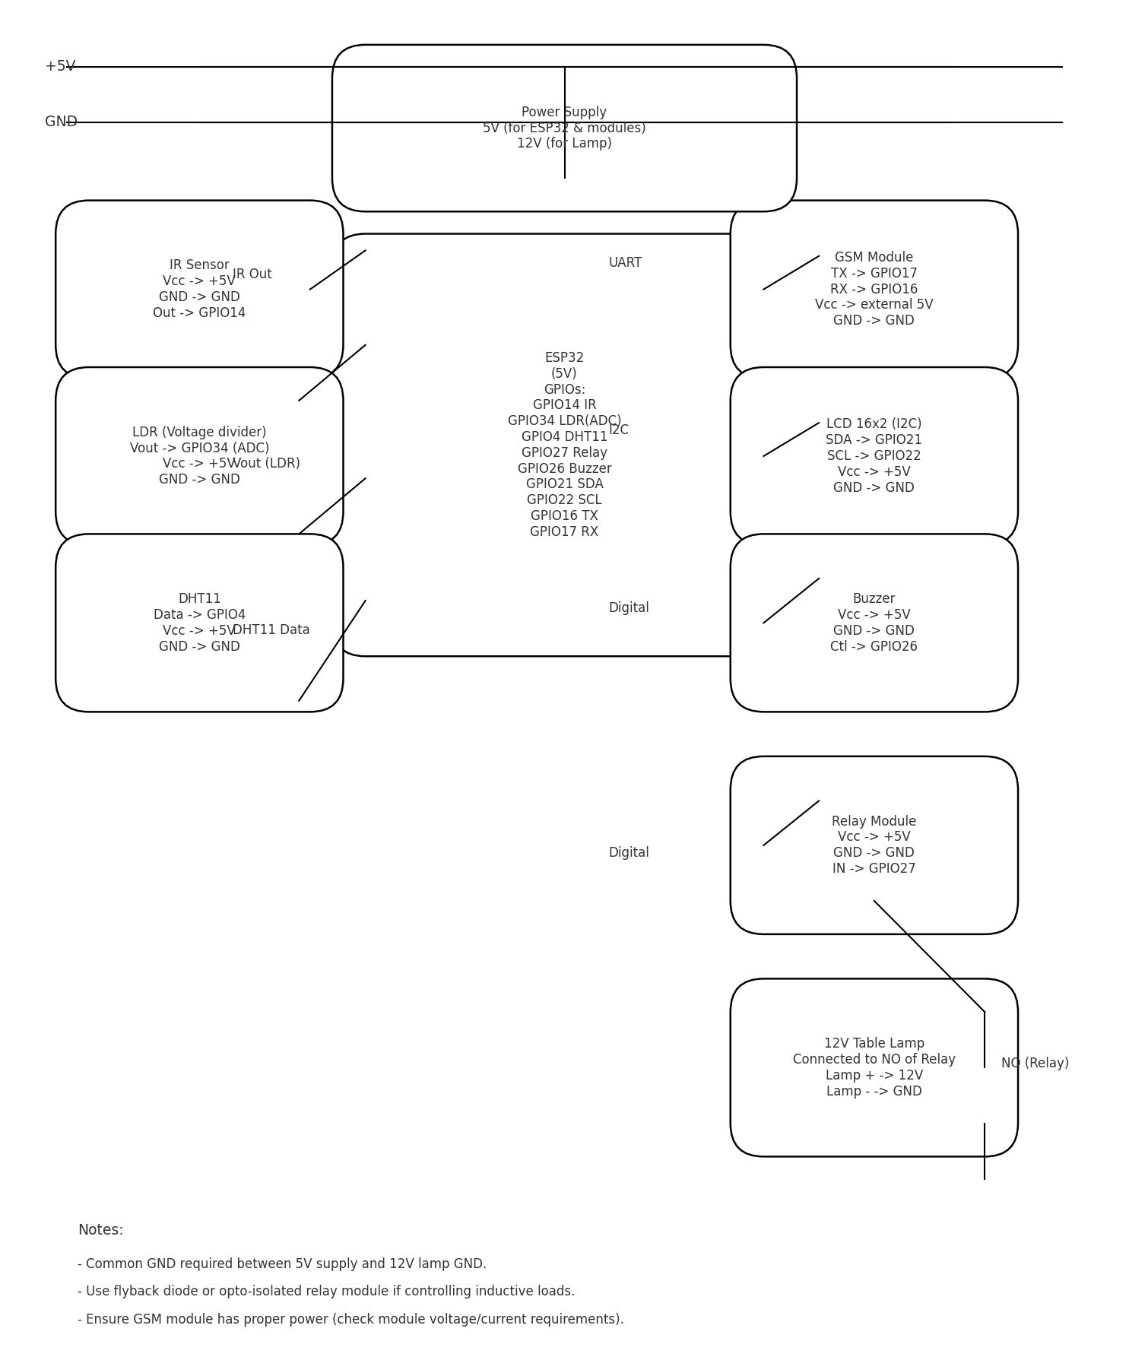
CIRCUIT DIAGRAM

Slide 6
COMPOENTS DETAILS
Arduino (main controller)
LDR/IR sensor – for automatic light control
Temperature/Humidity sensor – for environment monitoring
GSM module – for message alerts or communication
LCD display – for showing data/status
LED light/fan – controlled by Arduino
Power supply – for the whole system
Desk Lamp
Relay Module
Buzzer

Slide 7
ABOUT THE PROJECT(Operation/Working)
The Smart Desk for Students operates on the principle of sensor-based automation controlled by a microcontroller (Arduino).
The LDR/IR sensor detects ambient light levels and automatically turns the desk lamp ON or OFF to ensure proper lighting.
The temperature and humidity sensor continuously monitors the surrounding environment and displays the readings on an LCD screen for user awareness.
The GSM module enables message alerts or remote updates regarding desk status or environmental conditions.
All components are powered through a regulated power supply, and the Arduino processes sensor inputs to control output devices such as lights, fans, or indicators.
This automation enhances convenience, saves energy, and provides a smart, comfortable workspace for students.

Slide 8
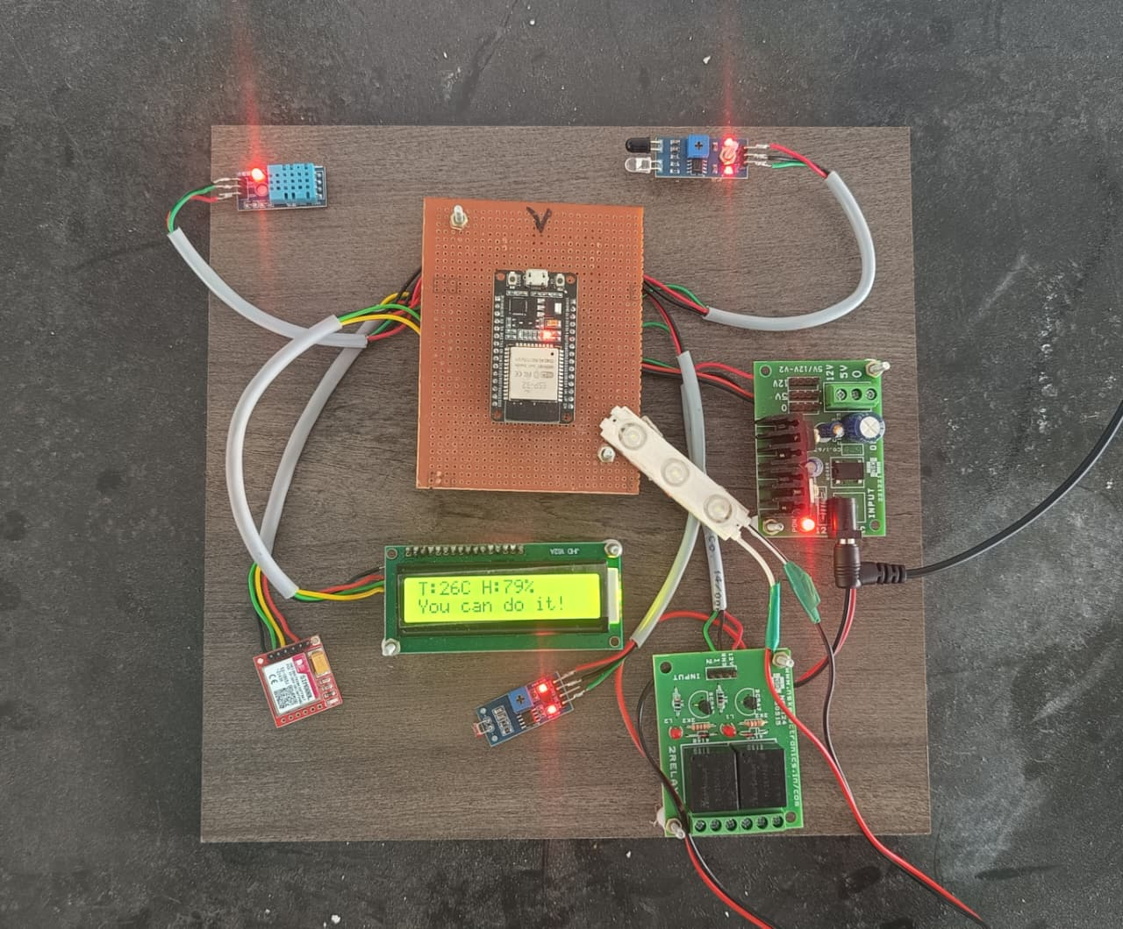
PHOTOS / VIDEOS OF THE PROJECT PROTOTYPE

Slide 9
CONCLUSION
The Smart Desk for Students successfully integrates automation and smart technology to create a modern, efficient, and student-friendly workspace.
By combining sensors, a microcontroller, and communication modules, the system provides automatic lighting control, environmental monitoring, and remote alert features.
This not only improves comfort and productivity but also promotes energy conservation and convenience.
The project demonstrates how simple electronic components can be combined to design an intelligent system that enhances the learning environment for students in both schools and homes.

Slide 10
FUTURE SCOPE
The smart desk can be integrated with IoT to allow remote monitoring and control using a
mobile app or web dashboard.
Addition of voice control using modules like Alexa or Google Assistant for hands-free
operation.
Integration of wireless charging pads for smartphones and wearables.
Implementation of motion detection to automatically power on/off devices when a student
approaches or leaves the desk.
Use of AI-based study reminders or time management features to improve focus and
productivity.
Enhanced data logging and cloud storage for tracking environmental conditions and
usage patterns

Slide 11
REFERENCES
Arduino Official Documentation – https://www.arduino.cc
GSM Module Interfacing Tutorials – Electronics Hub, Engineers Garage
IoT and Smart Automation Concepts – Research Papers from IEEE Xplore
Sensor Interfacing and Applications – All About Circuits (www.allaboutcircuits.com)
Academic Project Reports on Smart Furniture and Home Automation Systems
Instructables – “Smart Desk using Arduino and Sensors” Project – https://www.instructables.com
ResearchGate – “IoT-Based Smart Classroom and Study Desk Systems” Publications
Circuit Digest – Tutorials on Arduino-Based Automation Projects – https://circuitdigest.com

Slide 12
Thank you

