Slide 1
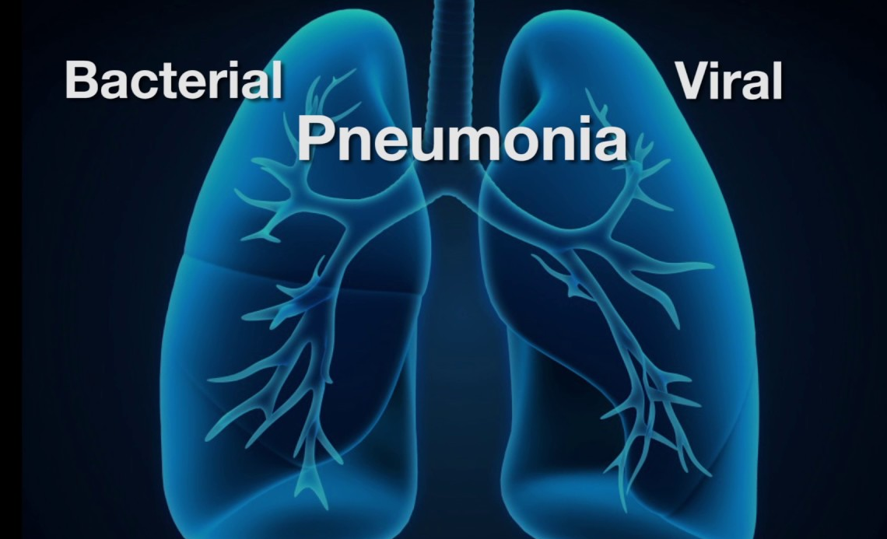
Computer Vision
Pneumonia Detection System
Aakash Banstola
banstola.1997520@studenti.uniroma1.it

Slide 2
Pneumonia Detection from Chest X-ray Images using Transfer Learning
Implementation of
Published in 2022 10th International Conference on Reliability, Infocom Technologies and Optimization (Trends and Future Directions) (ICRITO)

Slide 3
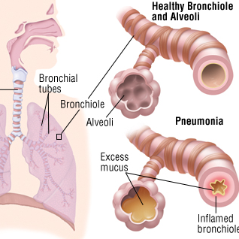
Outline
Introduction
Materials and Methods
Methodology
Dataset
Results and Discussion
Conclusion and Future Scope

Slide 4
Introduction
The paper “Pneumonia Detection from Chest X-ray Images using Transfer Learning” is about the detection of Pneumonia Disease in Human Body
Based on Transfer Learning Models called Visual Geometry Group-16 (VGG-16)

Slide 5
Pneumonia is a leading cause of morbidity and mortality, particularly among children under the age of five.
Diagnosing pneumonia through chest radiographs is a time-consuming process that requires experienced radiologists.
Statistical approaches, machine learning (ML), and deep learning (DL) techniques offer efficient methods for detecting respiratory diseases like pneumonia.
DL models, such as convolutional neural networks (CNNs), have shown promising results in analyzing medical images, including chest X-rays.
The VGG16 transfer learning model, derived from the ImageNet competition, has been widely used for pneumonia identification in chest X-ray images.
Previous studies have compared various DL models and identified VGG16 as one of the best performers in pneumonia detection.

Slide 6
Transfer Learning
Transfer learning is a technique in machine learning and deep learning that enables the use of pre-trained models to solve new tasks. In transfer learning, knowledge gained from solving one problem is transferred and applied to solve a different but related problem.
Transfer learning can save significant time and resources compared to training a new model from scratch, particularly in deep learning, where training large models on big datasets can be computationally expensive.
How transfer learning allows leveraging pre-trained models for new tasks?

Slide 7
Convolutional Neural Networks (CNN)
Convolutional Neural Networks (CNNs) have revolutionized image recognition tasks by leveraging their ability to automatically learn and extract meaningful features directly from raw pixel data. In this presentation, we explored the effectiveness of CNNs in image recognition
The architecture of a CNN allows it to automatically learn hierarchical representations of the input image, starting from low-level features (e.g., edges, textures) in early layers and gradually capturing more abstract and high-level features (e.g., shapes, objects) in deeper layers. This hierarchical feature learning capability is what makes CNNs highly effective in image recognition tasks.

Slide 8
VGG16
The VGG16 architecture is a widely used deep learning model for image classification tasks. In this presentation, we will explore the key components and design principles of VGG16 in a single slide.
Input Size: VGG16 requires input images of size 224x224 pixels.
Convolutional Layers: The architecture consists of multiple stacks of convolutional layers. Each stack uses a 3x3 filter for convolution, along with 1x1 convolution filters. The stride for convolution is fixed at 1 pixel.
Pooling Layers: After each stack of convolutional layers, a pooling layer is applied. The pooling layer operates on a 2x2 pixel architecture, with a stride of 2.
Dense Layers: The number of dense layers can be adjusted based on the specific requirements of the task.
Activation Function: The VGG16 architecture uses the Rectified Linear Unit (ReLU) as the activation function, providing non-linearity and enabling the network to learn complex patterns.

Slide 9
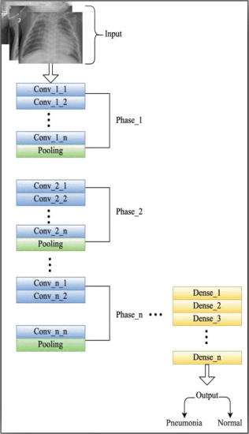
VGG16 Framework

Slide 10
Dataset Description
In this presentation, we will provide an overview of the dataset used for training and testing a pneumonia detection model. The dataset was collected from Kaggle and consists of two main folders: "train" and "test."
Each folder contains subdirectories with pneumonia radiographs and normal lung radiographs. The dataset comprises a total of 5,856 radiographs obtained from pediatric patients aged 1 to 5 years.

Slide 11
Dataset Description
To prepare the dataset for training and testing, the data categories were reviewed and combined, resulting in a restructured dataset.
For model evaluation, 4,685 radiographs were assigned to the training phase, while 1,171 radiographs were used for testing purposes. The dataset is publicly available in JPEG format, making it accessible worldwide.

Slide 12
Dataset Description
Data preprocessing involves normalizing the images and balancing the training dataset to avoid overfitting. Image augmentation is performed to create new training samples by applying various transformations such as resizing, rotation, shifts, and flips.
An oversampling technique is implemented to address the imbalanced nature of the training dataset, preventing overfitting and underfitting issues. The model architecture is defined, and a custom dataset is created to store the data frame and image transformations.

Slide 13
Methodology
In this presentation, we will discuss the various components and steps involved in implementing the VGG 16 transfer learning model for pneumonia detection.
The key components include image augmentation, feature extraction, data preprocessing, data augmentation, oversampling technique implementation, and model training and testing.

Slide 14
Methodology
The initial analysis reveals that the training dataset is imbalanced, with a significant amount of pneumonia data and fewer samples of normal lungs.
The test dataset, however, is balanced. To address this, data augmentation techniques are used to balance the training dataset by generating additional images from the existing samples.

Slide 15
Methodology
The model is then trained on the balanced training dataset, and the best model state is selected based on the validation loss. Loss and metric values are tracked and displayed at the end of each epoch during training.
By following these steps, the VGG 16 transfer learning model is utilized effectively for pneumonia prediction, improving the performance and accuracy of the model in detecting pneumonia from chest radiographs.

Slide 16
Model Training and Training
In this phase of the architecture, the complete model is trained on the training dataset. Depending on the value of validation loss, it helps in selecting the best model state.
This step results in showing and displaying a loss and metric values at the end of every epoch as shown in following:

Slide 17
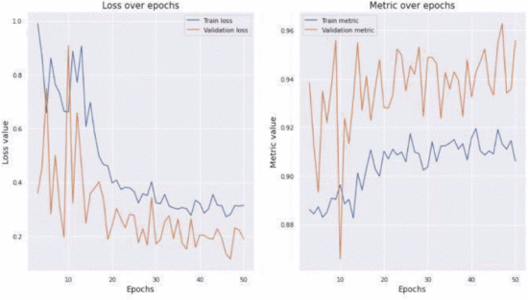

Slide 18
Results and Discussion
This section compares the performance of the VGG 16 transfer learning model with other existing models mentioned in the state-of-the-art section in terms of their accuracy, precision, recall and F l-score parameters.
Accuracy is a parameter for predicting the performance of the ML and DL models. It is the percentage of predictions that the model has predicted correctly.

Slide 19
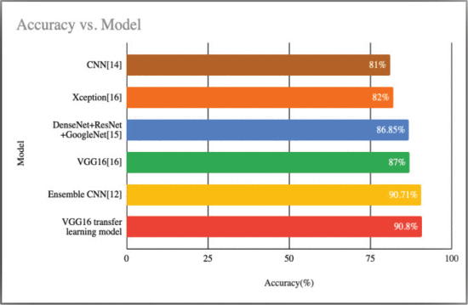
Accuracy Comparison of Different Models

Slide 20
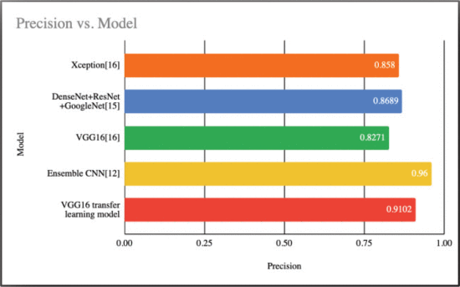
Precision Comparison of Different Models

Slide 21
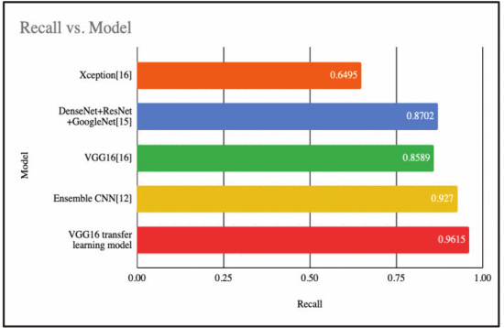
Recall Comparison of Different Models

Slide 22
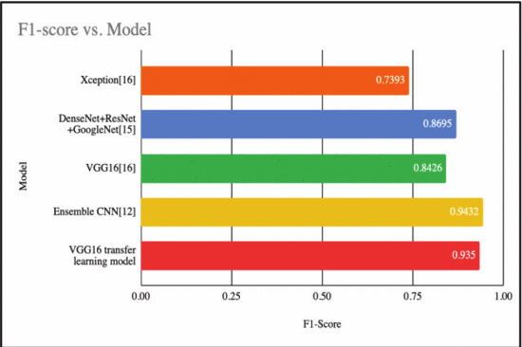
F1-score Comparison of Different Models

Slide 23
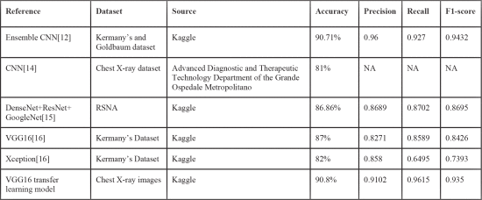
Performance Comparison of Different DL Models

Slide 24
Results and Discussion
This section compares the performance of the VGG 16 transfer learning model with other existing models mentioned in the state-of-the-art section in terms of their accuracy, precision, recall and F l-score parameters.
Accuracy is a parameter for predicting the performance of the ML and DL models. It is the percentage of predictions that the model has predicted correctly.

Slide 25
Conclusion
In this presentation, we conclude our work on using a CNN model with VGG16 for classifying pneumonia chest x-ray images. Pneumonia is a respiratory infection that can range from non-threatening to fatal, and early detection is crucial for reducing the mortality rate.
Our model achieved promising results with an accuracy of 90.8% and high precision, recall, and F1-score values. By leveraging the power of deep learning and the VGG16 architecture, we successfully classified pneumonia and normal lung images.

Slide 26

Future Improvements
For future improvements, the following areas can be explored:
Dataset Expansion: Increasing the size of the dataset can provide a more diverse set of images and potentially improve the model's performance.
Ensemble Learning: Utilizing an ensemble of deep learning models can enhance feature extraction and lead to better classification results.
Model Optimization: Fine-tuning hyperparameters, experimenting with different architectures, and exploring other pre-trained models can further improve the model's effectiveness.
Real-time Implementation: Extending the model for real-time pneumonia detection in clinical settings can aid in early diagnosis and treatment.
By continuously advancing our research and incorporating these future prospects, we can enhance the accuracy, efficiency, and impact of pneumonia detection using deep learning techniques.

Slide 27
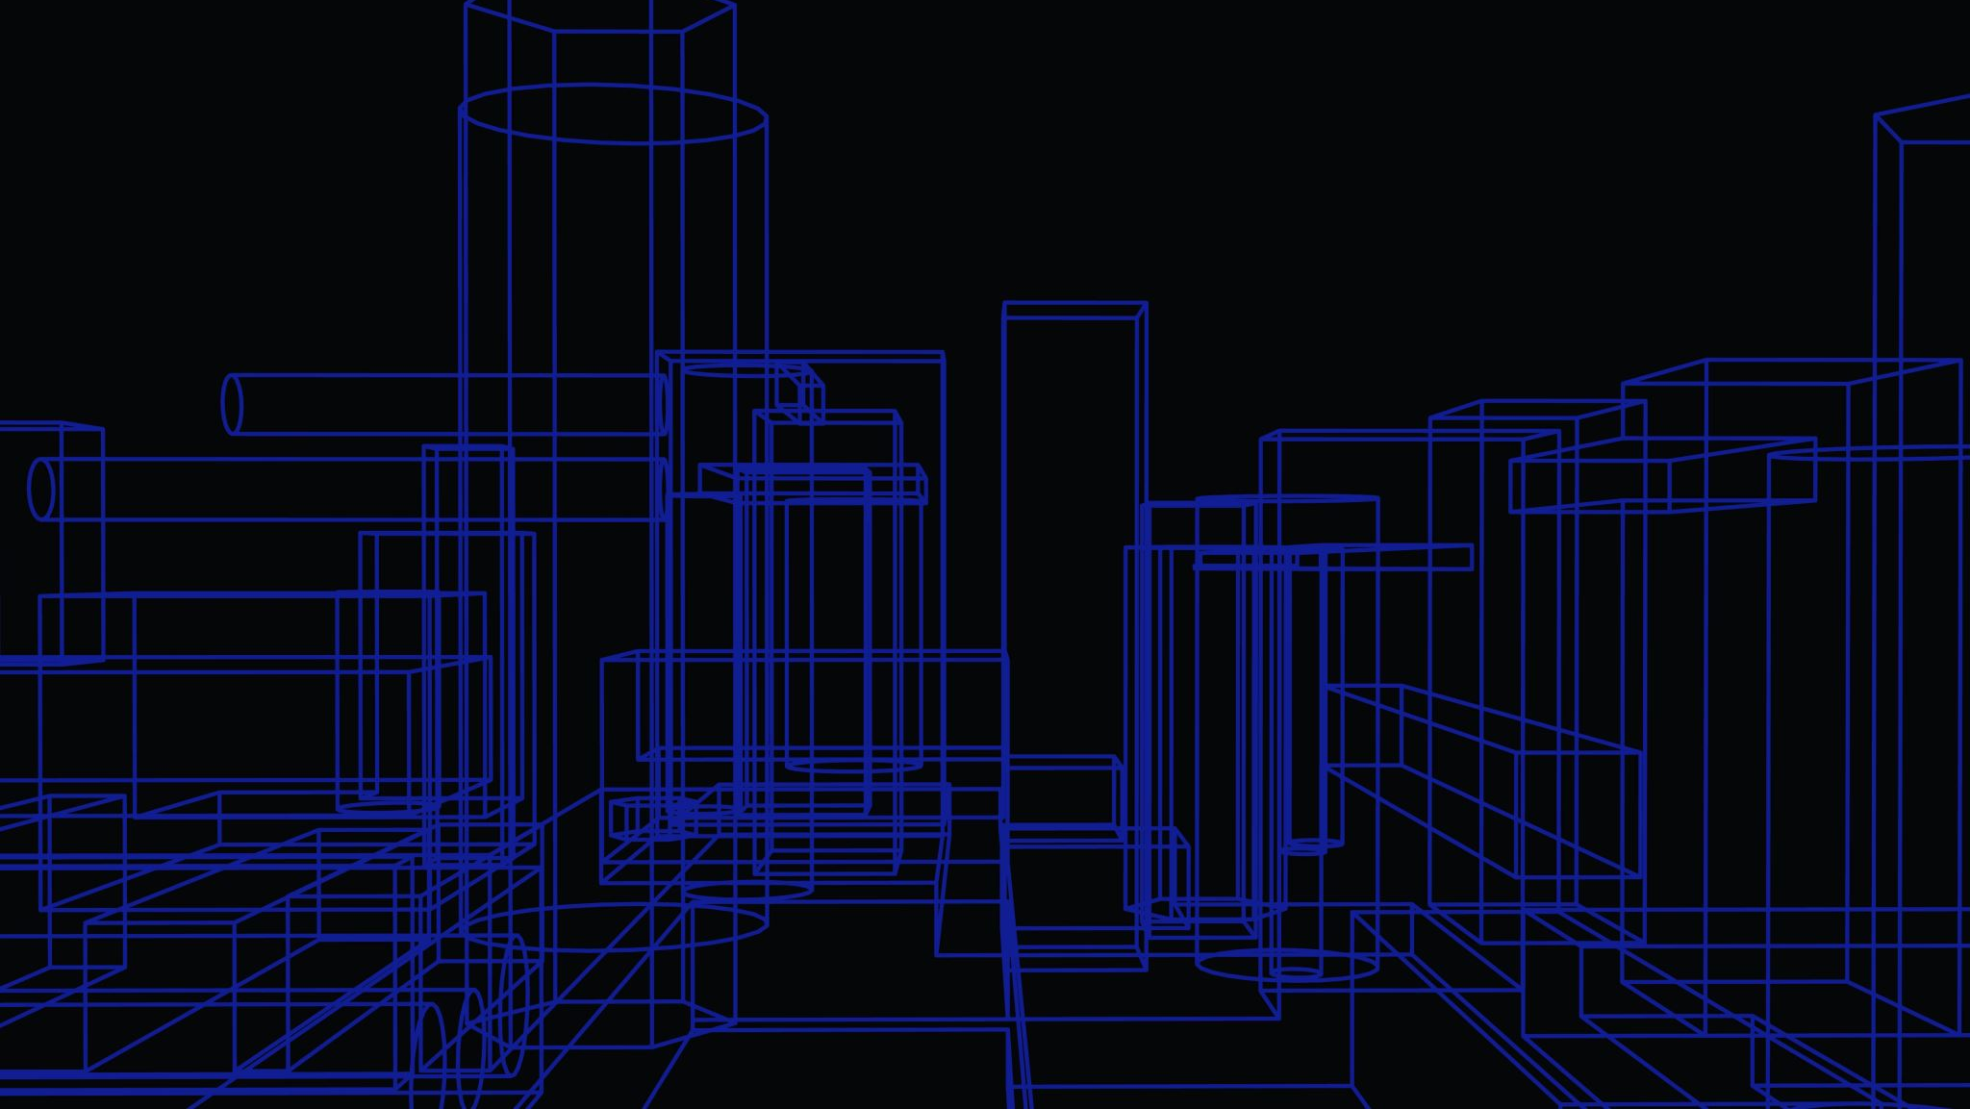
Thank you!
Aakash Banstola

