Slide 1
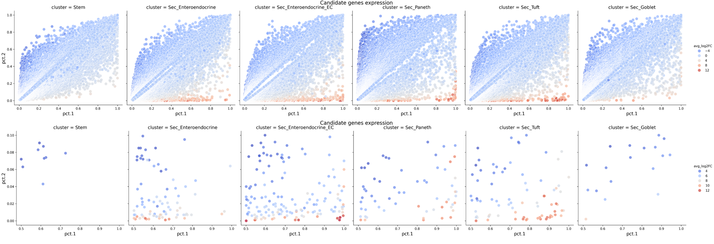

Slide 2
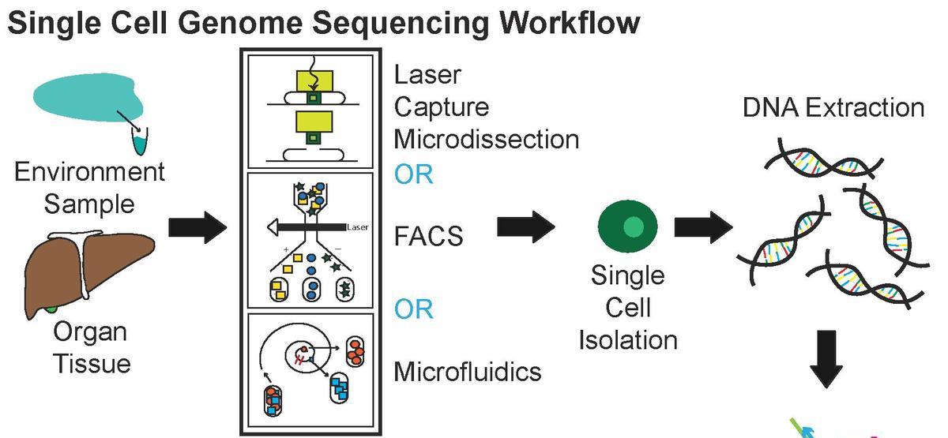
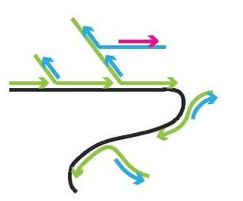
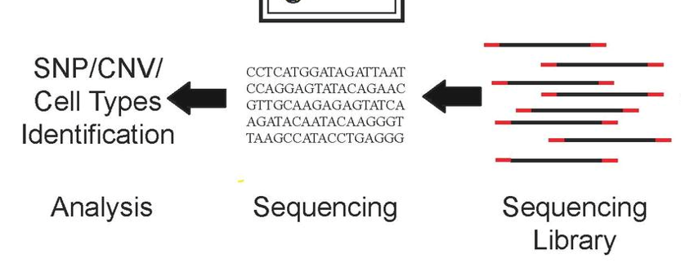
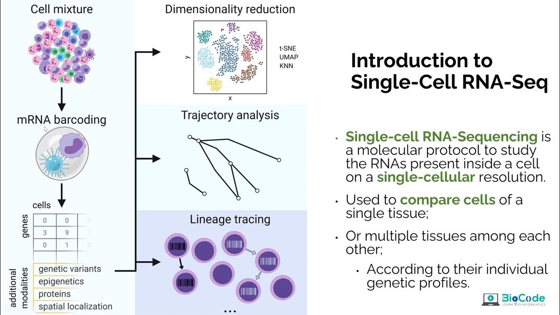
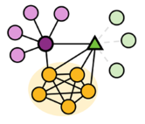
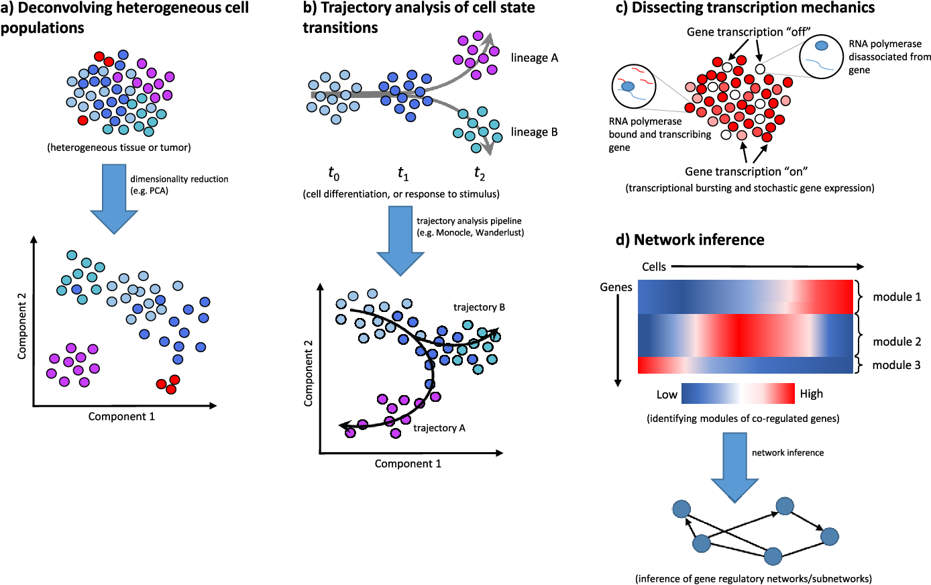
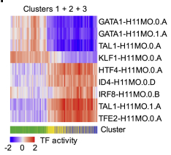
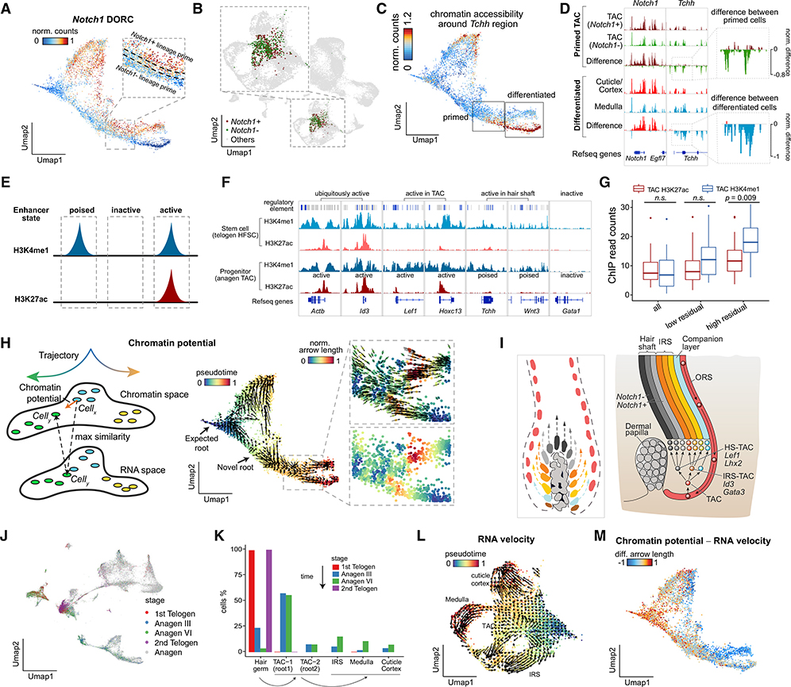
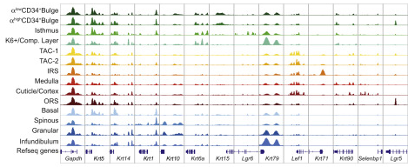
Shaked S. et al., 2021. Luecken MD et al., 2019. Cheng C. et al., 2023. https://holab-hku.github.io/Fundamental-scRNA/background.html
MDA
Sequencing
preprocessing
Serena Liu et al., 2016, Junha Cha., 2020
Trajectory analysis and lineage tracing
Dimensionality reduction
GRN
Regulons
Sai Ma et al., 2020
Label transfer
Regulatory motifs
Chromatin accessibility
scATAC-seq tracks (marker accessibility)
Chromatin potential

Slide 3
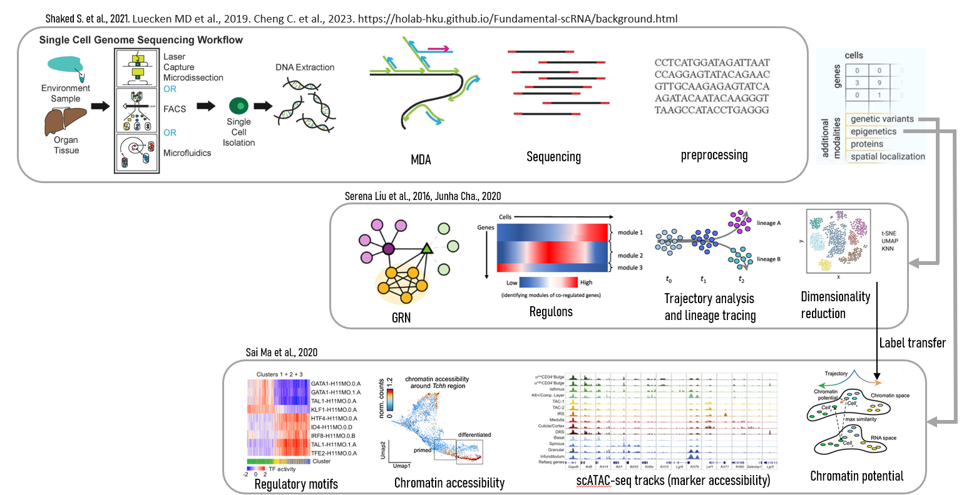
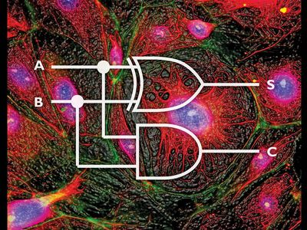
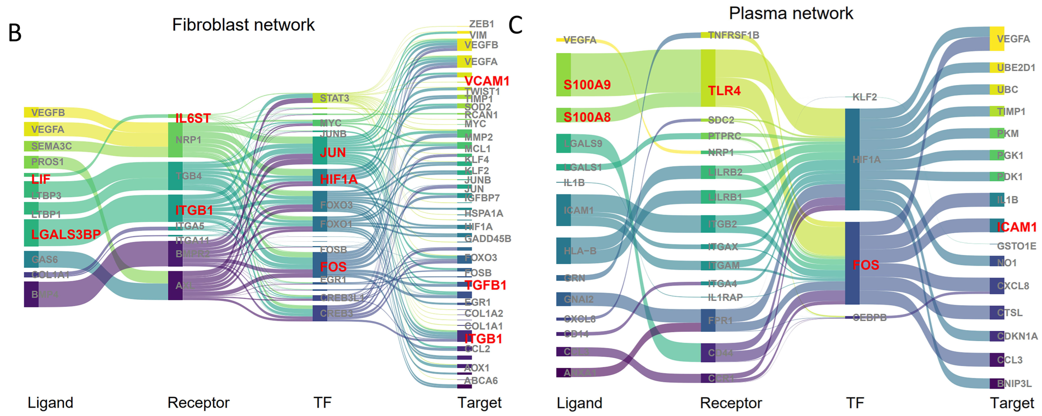
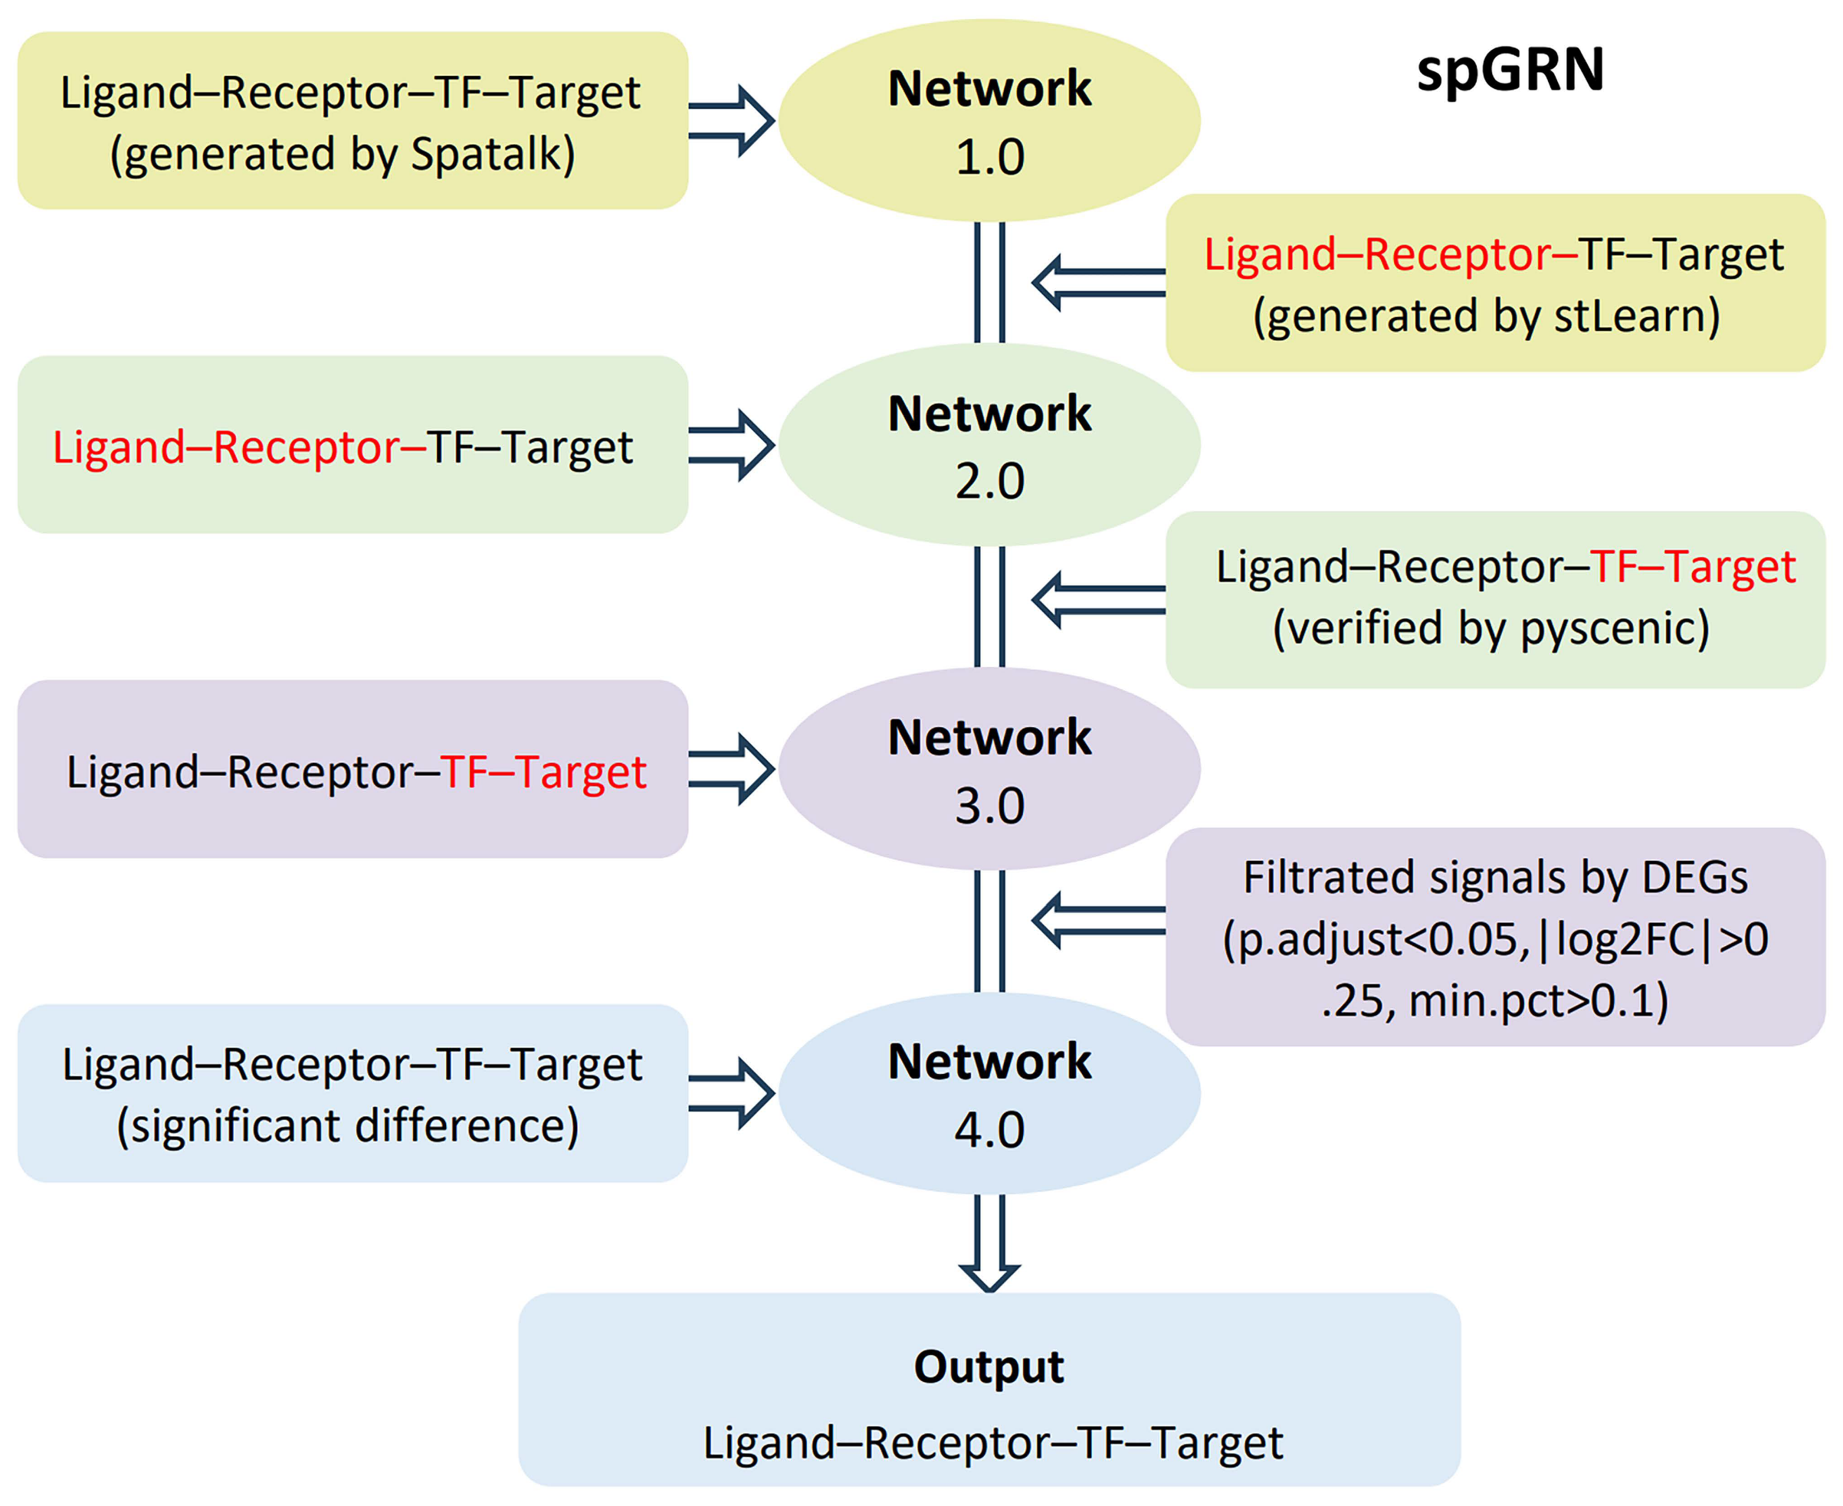
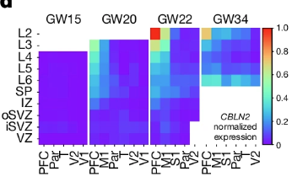
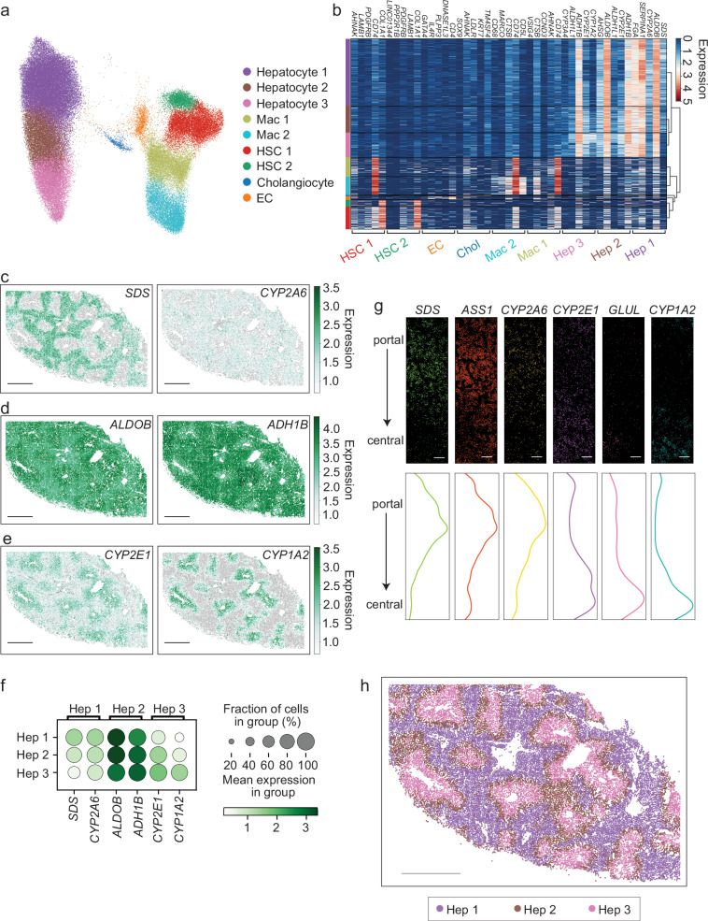
Shaked S. et al., 2021. Luecken MD et al., 2019. Cheng C. et al., 2023. https://holab-hku.github.io/Fundamental-scRNA/background.html
Library preparation
Library preparation
scRNA-Seq
scATAC-Seq
Spatial Transcriptomics
Custom modelling
scATAC-seq tracks (marker accessibility)
Watson BR et al., 2025, Du Y et al., 2025. Qian X et al., 2025. https://www.10xgenomics.com/analysis-guides/spatial-gex-lit-review
Label transfer
spGRN’s construction
Gene Spatiotemporal expression
Spatial distribution
Dimensionality reduction
spGRN of malignant cells interacting with fibroblasts and plasma cells

Slide 4
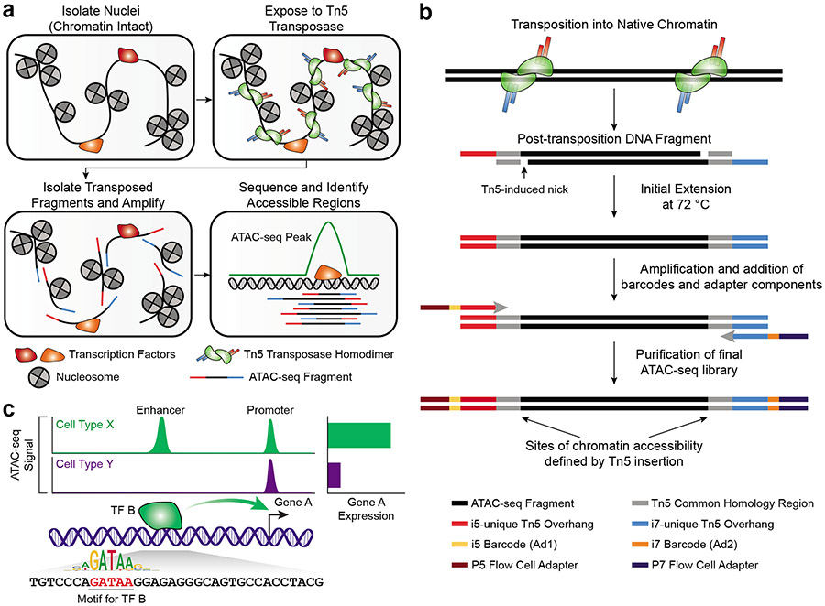
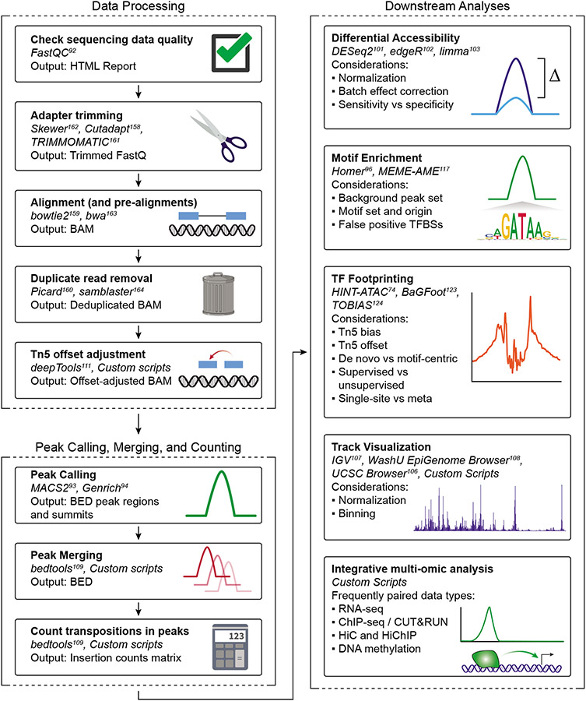

Slide 5
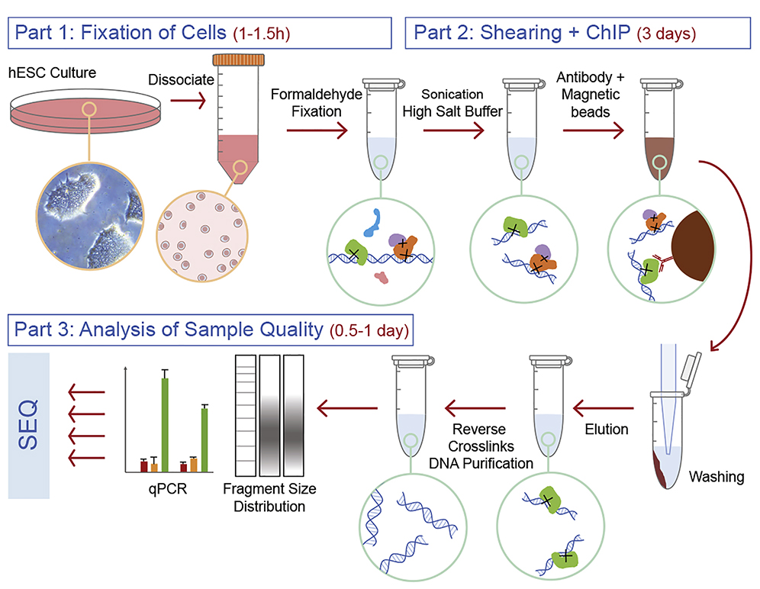
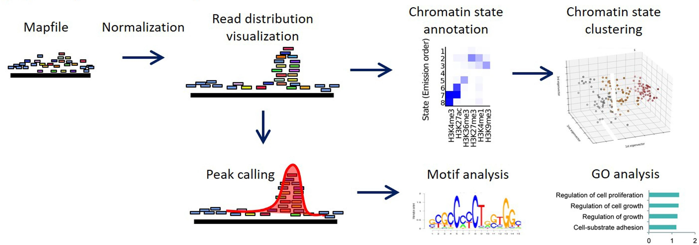

Slide 6
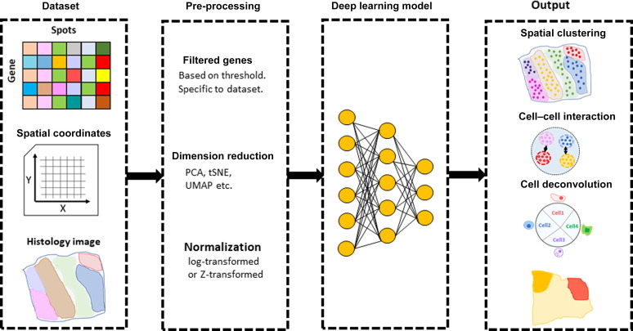
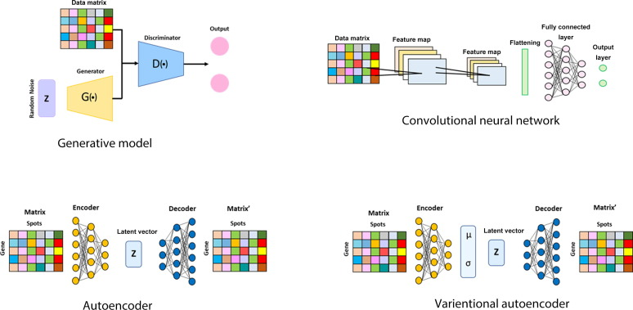

Slide 7
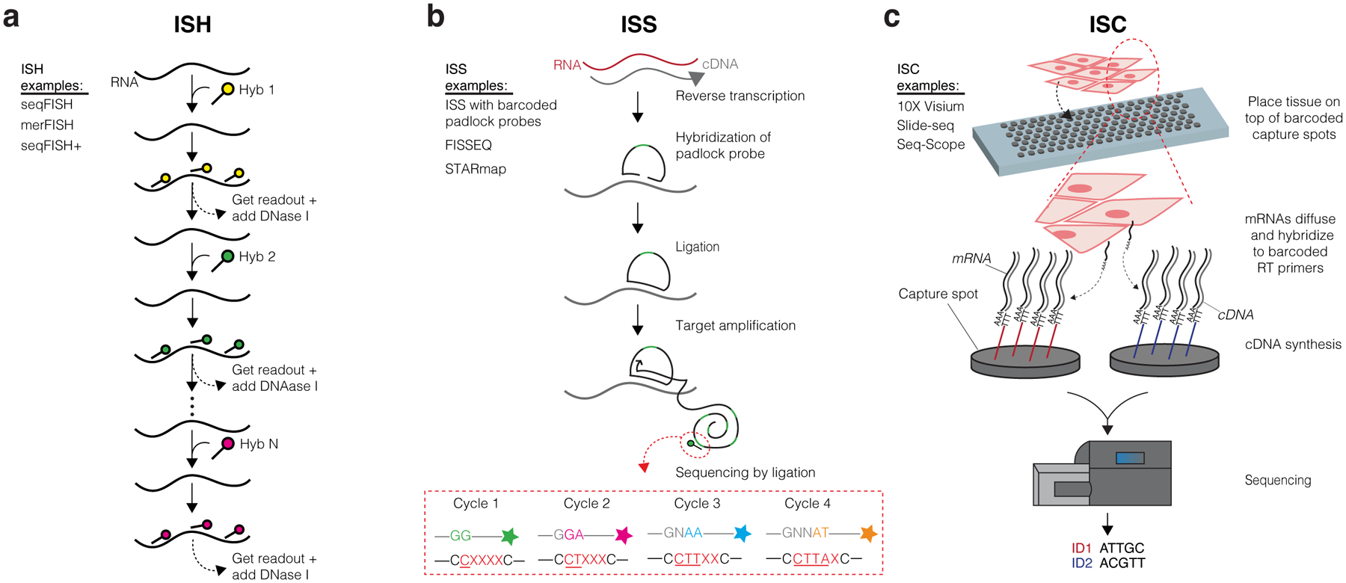
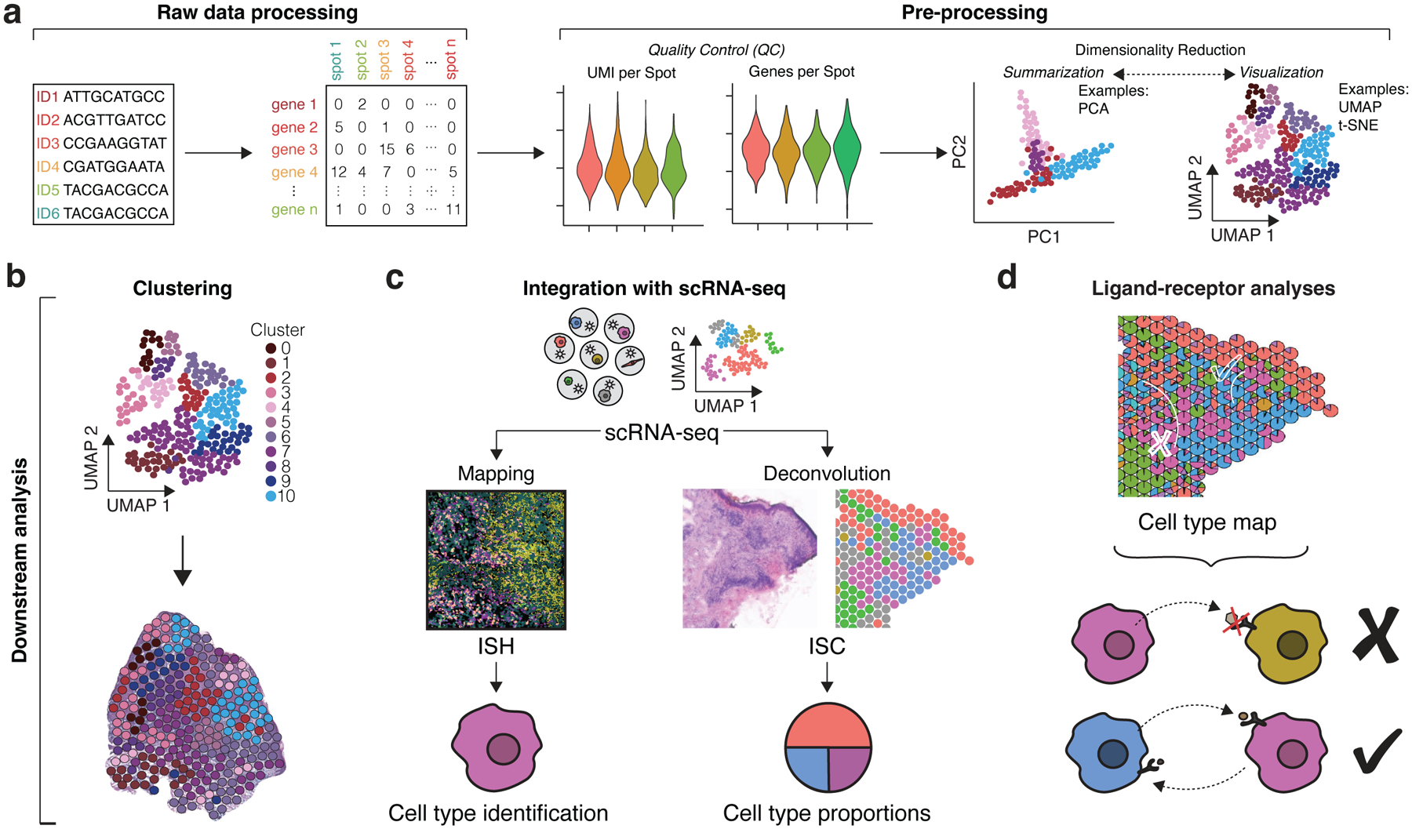

Slide 8
Ma, Sai et al. “Chromatin Potential Identified by Shared Single-Cell Profiling of RNA and Chromatin.” Cell vol. 183,4 (2020): 1103-1116.e20. doi:10.1016/j.cell.2020.09.056
Liu, Serena, and Cole Trapnell. “Single-cell transcriptome sequencing: recent advances and remaining challenges.” F1000Research vol. 5 F1000 Faculty Rev-182. 17 Feb. 2016, doi:10.12688/f1000research.7223.1
Cha, Junha, and Insuk Lee. “Single-cell network biology for resolving cellular heterogeneity in human diseases.” Experimental & molecular medicine vol. 52,11 (2020): 1798-1808. doi:10.1038/s12276-020-00528-0
Slovin, Shaked et al. “Single-Cell RNA Sequencing Analysis: A Step-by-Step Overview.” Methods in molecular biology (Clifton, N.J.) vol. 2284 (2021): 343-365. doi:10.1007/978-1-0716-1307-8_19
Luecken, Malte D, and Fabian J Theis. “Current best practices in single-cell RNA-seq analysis: a tutorial.” Molecular systems biology vol. 15,6 e8746. 19 Jun. 2019, doi:10.15252/msb.20188746
Cheng, Changde et al. “A Review of Single-Cell RNA-Seq Annotation, Integration, and Cell-Cell Communication.” Cells vol. 12,15 1970. 30 Jul. 2023, doi:10.3390/cells12151970
https://holab-hku.github.io/Fundamental-scRNA/background.html
Du, Yiwen et al. “Construction of Gene Regulatory Networks Based on Spatial Multi-Omics Data and Application in Tumor-Boundary Analysis.” Genes vol. 16,7 821. 13 Jul. 2025, doi:10.3390/genes16070821
Watson, Brianna R et al. “Spatial transcriptomics of healthy and fibrotic human liver at single-cell resolution.” Nature communications vol. 16,1 319. 2 Jan. 2025, doi:10.1038/s41467-024-55325-4
https://www.10xgenomics.com/analysis-guides/spatial-gex-lit-review
Qian, Xuyu et al. “Spatial transcriptomics reveals human cortical layer and area specification.” Nature vol. 644,8075 (2025): 153-163. doi:10.1038/s41586-025-09010-1
Grandi, Fiorella C et al. “Chromatin accessibility profiling by ATAC-seq.” Nature protocols vol. 17,6 (2022): 1518-1552. doi:10.1038/s41596-022-00692-9
Sullivan, Adrienne E, and Silvia D M Santos. “An Optimized Protocol for ChIP-Seq from Human Embryonic Stem Cell Cultures.” STAR protocols vol. 1,2 100062. 18 Sep. 2020, doi:10.1016/j.xpro.2020.100062
Nakato, Ryuichiro, and Toyonori Sakata. “Methods for ChIP-seq analysis: A practical workflow and advanced applications.” Methods (San Diego, Calif.) vol. 187 (2021): 44-53. doi:10.1016/j.ymeth.2020.03.005
Piñeiro, Arianna J et al. “Research Techniques Made Simple: Spatial Transcriptomics.” The Journal of investigative dermatology vol. 142,4 (2022): 993-1001.e1. doi:10.1016/j.jid.2021.12.014
Danishuddin et al. “Spatial transcriptomics data and analytical methods: An updated perspective.” Drug discovery today vol. 29,3 (2024): 103889. doi:10.1016/j.drudis.2024.103889
Li, Zhou et al. “Systematic comparison of label-free, metabolic labeling, and isobaric chemical labeling for quantitative proteomics on LTQ Orbitrap Velos.” Journal of proteome research vol. 11,3 (2012): 1582-90. doi:10.1021/pr200748h
https://www.creative-proteomics.com/resource/label-free-vs-labe-proteomics.htm
Chen, Chen et al. “Bioinformatics Methods for Mass Spectrometry-Based Proteomics Data Analysis.” International journal of molecular sciences vol. 21,8 2873. 20 Apr. 2020, doi:10.3390/ijms21082873
Wang, J., Huang, Y., Lu, F. et al. Benchmarking informatics workflows for data-independent acquisition single-cell proteomics. Nat Commun 16, 10276 (2025). https://doi.org/10.1038/s41467-025-65174-4
Wang, Xu et al. “Integrative multi-omics approaches to explore immune cell functions: Challenges and opportunities.” iScience vol. 26,4 106359. 9 Mar. 2023, doi:10.1016/j.isci.2023.106359

Slide 9
