Slide 1
Choosing your Identity (server)
Kevin Rich
@whoiskevinrich
whoiskevinrich.com
Senior Software Engineer
Bookbyte.com

Slide 2
A Note on Live Coding

Slide 3
Resources
leastprivilege.com/2016/08/21/why-does-my-authorize-attribute-not-work/
IdentityServer.io
auth0.com
Modern Authentication with Azure Active Directory for Web Applications by Vittorio Bertocci [2016] (Chapter 2: Identity Protocols and Application Types)
Google
Stack Overflow

Slide 4

Authentication vs. Authorization
Authentication
The process of IDENTIFYING a subject
Authorization
The process of ALLOWING a subject access to a resource
The bouncer asking for a college student’s ID at the bar is the act of authentication. That bouncer refusing entry to the student because she is 19 is the act of authorization.

Slide 5

In the before times

Slide 6
Basic & Form-Based Authentication
User Concerns
Vulnerable to social engineering
Easy to guess
Application Vendor Concerns
Login Database Maintenance and Security
Password management services for users
SSO Coordination is difficult, at best

Slide 7
Other Schemes
Digest Access Authentication (DAA)
Sends MD5-Hash of Credentials
Some implementations susceptible to Man-In-The-Middle attacks
SAML
Handles Authentication and Authorization
Similar to OIDC

Slide 8
OAuth 2.0
Open standard for Authorization
Enable users to consent to identity sharing
“I authorize Twitter to share my email address with the goodguy.com web application.”
Adds notion of a callback URI to redirect users back to client
User credentials can be exchanged for token without being exposed to the client application

Slide 9



OAuth 2.0
2. App seeks information from Twitter
3. Twitter seeks user consent
1. “Log in with Twitter”
4. User provides consent
5. Twitter provides information

Slide 10
Abuse of OAuth
Specification includes a “Password Grant”
Allows username/password to exchanged for token directly
Some client applications collect those credentials from the user directly and many users have been trained this is okay
This is bad
Don’t do this

Slide 11
Claims Based Identity
Specification includes a “Password Grant”
Allows username/password to exchanged for token directly
Some client applications collect those credentials from the user directly and many users have been trained this is okay
This is bad
Don’t do this

Slide 12

Openid connect (OIDC)

Slide 13
OpenID Connect (OIDC)
Open standard for Authentication
Extends OAuth 2.0
Enables user to authenticate at Identity Provider (Google, Facebook, Twitter, …) without disclosing credentials to the application
Enable site to verify user without managing credentials

Slide 14

Lingo

Slide 15
Claims
Provide declarations about a subject
Claims have issuers (Google, Facebook, Bob from Marketing)
Claims have types, which are non-standard ☹
Facbook: “email”
ActiveDirectory: “http://schemas.xmlsoap.org/ws/2005/05/identity/claims/emailaddress”

Slide 16
Identity
A series of claims about a subject
Example
The subject’s name is Bob
The subject works in Accounting
The subject is a Supervisor
The subject’s image resides at http://images.loblaw.com/...
The subject’s email address is bob@loblaw.com

Slide 17
Identity Provider or Authority
A server capable of authenticating and offering claims about a subject
Examples
Google
Facebook
Untapped
Azure Active Directory
Auth0
IdentityServer4

Slide 18
Audience
Also called “Relying Party”
The client application attempting to authenticate a user

Slide 19
Scope
The next evolution of Roles
A claim passed from an Identity Provider
Ex: customer.read, email.write, sales.delete
Scopes allow better granularity of users and groups
Scopes are defined at the identity provider
While the Identity Provider may need updates, once the resource scopes are configured, the codebase need not be changed again
Example:
http://api.goodguy.com/users/delete requires the users.delete scope

Slide 20
Policy
Policies define which combination of authentication and claims are needed to access a resource.
We load policies with scopes
Examples
The Admin policy requires the users.delete scope
The Editor policy requires the users.write & employee scope
The Reader policy requires the users.read scope

Slide 21
JSON Web Tokens

Slide 22
Look on the JWT, ye Mighty, and despair!
JSON Web Token
{
"sub": "1234567890",
"name": "John Doe",
"admin": true
}
Header
Payload
Verify Signature

Slide 23
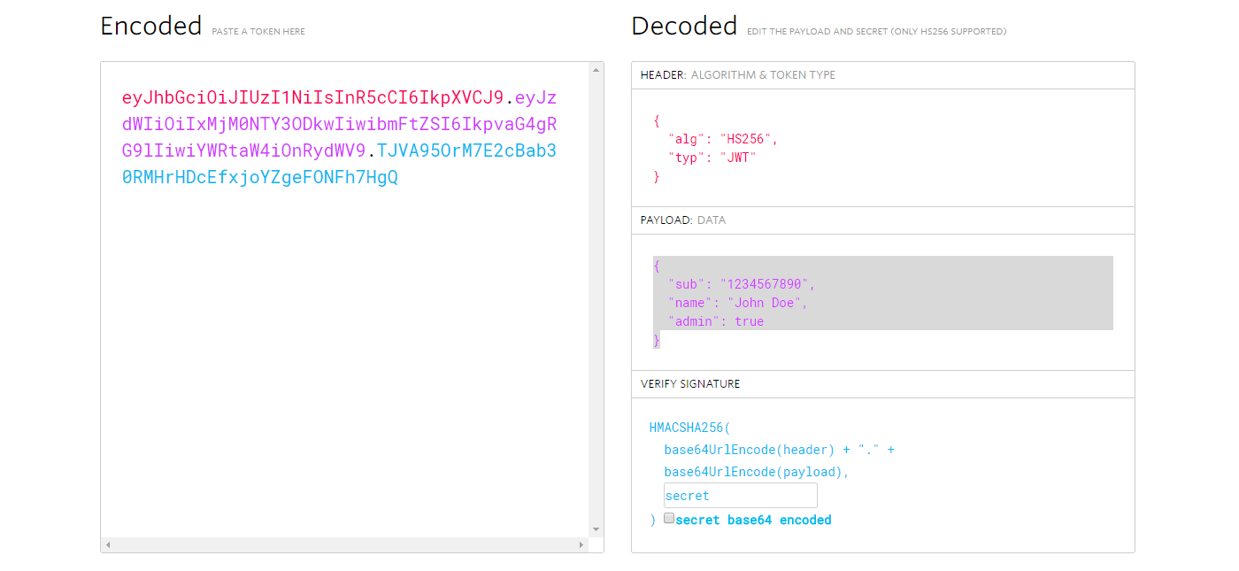
JWT.IO

Slide 24

Common Authentication Scenarios

Slide 25




Non-Interactive Clients
{ client_id = goodguy.com, scope = goodguy.api }
Bearer token
Bearer token

Slide 26

Web Applications w/Users
Authentication
Challenge User
Request Page
Request Identity
{ client_id = goodguy.com, scope = openid
Bearer Token

Slide 27
Other Authentication Scenarios
SPA Concerns
Cross-Origin Concerns
Token Lifetimes
Native/Mobile Applications Concerns
OAuth can potentially allow users to authenticate to Identity Provider via web-views, allowing app to eavesdrop, providing unpredictable UX, and teaching users to type master passwords int “external” applications. (see https://tools.ietf.org/html/draft-wdenniss-oauth-native-apps-02)

Slide 28

Practical examples

Slide 29
Just Show the Code Already!

Slide 30

Demonstrations

Slide 31
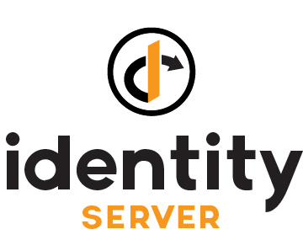
Demonstrations

Slide 32
Auth0 / IdentityServer4 Comparison
Common Features
OpenID Certified
SSO Integrations
Multifactor Authentication
Excellent Documentation
Social Connectors for Facebook, Twitter, Microsoft, Google+, etc
Extensibility*
Enterprise Identity*
* While Auth0 Offers these features, they require paid accounts

Slide 33
Auth0 / IdentityServer4 Comparison
Common Features
OpenID Certified
SSO Integrations
Multifactor Authentication
Excellent Documentation
Social Connectors for Facebook, Twitter, Microsoft, Google+, etc
Extensibility*
Enterprise Identity*
* While Auth0 Offers these features, they require paid accounts

Slide 34
Auth0 / IdentityServer4 Contrasts
Auth0
Examples featuring working code for your clients
Hosted Service
Expensive if implementing for Enterprise-level needs
IdentityServer4
Free (Paid Support and Consultation)
Open Source
You host the service
You implement the server (greater extensibility)

Slide 35
Miller time

