Slide 1

Introduction to Convolutional Neural Networks
Presenter: Anowarul Kabir
PhD Student in Computer Science
George Mason University
Date: 28 May, 2024
Notes:
Hello everyone, I am Anowarul Kabir.
This presentation is about to a hands-on experience on Convolutional Neural networks.

Slide 2
Outline
Convolutional Neural Networks
A hands-on demonstration
Notes:
So before going into the coding part, let's first look at why do we need this, how it looks like and what are the key components that define this neural network.

Slide 3
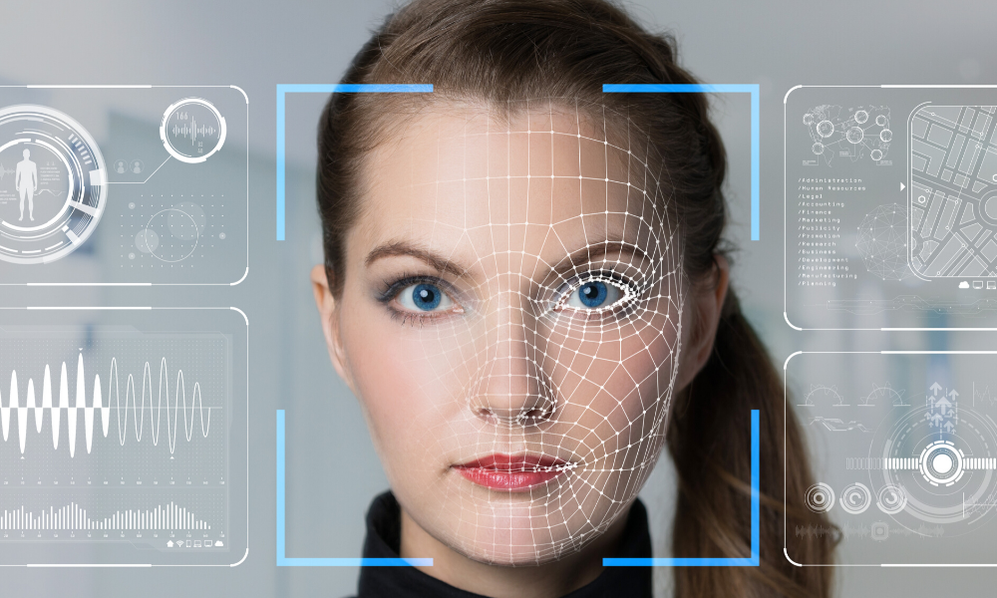
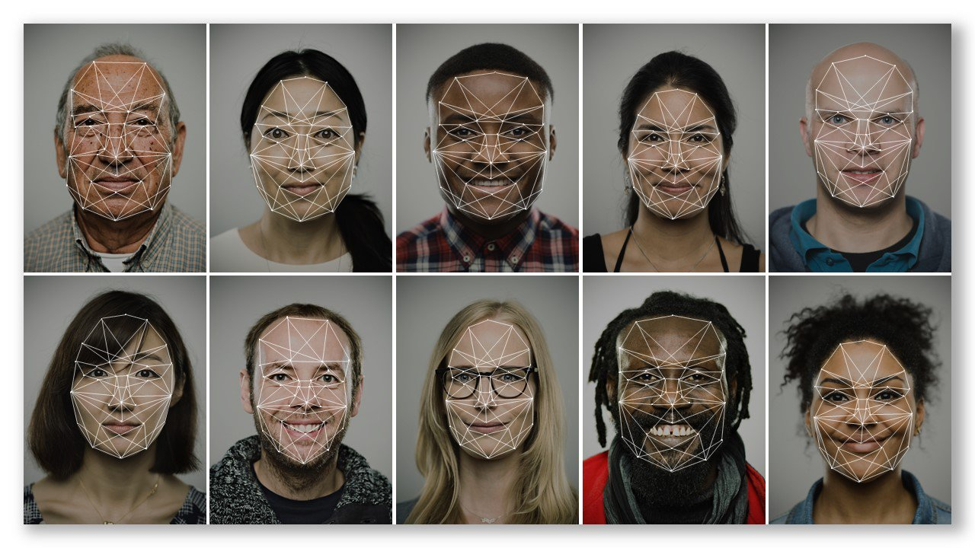
Why Convolutional Neural Networks (CNNs)?
Advantages over traditional methods:
Automatically detects important features without human intervention
Reduces the need for manual feature extraction
Excellent performance in computer vision tasks
Simple application:
Face recognition
Object detection
Handwritten digit classification
Tumor detection from CT images
And so on
Top: https://josephsteinberg.com/how-to-prevent-facial-recognition-technology-from-identifying-you/
Bottom: https://blogs.microsoft.com/on-the-issues/2018/12/06/facial-recognition-its-time-for-action/
Notes:
The major advantage of the convolutional neural networks or CNNs is that the model can automatically extract features which might be important for the prediction tasks.
Here we can see an example of face detection. The many dot points in the bottom figures show the features which might be necessary for the distinguishing faces.
And the top one looks just cool.
Next thing is if we know the features, then we can apply the model to many prediction tasks, for instance detecting objects from an image, or detecting tumors from the CT scans.

Slide 4
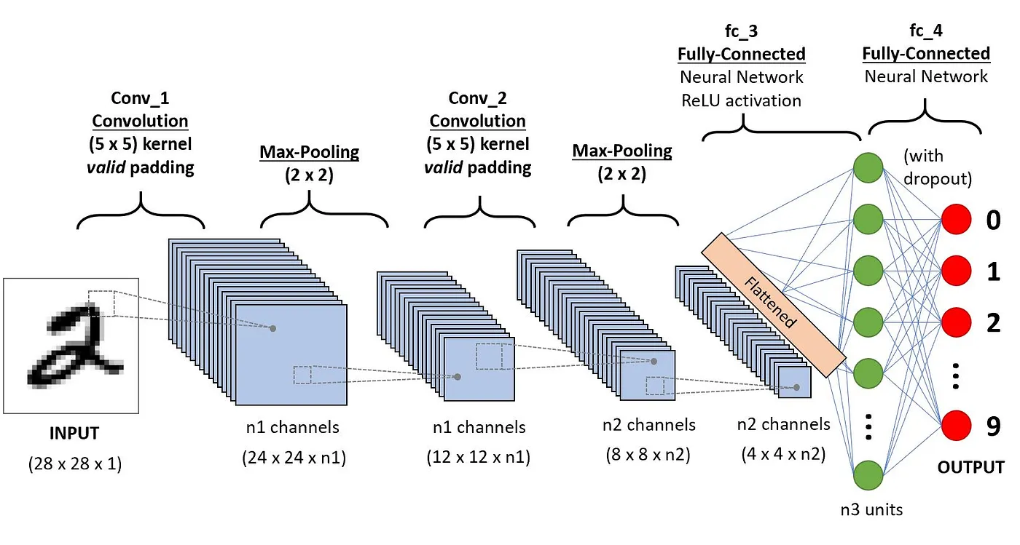
CNN Architecture
Key components
Input Layer
Convolutional Layers
Pooling Layers
Non-linear activation functions
Fully Connected Neural Networks
Output Layer
Image source: https://www.datacamp.com/tutorial/introduction-to-convolutional-neural-networks-cnns
Notes:
Here is an example CNN architecture which consists of five key components.
Input Layer: Accepts the input image.
Convolutional Layers: Apply filters to the input image to extract features.
Pooling Layers: Reduce the dimensionality of feature maps.
Fully Connected Layers: Connect every neuron from one layer to the next.
Output Layer: Produces the final prediction.
We will basically implement this network today, but before that, we will see how these components work.
CNNs are built upon a series of specialized layers that work together to process visual data. Convolutional layers are the heart of a CNN. They use filters (small matrices) to learn features like edges, lines, and shapes from the input image. Pooling layers then downsample the data,

Slide 5
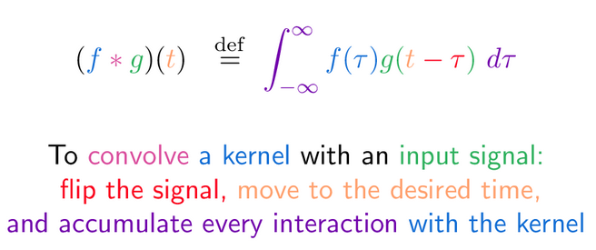
Formal definition: Convolution operation
Convolution is fancy multiplication
The convolution of f and g is written f ∗ g, denoting the operator with the symbol ∗. It is defined as the integral of the product of the two functions after one is reflected about an axis and shifted.
Image source: https://betterexplained.com/articles/intuitive-convolution/
Notes:
First the convolution operation, which is a fancy multiplication.
In easy terms, the equation says that the convolution of two functions is defined by the integral of the products of those two functions after one is reflected on an axis and shifted.
Lets see what it means

Slide 6
Demonstration: Convolution operation
Notes:
Lets look at the left one only, the top is the input, and the bottom is the kernel. We set our kernel at the top-left of the input, all overlapped positions will be multiplied and summed. Next we shift the kernel to the right until we reach the end. By this way, we are computing features. An important question here is, what should be the values in the kernel? We will basically learn these values.

Slide 7
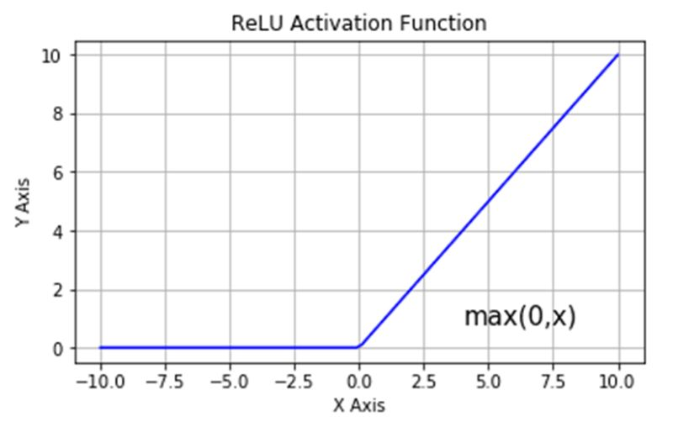
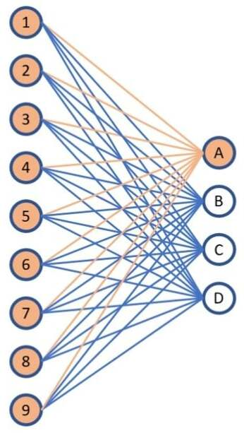
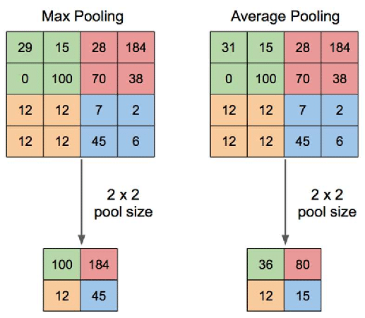
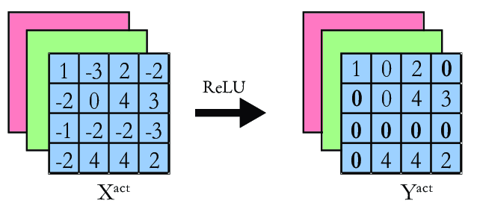
Pooling
ReLU function
FCNN
Notes:
Next, we may want to apply pooling operation for extracting activation to reduce spatial dimension. We can see two examples here: max and average pooling. We fix a 2x2 location, then we take the max or average value of that grid as the output.
In the middle, we see an example of a non-linear function to induce non-linearity, called rectifier linear unit, in short relu. The idea is simple, we will discard any negative values.
Next is the fully connected neural networks, which connects all neurons from the previous layer to the next layer. It combines features to classify the image.

Slide 8
Hands-on experience: CNNs

Slide 9
More things
Model optimization: Gradient descent
Variety of Neural Networks
Variety of loss functions
Variety of activation functions
Possibly more complicated things
Protein fold classification
Biomarkers (tumor) detection
Unsupervised feature extraction
Thank You and Any questions?
My email: akabir4@gmu.edu
My Advisor: Dr. Amarda Shehu (ashehu@gmu.edu)

Slide 10
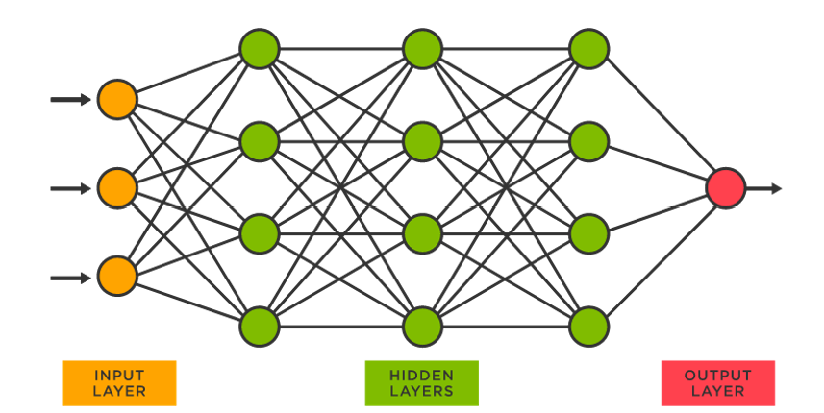
Neural Networks
Key components:
Input layer
Hidden layers
Output layer
Image source: https://medium.com/@srempe/an-introduction-to-neural-networks-8c61b880f358

