Slide 1
Protein Contact-Map Prediction using Variational Autoencoder
Presented by: Anowarul Kabir

Slide 2
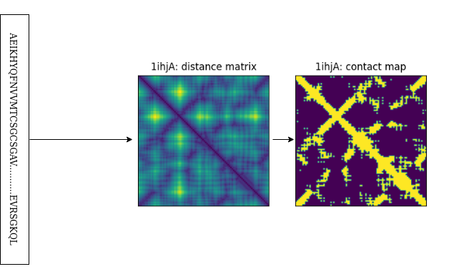
Background
Protein structure prediction
Primary structure
Secondary structure
Tertiary or quaternary structure
Protein primary sequence
Distance matrix
Beta-beta carbon
Alpha-alpha for Glycine
Contact-map
<12 angstrom
Fig 1: Primary sequence to contact-map generation

Slide 3
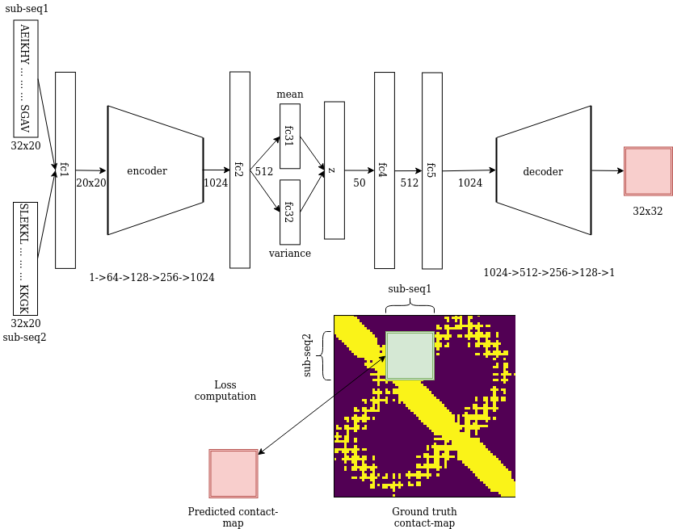
Methodology
Datasets
Train: 900
Validation: 300
Test: 300
Model: Variational Autoencoder
Loss computation
BCE
BCE + KLD
Fig 2: Model architecture and loss computation

Slide 4
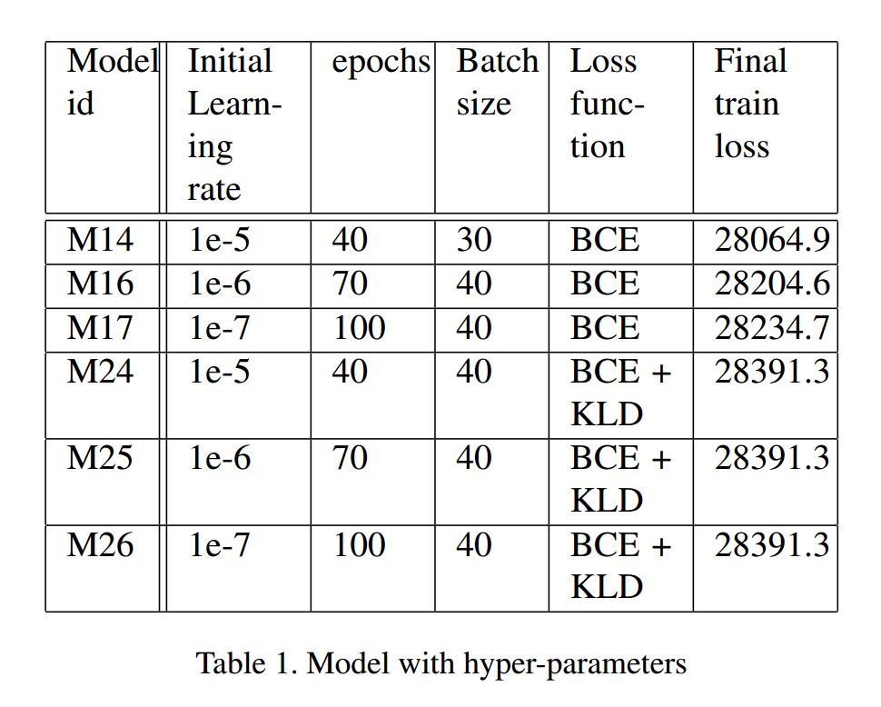
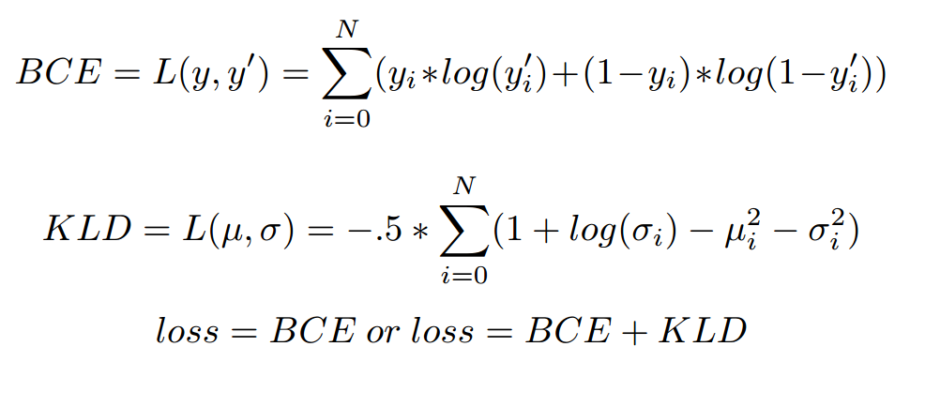
Models with Hyperparameters

Slide 5
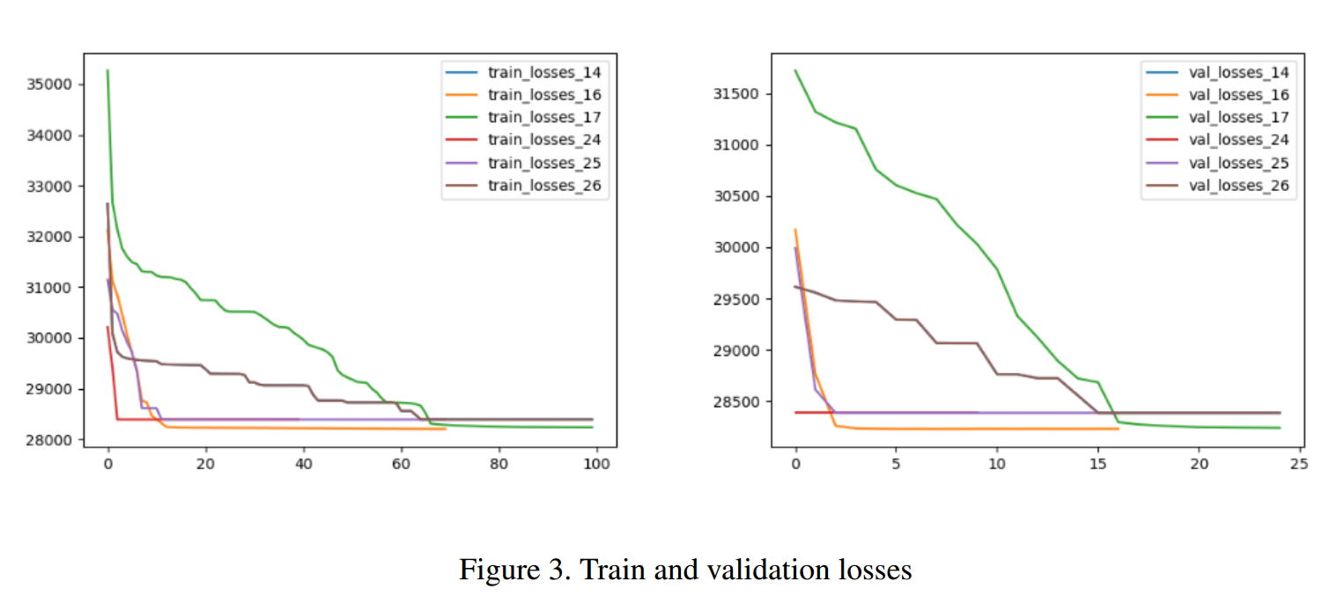
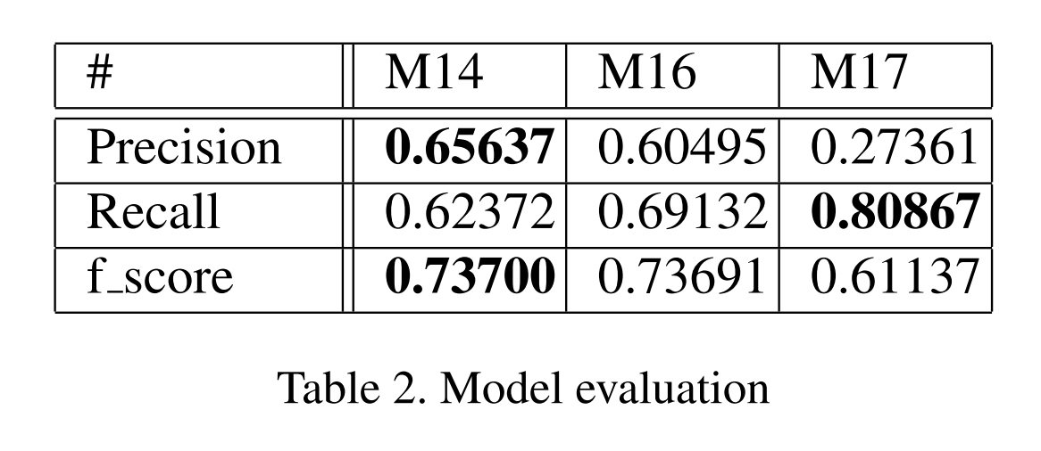
Model Evaluation

Slide 6
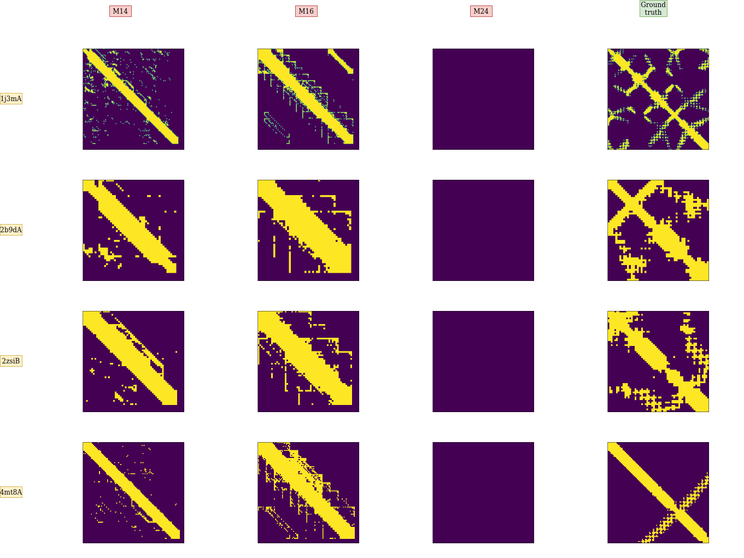
Outputs
Right most column: ground truth contact map
Three predicted contact map using M14, M16 and M24 from left
Each row corresponds to a protein
Fig 4: Sample outputs

Slide 7
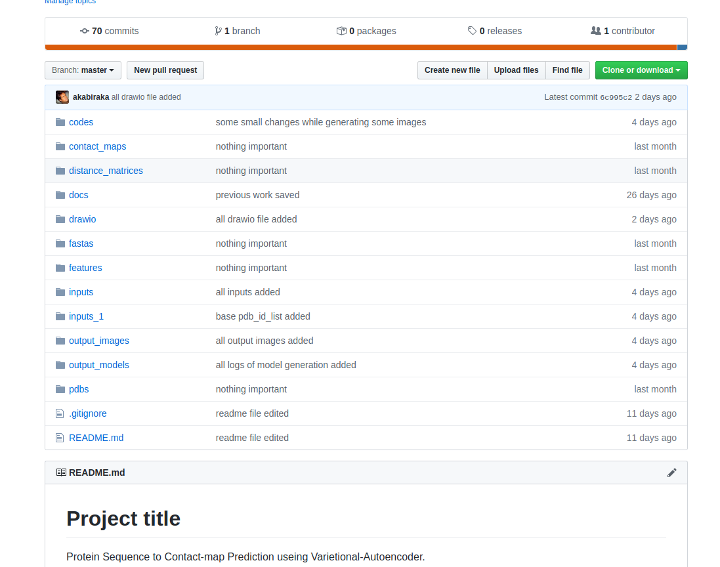
Miscellaneous
Model is trained and evaluated in GMU Argo Cluster.
64GB Memory
16GB GPU
Project code could be found in Github.
Github page describes how to run the code

Slide 8


