Slide 1

Wayfair WEB Analysis Gary GAO

Slide 2
Background
Wayfair acquires customers from multiple channels (examples include Search, Display Ads, Social Media etc.) across different device types. Post-acquisition, our focus is on providing the best customer experience to help her find the right product and make the purchase process easy. Major steps in the purchase process includes, ‘finding and viewing the product’ followed by ‘adding product to cart’ and eventually ‘placing the order’. We utilize customer data captured at different steps to build short term funnel improvement and long term customer engagement strategies.

Slide 3






Customer roadmap
Acquired Email by Channel/device
Purchase
Generate Revenue
Add into cart
Skus View
Notes:
Firstly I will just try to iterate the roadmap from how a customer attracted to our website to finally purchase the products.
To begin with, we have the channel data to collect the info on which acquisition device would be used to log in and what channel led them to log in from 2002 to 2016.
Then as for the funnel data, we have a sequence of purchasing journey.

Slide 4
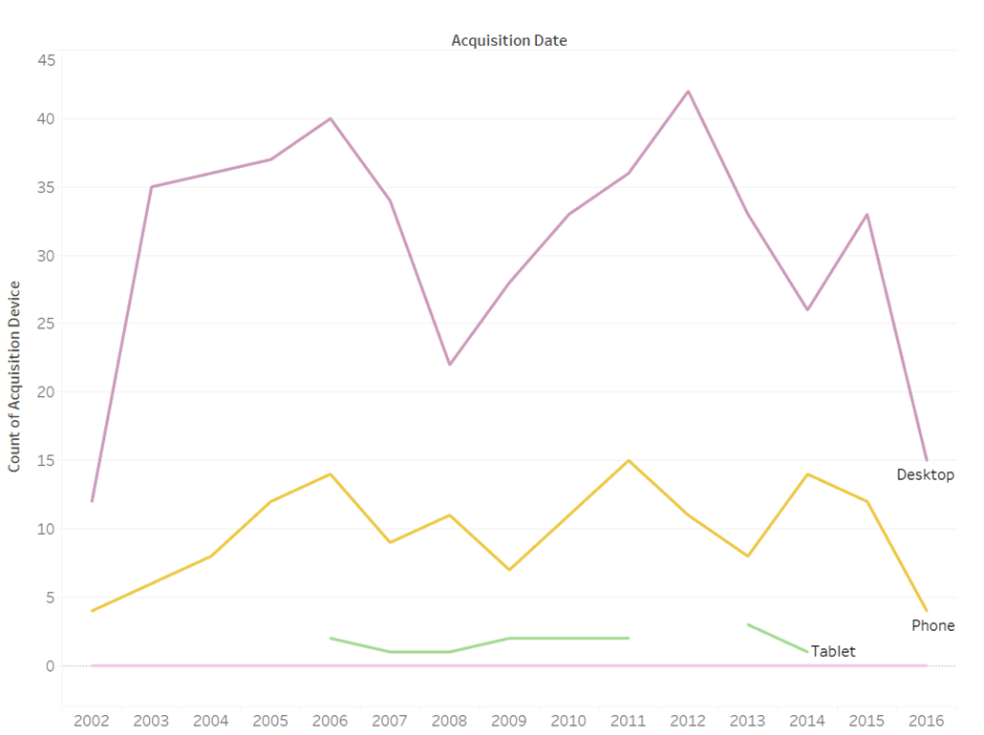
Hard to generate time-series insights from Acquisition Device/ Channel
44% of the customer has the data for Acquisition Device.
69 % of the customer has the data for Acquisition Channel.
Few data collected in 2002 & 2016
Acquisition device is fluctuating yearly
Notes:
To begin with, I draw a quick line chart to show the relationship between device and years. Although we collect 1400 custmer id , only 44% of the customer id has the data for Acquisition_Device while 69 % of the customer id has the data for Acquisition Channel which makes it hard for us to detect any trends of acquisition device/ channel from 2002 to 2016. Each device remains very fluctuating year by year.
Also, we have very few data on 2002 and 2016 which we can see a slump of device /count id in both years. We can also see some data are missing like Tablet.

Slide 5
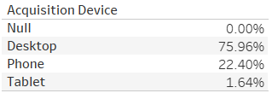
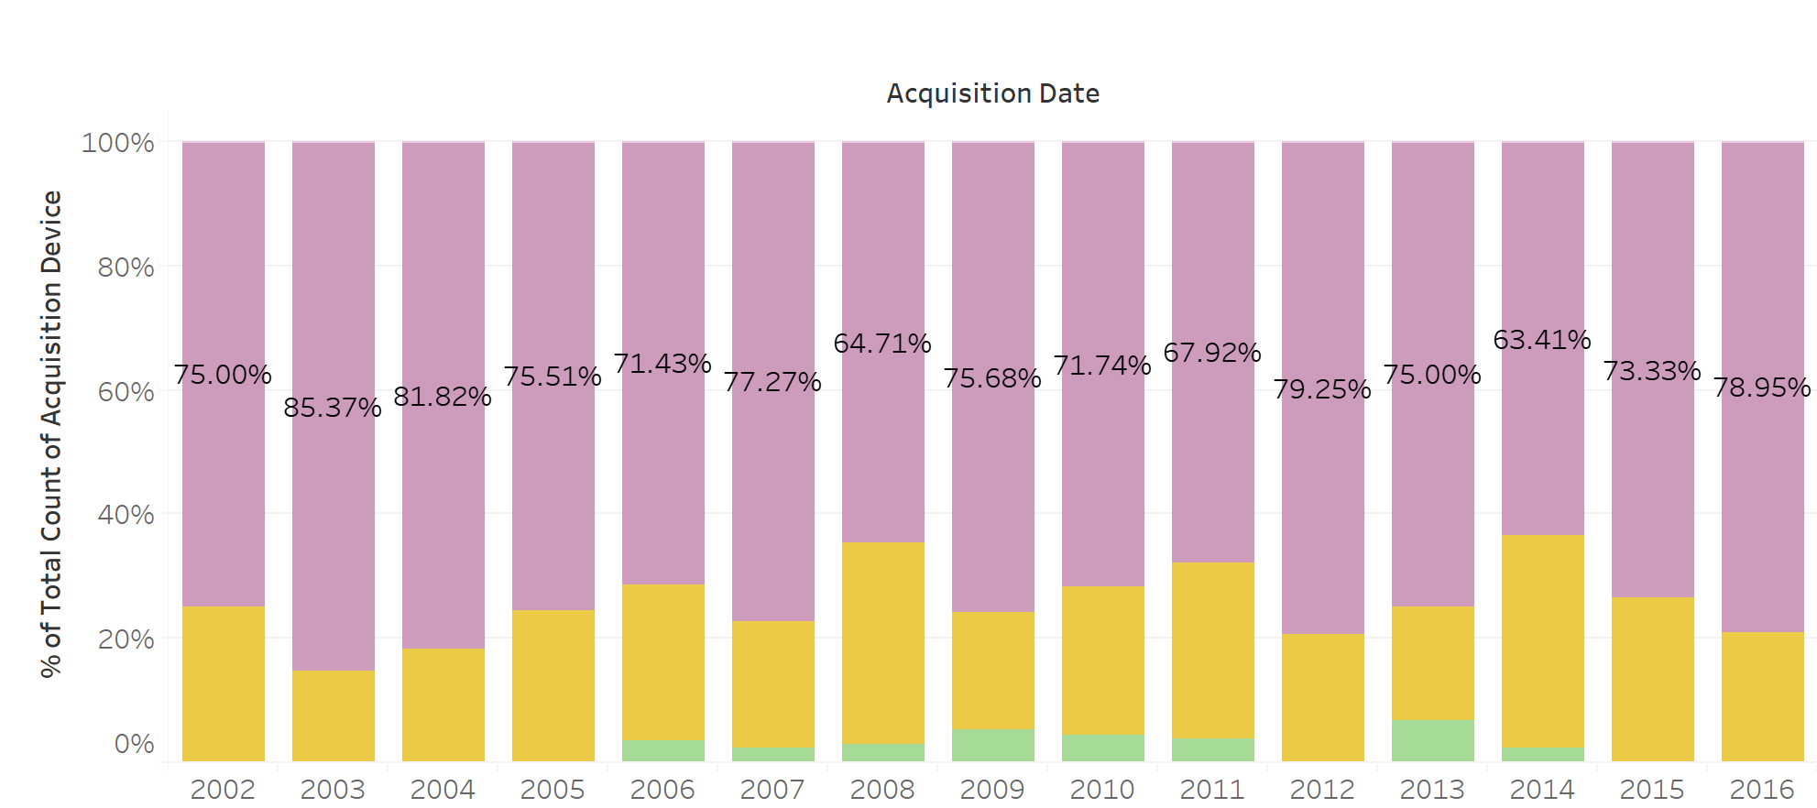
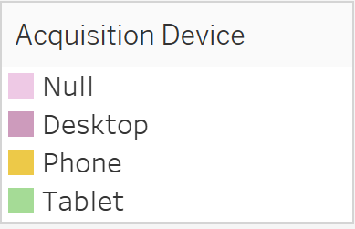
Desktop & phone are two most effective acquisition devices.
Notes:
I use stacked bars to monitor the proportion of acquisition devices through 15 years to avoid data imbalance. We can see that from the chart, no deny the desktop is the most popular acquisition device among all the others with the total ratio of 76%. Apart from that, the phone also play an important position with 22% acquisition size.
Given the data available, I suggest the company could invest in desktop plateform to attract customer sign-up especially building stability and speed when user log in our website though desktop. Phone APP is another option to invest.

Slide 6
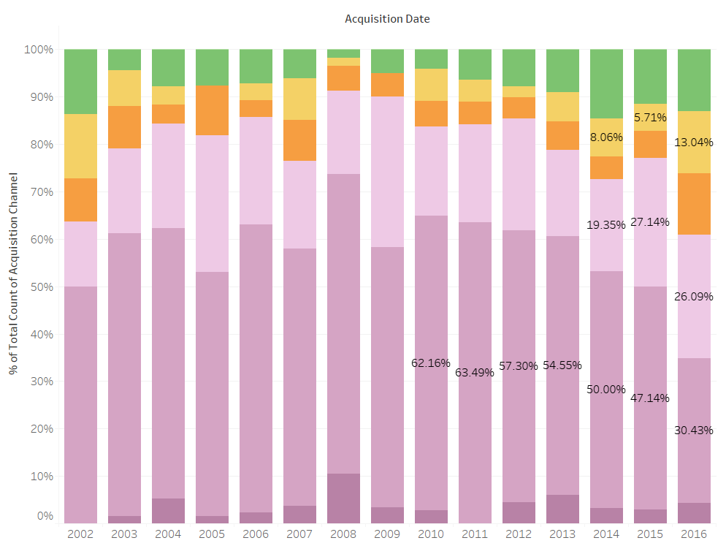
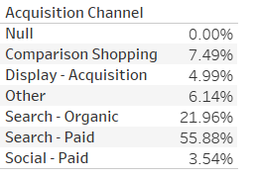
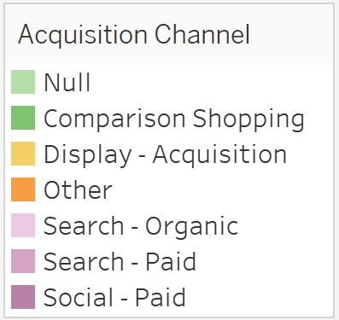
Search Paid, Search Organic & Comparison shopping adds up 85% of total Acquisition channel
Notes:
From this picture, we can see that Search Paid, Search Organic & Comparison shopping adds up 85% of total Acquisition channel in 15 years. The traditonal search paid channel has an overwhelming popularity over other channels. However, we also notice that the ratio of Search-Paid is decreasing which gives more opportunity to search organic, display acquisition. Given the data available, I suggest the company could invest in SEM channels to attract customer sign-up. While at the same time, SEO is still growing and requires more time to build a more mature search ecosystem. Combined with the last chart, I general, the company has to keep focusing on search-paid system especially in device platforms.

Slide 7
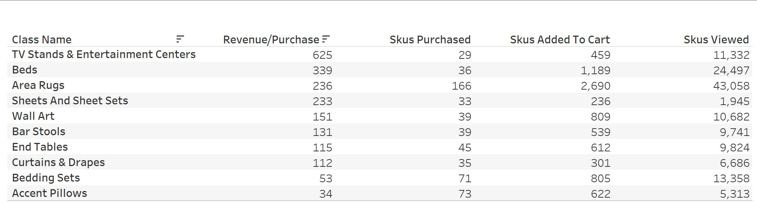
TV stands/Entertainment centers and Beds had the most Revenue Generated per purchase but with low purchase in the data.
Purchase rate = sum(Skus Purchased)/ sum(Skus Added to Cart)
Add to cart rate = sum(Skus added to cart)/ sum(Skus Viewed)
Notes:
Here we come to the funnel data from Sept 2016 to Aug 2018. Revenue Generated per purchase is the most important ratio to decide which class to target at in order to boost the revenue. We can see that from the chart, TV stands & Entertainment Centers can generate two times or even 6 times revenue compared with other small products while their Skus purchased seems quite few. However, the skus added to cart and skus viewed was not far away from other skus. I believe there must be something need to improve in the purchase rate and add to cart rate of TV stands and Beds.

Slide 8
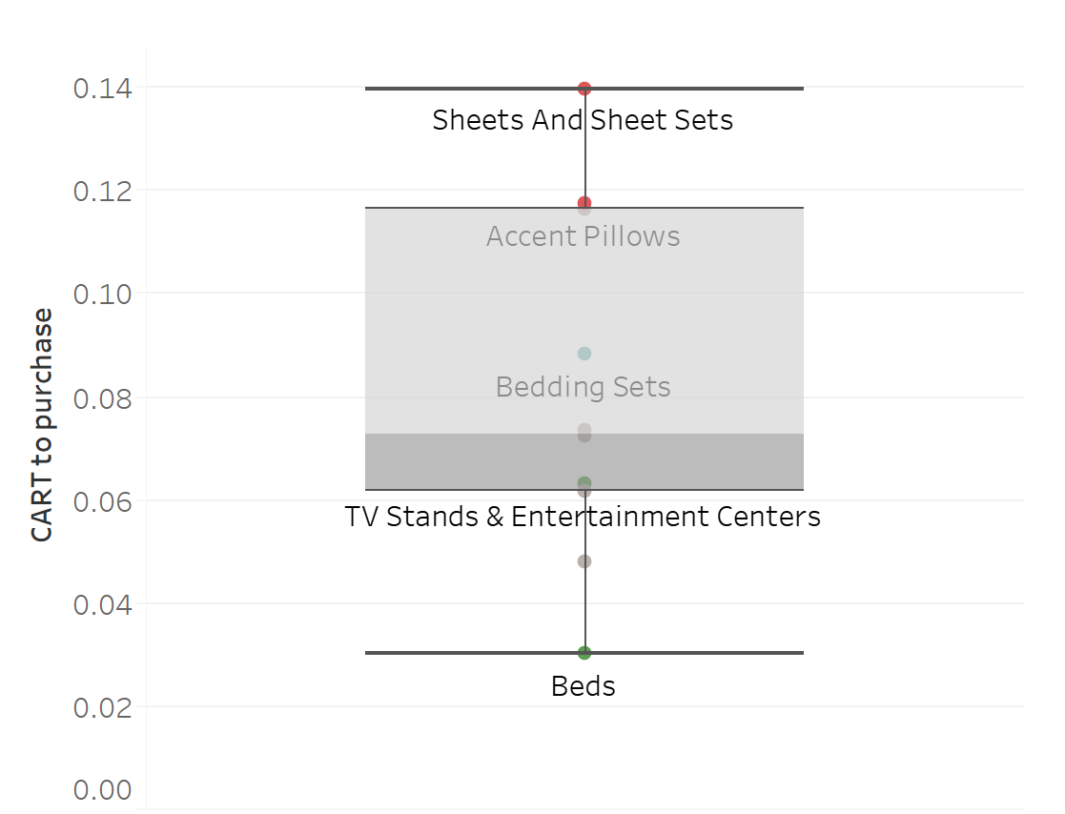
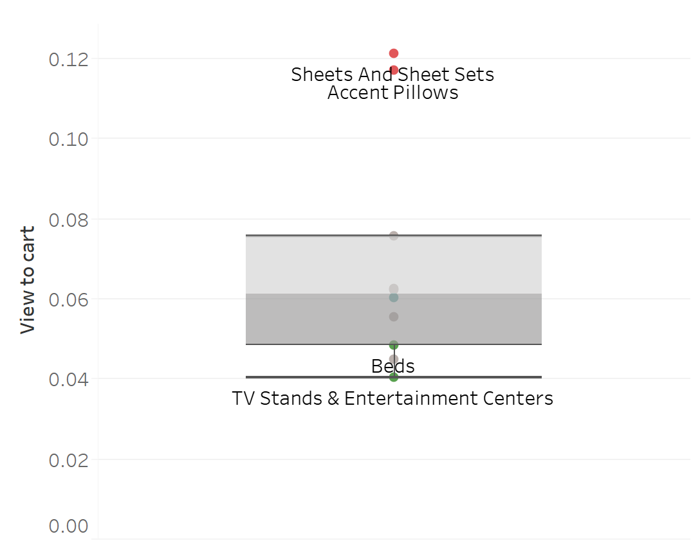
Both two profitable class performs worst in purchase rate and add to cart rate.
Purchase rate
Add to cart rate
Notes:
In order to testify our idea, We draw the box plot to show where TV stands/entertainment and beds position in these two metrics. We can see that in the purchase rate, TV stands & Entertainment Centers stays at the third quartile of the total classes while the Beds as the lowest purchase rate. Here 0.03 means if we add a bed in our cart, there is only 3% chance that it will be purchased by customer, compared to 14% in sheets. Also, for the add to cart rate, Beds and TV also performs the worst.

Slide 9

How to add more purchase from cart?
How to add more cart from view?
1. Make it easy for people to buy, add an add to cart button on every page next to each product
2. Write out more comprehensive and easy understanding description to meet the demands of all level customer.
1. load up carts to see which retailer will follow up with the best incentive to complete the transaction
2. Design reasonable expected Shipping cost/ convenient checkout system/ more ways to pay
Free shipping qualification / Shipping time too long /hard to create account
Notes:
Here we come the question: How to improve our cart rate and purchase rate? We all know that TV stands and beds are quite expensive compared to other classes. But still, we have to think about the ways to improve the purchase rate and add to cart rate because these profitable skus are cash cows.
For purchase rate, If users are leaving after adding items to their carts, there might be comparison shopping, loading up carts to see which retailer will follow up with the best incentive to complete the transaction. Compare pricing and incentives with other TV stands/beds retailers: you have an opportunity to be the first to offer a price or incentive that distinguishes you from everyone else.
Also, If users abandon the process at checkout, the process might be too complicated, or users might be surprised by excessively high shipping charges.
For add to cart rate, we can Make it easy for people to buy, add an add to cart button on every page next to each product.
Also, Write out more comprehensive and easy understanding description to meet the demands of all level customer.
For example, if your audience is mainstream consumer and your product descriptions are overly technical, those details might not constitute a convincing argument.

Slide 10
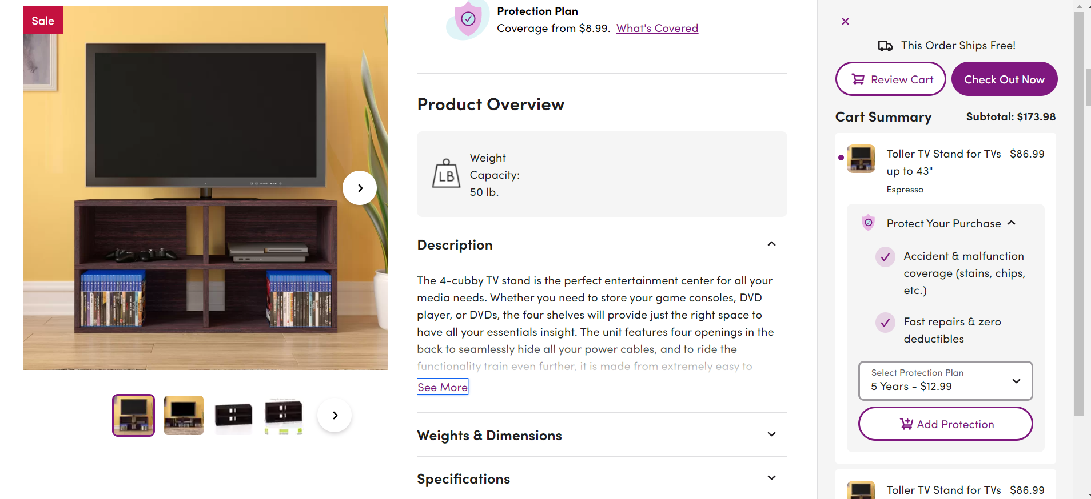
Notes:
For one TV stands sku example on wayfair website, we can see that wayfair has already made some progress in uplifting purchase rate and add to cart rate. For example, the one page check out page as well as detailed product description including weights and dimensions. Order ship free icon is quite eye catching when I decide to purchase.

Slide 11
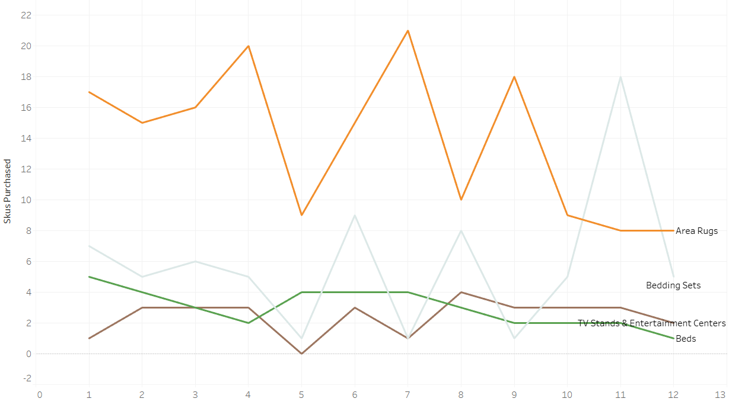
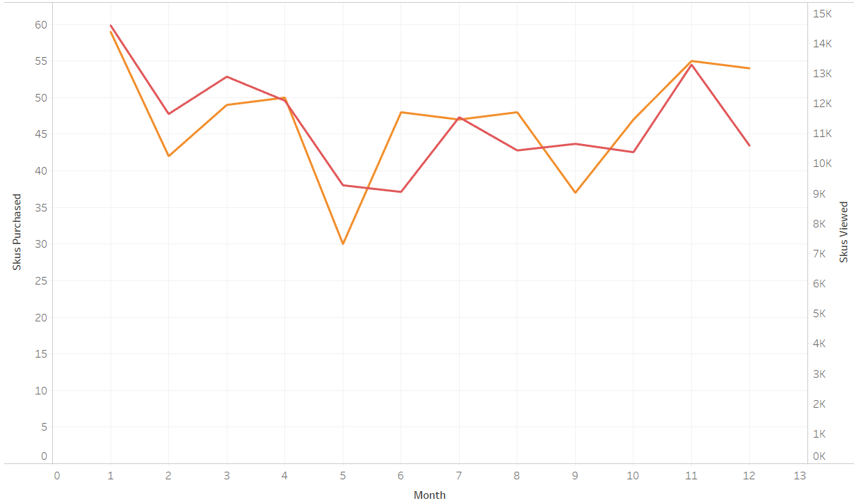

What can we do in the future with more data?
The monthly purchasing behavior of different classes based on Funnel Data from 09-2016 to 08-2018
Correlation seems not strong between beds and bedding Sets
More purchsing data is required to apply Market Campaign to cash cows
Other factors influencing purchasing
Notes:
At last I try to generate month purchasing behavior of different classes based on Funnel Data from 09-2016 to 08-2018 . It seems like TV stands/ entertainment center & beds are selling at a stable but low rate monthly. The most sold quantity is only 4 pieces for both two classes. It’ s hard to spot any boost or deliver some market campaign at certain month due to limited data points.
However, we can see that Area Rugs seem to have a boost in July and Sept. Maybe we can send emails to these rug buyers/ general customers at July and Sept next year in these seasonality to attract the sales of area rugs. On the other hand, it seems that TV Stands & Entertainment Centers and Sheets are very likely in purchasing trend pattern, but they are have no correlation in the business sense. Beds and bedding sets are usually bought together but we can not generate the idea from the pics. I am also curious to see why there is a drastic slump in purchasing from April to May with little decrease in views. Possibly due to purchasing system broke in large traffic. If we have more data of purchasing and viewing behavior. We can testify out assumptions and target at beds and tv stands to deliver more market campaign.

Slide 12

Summary
Focus on Search Paid and Device
Lift Purchase rate & Add to cart rate of cash cows
More data needed to generate market campaign

Slide 13
Thanks!

