Slide 1
Economics
Week #6

Slide 2
Topics of Week #6
Explicit Cost
Implicit Cost
Accounting Profit
Economic Profit
Short-Run vs. Long-Run*
TP, MP, AP, and DMP*
TC, TVC, and TFC
ATC, AVC, and AFC*
"*" Indicates the most important topics.
Mateer ve Coppock: Chapter #8

Slide 3
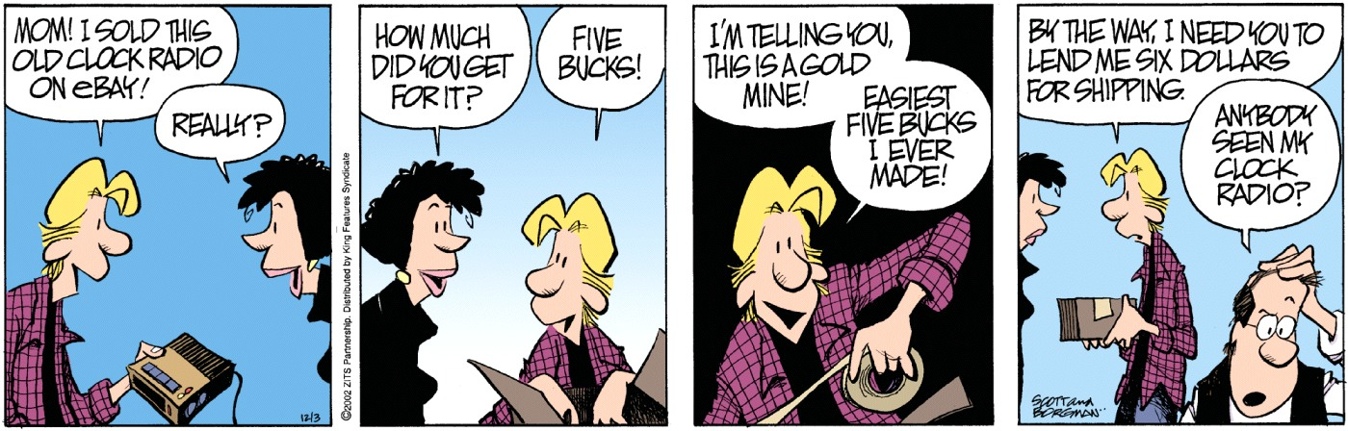

Slide 4
Calculating Profit and Loss
Total Revenue (TR)
The amount a firm receives from the sale of goods and services.
Total Cost (TC)
The amount a firm spends in order to produce those goods and services.
Profit (or loss) = TR – TC
Profits occurs when TR > TC
Losses occurs when TR < TC
Notes:
Assuming a firm just sells one product at the same price, TR = P * Q. Think of revenues as the money in your cash register at the end of the day.
You count up all that money, but you don't get to keep it all. You have to pay your workers and other bills. If you still have money left over, that is profit. If you can't cover all your expenses, you have losses.

Slide 5
Explicit and Implicit Costs
Explicit costs
Tangible expenses: Bills that the owner has to pay.
Wages, insurance, and food ingredients.
Implicit costs
Opportunity costs of doing business.
Opportunity cost of capital.
Bought a franchise for a large sum of money. How could the money have been invested otherwise?
Opportunity cost of owner's time above salary paid.
How much could the owner get paid elsewhere?
Notes:
Explicit costs:
Bills you actually have to pay.
You can physically see cash leaving your hand to pay this bill. Or, you could write a check.
These tend to be easy to calculate—it's easy to see explicit expenses.
Implicit costs:
Tend to be opportunity costs. These are harder to calculate.
Suppose I give myself a salary based on if I were here 40 hours a week. Often, I'm actually here for 52 hours a week. What's the opportunity cost of that 12 hours of time? How much money could I make if I was getting paid somewhere else for those 12 hours?
Also, what if I invested $500,000 instead of buying a building with it? What WOULD my return have been?

Slide 6
Explicit and Implicit Costs
Explicit Costs | Implicit Costs
The electricity bill | Labor of owner who works for the company but does not draw a salary
Advertising in the newspaper | The capital invested in the business
Employee wages | The use of the owner's car, computer, or other personal equipment to conduct business
Notes:
Explicit costs: Costs directly paid (you see money leaving your hands).
Implicit costs: Opportunity costs.
Implicit costs are hard to calculate and easy to miss. It is difficult to determine how much an investor could have earned from an alternative activity. Is the opportunity cost the 3% interest you might have earned by placing the money in a bank, the 10% you hope to earn in the stock market, or the 15% you might have gained by investing in a different business? We can be sure that there is an opportunity cost for owner-provided capital, but we can never know exactly how much that might be.
In addition to capital, implicit costs include the opportunity cost of the owner's labor. Often business owners do not pay themselves a direct salary. However, since they could have been working somewhere else, it is reasonable to consider the fair value of the owner's time—income the owner could have earned by working elsewhere—as part of the businesses costs.

Slide 7
Profits
Accounting Profit
Does not take into account implicit costs of doing business.
Accounting Profit = Total Revenues – Explicit Costs
Economic Profit
Considers "All Costs" = Explicit Costs + Implicit Costs
Economic Profit = Total Revenues – All Costs
*As Economists, we use "All Costs" and define it as Total Cost. Similarly, we use "Economic Profit" in our analyses. In short we call it "Profit".
Notes:
The difference between accounting profits and economic profits explains why companies that announce solid accounting profits may, nevertheless, see their stock prices fall. For instance, if a company with $1 billion in assets reports an annual profit of $20 million, we might think it is doing well. After all, wouldn't you be happy to make $20 million in a year? However, that $20 million is only 2% of the $1 billion the company holds in assets.

Slide 8
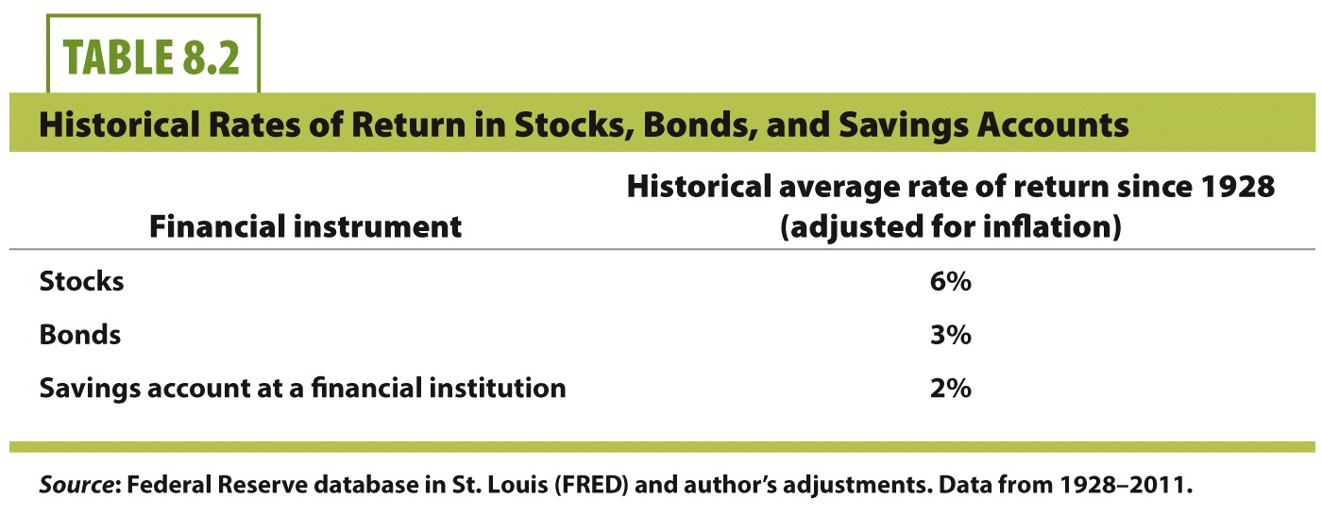
Rates of Return, Historically
Notes:
Accounting profits can be misleading. However, economic profits are never misleading.
If a business has an economic profit, its revenues are larger than the combination of its explicit and implicit costs. The difficulty in determining economic profits lies in calculating the tangible value of implicit costs.
If you invest in bonds, you may get a 3% return and think it's a great deal.
However, you could have earned 6% in stocks!

Slide 9
Accounting and Economic Profits
Item | Cost Type | Amount ($)
Revenues |  | $8,000
Workers' Wages | Explicit | $4,000
Insurance and Rent | Explicit | $2,500
Food Ingredients | Explicit | $1,000
Accounting Profits |  | $8,000 - $7,500 = $500
Opportunity Cost of Owner's Time | Implicit | $300
Opportunity Cost of Owner's Capital | Implicit | $400
Economic Profits |  | $8,000 - $8,200 = -$200
Notes:
In this example, the accountant would say the firm is making a profit of $500.
However, the economist would say the firm is earning economic losses when opportunity costs are included.
Explicit costs = 4000 + 2500 + 1000 = 7500.
Implicit costs = 300 + 400 = 700.
Thus, ALL costs (Explicit + Implicit) = 8200.
Red ink means the firm is experiencing losses.

Slide 10
Production
Input
Resources used in the production process. Also called factors of production.
Labor (L), Capital (K), and sometimes materials (M).
Output
The product that the firm creates:
Input:
Capital (K)
Labor (L)
The firm's production process
Output (Q)
Notes:
For a firm to earn an economic profit, it must control costs. To accomplish this, it must use resources efficiently and create a final product, known as its output, which the consumer desires. There are three primary components of output, known as the factors of production: labor, materials (sometimes referred to as land), and capital. Each of the factors of production is an input, or a resource used in the production process, to create the firm's output. Capital resources at a McDonald's include the building, kitchen equipment, furniture, and even the parking lot.
The "black box" notation shows that we don't necessarily get into the details of how inputs interact and physically create the output. In addition, we just consider the "firm" as a single decision-making entity. Inputs go in, outputs come out.

Slide 11
Production Function
Production function
The relationship between inputs and outputs.
To create output, the owner needs to decide how many inputs to employ.
Mathematically:
Q = f (K, L)
Notes:
The manager of a McDonald's must make many decisions about inputs. If the manager hires too little labor, some materials and capital will be underutilized. Likewise, with too many workers and not enough materials or capital, some workers will not have enough to keep them busy. For example, suppose that only a single worker shows up. This employee will have to do all the cooking, bag up the meals, handle the register, the drive-through, and the drinks, and clean the tables. This single worker, no matter how productive, will not be able to keep up with demand. Hungry customers will grow tired of waiting and take their business elsewhere—maybe for good!

Slide 12
Short-Run vs. Long-Run
Short-Run: is a period of production during which some inputs cannot be varied.
Long-Run: is a period of production during which all inputs can vary. In the long-run there are no fixed inputs.
Variable Input: is one whose quantity can be changed over the short-run.
Fixed Input: is one whose quantity cannot be changed over the short-run.
We will assume labor is a variable input and capital is a fixed input in the short-run.

Slide 13
Total Product
Total Product:
Describes how output varies in the short-run as more of any one input is used together with fixed amounts of other inputs.
Total Product (TP) : Q
Total Product of Labor:
The amount of output produced over a given period by a certain amount of labor (L) employed together with fixed inputs (K).
Total Product of Labor: TP_{L}
Total Product (TP) : Q

Slide 14
Marginal Product
Marginal Product (MP) of an input is the increase in output from one more unit of that input when the quantity of all other inputs is unchanged.
Change in output divided by the change in input.
Marginal Product of Labor (MP_{L})
Marginal Product of Capital (MP_{K})
Mathematically:
Notes:
∆ = "Change"
When the manager adds one worker, output goes from 0 meals to 5 meals. Going from one worker to two workers increases total output to 15 meals. This means that a second worker has increased the number of meals produced from 5 to 15, or an increase of 10 meals. This increase in output is known as the marginal product, which is calculated by dividing the change in output by the change in input.
From the text:
When a second worker shows up, the two employees can begin to specialize at what they do well. Recall that specialization and comparative advantage leads to higher levels of output. Therefore, individual workers will be assigned to tasks that match their skills. For example, one worker can take the orders, fill the bags, and get the drinks. The other can work the grill area and drive-through. Production per worker expands as long as additional workers are able to become more specialized and there are enough capital resources to keep each worker occupied.
Capital resources are readily available when there are only a few workers, but what happens when the restaurant is very busy? The manager can hire more staff for the busiest shifts, but the amount of space for cooking, the number of cash registers, drink dispensers, and tables in the seating area are fixed. Because the added employees have less capital to work with, any additional labor, beyond a certain point, will not continue to increase the productivity at the same rate as the earlier additions.
This situation should be familiar to anyone who has gone into a fast-food restaurant at lunch time. Even though the space behind the counter is filled with busy employees, they can't keep up with the orders. If the manager hires too many workers or not enough, or does not have enough supplies to meet customer orders, output will suffer.

Slide 15
Marginal Product of Labor
Marginal Product of Labor (MP_{L})
The extra output produced with one more unit of labor.
MP_{L} increases at first and then decreases.
When MP_{L} is decreasing, the rate of increase in total product (TP) is declining since MP_{L} is the slope of the TP curve.
When the marginal product of labor is zero, total product is at its maximum value.
When the marginal product is negative, additional workers decrease the total product.
Mathematically:

Slide 16
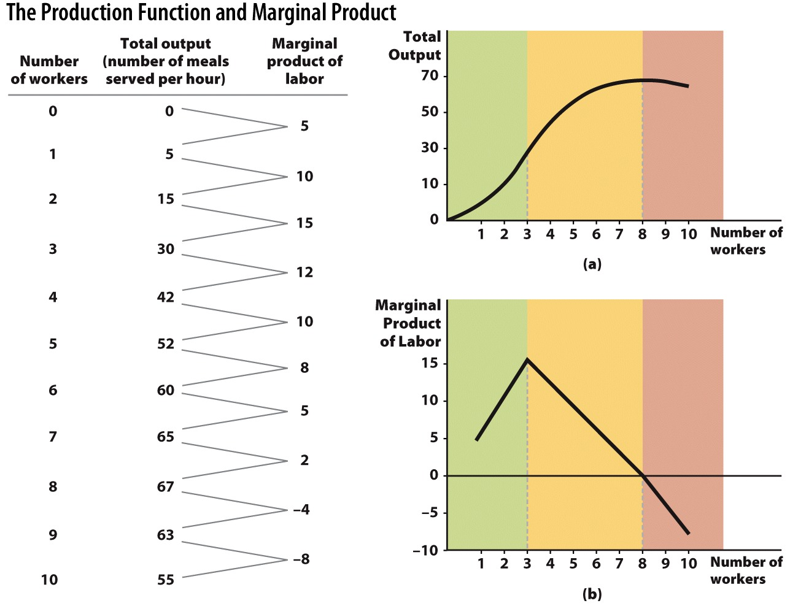
Notes:
Looking down the three columns, we see that for the first three workers, marginal product increases. This happens as workers are able to specialize in different tasks and become more efficient.
After the first three workers, the rate of increase in the marginal product slows down. This is diminishing marginal product. Workers begin to run out of additional tasks in which to specialize. But the marginal product continues to expand, remaining positive through eight workers. This occurs because the gains from specialization are slowly declining.
By the ninth worker (going from 8 to 9), we see a negative marginal product. Once the cash registers, drive-through, grill area, and other service stations are fully staffed, there is not much for an extra worker to do. Eventually, extra workers will get in the way or distract other workers from completing their tasks.
Image: Animated Figure 8.1
Lecture notes:
The graph shows (a) total output and (b) marginal product. The blue total output line in (a) corresponds with the total output data in the table. As the number of workers goes from 0 to 3, total output rises at an increasing rate from 0 to 30. Therefore the slope of the total output curve rises until it reaches the first dashed line. This is shown in the green area. Output increasing at an increasing rate.
Between the first dashed line, at 3 workers, and the second dashed line at 8, the total output curve continues to rise, though at a slower rate; the slope of the total output curve is still positive but becomes progressively flatter. This is the yellow area. Output is increasing at a decreasing rate. Diminishing MPL starts after the 3rd worker. In other words, worker #4 produces less additional output than worker #3. The peak of the MPL curve can be thought of as the point of diminishing MPL.
Finally, once we reach the ninth worker, total output begins to fall and the slope of total output becomes negative. Marginal product is actually negative now. Adding more workers here actually decreases total output. This is shown by the red area.
FIGURE 8.1 The Production Function and Marginal Product
(a) Total output rises rapidly in the green-shaded zone from 0 to 3 workers, rises less rapidly in the yellow zone between 3 and 8 workers, and falls in the red zone after 8 workers. (b) The marginal product of labor rises in the green zone from 0 to 3 workers, falls in the yellow zone from 3 to 8 workers but remains positive, and becomes negative after 8 workers. Notice that the marginal product becomes negative after total output reaches its maximum at 8 workers. As long as marginal product is positive, total output rises. Once marginal product becomes negative, total output falls.

Slide 17
The Law of Diminishing Marginal Product
The extra production obtained from increases in a variable input will eventually decrease as more of the variable input is used together with the fixed inputs.
Diminishing Marginal Product (DMP)
Successive increases in an input eventually cause output to increase at a slower rate.
The point of diminishing returns corresponds to the level that the marginal product begins to decline.
Notes:
Why does the rate of output slow? Recall that in our example, the size of the McDonald's restaurant is fixed in the short-run. Because the building cannot grow, extra workers eventually have less to do or even interfere with the productivity of other workers. Marginal product begins to decline, which we see in the fall of the marginal product curve.
The slope of the total output function reflects diminishing marginal product. At first, increased specialization and division of labor causes the slope of the total output function to rise. However, with the fourth worker, the slope begins to flatten out. This continues as additional workers are added, until total output eventually peaks at 67 meals. Workers nine and ten make matters worse; they have negative marginal products. At that point, the total amount produced declines and the slope becomes negative.
The word eventually is italicized. Note that diminishing MPL may not happen right away.
Note that worker #5 still ADDS to our total output. He just doesn't add AS MUCH as the previous worker! Diminishing MPL does NOT mean that workers decrease our total output.

Slide 18

The Law of Diminishing Marginal Product
Assuming capital (K) is fixed, we eventually get to a point where a new worker (L) adds less output than the previous worker.
Example:
Laborer #3 increases output by 15.
Laborer #4 increases output by 12.
Laborer #5 increases output by 10.
Notes:
Why does the rate of output slow? Recall that in our example, the size of the McDonald's restaurant is fixed in the short-run. Because the building cannot grow, extra workers eventually have less to do or even interfere with the productivity of other workers. Marginal product begins to decline, which we see in the fall of the marginal product curve.
The slope of the total output function reflects diminishing marginal product. At first, increased specialization and division of labor causes the slope of the total output function to rise. However, with the fourth worker, the slope begins to flatten out. This continues as additional workers are added, until total output eventually peaks at 67 meals. Workers nine and ten make matters worse; they have negative marginal products. At that point, the total amount produced declines and the slope becomes negative.
The word eventually is italicized. Note that diminishing MPL may not happen right away.
Note that worker #5 still ADDS to our total output. He just doesn't add AS MUCH as the previous worker! Diminishing MPL does NOT mean that workers decrease our total output.

Slide 19
Why Does This Happen?
Think about the fixed amount of capital:
"Too many cooks in the kitchen".
Extra workers will eventually have less work to do, won't be able to add as much to the overall output.
Not because new workers are less skilled.
With a very large amount of L:
New workers could actually interfere with existing workers and slow them down.
This means negative marginal product!
Notes:
The manager can hire more staff for the busiest shifts, but the amount of space for cooking, the number of cash registers, drink dispensers, and tables in the seating area are fixed. Because the added employees have less capital to work with, any additional labor, beyond a certain point, will not continue to increase the productivity at the same rate as the earlier additions.

Slide 20

Illustration of Diminishing MP_{L}
Use garbage collection as an example:
Fixed input
Capital
One truck
Variable input
Labor
Workers on the truck
Output
Trash cans picked up
Notes:
"Beyond the Book" Slide
Lecture tip:
The next slide has some awesome pictures and animation for your garbage truck.

Slide 21
Garbage
Notes:
Lecture tip:
Click through the slide to reveal workers one at a time.
Before revealing each additional worker, ask the students where the worker should be placed.
We just have one truck and no workers. Where does L #1 go?
He has to be the driver. This would be VERY SLOW. Drive 20 feet, park, get out, get trash, get back in, drive 20 more feet, park, get out, etc. . . .
Where does L #2 go?
In the back. Here, we have specialization and division of labor. Worker #2 has a higher MPL than worker #1. He's not more skilled or educated, but division of labor greatly increases production.
Where does L #3 go?
Perhaps also in the back. Worker #1 drives, #2 gets north side of street, #3 gets south side. Even more specialization.
Where does L #4 go?
We could have him riding shotgun. Perhaps he could give directions. At this point, we probably have diminishing marginal utility. Worker #4 might add a little bit of output but definitely not as much as #3 added.
Where does L #5 go?
I don't know—put him on top of the truck as a lookout? Yell at the kids to get out of the way of the truck? There's not much for him to do!
Where do L #6, 7, 8 go?
Adding too many workers could actually make us experience NEGATIVE marginal product of labor. Too many workers could actually slow us down. (We have to wait for them to all get on the truck, someone falls in the truck, etc . . . .)

Slide 22
Average Product
The average product of an input is the total output produced over a given period divided by the number of units of that input used.
The notation we use is AP.

Slide 23
Average Product of Labor
The average product of labor (AP_{L})is output per unit labor.
The AP_{L} is a measure of productivity.
The AP_{L} increases at first, reaches a maximum, and then decreases. So, the labor productivity increases at first and then decreases.
Although AP_{L} becomes smaller and smaller, it never reaches to zero.

Slide 24
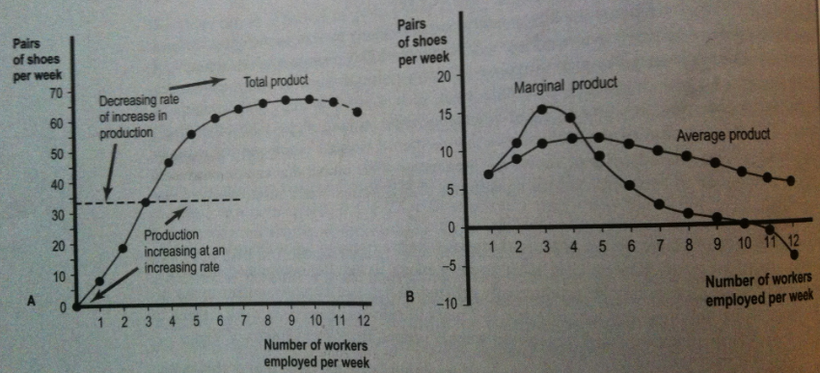
Average Product of Labor

Slide 25
Margin and Average Relationship
How do we know if the average product will increase or decrease when we produce more?
We need to compare the current average to the marginal product of producing another unit.
Key phrase to remember:
"The average follows the margin."
If the margin is above the average
The average will increase.
If the margin is below the average
The average will decrease.
Notes:
You could also say "the margin leads the average."

Slide 26

Margin and Average Relationship
Suppose Lebron James has a scoring average of 30 points per game.
If he has a game in which he scores 45 points
His average increases.
If he has a game in which he scores 12 points
His average decreases.
Once again:
The average follows the margin
Notes:
Try to get the students to finish the phrases on this slide by leading them through it.

Slide 27
MP_{L} and AP_{L} Relationship
When MP_{L} > AP_{L} the average product of labor will rise.
When MP_{L} = AP_{L} the average product of labor will be at the maximum.
When MP_{L} < AP_{L} the average product of labor will decline.
DMP_{L} implies that the average product of labor will eventually decline as more of labor is used together with fixed inputs.
Law of diminishing marginal returns ➔ decline in MP_{L}
Decline in MP_{L} eventually causes ➔ decline in AP_{L}

Slide 28
Economics in Seinfeld
"Seinfeld"
An introduction to costs.
Changing the cost structure by lowering costs can make an activity more profitable.
Notes:
Economics in the Media
Lecture tip:
The clip mentioned on the slide can be found in the Interactive Instructor's Guide. Access the direct link by clicking the icon in the PowerPoint above.

Slide 29
Costs in the Short-Run
Variable Costs (VC)
Costs that are directly related with the rate of output.
Worker wages, electric bill, and food ingredients.
Fixed Costs (FC)
Costs that do not vary with output.
Costs that exist even if output is zero.
Building rent, insurance, and down-payments.
Costs that must be incurred in the short-run even if the firm does not produce anything. There is no fixed cost in long-run.
Total Costs (TC)
The sum of variable and fixed costs.
Notes:
Higher output means higher variable costs.
Fixed costs do not change when output changes.
Fixed costs must be paid, even if Q = 0. Still have to pay the rent on the building even if you don't make any burgers this month.

Slide 30
Costs in the Short-Run
Average Total Cost (ATC)
Total cost divided by the number of units produced: "cost per unit."
Analogously,
Average Variable Cost (AVC)
Average Fixed Cost (AFC)
Marginal Cost (MC)
The increase in total cost that occurs from producing additional output.
Change in total cost divided by change in output.
Notes:
We can find three averages as shown above.
Marginal analysis is important to economists. We will see how the average is affected by changes at the margin.

Slide 31
Some Notes About the Equations
Set ΔQ = 1
MC
Easy if we can set the denominator equal to 1
Makes division and intuition simpler.
AFC
Will always decrease as we produce more output.
Why?
Notes:
We can't always set the denominator = to 1, but it is easier intuitively if we can.
"We produced one more burger. How did our total costs change as a result?"
Why does AFC always decrease?
Mathematically, as you increase output, you are taking a constant (TFC) and dividing it by a larger and larger denominator (Q).

Slide 32
Cost Equations
Notes:
Red rectangle:
How to find ALL costs. Variable + Fixed
Green shape:
The three average equations. All are similar—notice the Q in the denominator.
Purple rectangle:
Just as the total variable + total fixed = total costs, so the sum of the averages gives the total average. Realize that this equation can also be found just by dividing the first equation by Q. (Divide by Q on both sides.)
Blue rectangle:
Δ = change
We want to examine how total cost is changed when we change output levels.

Slide 33
Q | TVC | TFC | TC TVC + TFC | AVC TVC ÷ Q | AFC TFC ÷ Q | ATC TC ÷ Q or AVC + AFC | MC Δ TVC÷ΔQ
0 | $0.00 | $100.00 | $100.00
10 | 30.00 | 100.00 | 130.00 | $3.00 | $10.00 | $13.00 | $3.00
20 | 50.00 | 100.00 | 150.00 | 2.50 | 5.00 | 7.50 | 2.00
30 | 65.00 | 100.00 | 165.00 | 2.17 | 3.33 | 5.50 | 1.50
40 | 77.00 | 100.00 | 177.00 | 1.93 | 2.50 | 4.43 | 1.20
50 | 87.00 | 100.00 | 187.00 | 1.74 | 2.00 | 3.74 | 1.00
60 | 100.00 | 100.00 | 200.00 | 1.67 | 1.67 | 3.34 | 1.30
70 | 120.00 | 100.00 | 220.00 | 1.71 | 1.43 | 3.14 | 2.00
80 | 160.00 | 100.00 | 260.00 | 2.00 | 1.25 | 3.25 | 4.00
90 | 220.00 | 100.00 | 320.00 | 2.44 | 1.11 | 3.55 | 6.00
100 | 300.00 | 100.00 | 400.00 | 3.00 | 1.00 | 4.00 | 8.00
Notes:
Rectangle 1:
Q: This column just shows our total output. Costs are a function of our output level.
Rectangles 2 and 3:
TVC: Notice that if output is zero, TVC is zero. If we produce nothing, we don't have to pay workers, turn the lights on, pay for ingredients, etc. More production means more TVC.
Rectangle 4:
TFC: Note two things about TFC.
Even if output is zero, we still have fixed costs! Got to pay the rent on the building even if we don't make any burgers this month.
TFC does not change with output. Our rent won't go up just because we make more burgers. It stays the same.
Rectangle 5:
TC: Total cost is the sum of ALL COSTS. Total costs are positive at Q = 0 because FC is positive at Q = 0. Mathematically, TC = TVC + TFC. There is direct relationship between Q and TC.
Rectangle 6:
Blank spaces in table: At Q = 0, we can't compute averages since we can't divide by zero. Also, we can't experience the marginal cost of the 0th unit of output. That doesn't make sense. For in this table, the MC is given directly to the right of the unit. In other words, the marginal cost of the 10th unit is $3.00.
Rectangle 7:
AVC: AVC is U-shaped. It hits the minimum at Q = 60. This is shown in red text, as are the minimums of the other average and marginal curves. Mathematically, AVC = TVC ÷ Q
Rectangle 8:
AFC: AFC is the only average or marginal curve that is NOT U-shaped. AFC is downward-sloping, and always decreases with higher production levels. Remember that this is called "spreading overhead." AFC is minimized at the highest output level in this table, Q = 100.
Rectangle 9:
ATC: ATC is U-shaped. Mathematically, it can be found by one of two ways:
ATC = TC ÷ Q
ATC = AVC + AFC
The minimum ATC is called efficient scale. A firm will be efficiently producing if average costs are minimized.
Rectangle 10:
MC: MC is U-shaped as well. Mathematically, MC = ΔTVC ÷ ΔQ, and in this particular table, ΔQ always equals 10. Remember that Δ means change. MC is minimized at Q = 50 and starts to rise after that. Minimum marginal cost is associated with maximum marginal product. Increasing marginal cost is associated with diminishing marginal product.

Slide 34
Practice What You Know Using the Equations
Fill in the table below using the cost equations.
You have five minutes. Work with your classmates!
Q | TVC | TFC | TC | AVC | AFC | ATC | MC
0 |  |  | 720 | -- | -- | -- | --
1 | 7
2 |  |  | 740
3 |  |  |  | 15
4 |  |  |  |  |  | 202
Notes:
Give the students five minutes to fill out this table.
Hint for students: You may to switch around parts of your cost equations to solve this! Instead of adding, you may have to subtract. Instead of dividing, you may have to multiply!
Tell your students this is Economics Sudoku.
Another hint:
Tell the students there are two columns they can fill out completely right away. Then, it may be best to go row by row.

Slide 35
Practice What You Know Using the Equations
Fill in the table below using the cost equations.
Q | TVC | TFC | TC | AVC | AFC | ATC | MC
0 | 0 | 720 | 720 | -- | -- | -- | --
1 | 7 | 720 | 727 | 7 | 720 | 727 | 7
2 | 20 | 720 | 740 | 10 | 360 | 370 | 13
3 | 45 | 720 | 765 | 15 | 240 | 255 | 25
4 | 88 | 720 | 808 | 22 | 180 | 202 | 43
Notes:
Here is a good "order" to fill out the table.
When output is zero, TVC is zero. Fill that zero in.
TVC + TFC = TC, so TFC = 720 when Q =0.
TFC is always 720! Fill in that whole column.
We can now find AFC easily by dividing TFC by Q in each row. Fill in the whole AFC column.
Fill out row Q = 1. TC is the sum, TC = 727. Divide to find the averages. MC = 7 since our costs increased by 7 when we increased output by 1. ∆Q in this table is 1. Easy division and intuition.
Fill out row Q = 2. TVC must be 20. Divide to find the averages. MC = 13.
In row Q = 3, we can find ATC first by adding AVC and AFC. ATC = 255. Then, we can multiply the averages by Q = 3 to get the totals! MC = 25.
In row Q = 4, find AVC by subtracting AFC from ATC. AVC = 22. Then, multiply to find totals. Subtract current TVC from previous TVC to get MC = 43.

Slide 36
TC, TVC, and TFC
Notes:
At first total cost rises at a decreasing rate due to gains from specialization. Eventually diminishing marginal product causes the total cost curve to rise at an increasing rate.
This point in the curve is called an inflection point.
Costs are increasing at a decreasing rate . . . then it switches to. . . . Costs are increasing at an increasing rate.
Note that the entire curve is still sloped upward, though. More production means more total costs.
Why is the vertical intercept positive (instead of at zero)? Because of the existence of fixed costs. Even if Q = 0, you have fixed costs to pay.

Slide 37
MC, ATC, AVC, and AFC
Notes:
The AFC function is downward-sloping (spreading overhead). Sometimes, we don't even draw the AFC curve because of its uninteresting shape.
The other curves (ATC, AVC, MC) are U-shaped. The U-shaped cost curves are derived from the hill-shaped product curves.
Note that the marginal cost curve cuts through the average variable cost (AVC) curve and the average total cost (ATC) curve at their lowest point. This reflects the mathematical relationship. Recall the process we used to describe your GPA. A good grade brings your grade point average up and a poor grade brings the average down. Similarly, the marginal change always leads the average; when the marginal cost is below the average, it brings the average down, and when the marginal cost is above the average it brings the average up.
The MC curve reaches its lowest point before the lowest point in the AVC and ATC curves. For this reason, a business executive concerned about rising costs would look to the MC curve as an early indicator. Once marginal cost begins to increase, it continues to pull down average variable cost until sales reaches 60 Big Macs. After 60 Big Macs are sold, MC is above AVC and the AVC begins to rise as well. However, ATC continues to fall until 70 Big Macs are sold. Why does average total cost fall while MC and AVC are rising? The answer lies with the average fixed cost (AFC) curve. Since ATC = AFC + AVC, and AFC declines as output rises, ATC declines until 70 Big Macs are sold. After that point, increases in output cause all three of the U-shaped cost curves (MC, AVC, and ATC) to rise.
It makes sense that variable costs should initially decline as a result of increased specialization. However, at some point the advantages of continued specialization are overtaken by diminishing marginal product. The transition from falling costs to rising costs is of particular interest because as long as costs are declining the firm will be able to lower its costs by increasing its output. Economists refer to the quantity of output that minimizes average total costs as the efficient scale.

Slide 38
Why U-Shaped Cost Curves?
Why are the short-run cost curves, including the ATC, AVC, and MC, U-shaped?
Diminishing marginal product!
Explanation?
Assume all labor is paid the same wage.
Eventually, inputs become less productive at the margin (lower productivity).
This implies that output costs will start to rise.

Slide 39
Why U-Shaped Cost Curves?
Is there a mathematical relationship between input productivity and output costs?
Example
Each worker gets paid w = $100.
If Bob has high MPL and produces q = 20, the cost of those output units is $5 each.
If Carl has low MPL and produces q = 10, the cost of those output units is $10 each.
Notes:
W = wage rate paid to the workers.
It's not that Carl is dumb or unmotivated, he may have just been hired at a time of low marginal productivity. There may have not been a task left that he could specialize in.

Slide 40
Economics in The Office
"The Office, Broke"
Michael Scott starts his own paper company to compete with Staples and Dunder Mifflin.
Notes:
"Economics in the Media" Slide
Lecture tip:
The clip mentioned on the slide can be found in the Interactive Instructor's Guide. Access the direct link by clicking the icon in the PowerPoint above.
The key concepts covered in this clip are:
Variable costs
Fixed costs
You can follow up this clip by asking students these questions:
What are Michael's fixed costs? His variable costs?
Is hiring essential employees and not paying benefits sustainable?
Is it better to have more costs but have more loyal employees?

Slide 41
Economics in The Simpsons
"The Simpsons"
"Homer Versus Lisa & the 8th Commandment"
Variable costs and fixed costs
Notes:
"Economics in the Media" Slide
Lecture tip:
The clip mentioned on the slide can be found in the Interactive Instructor's Guide. Access the direct link by clicking the icon in the PowerPoint above.
The key concepts covered in this clip are:
Variable costs
Fixed costs
You can follow up this clip by asking students these questions:
What is Homer's fixed cost of getting cable? His variable cost?
What does this clip say about economic incentives and stealing?

Slide 42
Conclusion
Costs are defined in a number of ways, but marginal cost plays the most crucial role in a firm's cost structure.
By observing what happens to marginal cost you can understand changes in average cost and total cost. This is why economists place so much emphasis on marginal costs.

Slide 43
Summary
Economists break cost into two components.
Explicit costs (can be easily calculated).
Implicit costs (are hard to calculate).
There are also two types of profits.
Accounting profits
Occurs when revenues are larger than the explicit costs.
Economic profits
Occurs when revenues are larger than the combination of explicit and implicit costs.
To optimize production, firms must effectively combine labor and capital in the right quantities.

Slide 44
Summary
In any short-run production process there will be a point of diminishing marginal product.
Adding additional units of a variable input will no longer produce as much additional output as before.

Slide 45
Summary
The MC curve always leads the ATC and AVC curves.
With the exception of the AFC curve, which always declines, short-run cost curves are U-shaped.
All variable costs initially decline due to increased specialization.
Eventually, the advantages of continued specialization give way to diminishing marginal product and the MC, AVC, and ATC curves begin to rise.

Slide 46
Practice What You Know
Bob runs a small family restaurant. How would you describe the monthly rent he pays on the building?
Explicit cost, variable cost.
Explicit cost, fixed cost.
Implicit cost, variable cost.
Implicit cost, fixed cost.
Notes:
Correct answer: B
Rent is explicit cost—you have to write a check to whoever owns the building
Rent is a fixed cost—it's the same rent each month, no matter how many or few patrons you serve.

Slide 47
Practice What You Know
Which of the following is an example of an implicit cost?
Wages paid to employees.
Cost of food delivery.
The opportunity cost of the owner's time.
Monthly insurance premiums.
Notes:
Correct answer: C
Implicit costs are indirect expenses, or opportunity costs. The owner could be getting paid doing something else. How much is he giving up by being at his current job?

Slide 48
Practice What You Know
Assuming the existence of efficient scale, the MC, ATC, and AVC curves are:
Vertical
Horizontal
hill-shaped
U-shaped
Notes:
Correct answer: D
Efficient scale is the output associated with the bottom of the ATC curve.

Slide 49
Practice What You Know
Suppose the wage rate that a company pays its workers increases. In terms of the cost equations, which of the following is true?
TC will increase, but ATC will decrease.
TVC will increase, but AVC will decrease.
The MC curve will become hill-shaped.
The TFC and AFC will not change.
Notes:
Correct answer: D
Wage rates are a variable expense, but the fixed costs won't change.
All variable expenses will increase as the result of a wage increase.

Slide 50
Practice What You Know
Total output with seven workers is Q = 70. Total output with eight workers is Q = 82. What is the marginal product of the eighth worker?
12
10
82
8
Notes:
Correct answer: A
82 – 70 = 12

Slide 51
Sources
"Principles of Economics with Smartwork Access (ISBN: 978-0-26314-5), 1st Edition, 2013" by Mateer and Coppock
"Economics: Custom Edition for NCSU (ISBN: 9781937435202" by David Hyman

