Slide 1
Economics
Week #9

Slide 2
Topics of Week #9
Uses of GDP Data
Business Cycle*
Unemployment
Types of Unemployment*
Full Employment Output (Potential Real GDP)*
Consumer Price Index
Comparing Dollar Values Across Time*
Inflation*
Cost of Inflation*
"*" Indicates the most important topics.
Mateer and Coppock: Chapter #19, #20 and #21

Slide 3
Three Uses of GDP Data
Why is GDP useful to examine?
Estimate living standards across time and nations.
Measure economic growth.
Determine whether an economy is experiencing a short-run expansion or recession.

Slide 4
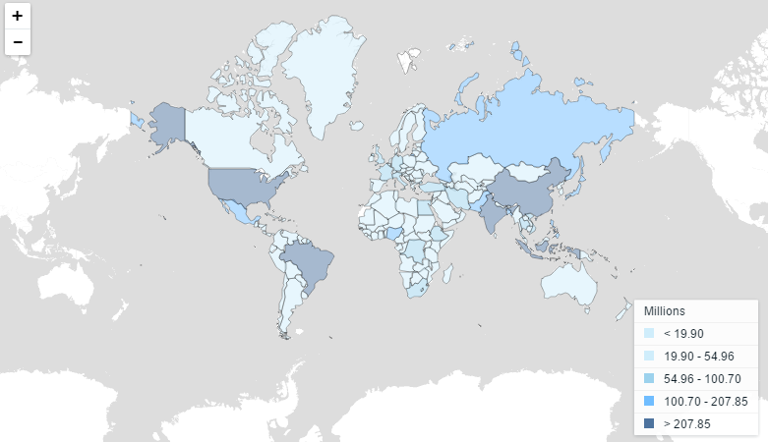
Measuring Living Standards
Total GDP:
Not as accurate for cross-country comparisons
Does not adjust for population size of country
Notes:
Lecture notes:
The level of GDP may not be the best measure to compare across countries. The population varies dramatically across countries. These differences are displayed on the map. Failing to account for variation in population size when measuring total production could lead to biased results.

Slide 5
Measuring Living Standards
Per capita GDP
GDP per person (GDP divided by population).
Average living standards in a nation.
Remember to use Real GDP instead of Nominal GDP.
Notes:
Example:
India has a higher total GDP than Australia. However, per capita GDP of Australia is much higher than India’s, due to the very large population of India.

Slide 6
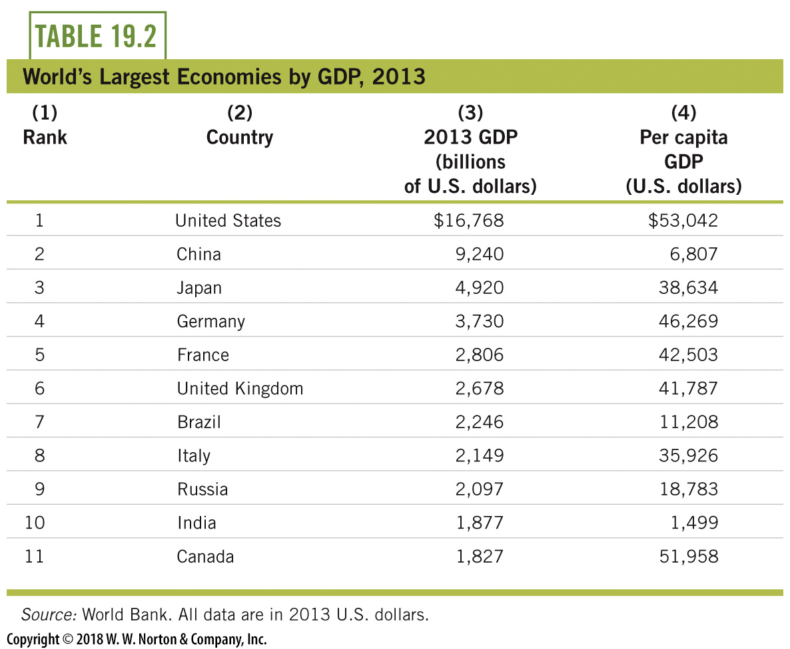
Measuring Living Standards
1) Rank | 2) Country | 3) 2013 GDP (billions of U S dollars) | 4) Per capita GDP (U S dollars)
1 | United states | 16,768 dollars | 53,042 dollars
2 | China | 9,240 dollars | 6,807 dollars
3 | Japan | 4,920 dollars | 38,634 dollars
4 | Germany | 3,730 dollars | 46,269 dollars
5 | France | 2,806 dollars | 42,503 dollars
6 | United Kingdom | 2,678 dollars | 41,787 dollars
7 | Brazil | 2,246 dollars | 11,208 dollars
8 | Italy | 2,149 dollars | 35,926 dollars
9 | Russia | 2,097 dollars | 18,783 dollars
10 | India | 1,877 dollars | 1,499 dollars
11 | Canada | 1,827 dollars | 51,958 dollars
Notes:
Lecture notes:
We start with a look at the nations with the highest GDP in the world.
The table lists the world’s largest economies by GDP in 2013.
The third column shows GDP for the top eleven economies.
This column gives us a picture of the overall output and income of each of these nations.
Total world GDP in 2013 was $76 trillion, which means that the United States produced over 20 percent of all final goods and services in the world.
The most significant movement on this list belongs to China, who ranked only seventh in 1999.
By 2010, China actually surpassed Japan for second highest GDP in the world and remains above Japan in 2013.
If we instead consider GDP per capita, the rankings would be different.
For example, in 2013, there was about $39,000 worth of GDP or income for every person in Japan and only about $7,000 per person in China.
While China produced a larger amount of overall GDP than Japan, the income generated by GDP in China has to be divided over about ten times more than in Japan (the population in China is about 1.4 billion; in Japan, it is about 127 million).
Real-world example: Distribution of Worldwide Real GDP per Capita
This would be a good point in the lecture to discuss the real-world example on distribution of worldwide real GDP per capita, from the Interactive Instructor’s Guide (see Tip #208).

Slide 7
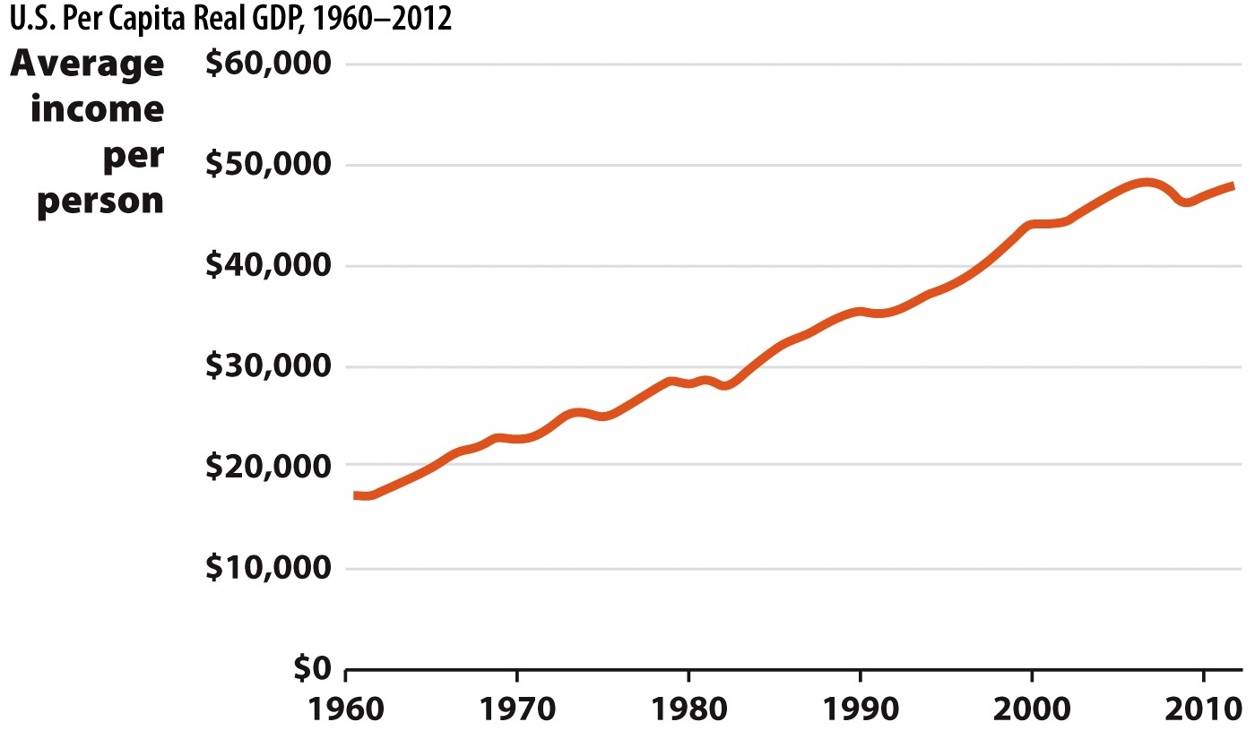
Measuring Economic Growth U.S. Per Capita Real GDP
Notes:
We also use GDP data to measure economic growth over time, or changes in average living standards. When economies grow and living standards rise, this shows up in the GDP data.
This figure shows the change in inflation–adjusted per capita GDP for the United States from 1960 to 2012. This graph helps us see that living standards rose in the United States over the past 50 years, even though growth was not positive in every year.

Slide 8
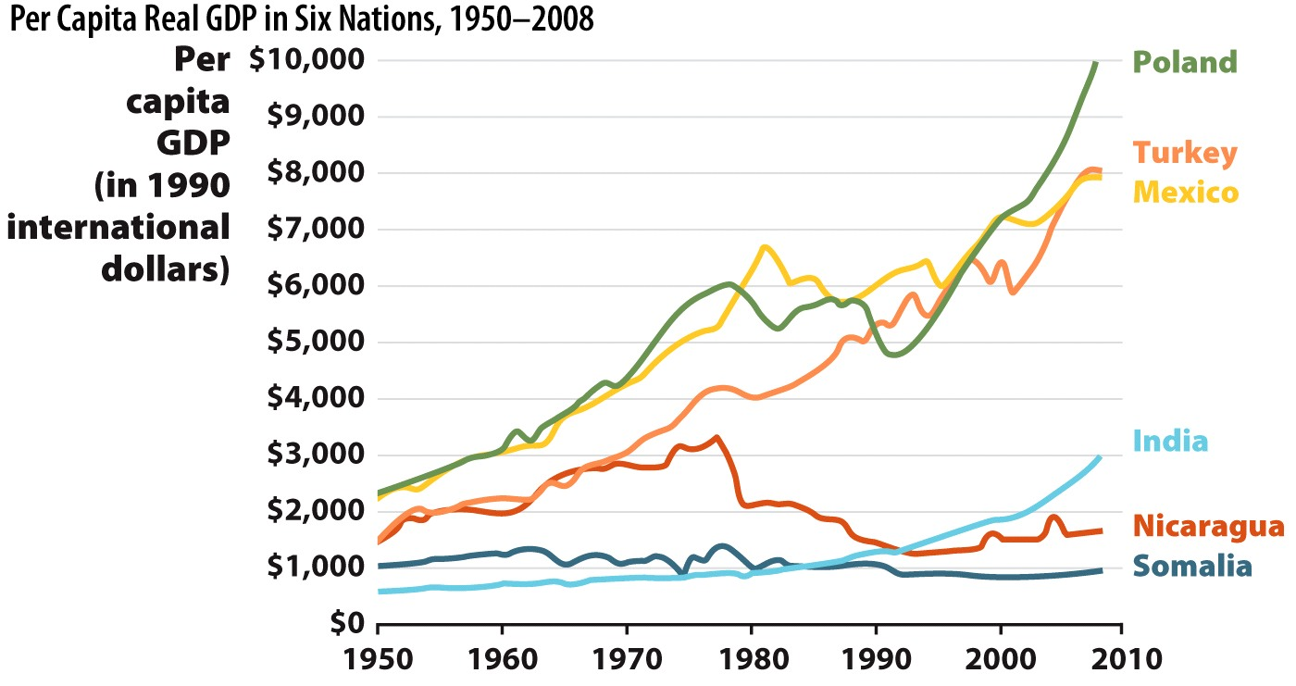
Per Capita Real GDP in Six Nations
Notes:
We start with a look at the nations with highest GDP in the world. The table lists the world’s largest economies by GDP in 2009. The third column shows GDP for the top fifteen economies. This column gives us a picture of the overall output and income of each of these nations.
Total world GDP in 2009 was $58 trillion which means the U.S. produced almost 25% of all final goods and services in the world. The most significant movement on this list belongs to China, who ranked only seventh in 1999. By 2010, China actually surpassed Japan for second-most GDP in the world.
By using the per capita GDP, the table above reveals that (in 2009) there was about $40,000 worth of GDP or income for every person in Japan, and $4,000 per person in China. In 2009, Japan and China had about the same amount of overall GDP, but the income generated by this GDP in China has to be divided over about ten times as in Japan (the population in China is about 1.3 billion; in Japan, it is about 130 million).
But you should not presume that economic growth is automatic or even standard. Figure 19.2 shows the experience of six other nations—six distinct experiences.

Slide 9
Measuring Business Cycles
Business Cycle
Short-run fluctuations in economic activity that can cause output to be above or below the long-run trend.
Parts of a business cycle
Expansion
Contraction
Peak
Trough
Notes:
Even if an economy is expanding in the long run, it is normal to go through periodic contractions in growth. Typically economic growth follows a short-run pattern of alternating periods of expansion and contraction, characterized by changes in employment, productivity and interest rates known as the business cycle.

Slide 10
The Business Cycle
Notes:
The figure illustrates the business cycle against the long-term trend in Real GDP growth.
Instead of tracking along the long-run growth line of GDP, the economy experiences fluctuations in output, climbing to short-run peaks when GDP is higher than usual and falling to short-run troughs when output is below the trend. The peaks and troughs, or high and low watermarks, divide the business cycle into two distinct phases, expansions and contractions. Expansions occur from the bottom of a trough to the next peak. After a period of time, the economy enters a contraction, or the period from the peak downward to the trough. During this phase, the economy is growing at a slower rate than normal.

Slide 11
The Business Cycle
Peak: is the highest level of real GDP in the cycle. Each peak indicates an economy operating at close to full capacity. ➔ Likely to have a shortage of labor and materials; low unemployment.
Contraction or Recession: is a period of declining or abnormally low real GDP (when real GDP declines for two consecutive three-month reporting periods). ➔ Income, business profits, business demand for investment goods decline in recessions.
Trough: is the lowest level of real GDP observed over the business cycle. ➔High unemployment, low demand for goods.
Recovery: is used to describe an expansion in economic activity after a trough if the expansion follows a period of contraction severe enough to be classified as a recession. ➔ Income, business profits, business demand for investment goods increase in recovery.

Slide 12
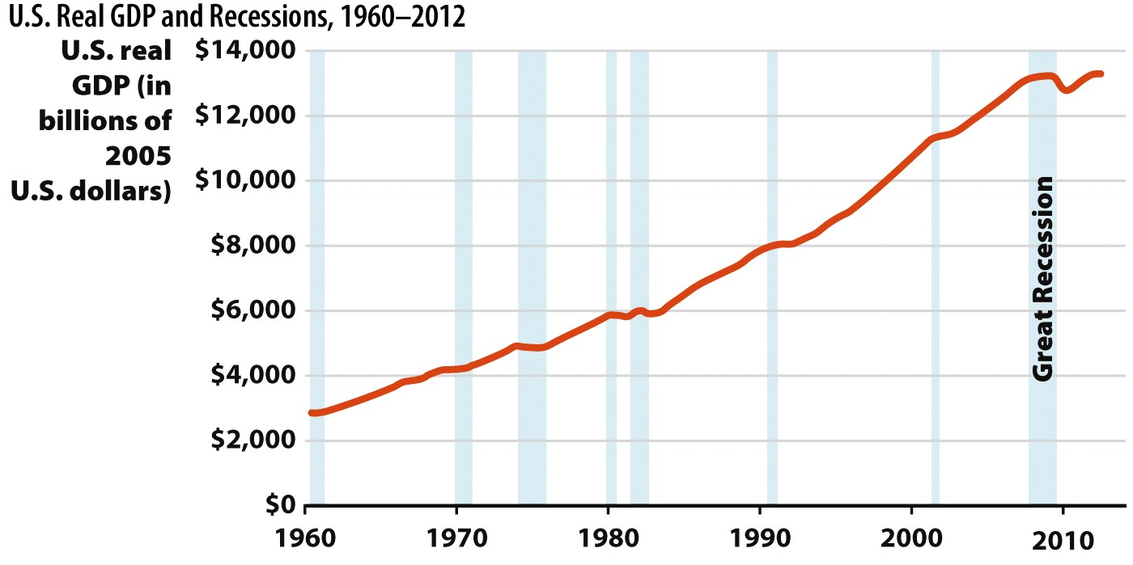
U.S. Real GDP and Recessions, 1960—2012
Notes:
This figure is a plot of actual U.S. real GDP over time, with contractionary periods shaded. These shaded areas are areas of official recession of the U.S. economy. Notice how real GDP consistently declines in these contractionary periods. You may recall the recession that began at the end of 2007—this episode shows up clearly in the data.

Slide 13
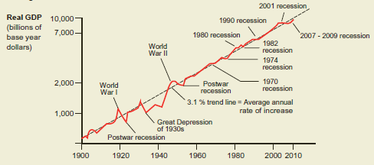

Slide 14
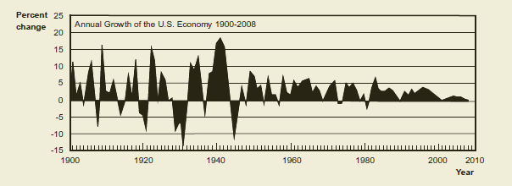

Slide 15
Unemployment
Why so much unemployment after recession?
Certain industries hit hard
Housing
Adjustment lags
Corrections take time, not instant
Government policy
Unintended consequences lengthened unemployment
How unemployment is measured?
If you’re not looking for a job, you’re not counted as unemployed. If you start looking again, you’re unemployed.
Notes:
Adjustment lags—it takes time to switch jobs and it takes time to hire workers.
Some government policies enacted during the recession had unintended consequences and inadvertently extended the duration of unemployment for many workers.
Unemployment is sometimes a bit inaccurate in the sense that people who are not working and not actively searching for work are not considered part of the labor force, and are thus not considered unemployed. This is true even if the person really does want to work. Once that person starts to search for work, they are then once again considered part of the labor force and are unemployed.

Slide 16
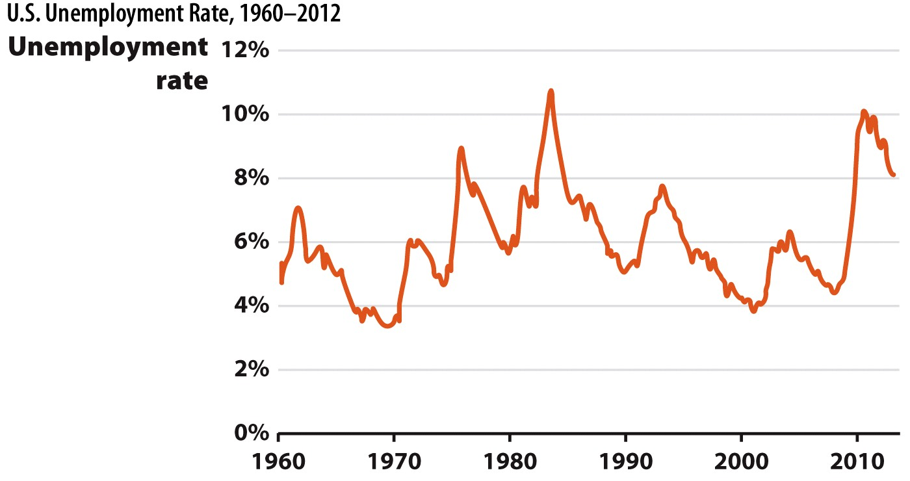
U.S. Unemployment Rate 1960–2012
Notes:
The unemployment rate is an important indicator of the economy’s health. Since 1960, the average unemployment rate in the United States has been about 6%.

Slide 17

Looking at the Data
Labor force
People who are employed or actively seeking work.
Who is not in the labor force?
Jobless people not actively seeking employment (no efforts made in four weeks)
Retirees
Students
Institutionalized
Unemployment Rate =
Notes:
It makes sense to filter out groups that aren’t really looking for a job. These groups include retirees, stay-at-home parents, people in jail, military personnel, children, and many full-time students.

Slide 18
Measuring Unemployment in the United States, April 2012
Relevant Population: 243 million
- Noninstitutionalized
- Civilian
- Aged 16+
Not in Labor Force: 89 million
- Students
- Homemakers
-Retirees
- Others
Labor Force: 154 million
Employed: 142 million
91.9% of labor force
Unemployed: 12 million
8.1% of labor force
Notes:
To compute the unemployment rate, we divide the relevant adult population between those who are in the labor force and those who are not. To be counted in the labor force, a person must either have a job or be actively seeking work. The unemployment rate is the percentage of the labor force that is unemployed.

Slide 19
Three Types of Unemployment
Is it practical to have zero unemployment?
Generally, unemployment is a drain on society and very difficult for certain individual households.
However, as our economy changes and progresses, certain jobs are destroyed.
We can never eliminate unemployment entirely.
Three types of unemployment
Structural
Frictional
Cyclical

Slide 20
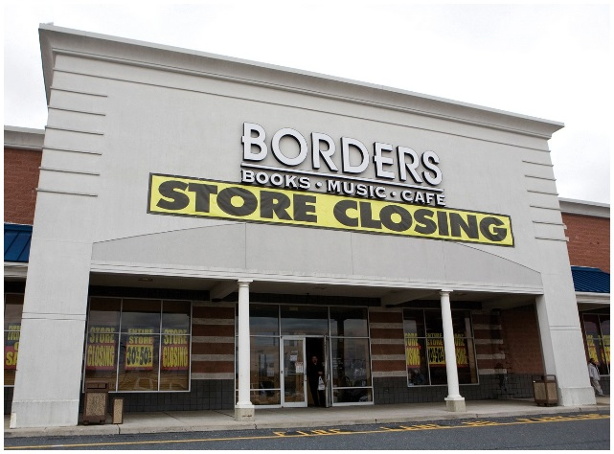
Structural Unemployment
Structural unemployment
Unemployment caused by changes in the industrial makeup (structure) of the economy.
Joseph Schumpeter: "creative destruction."
New industries are created, and old ones are destroyed.
Examples:
Borders (bookstore) bankrupt in 2011. Job losses in the book industry. Why?
U.S. steel industry:
1980: 500,000 laborers
2010: 150,000 laborers
More automated equipment, safer and more efficient.
Notes:
Structural unemployment can create short-run problems of transition, but usually it is a sign of a healthy, growing economy.
Steel production has become much more efficient, and advanced engineering has made it possible for firms to replace workers with automated equipment. These changes mean that the steel that is manufactured today is safer than ever before but also that fewer workers are needed to make it. That trade-off is reflected in the employment numbers for the industry.
We could perhaps "protect" jobs that are about to be creatively destroyed, but doing so would be an inefficient use of resources and a drag on our economy. There are even tradeoffs to economic progress, as some "old" jobs are destroyed.

Slide 21


Structural Unemployment
Changes in American economy over time
Agricultural (working in fields)
Manufacturing (working in factories)
Service (working in offices, online)
Today: United States = "service economy"
Notes:
Job turnover is normal in a growing economy. In 2006, real GDP in the U.S. grew by 2.7%, and 2 million new jobs were created. Yet in that year of growth, there were approximately 5 million job separations (quits and layoffs) every month.
All of this churning causes temporary job loss. In the short run, many workers’ jobs are rendered obsolete by the churn of creative destruction. This leads to structural unemployment, and this unemployment exists even though there are jobs available and there are workers to fill those jobs.

Slide 22
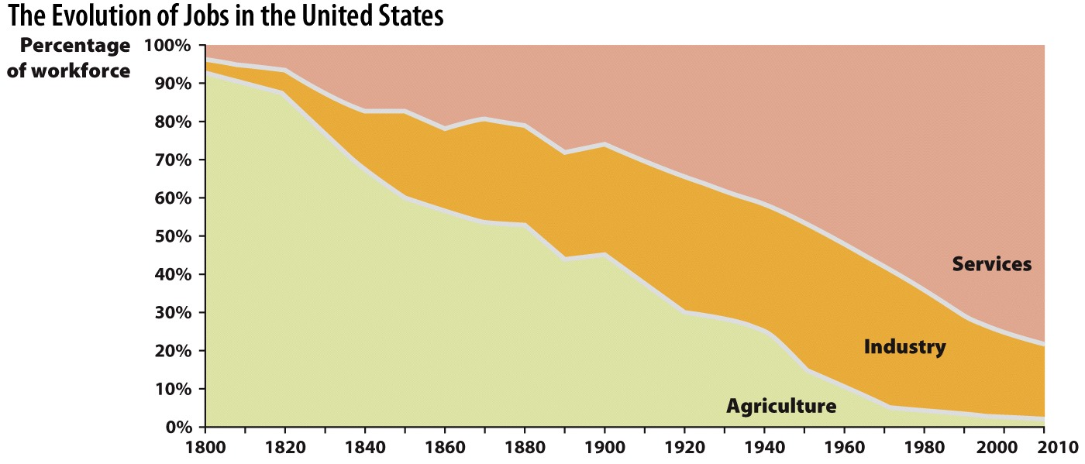
Growing and Changing Economies
Notes:
In the past 200 years the majority of lost jobs were first from agriculture and then manufacturing, as the service sector became the largest employment sector. American workers moved from the fields into factories and then into office buildings, and today they are increasingly working online.
Since 1979, manufacturing employment in the United States. has fallen from almost 20 million to just 11.5 million. Over the same period, employment in service-providing industries has risen from 65 million to about 112 million. Today, five out of every six U.S. workers works in a service-providing occupation.

Slide 23

Frictional Unemployment
Frictional unemployment
Unemployment caused by time delays in matching available jobs and workers.
People don’t instantly take a new job, and they might not want to take the first available job.
Firms don’t always hire the first applicant.
Example:
Recent college grads
Spouse of a person who moves for a new job
Notes:
When you graduate from college, it will likely take you a while to determine the very best job offer you have. You won’t be just interested in any job, you want the best job possible.
On the other side of the job market, employers rarely hire the first applicant they see, even though it may be costly to leave the position vacant. These time lags create frictional unemployment.
Frictional unemployment is considered "natural" by economists.

Slide 24
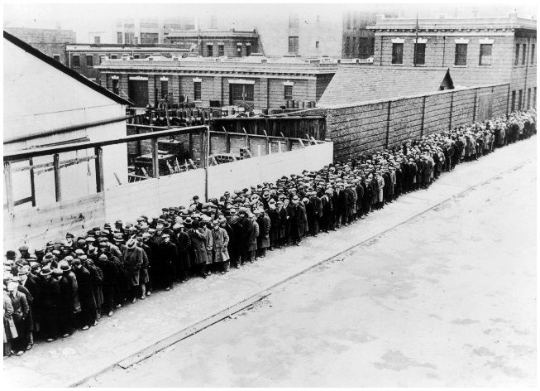
Cyclical Unemployment
Cyclical Unemployment
Caused by economic downturns.
The "worst" kind of unemployment.
Occurs for an unknown length of time.
2008: 18 months, 10% unemployed.
Natural Rate of Unemployment (u*)
Typical rate of unemployment in a healthy economy.
Actual rate of unemployment denoted by (u).
Full Employment Output (Y*)
Output by an economy with no cyclical unemployment.
In some books, Full Employment Output = Potential Real GDP = Natural Rate of Output.
Actual Output denoted by (Y).
Notes:
Frictional unemployment is clearly temporary; it disappears when workers are matched with jobs. Structural employment is also temporary; it disappears when workers take the new jobs created by the structural change. But the duration of cyclical unemployment is open ended. This type of unemployment is due to general macroeconomic downturns, and nobody knows how long these may last. Fortunately, recessions in the United States have been fairly short in recent times.
The additional notation shown here (u, u* Y, Y*) will be discussed in the upcoming slides and table.

Slide 25
Three Types of Unemployment
Actual Unemployment Rate during Recession
Cyclical
Bad!
Actual Unemployment Rate during Normal Macroeconomic Conditions
Always occurring, denoted as u*
Structural
Structural
Natural Unemployment
Frictional
Frictional
Natural unemployment is currently
estimated to be around 6%.
Notes:
During recessions, people may be unemployed for any one of the three reasons. But during normal healthy economic periods, cyclical unemployment falls toward zero. The unemployment that’s left (structural and cyclical) makes up what we call the natural rate of unemployment.
The natural rate of unemployment (u*) is the typical rate of unemployment when the economy is growing normally. The figure shows the relationship between all three types of unemployment and macroeconomic conditions.

Slide 26
Economics in Bronze Age Orientation
"Bronze Age Orientation"
This clip illustrates two, Mitchell and Webb, cavemen facing possible structural unemployment during the movement from the Stone Age to the Bronze Age
Notes:
"Economics in the Media" Slide
Lecture tip:
The clip mentioned on the slide can be found in the Interactive Instructor’s Guide. Access the direct link by clicking the icon in the PowerPoint above.
The key concepts covered in this clip are:
Jobs and unemployment
Economic growth
Structural unemployment

Slide 27
Natural Rate of Unemployment and Output
Healthy Economy (Long Run) | Recession (Temporary) | Super-Normal Expansion (Temporary)
u = u* | u > u* | u < u*
Y = Y* | Y < Y* | Y > Y*
Cyclical unemployment is zero | Cyclical unemployment is positive | Cyclical unemployment is negative
Long Run
Notes:
Intuition:
You can think of the asterisk (*) as showing the natural or "optimal" levels.
u* and Y* are the natural rate of unemployment and the rate of output with that rate of unemployment.
u and Y (no asterisks) are the ACTUAL rates of unemployment and output in the economy.
From text:
For completeness, we note that sometimes the actual unemployment rate is less than the natural rate (u < u*). This happens temporarily when the economy is expanding beyond its long-run capabilities. Think about the conditions that might bring this about. Demand for output might be so high that firms keep their factories open for an extra shift and pay their workers to work overtime. Resources are employed at levels greater than those sustainable for the long run.
Under these circumstances, output is at greater than full employment output (Y > Y*), and the unemployment rate is less than the natural rate (u < u*). Sometimes economists refer to full employment output as potential output or potential GDP. These terms clarify that, without additional changes, the economy cannot sustain an output greater than Y* in the long run.

Slide 28
Full Employment Output (Potential Real GDP)
Potential real GDP is the "benchmark" against which actual performance of the economy is measured.
When the economy operates below potential real GDP there will be cyclical unemployment.
Sometimes the economy operates at levels of production that exceed potential real GDP as the economy "overheats". When the economy is overheated upward pressures on wages and prices occur and real GDP falls.
Potential Real GDP grows over time with growth in resources, and improvement in resource quality and in technology. Without additional changes, the economy cannot sustain an output greater than Potential Real GDP in the long run.

Slide 29
The Business Cycle
If the actual real GDP is above the Long-run trend of GDP (you can consider it as Full Employment Output-Potential Real GDP trend) cyclical unemployment is negative and natural unemployment is higher than actual unemployment.
On the Long-run trend of GDP (you can consider it as Full Employment Output-Potential Real GDP trend) cyclical unemployment is zero and natural unemployment is equal to actual unemployment.
If the actual real GDP is below the Long-run trend of GDP (you can consider it as Full Employment Output-Potential Real GDP trend) cyclical unemployment is positive and natural unemployment is less than actual unemployment.
Notes:
The figure illustrates the business cycle against the long-term trend in Real GDP growth.
Instead of tracking along the long-run growth line of GDP, the economy experiences fluctuations in output, climbing to short-run peaks when GDP is higher than usual and falling to short-run troughs when output is below the trend. The peaks and troughs, or high and low watermarks, divide the business cycle into two distinct phases, expansions and contractions. Expansions occur from the bottom of a trough to the next peak. After a period of time, the economy enters a contraction, or the period from the peak downward to the trough. During this phase, the economy is growing at a slower rate than normal.

Slide 30
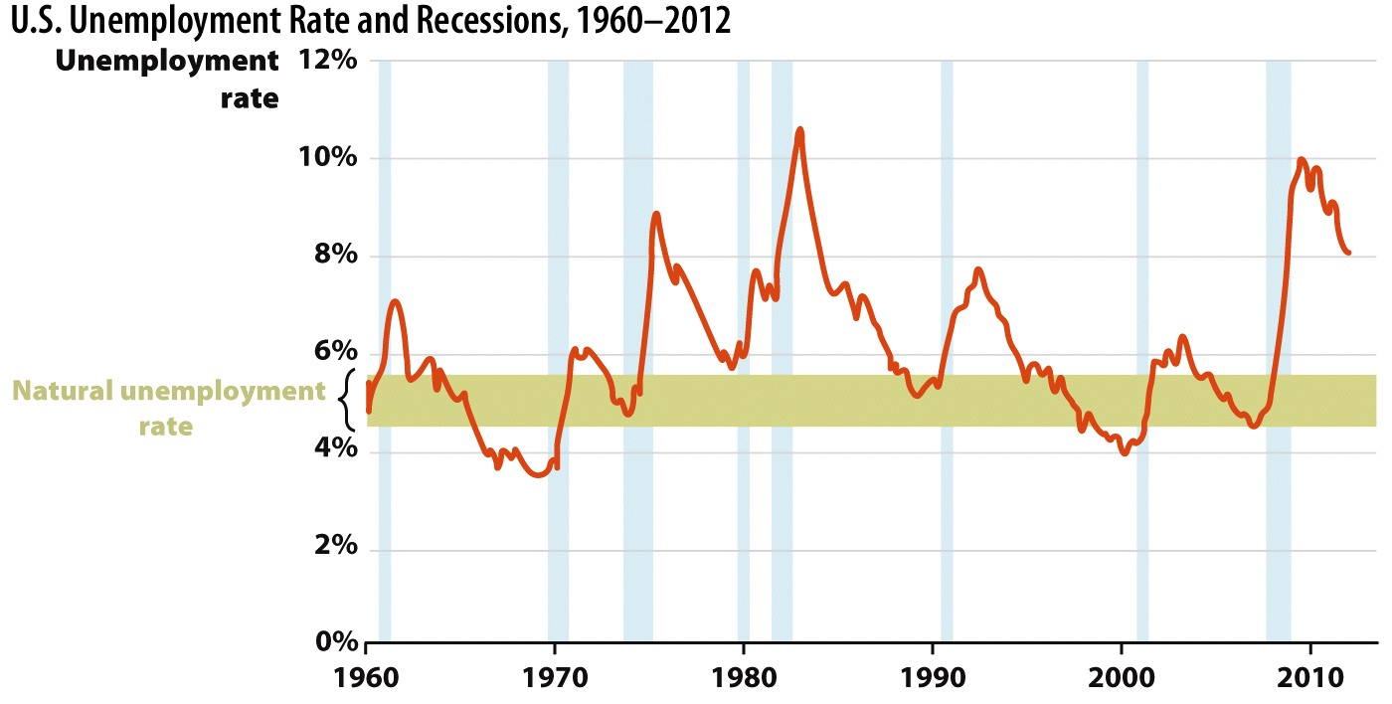
Notes:
The U.S. unemployment rate consistently spikes during recessions, which are indicated here by the blue-shaded bars. During recessions, cyclical unemployment rises. During non-recessionary periods, the unemployment rate drops toward the natural rate of approximately 5%, and only structural and frictional unemployment remain.
Source: U.S. Bureau of Labor Statistics.

Slide 31
Economics in Geography of Jobs
"Geography of Jobs"
An interactive map which shows unemployment rates changing across America during the Great Recession which began in December 2007
Notes:
"Beyond the Book Slide"
Lecture Tip:
The clip mentioned on the slide can be found in the Interactive Instructor’s Guide. Access the direct link by clicking the icon in the PowerPoint above.

Slide 32

Shortcomings of the Unemployment Rate
Unemployment timeline
Unemployment rate lags behind economic activity.
Recovery happens, people re-enter the labor force, and the unemployment rate can actually increase!
Who is unemployed?
Do not know who is unemployed.
Do not know how long they have been out of work.
Short-run unemployment may not be a big concern, but long-term unemployment is a big concern.
Notes:
Many people take issue with the way that unemployment is "counted." Sometimes in a severe recession, unemployment is underestimated because people get discouraged and drop out of the labor force. Once they re-enter the labor force and look for a job, unemployment rates actually go up (due to the way unemployment is counted), even though the job situation did not change for the workers. They just decided to start looking for a job again.

Slide 33
Summary
Frictional and structural unemployment explain why unemployment is naturally greater than zero.
Cyclical unemployment explains changes in the rate across the business cycle.
The unemployment rate is the percentage of the labor force that would like to work who are unemployed.

Slide 34
Practice What You Know
Which of the following is an example of structural unemployment?
Alfred the VCR repairman is unemployed because there are very few people that still own VCRs.
Bernie the construction worker is unemployed because no one is building houses right now.
Carl the restaurant chef is unemployed because he and his wife recently moved to a new city.
Notes:
Correct answer: A
Structural unemployment is unemployment caused by changes in the industrial makeup (structure) of the economy. We no longer have VCRs, so we don’t need VCR repairmen.

Slide 35
Practice What You Know
Which of the following is an example of frictional unemployment?
Alfred the VCR repairman is unemployed because there are very few people that still own VCRs.
Bernie the construction worker is unemployed because no one is building houses right now.
Carl the restaurant chef is unemployed because he and his wife recently moved to a new city.
Notes:
Correct answer: C
This is "natural" since Carl won’t find a job instantly. He may look for a while.
Answer B could be cyclical unemployment, a sign of a recession.

Slide 36
Practice What You Know
Who is considered unemployed?
Jean, a college student who is currently not working.
Zoe, a recent college graduate who sent out job application, but has yet to hear back from the businesses.
Michael, a stay-at-home dad.
All of the above.
Notes:
Correct answer: B
Full-time students and people who are currently not looking for jobs are not considered in the labor force and are therefore not considered unemployed. If Michael’s kids go to college and he starts looking for a job, he will then re-enter the labor force.

Slide 37

Consumer Price Index
Consumer Price Index (CPI)
A measure of the price level based on the consumption pattern of a typical consumer.
Goal: include everything purchased by a typical consumer to get a measure of the cost of living.
Bureau of Labor statistics
The government agency that reports inflation and unemployment data.
Determines how much "weight" to put on certain consumer prices.
Notes:
"Weight" on prices means that we must consider the fact that some price changes affect us more than others. For example, if the price of housing goes up 20%, that could be a very bad and harsh adjustment for many families. However, if the price of popcorn goes up 20%, this won’t be near as bad.
"Typical" consumer—we try to find what the "average" consumer buys. We obviously all do not buy the same things. College students, senior citizens, and young parents may buy different goods.
GDP and the GDP deflator are measures that are too broad to use here, since they include things that the average consumer will never buy, such as tractors and wind turbines.

Slide 38
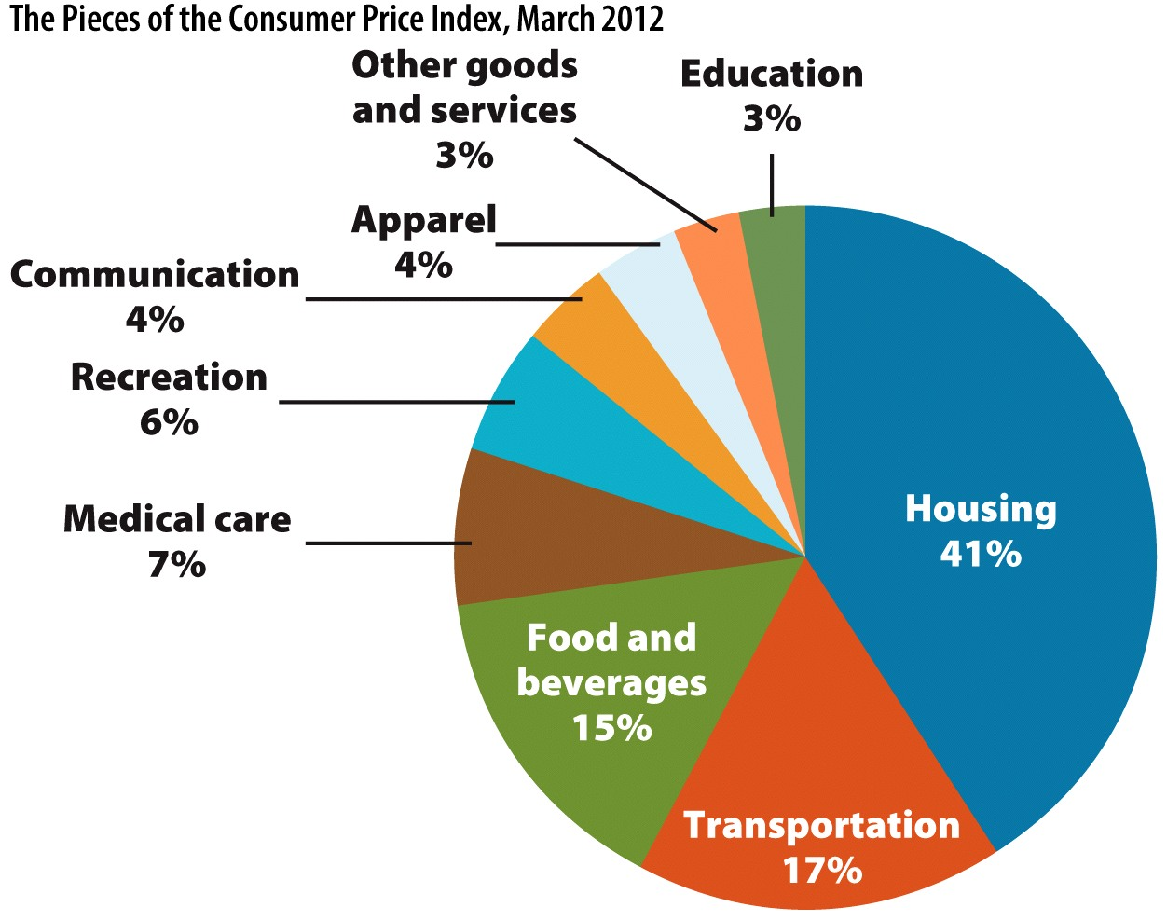
What Prices Are Included in the CPI?
Notes:
Before showing this slide, you could ask the students what general types of expenditures they make.
Clearly, housing is the biggest portion of our expenditures. This could include paying rent or mortgages.
Note that inside these categories, there are very specific prices. For example, "Food and beverages" includes prices for everything from potato chips to oranges to flour.
The weights assigned to the different categories of expenditures are based on the spending patterns of a typical American.
Example: For a typical American, 17% of their expenditures involve transportation, while 41% of their expenditures involve housing.

Slide 39
Calculating a Simple Price Index
 |  | 2013 |  | 2014
Good | Quantity | Price | Cost | Price | Cost
Popcorn | 2 | $4 | $8 | $6 | $12
Limeade | 2 | $4 | $8 | $4 | $8
Movie ticket | 1 | $8 | $8 | $10 | $10
Consumer Price |  |  | $24 |  | $30
Index (CPI)
Which year is the base year here?
Notes:
Consider the three goods, each given a price and quantity.
"Cost" in this case is the total amount of money you expended on the item. Your total money spend is shown too.
Main point of the table: Given a "base" year of 2013, we purchased some goods and spent $24. In the next year 2014, we purchased the same goods, but we note that some (but not all) of the prices have changed, and we spend a total of $30 for the same goods.
To create an index, we use our "base" year and give it an index of 100 as a figure to compare other years to. To get the index for the other years, we divide the basket price in the new year divided by the basket price in the base year.
With steady inflation, all indices before our base year should be less than 100, and all indices after our base year should be greater than 100.

Slide 40
Calculating a Simple Price Index
Finding the price index
OR
The CPI is computed monthly and since 1988 an average of prices for the period 1982-1984 has been used as the base.
Ex: CPI as of August 2013 is 233.9, which means that prices for the CPI market basket in 2013 were 133.9% higher than they were in 1983.
Notes:
In our example above, the price index rose from 100 to 125 in a year.
So the inflation for that year was 25%.
Lecture Tip:
You may have to go back to the previous slide to show the numbers again.

Slide 41
Inflation
Inflation
Continuing rise in the general price level.
Measured as a growth rate (percentage change) in the average level of prices. For example, %4 for 2010.
Deflation: opposite of inflation . . . price level falls. For example, %-4 for 2008.
Disinflation: price level increases but with a decreasing rate. For example, %6 for 1950, %4 for 1951 and %3 for 1952.
Biggest problem of inflation?
Uncertainty about price changes creates problems for firms and workers.
Long-term wages difficult to agree upon.
Consumers may change buying patterns due to uncertainty.
Notes:
Inflation is not the prices of a certain good going up due to a shift in demand or supply for that good. Inflation is the increase in the price level (the price of all goods). Inflation by itself will decrease the purchasing power of your dollars.

Slide 42
Inflation
Having found the price levels, we can find inflation by using a percentage change formula
Inflation rates are measured over the course of a year
The general formula is
In the previous example (slide 37), inflation is 25%
Notes:
In our example above, the price index rose from 100 to 125 in a year.
So the inflation for that year was 25%.
Lecture Tip:
You may have to go back to the previous slide to show the numbers again.

Slide 43
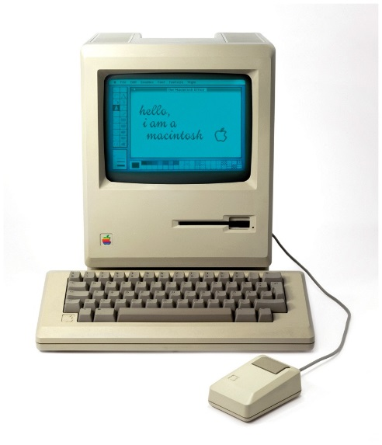

Prices Don’t All Move Together
Clearly, most prices rise over time.
Travel
Education
Health care
However, some prices fall over time.
Consumer electronics
Usually due to a result of great technological advancements
Flat panel TV, 1997: $7,000
Flat panel TV 2012: $500
Notes:
Computers are another example.
In the ’80s, when we discussed megabytes and megahertz, computers were often in the $3,000-to-$5,000 range, if not more. Today, we talk about terabytes and gigahertz, and the best computers are $2,500.

Slide 44
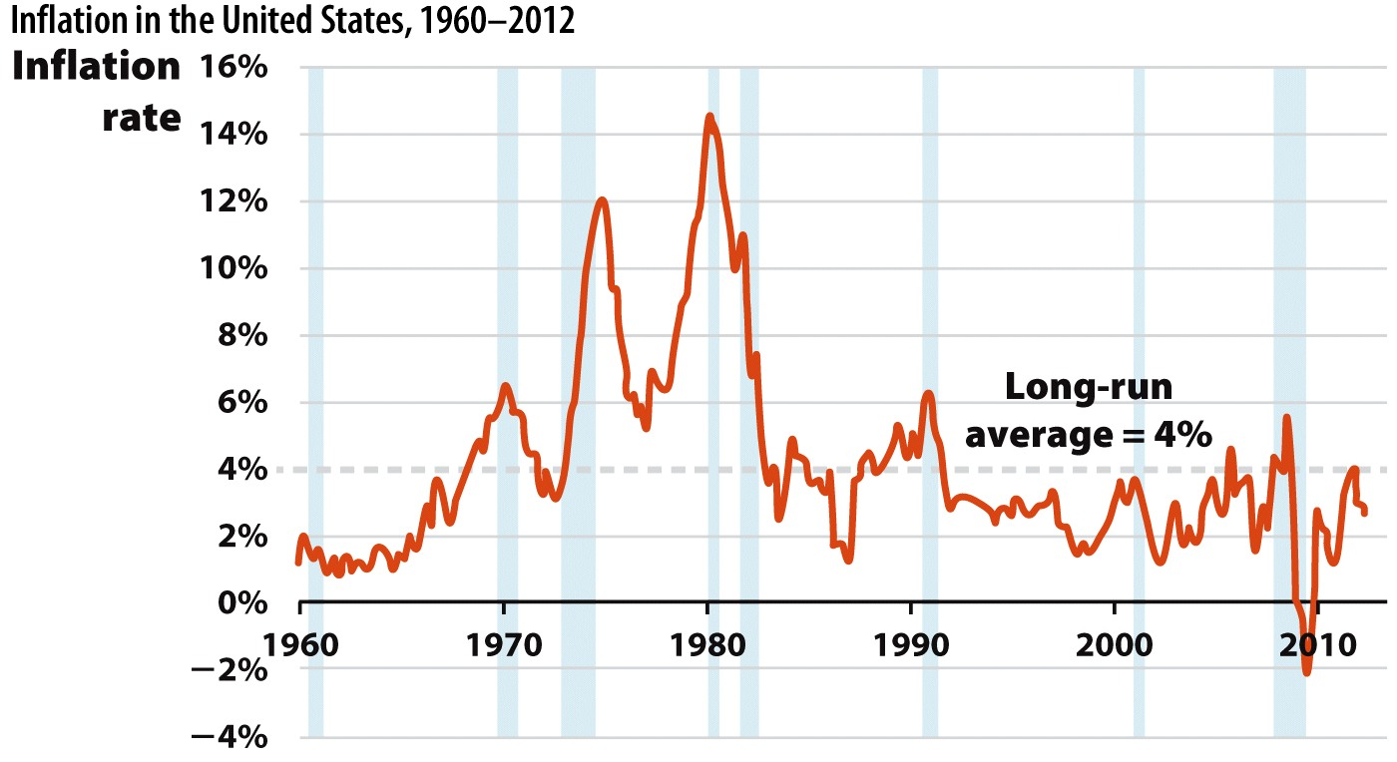
Inflation in the United States
Notes:
From 1960 to 2012, inflation rates in the United States averaged 4%. This number is high because of excessive inflation in the 1970s. Inflation peaked at over 14% in 1980. More recently, inflation rates have averaged between 2% and 3%.

Slide 45
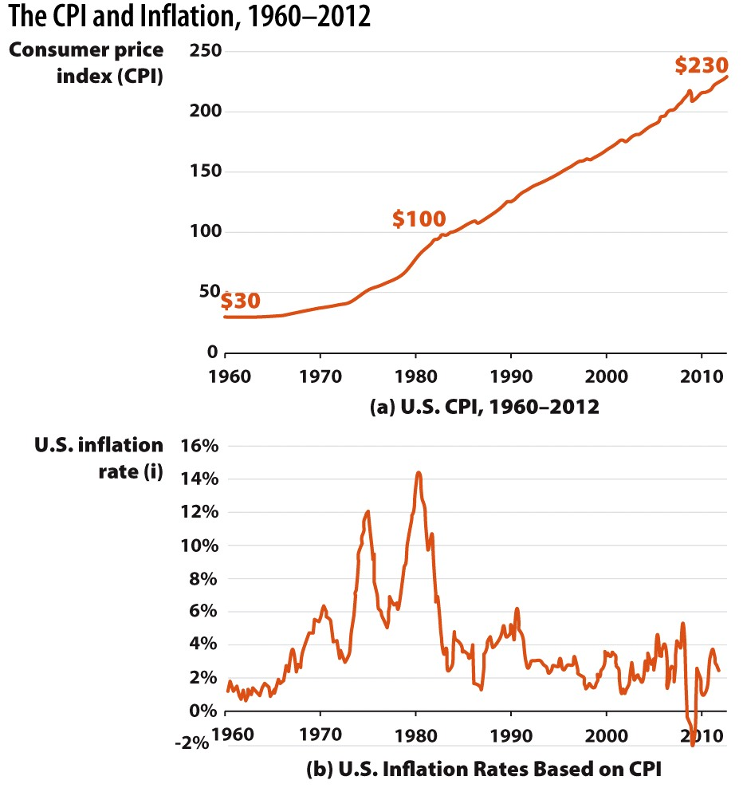
CPI and Inflation over the Long Run
Notes:
CPI: The CPI measures the cost of a typical consumer’s basket of goods over time. The index was set to 100 in 1982–84. Given the current level of over 220, it shows consumer prices more than doubled on average since 1982–84.
Inflation rates Inflation as measured as the percentage change in the CPI. The higher the inflation rate, the greater the rate of CPI increases.

Slide 46
Using the CPI to Compare Dollar Values across Time
Prices from different time periods can be confusing.
In 1921, you could buy a fully constructed house for $2000.
To compare, we can transform this into a "price in today’s dollars" (In the analysis we will use 2012 as today).
The house with the value of $2000 in 1921 is $25555.55 today.
Notes:
Intuition: We take the earlier price and adjust it for the differences in prices levels between the past and present.
Spoken: We are adjusting the past price for inflation to see what the price would be today.
We can then examine the "Price Today" that we found to see if the price of the good has generally risen slower or faster than the rate of inflation.

Slide 47
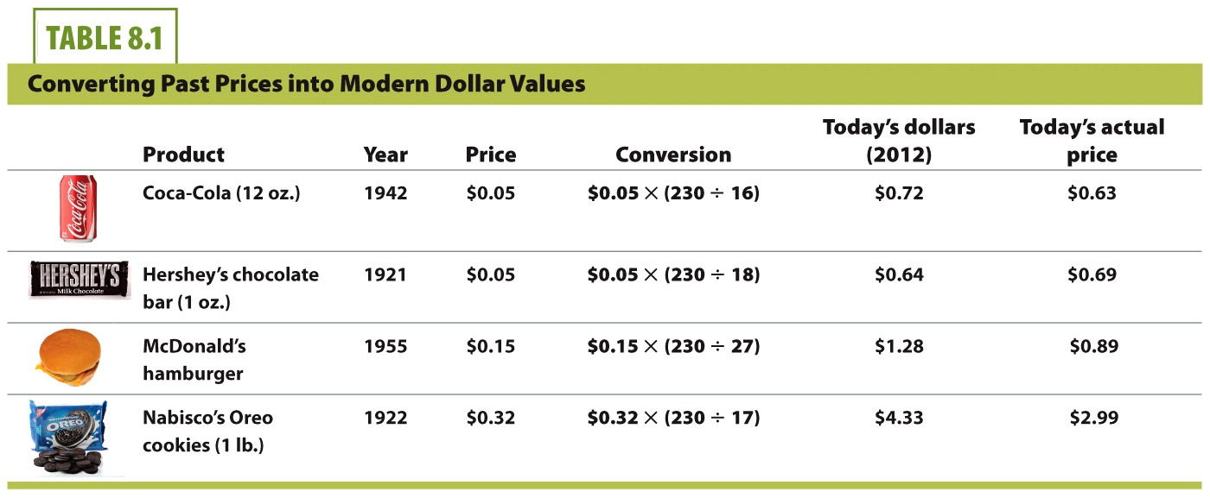
CPI 2012: 230
CPI 1942: 16
CPI 1921: 18
CPI 1955: 27
CPI 1922: 17
Notes:
The price level in 2012 was 230.
The price level in 1942 was 16.
The price level in 1921 was 18.
The price level in 1955 was 27.
The price level in 1922 was 17.
From the table, it appears that Coca-Cola and Hershey’s bars have had price changes on par with inflation.
McDonald’s hamburgers and Oreo cookies have gone down in real prices over time.
Students might hear the following phrase:
"Back in my day, everything was cheaper." This is nominally true, but not necessarily true in real terms.

Slide 48
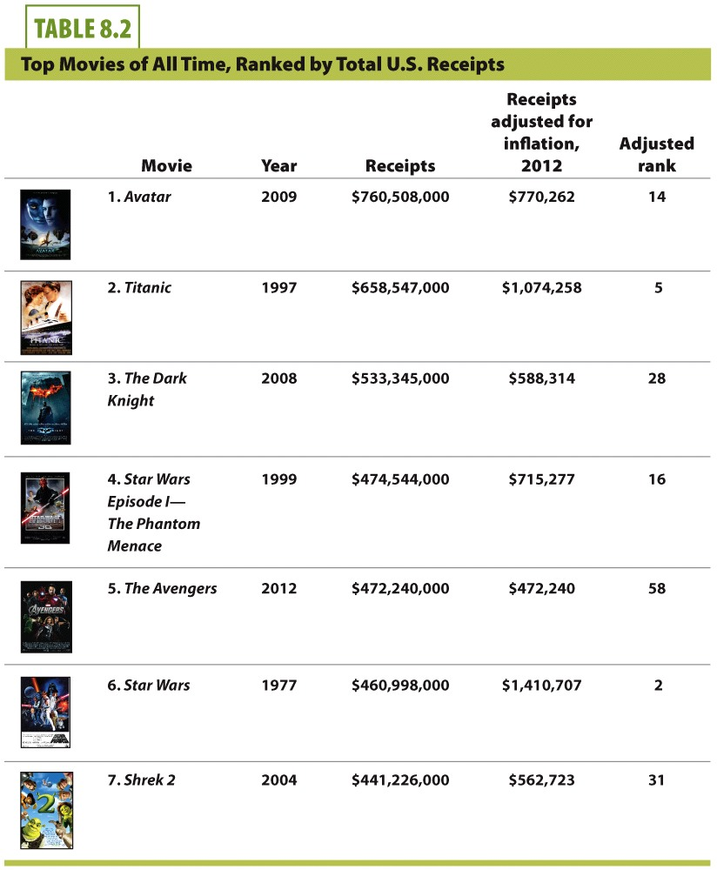

Slide 49
Economics in CPI Inflation Calculator
"CPI Inflation Calculator"
Notes:
"Beyond the Book Slide"
Lecture Tip:
The clip mentioned on the slide can be found in the Interactive Instructor’s Guide. Access the direct link by clicking the icon in the PowerPoint above.

Slide 50
The Costs of Inflation
Future price level uncertainty
Firms often make long-term agreements that involve paying salaries to workers and paying loans on capital goods.
Uncertain inflation makes long-term contracts riskier.
Workers: fear of getting underpaid next year.
Lenders: fear of lending out money today and getting paid back in less-valuable dollars next year.
If long-term contracts don’t transpire, GDP growth is slowed.
Notes:
Coffee shop example:
Before you can sell a single cup of coffee, you have to spend funds on your resources. You have to buy capital goods like an espresso bar, tables, chairs, and a cash register. You have to hire workers and give them some assurances they’ll be paid someday. The key for this discussion is this: if you are ever going to produce output (coffee), you have to spend first on resources.
Lenders are typically banks. A firm may have to borrow money for large capital equipment and pay that loaned money back. Inflation will hurt the lender (the bank) and make the bank less likely to want to make a large or long-term loan.

Slide 51
The Costs of Inflation
Uncertainty about future price levels
Wage and other input contracts often have a long-term commitment. Firms may have to borrow today and pay back the money later.
Uncertainty about prices may make lending riskier.
The real value of these future dollars depends on inflation.
Prepare to Produce
Produce
Sell Output
Borrow $$
Build Capital Goods
Hire Workers
Repay Loans $$
Pay Workers $$
Today
Future Periods
Time
Notes:
The important point is that in a normal production process, funds must be spent today and then repaid in the future—after the output sells. But for this sequence of events to occur, businesses must make promises to deliver payments in the future: these include payments to workers and lenders. Thus, two types of long-term agreements form the foundation for production: wage and loan contracts. Both of these involve agreements for dollars to be delivered in future periods.
The "future periods" may have lower values of money if inflation occurs. This could hurt workers and lenders, and makes those parties incur risk when they agree to long-term monetary agreements.

Slide 52
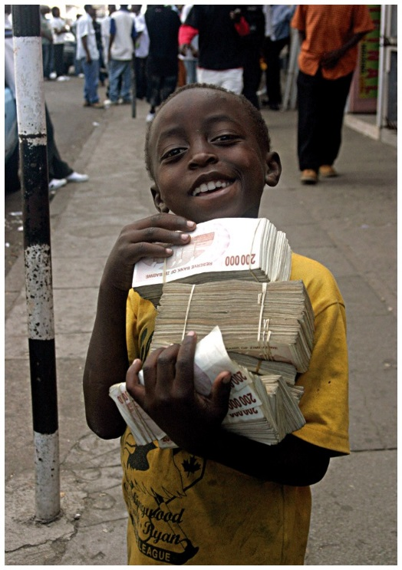
The Costs of Inflation
Money Illusion
People interpreting nominal wage or price changes as real changes.
If prices and wages all go up by 2%, there is no real change in your purchasing power. People with money illusion think they are richer in this case.
Nominal wage
The wage in current dollars, analogous to nominal GDP
Real wage
Nominal wage adjusted for inflation (changes in the price level)
Another money illusion example:
If nominal wages go up by 3%, but prices go up by 5%, money
illusion may cause you to think of yourself as wealthier,
but your real wages have actually decreased!
Notes:
If the price of a movie goes up 10%, but our wage and all other prices go up about the same amount, we ought to conclude that the real terms of trade have stayed more or less the same. But many people conclude, mistakenly, that movies have become "more expensive." They treat this as a change in relative price: they may go see fewer movies or make other decisions based on this new price. Economists call this "money illusion."
The real wage is more informative, as it gives you what the worker earns in terms of purchasing power.
Money illusion causes workers to irrationally focus on their nominal wage instead of their real wage. They might then insist on real wages that are too high, given changes in the price level. In particular, when prices fall, any given nominal wage is worth more in real terms.

Slide 53
The Costs of Inflation
Wealth redistribution
Wealth can be redistributed between borrowers and lenders.
Example:
You borrow $50,000, and expect to pay back $60,000 in five years.
If unexpected inflation occurs
You are better off, bank is worse off.
If the inflation was expected
The bank would have required more in return for the loan (you’d have to repay $75,000 in five years for example).
Real Interest Rate = Nominal Interest Rate – Inflation Rate
Notes:
If inflation unexpectedly rises during those five years, the inflation will devalue your future payment to the bank—as a result, you will be better off, but the bank will be worse off. Thus, surprise inflation redistributes wealth from borrowers to lenders. If both you and the bank fully expect the inflation to occur, the bank will require more in return for the loan, so the inflation will not be a problem. In the United States, inflation has been low and steady since the early 1980s. Therefore, surprises are rare. But nations with higher inflation rates also have a higher variability of inflation, which makes it difficult to predict the future. This is one more reason why high inflation increases the risk of making the loans that are an important source of funding for business ventures.

Slide 54
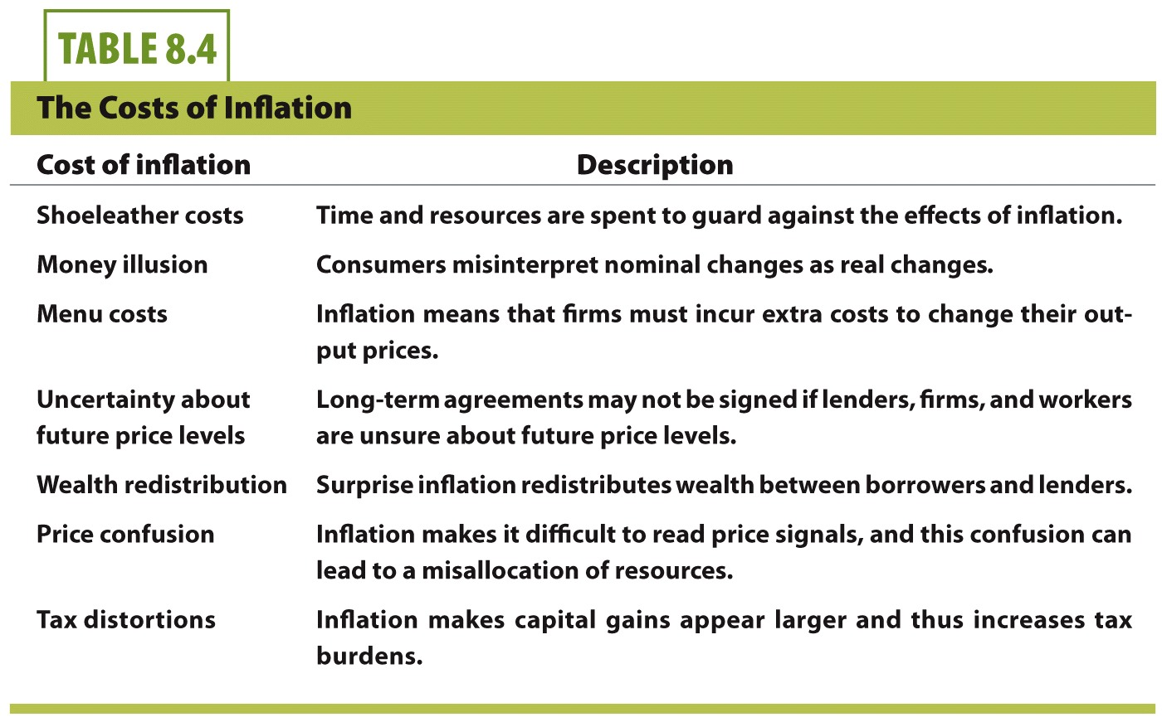
The Costs of Inflation
These 3 are enough to know for this class.

Slide 55
Summary
The CPI is the primary measure of the general price level in the United States.
Computed using prices from a basket of goods formed by the spending habits of the typical consumer .
Measuring inflation is straightforward once the CPI is calculated. The inflation rate is the growth rate of the CPI, expressed in percentage terms.
The CPI is also useful for equating monetary values (or prices) over time.
There are several macroeconomic costs from inflation, including future price level uncertainty and money illusion.

Slide 56
Practice What You Know
If inflation is a general rise in the price level, why have consumer electronic prices fell over time?
The demand for electronics has decreased.
Electronics are not counted in the CPI.
Electronics are getting smaller in size so the price is falling as well.
Increases in technology have greatly reduced production costs for these goods.
Notes:
Correct answer: D
Increases in technology shift the supply curve rightward (according to standard micro theory).

Slide 57
Practice What You Know
Suppose that prices and wages both double next year. What is true about next year compared to this year?
Nominal wages are higher and real wages remained constant.
Nominal wages and real wages are both higher.
Nominal wages are higher and real wages are lower.
Nominal wages decreased and real wages increased.
Notes:
Correct answer: A
If prices and wages both change at the same rate, nothing changes in real terms. However, they both went up, so that is a nominal (nonadjusted) increase.

Slide 58
Practice What You Know
In 2012, John takes out a 30-year bank mortgage loan at a fixed interest rate. He buys a house with the loan. In 2014 to 2018, there is a large amount of inflation. Who is hurt and helped by this inflation, ceteris paribus?
John is helped and the bank is hurt.
The bank is helped and John is hurt.
John and the bank are both hurt.
John and the bank are both helped.
Notes:
Correct answer: A
Explanation:
Suppose John borrowed $200,000. He buys a house with that money.
In the next few years, inflation causes housing prices to rise, and the value of money to fall. John’s house is now worth $250,000, but he still only owes the bank the original $200,000 that he borrowed (plus some interest).
The bank is hurt because the money it receives in the future from John (when he pays back the loan) will be worth less than when they loaned it out to him.

Slide 59
Practice What You Know
Suppose that Felix gets a 1% raise this year, but prices have also risen by 1%. Felix feels richer due to his raise and attempts to change his spending habits. Felix is suffering from
irrational exuberance.
macroeconomics.
money illusion.
inflation pricing.
Notes:
Correct answer: C
Money illusion is where people only consider nominal changes instead of real changes in prices and wages.

Slide 60
Sources
"Principles of Economics with Smartwork Access (ISBN: 978-0-26314-5), 1st Edition, 2013" by Mateer and Coppock
"Economics: Custom Edition for NCSU (ISBN: 9781937435202" by David Hyman

