Slide 1
Economics I
Week #10

Slide 2
Topics of Week #10
Monopolistic Competition*
Comparing Market Structures*
Product Differentiation Forms
Monopolistic Competition in Short-run*
Monopolistic Competition in Long-run*
Markup*
Long-run Equilibrium*
Scale and Output
Excess Capacity and Efficiency*
Advertising*
"*" Indicates the most important topics.
Mateer and Coppock: Chapter #12

Slide 3
Previously
Price discrimination
Occurs when a firm sells the same good at different prices.
Will increase firm profitability.
Can increase economic efficiency.
General rule for price discrimination
Charge a higher price to relatively inelastic consumer group
Charge a lower price to relatively elastic consumer group
Notes:
Lecture notes:
Recall the conditions necessary for a firm to be able to price discriminate:
Market power—price maker
Ability to separate consumers based on willingness to pay
Have to be able to prevent resale

Slide 4
Big Questions
What is monopolistic competition?
What are the differences among monopolistic competition, competitive markets, and monopoly?
Why is advertising prevalent in monopolistic competition?
Notes:
Lecture notes:
As its name would suggest, monopolistic competition takes part of two previous models:
It behaves like a monopoly in that it is a price maker.
It performs like perfect competition in that long-run economic profit is equal to zero.

Slide 5
What Is Monopolistic Competition?
Monopolistic competition
A market structure characterized by
Free entry and exit
Many different firms
Product differentiation
Product differentiation
The process that firms use to make a product more attractive by contrasting its unique qualities with competing products.
Notes:
Monopolistic competition
Think about fast-food restaurants. Lots of them around, free entry, and they all offer a substitutable but not identical (differentiated) product.
Product differentiation
Think about imperfect substitutes. The products are "the same, but different." A firm's goal here is to convince the consumer that its product is better than the competitor's. A highly differentiated product may even command a higher demand and price.
Lecture notes:
Some examples of monopolistic competition can include:
Fast-food restaurants
Clothing retailers
Gas stations
Hair salons
Product differentiation:
Goods are imperfect substitutes—“the same but different.”
Note that differentiation can be real or spurious.
A firm’s goal here is to convince consumers that its product is better than the competitors’.
A highly differentiated product may even command a higher demand and price.

Slide 6
Comparing Market Structures
Perfectly Competitive Markets | Monopolistic Competition | Monopoly
Many sellers | Many sellers | One seller
Similar products | Differentiated products | A unique product without close substitutes
Free/Easy entry and exit | Free/Easy entry and exit | High barriers to entry and exit
Notes:
Lecture notes:
So far, we have talked about two “extreme” market structures.
Perfect competition:
Each firm has zero market power and is a price taker.
Each firm faces a horizontal demand curve.
Because of free entry, a competitive firm earns zero economic profits in the long run.
Monopoly:
A monopoly has market power and is a price maker.
It faces a downward-sloping demand curve.
Because of barriers, a monopoly can earn economic profits in the long run.
Monopolistic competition:
Many sellers like perfect competition.
Since firms sell a differentiated product, firms face downward-sloping demand curve like a monopoly.
Each firm has some market power, but it is limited since there are many sellers.
Because of free entry, a competitive firm earns zero economic profits in the long run.
Monopolistic competition would be closer to perfect competition than monopoly.

Slide 7
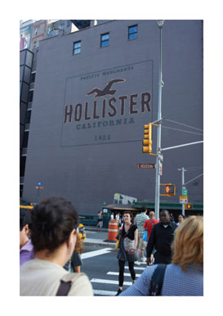

Product Differentiation Forms
What are some ways firms differentiate their products?
1. Style or type
Clothing stores
Food court at mall
2. Location
Gas stations
Dry cleaners
Barber shops
Notes:
Some clothing stores (Abercrombie & Fitch, Urban Outfitters) aim for the teen or trendy demographic. Others, such as Hot Topic, aim to serve a more narrow group of consumers. Others, such as Ann Taylor, Bon-Ton, or J.C. Penney, aim for a more adult consumer type.
Food courts have many different types of food vendors, all competing for various consumers with different tastes.
Gas stations, dry cleaners, barber shops, and maybe even some higher-end services such as dentistry may compete on location rather than price. Location can save time and give consumer convenience, which is sometimes valued more than price differences. The gas station right off the interstate may seem like a more attractive place to stop even if it charges a slightly higher price than a gas station in the city. It may be convenient to get your hair cut or dry cleaning done at a business closest to your home.
Lecture notes:
Style or type:
Abercrombie & Fitch and Hollister target a young/trendy demographic.
Ann Taylor, Bon-Ton, and J.C. Penney aim for a more adult consumer type.
Dick’s Sports and Big Five Sport
Restaurants of all ethnic types to satisfy different consumer tastes
Location:
Even if the product is very similar, convenient locations may give some firms pricing power.
Quality:
Quality differentiation allows firms to capture consumers that have not only different tastes but also different incomes or willingness to pay.
[Crosswalk: © TravelCollection/Alamy Stock Photo;; Urban Outfitters: © Jen Grantham/iStockphoto.com; Chipotle: Marcnorman | Dreamstime.com; Taco Bell: © swalls/i-Stock.com]

Slide 8
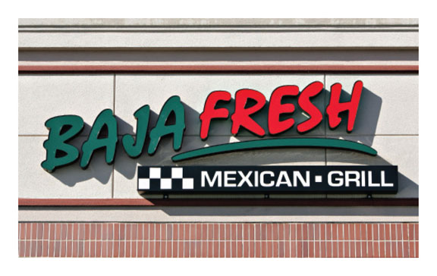
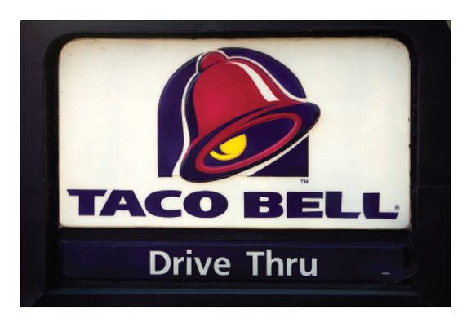
Product Differentiation Forms
3. Quality
Low quality versus high quality
Taco Bell versus Baja Fresh
Subway versus Quiznos
McDonald's versus White Castle
Trade-off:
Lower quality, lower prices, faster service
Higher quality, higher prices, slower service
Notes:
The high- and low-quality restaurants may not directly compete with each other. The low-quality restaurants may compete with each other, and the high- quality restaurants compete with each other. This may be true even if a low- and high-quality restaurant each serve the same type of food, such as Taco Bell and Baja Fresh.
The trade-off listed doesn't always happen exactly as stated—it's just an example. Different people have different preferences, so both types of firms (high and low quality) are able to serve customers.

Slide 9
Economics in Seinfeld
"Seinfeld"
"The Café" (1991)
Jerry convinces Babu to serve Pakistani food—he'll be the only Pakistani restaurant in the neighborhood. When the restaurant fails, Jerry blames it on a bad location.
Notes:
Economics in the media
Lecture tip:
The clip mentioned on the slide can be found in the Interactive Instructor's Guide. Access the direct link by clicking the icon in the PowerPoint above.

Slide 10
Monopolistic Competition in the Short-Run and Long-Run
Monopolistically Competitive Firm
Sells a differentiated product.
Has market power.
Uses profit-maximizing rule of MR = MC.
Charges a price on the demand curve corresponding to this point, and P > MC.
Long-run profits will depend on firm entry and exit. Generally, there is free/easy entry and exit which causes zero long-run profits.
Notes:
Thus, once again, we can begin to see that monopolistic competition has some characteristics of:
Perfect competition (free entry and exit, causing zero long run profits).
It also has some characteristics of monopoly (market power, P > MC).

Slide 11
Monopolistic Competition in the Short-Run
Notes:
Note that this short run graph has the same general look as the monopoly graph, especially the downward-sloping demand function. A slight difference that you may want to mention is the fact that in monopolistic competition, the demand curve for a single firm may be a little more elastic due to the existence of imperfect substitutes.
From the text:
In panel (a) the firm makes a profit and panel (b) shows the same firm making a loss. In each case the firm has used the profit-maximizing rule to determine the best price to charge by locating the point where marginal revenue equals marginal cost. This establishes the profit-maximizing output along the vertical dashed line. Finally, the firm determines the price to charge by locating the intersection of the demand curve with the vertical dashed line.

Slide 12
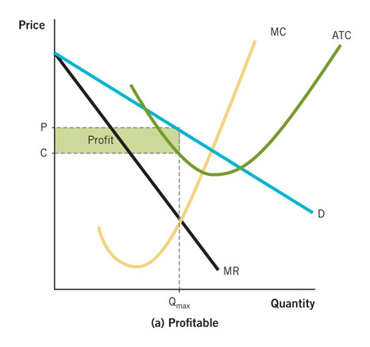
Monopolistic Competition in the Short-Run
Graph summary
Firm chooses output level where MR = MC
The price is determined by the height of the demand curve at this level of output.
Firm could make a profit or loss. This depends on whether price is greater than or less than the ATC of production at the profit-maximizing output level.
Notes:
How could a firm make a loss? Either the demand is too low, the costs are too high, or some combination of both. The price charged by the firm is still set by the height of the demand curve at the MR = MC quantity.

Slide 13
Monopolistic Competition in the Long-Run
Notes:
In the long run:
Similar to perfect competition, free entry causes monopolistic competition firms to earn zero profit in the long run. The dynamic is similar to perfect competition (see the summary on the next slide).
From the text:
If a firm is making an economic profit, it attracts new entrants to the business. The larger supply of competing firms means that the demand for an individual firm's product will contract. Eventually, as more firms enter the market, it will no longer be possible for existing firms to make an economic profit. A reverse process unfolds in the case of a market that is experiencing a loss. Some firms will exit the industry. Consumers will have fewer options to choose from and the remaining firms will experience an increase in demand. Eventually, demand will increase to the point where firms will no longer experience a loss.
Note that the demand curve is drawn just tangent to the average total cost curve. At this point, P = ATC, and profits are zero. This demand adjustment occurs with the entry and exit of firms.

Slide 14
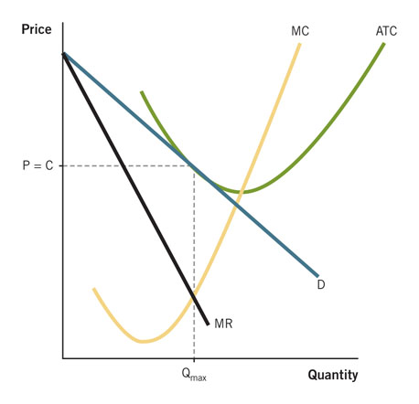
Monopolistic Competition in the Long-Run
Graph summary
A key idea is free/easy entry and exit.
If the industry is profitable, other firms will enter, causing the demand for existing firms' products to decrease.
If the industry is experiencing losses, firms will exit, causing demand for remaining firms' products to increase.
Entry and exit will stop when profits are zero. This occurs when P = ATC.
Check this website for long-run adjustments.

Slide 15
Relationship between Price, Marginal Cost, and LRATC
Markup
The difference between P and MC
Markups are possible when a firm has market power and sells a differentiated product.
Results in consumers paying more
Price, Marginal Cost and Long-Run ATC
Monopolistic competition: P > MC
Monopolistic competition in the Long-run: P > min ATC
Perfect competition: P = MC
Perfect competition in the Long-run: P = min ATC
Notes:
Note that just like monopoly, we have P > MC with monopolistic competition. This difference is called the markup.
A markup is possible when a firm enjoys some market power and sells a differentiated product. Products such as bottled water, cosmetics, prescription medicines, eyeglass frames, brand name clothing, restaurant drinks, and greeting cards all have hefty markups.
Generally, the more differentiated a product is, the higher the markup for that product.
Markups are possible when a firm enjoys some market power and sells a differentiated product.
The more differentiated a product is, the higher the markup for that product.

Slide 16
Long-Run Equilibrium in Two Market Structures
Notes:
The right panel is the familiar perfect competition graph.
On the left, note that in LR equilibrium, the monopolistic competition prices are higher than perfect competition.
From the text:
Since a monopolistic competitor has a downward-sloping demand curve, the point of tangency between the demand curve and ATC curve occurs at different points. As a result, the point where P = C is higher for the monopolistic firm. Panel (b) shows the demand curve just tangent to the ATC at its lowest point under perfect competition. Consequently, monopolistic competition produces higher prices than perfect competition.
If this result seems odd to you, recall that entry and exit do not ensure the lowest possible price, only that the price that is charged is equal to the average total cost of production. Under perfect competition, where the demand curve is horizontal, the price that is charged is always the lowest possible cost of production. This is not the case for monopolistic competition.

Slide 17
Scale and Output
Excess capacity
Firms are relatively small, so they are not at the output level where ATC is minimized.
Why not produce more?
To sell more, the firm would have to lower the price of output. It is more profitable to produce at excess capacity (below efficient scale).
Compare to perfect competition
Perfectly competitive firms operate at capacity at the minimum of ATC. Overall output is higher in perfect competition.
Notes:
Monopolistic competition produces less output at a higher price than perfect competition. Graphically, you can see that due to the downward-sloping demand curve in monopolistic competition, the price = ATC at a higher point on the ATC curve.
ATC is not minimized in LR equilibrium with monopolistic competition, so there is excess capacity. This means that the firms could lower their ATC by producing more. Why don't they do this? It would decrease overall profits.

Slide 18
Inefficiency and Social Welfare
Two sources of inefficiency in monopolistic competition
ATC is higher compared to perfect competition.
Firm could lower the price it charges and sell more.
Markup
P > MC
If the firm tries to set P = MC, the level of output sold would occur where ATC > P, and the firm would lose profits.
Notes:
Inefficiency here can be thought of as:
Reduced number of transactions (compared to perfect competition)
Existence of DWL (compared to zero in perfect competition)
However, this inefficiency is small compared to monopoly inefficiency.

Slide 19
Inefficiency and Social Welfare
Could government intervention be helpful?
Due to free entry, firms are not able to earn long-run profits like monopolists.
Regulation may put many firms out of business.
Less firms may mean more inconvenience and fewer choices for consumers.
Already have seen problems of marginal cost pricing regulation
Inefficiency not large enough to warrant government intervention
Notes:
In monopoly, we discussed how governments often intervene. Could that also work with monopolistic competition? Probably not. The problems of inefficiency, market power, and high prices aren't as big of an issue here. In fact, intervention may make things worse.

Slide 20
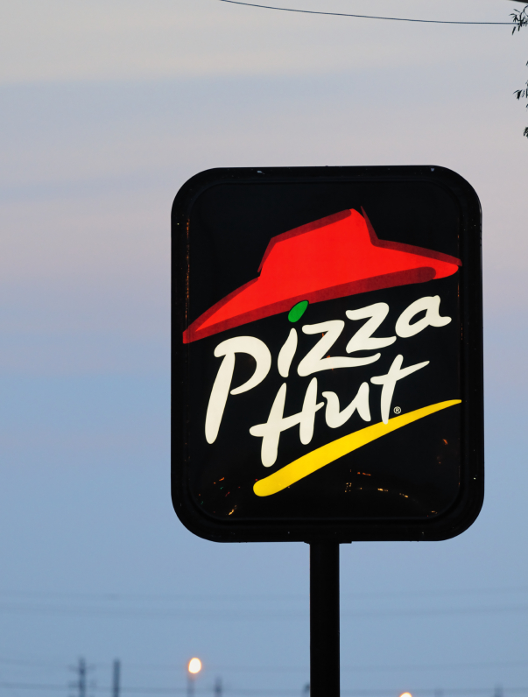
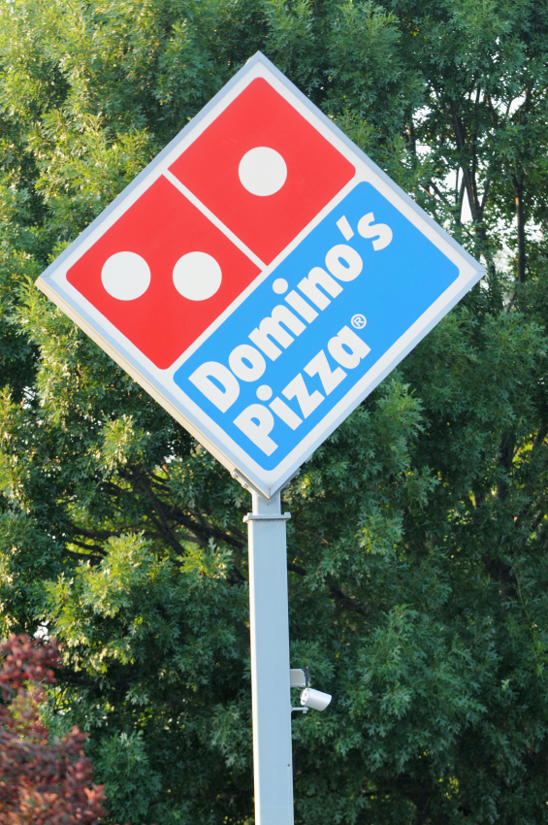
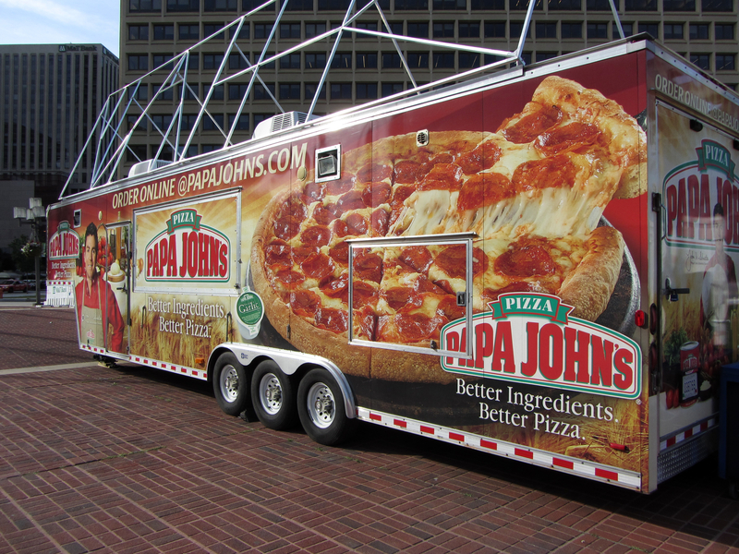
Is the Inefficiency So Bad?
Perfect competition
Lower prices
Higher quantities
Efficiency (P = MC, minimum ATC)
Homogenous products (no variety)
Monopolistic competition
Slightly higher prices
Slightly lower quantities
Inefficiency (P > MC, not at minimum ATC)
Differentiated products (variety and choice)
Notes:
What would you rather have?
Situation A: pizza is produced in slightly higher quantities with slightly lower prices than it currently is. However, all pizza is the same brand (all pizza restaurants are Domino's, for example)
Situation B: pizza is produced as it currently is today. Slightly lower quantities with slightly higher prices (compared to perfect competition). However, you have more variety and choice, and there are many different types and styles of pizza being made at different restaurants.
If the benefit of variety and choice outweighs the costs of higher prices and inefficiency, consumers may be better of with monopolistic competition instead of perfect competition.

Slide 21
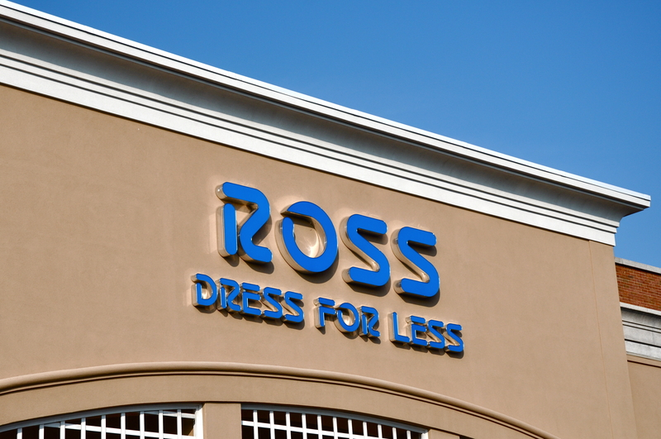
Varying Degrees of Product Differentiation
A highly differentiated product means
Higher prices and markups.
Larger excess capacity.
A less-differentiated product means
Lower prices and markups.
Less excess capacity.
Notes:
Not all monopolistic firms have the same amount of differentiation.
Some firms sell products that are very close substitutes to their competitors' products. Think about various pizza brands. Most are pretty similar.
Other firms sell a product that is very differentiated but still somewhat substitutable with a competitor's product. This can be said about various clothing stores (Abercrombie & Fitch versus Old Navy).
Abercrombie & Fitch is highly differentiated with a higher markup.
T.J.Maxx, Ross, and other "lower" end stores aren't as differentiated.

Slide 22
Differentiation, Excess Capacity, and Efficiency
Notes:
Some key phrases in each paragraph are italicized.
On the left:
Firm A enjoys significant differentiation. The firm has an especially attractive location, style, type, or quality of product that is in high demand among consumers, and it is not easily replicated by competitors. H&M, Urban Outfitters, and Abercrombie & Fitch are good examples. Consumers have strong brand loyalty for the clothes these firms sell and the demand curve is more inelastic. The relatively steep slope of the demand curve means that the point of tangency between the demand curve and the average total cost curve occurs at a high price. This produces a large amount of excess capacity.
On the right:
Firm B sells a product that is only slightly different from its competitors. Here we can think of T.J.Maxx, Ross, and Marshalls—three companies that primarily sell discounted clothes. In this case, consumers have only weak preferences about which firm they prefer and consumer demand is elastic. The relatively flat nature of the demand curve means that the point of tangency between demand and average total cost occurs at a relatively low cost. This produces a small amount of excess capacity.

Slide 23
Economics in “Hugs”
“Free Hugs Prank: $2 Deluxe Hugs”
Is a $2 hug better than a free hug?
Notes:
“Economics in the Media” Slide
Lecture tip:
The clip mentioned on the slide can be found in the Interactive Instructor’s Guide. Access the direct link by clicking the icon in the PowerPoint above.
This prank illustrates how price can signal the quality of luxury brands.

Slide 24
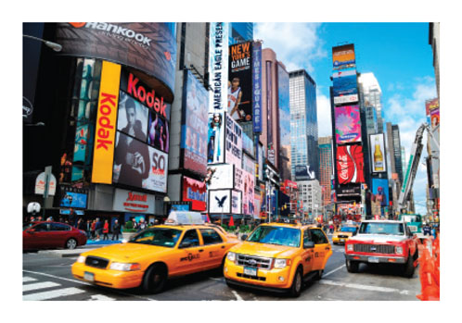
Advertising
Advertising
A method of nonprice competition
Represents 2% of U.S. annual economic output
Why advertise?
Provide information for consumers
Further differentiate the product
Increase demand for the product
Notes:
Why do firms advertise?
Answer: To get you to buy their product. (Increase demand for the product).
Not only does advertising make up 2% of U.S. annual output, it makes up 1% of global economic activity.
Firms often try to make their advertising humorous, strange, different, colorful, loud, or just about anything else to get your attention and help you remember the product. Think about Super Bowl ads.

Slide 25
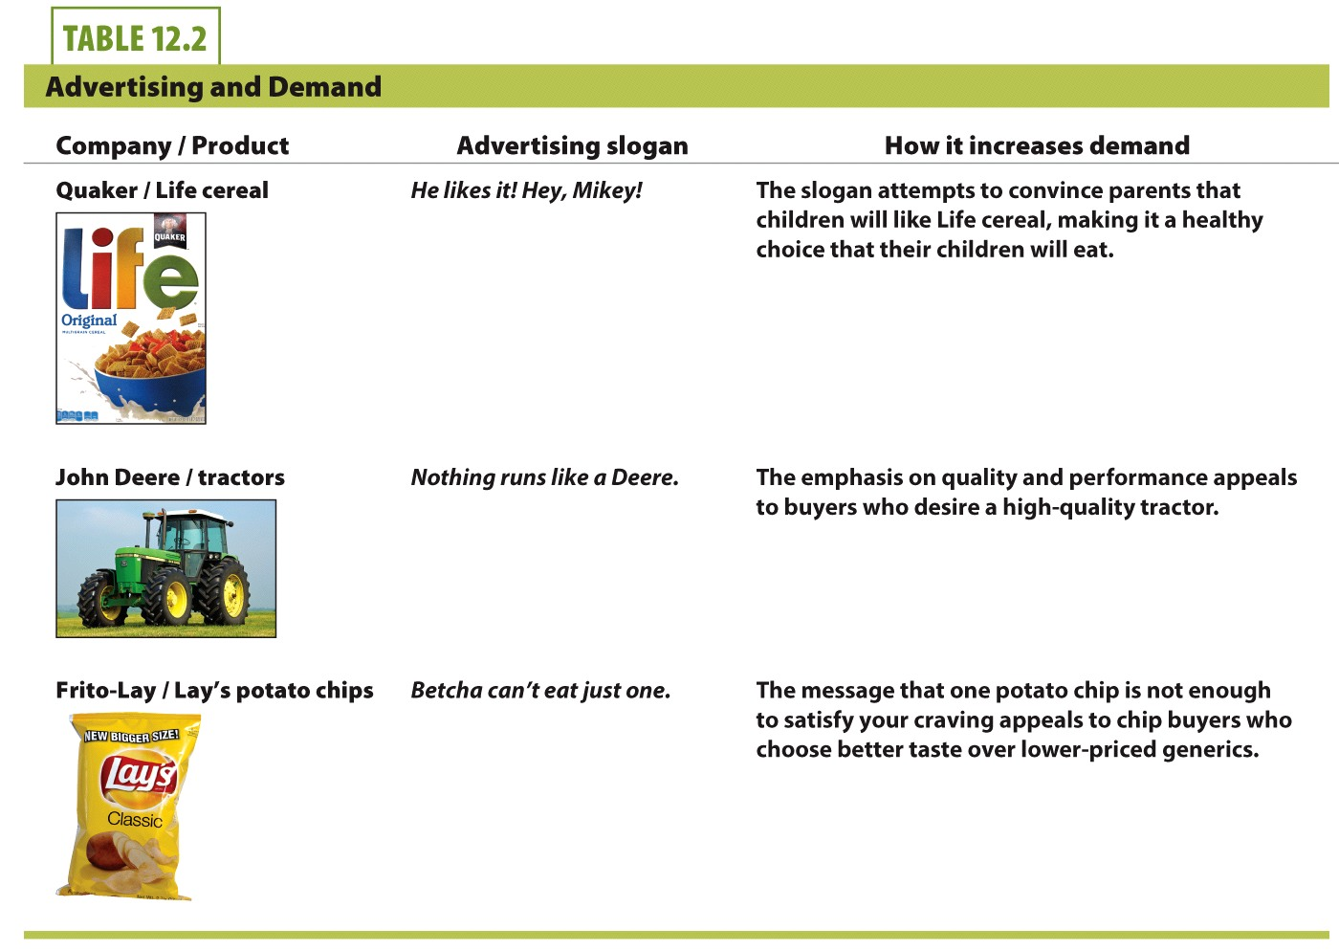

Slide 26
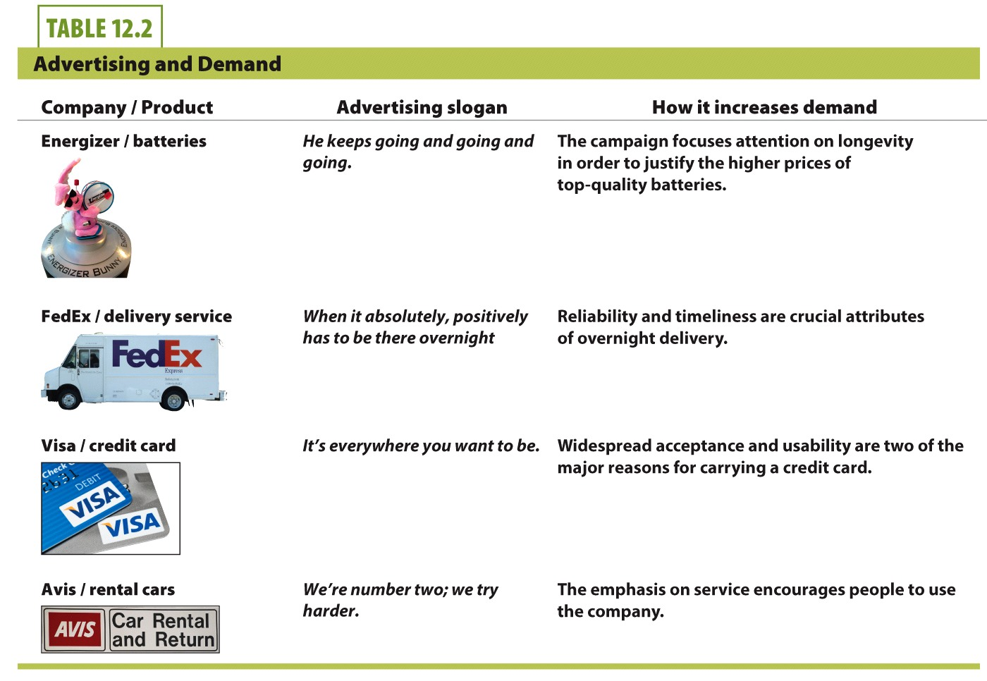

Slide 27
Advertising and Demand
Advertising is designed to decrease the
price elasticity of demand (makes more
inelastic) for the firm and shift firm's
demand curve right.
Notes:
This simple graph shows the effect advertising has on demand for a product.
First, the demand curve shifts right in response to the additional demand created by the advertising.
Second, the demand curve becomes more inelastic. This happens because advertising has highlighted features that make the product attractive to specific customers who are now more likely to want it. Since demand is more inelastic after advertising, the firm increases its market power and can increase the price it charges.

Slide 28
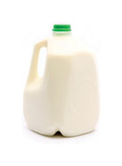
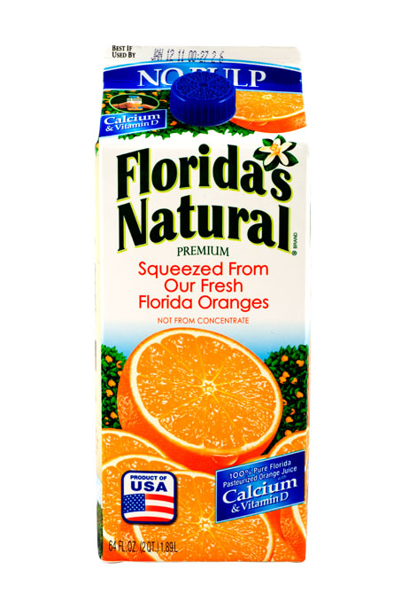
Who Advertises?
Perfect competition
Homogenous products means that advertising won't help an individual firm.
Advertising is less effective in a perfectly competitive industry.
A single firm that advertises would be at a cost disadvantage.
However, the industry can still benefit from advertising.
Examples:
Beef
Milk
Orange juice
Notes:
Would it make sense for a perfectly competitive firm to advertise? Why or why not?
Answer:
Advertising would not benefit as single perfectly competitive firm under the assumption of identical products. Advertising would only drive up that firm's cost, but keep its price the same (the market price given to it).
However, we often see advertisements promoting an industry that is competitive with homogenous products.

Slide 29
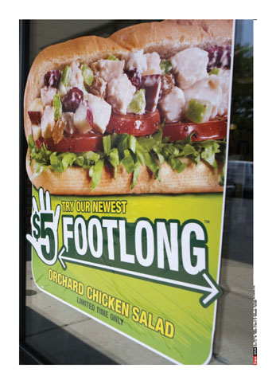
Who Advertises?
Monopolistic competition
Advertising is widespread and beneficial to individual firms with differentiated products.
Advertising can increase demand for single firm's product.
Examples:
Fast-food restaurants
Clothing stores
Notes:
Monopolistic competition is where we see a lot of advertising. Firms try to use advertising to differentiate their product, make it more attractive, increase demand, and disseminate information about the good. Firms can often spend a lot of money on various forms of advertising (TV, radio, Internet, billboards).
It probably won't take many hours of TV-watching before you see a pizza or clothing commercial.

Slide 30
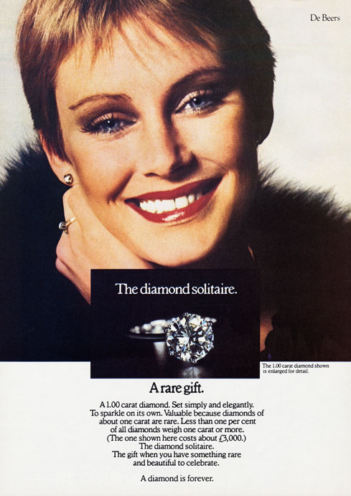
Who Advertises?
Monopoly
Not as necessary to advertise since the product has no close substitutes and consumer choice is limited
May advertise simply to inform consumer about the product and stimulate demand.
Example:
De Beers (diamond monopoly)
Notes:
A monopoly in many cases would have no incentive to advertise. Consumers have no alternative, so why promote your product?
Sometimes, a monopoly may try to increase demand just by letting "unaware" consumers know about the product. Other times, it may just be a "reminder" of the product to stimulate demand. Think about diamond commercials around Valentine's Day!

Slide 31
Negative Effects of Advertising
Advertising raises costs
One firm advertises, others follow suit.
When all firms advertise, the demand-increasing effects may cancel each other out.
No overall demand change, but higher costs still exist.
Price for consumers raise as well.
Business stealing externality: no individual firm can easily gain market share but feels compelled to advertise to protect its customer base.
Inspiring brand loyalty
Creates more inelastic demand, which raises prices
Notes:
With advertising, if your competitors advertise and you don't, you may lose some of your market share. You must advertise to keep up. When that happens, demand changes may cancel out, and all firms are just left with higher expenses but no increased revenues.
When people have strong preferences, they are willing to pay higher prices. Inelastic demand can increase prices.

Slide 32
Advertising Increases Cost
Notes:
This simple graph shows the paradox of advertising for most firms. Basically, the firm is hoping to move from point 1 to point 2, but they actually move from point 1 to point 3.
From the text:
In monopolistic competition each firm is competing with many other firms selling somewhat different products. Rival firms will respond with advertising of their own. This dynamic makes advertising the norm in monopolistic competition. Each firm engages in competitive advertising to win new customers and keep the old ones. As a result, the impact on each individual firm's demand largely cancels out. This result is shown in the movement from point 1 to point 3. Costs rise from C₁ to C₃, but demand remains constant at q₁ .The net result is that advertising creates higher costs. In this case we can think of advertising as causing a negative business-stealing externality where no individual firm is able to easily gain market share but it feels compelled to advertise to protect its customer base.

Slide 33
Economics in Mad Men
"Mad Men"
“Smoke Gets in Your Eyes”
“Everybody else’s tobacco is poisonous. Lucky Strike’s is toasted.”
Notes:
“Economics in the Media” Slide
Lecture tip:
The clip mentioned on the slide can be found in the Interactive Instructor’s Guide. Access the direct link by clicking the icon in the PowerPoint above.
This clip provides a good illustration of the negative effects of advertising. The key concepts covered in this clip are:
Product differentiation
Monopolistic competition
Oligopoly
Advertising

Slide 34

Negative Effects of Advertising
Many advertisements are persuasive rather than informative
May cross the line from beneficial to manipulative
Creates an incentive to lie about a product
Advertising regulations
FTC (Federal Trade Commission) regulates advertising.
Goal: enforce truth-in-advertising laws
Special attention paid to food, drugs, supplements, alcohol, and tobacco
Internet has increased unsubstantiated claims.
Notes:
Informative advertising:
Here is some information about our product.
Persuasive advertising:
Here is why you should buy our product instead of a competitor's product.
The man in the picture is Kevin Trudeau. He is the author of most books that are titled <Something Good and Amazing> "They" don't want you to know about.
He has been in legal troubles many times over product misrepresentation. Newsletters are listed as "free," but then customers get charged $9.95 per month if they don't cancel the subscription to his newsletter.
In 2004 he was lifetime-banned from selling anything on infomercials (except for his own books). He was banned from appearing in any infomercial for three years in 2009.

Slide 35
Conclusion
Monopolistic competition
Exists when many competing firms produce differentiated products.
Has features of both perfect competition and monopoly.
Is closer to perfect competition than monopoly in terms of prices, output, and efficiency.
Is prevalent throughout our economy.
Notes:
We've now discussed three out of four market structures. The fourth market structure, oligopoly, will be discussed in the next chapter.

Slide 36
Summary
Monopolistic competition is a market characterized by free entry and many firms selling differentiated products.
Differentiation of products takes on three forms:
Style or type
Location
Quality

Slide 37
Summary
Monopolistic competitors, like monopolists, are price makers who have downward-sloping demand curves.
Whenever the demand curve is downward-sloping the firm is able to mark up the price above marginal cost.
This leads to excess capacity and an inefficient level of output.
Monopolistic competition is largely beneficial.

Slide 38
Summary
In the long-run, free entry and exit do not allow monopolistically competitive firms to make positive economic profits.
Advertising performs useful functions:
Information, location, new products, quality differences
However, advertising also increases costs.
Advertising can be misleading.

Slide 39
Practice What You Know
Which of the following industries fits most closely with the model of monopolistic competition?
Automobile production
Farming
Diamond mining
Fast-food restaurants
Notes:
Correct answer: D
Looking for an industry with a lot of competitors offering imperfectly substitutable products.

Slide 40
Practice What You Know
Which of the following is a monopolistic competitor?
a local farm that grows Granny Smith apples
a big and tall clothing store
your local electric company
General Motors
Notes:
Correct answer: B
We’re looking for an industry with a lot of competitors offering imperfectly substitutable products.

Slide 41
Practice What You Know
Which of the following is true about monopolistic competition?
It results in higher prices than monopoly.
It results in higher prices than perfect competition.
It results in lower quantity than monopoly.
It is economically more efficient than perfect competition.
Notes:
Correct answer: B
Monopolistic competition has higher prices and lower output compared to perfect competition.
Monopolistic competition has lower prices and higher output compared to monopoly.
Perfect competition is the most efficient market structure, where P = min(ATC) in equilibrium, and there is no deadweight loss.

Slide 42
Practice What You Know
What is a possible negative effect when many competitors all advertise?
Demand increasing effects cancel out and costs are higher.
Consumers want the products more.
Products become too differentiated.
Firms will begin to cooperate instead of compete.
Notes:
Correct answer: A
If ALL firms advertise, market shares may not change much (if at all), but costs increase. This can hurt firms (lower profits) and consumers (higher prices).

Slide 43
Practice What You Know
What is true about the long-run equilibrium for firms in a monopolistically competitive industry?
MR < MC, P < min(ATC)
P = MR = MC = min(ATC)
P = ATC, P > MC, P > min(ATC)
P > ATC, P = MC
Notes:
Correct answer: C
P = ATC means there are zero profits, but there is a markup (P > MC) and a little bit of inefficiency (P > min(ATC)).

Slide 44
Practice What You Know
Which of the following is true about product differentiation?
More differentiation means products are more substitutable for each other
More differentiation leads to greater differences in price
More differentiation leads to converging prices
Differentiation lowers firm profits
Notes:
Correct answer: B
The more different products are, the more prices can differ. Goods that are less and less substitutable can command different prices. (Higher quality, better location, better style . . . leads to higher price.)

Slide 45
Sources
"Principles of Economics with Smartwork Access (ISBN: 978-0-26314-5), 1st Edition, 2013" by Mateer and Coppock
"Economics: Custom Edition for NCSU (ISBN: 9781937435202" by David Hyman

