Slide 1
Backup DB
yang

Slide 2
backup_scheduler.bat
@echo off
echo Start Bakup...
mysqldump -h 192.168.1.166 -uroot -proot dbparking > "C:\sql_backup\dbparking_backup.%date%.sql"
echo End Bakup...

Slide 3
scheduler_create.bat
schtasks /create /sc daily /mo 1 /tn "MySQL BackUp Schedule" /tr C:\sql_backup\backup_scheduler.bat

Slide 4
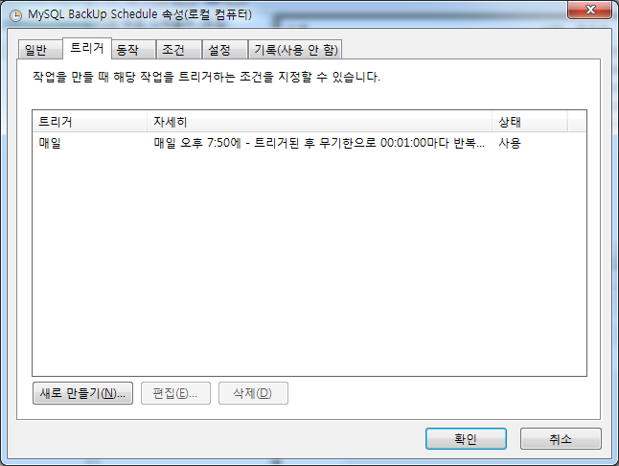
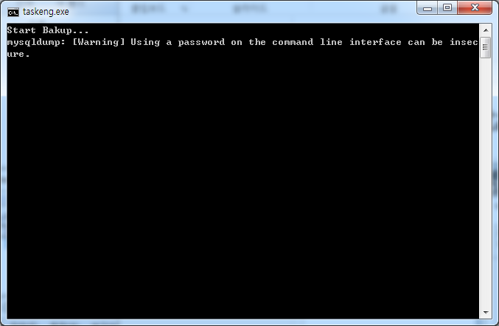
Register task scheduler
Regularly execute backup_scheduler.bat

Slide 5
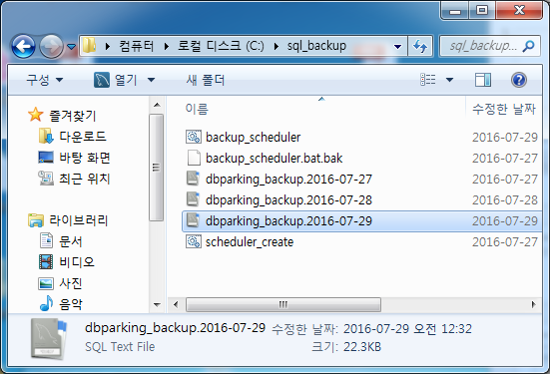
Backup success!

Slide 6
THE END

