Slide 1
Group mempers:
Turki albusairi
Thamer ben hedian
Sultan ben kanaan

Slide 2
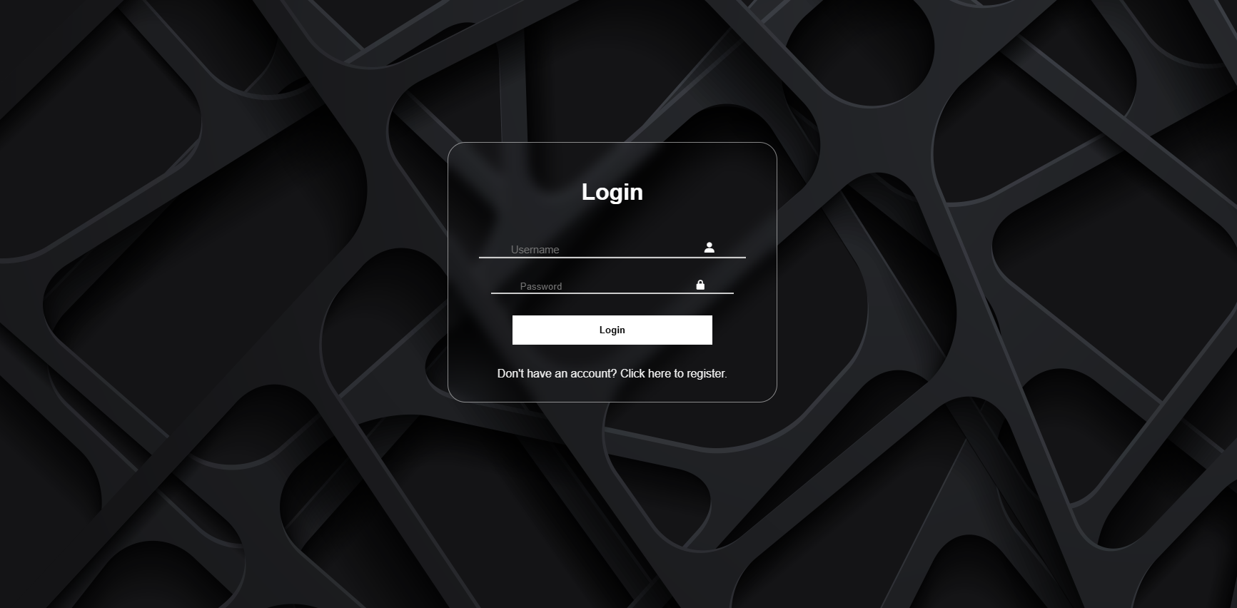
Interacvtive login page that is linked with the database and the passwords are encrypted

Slide 3
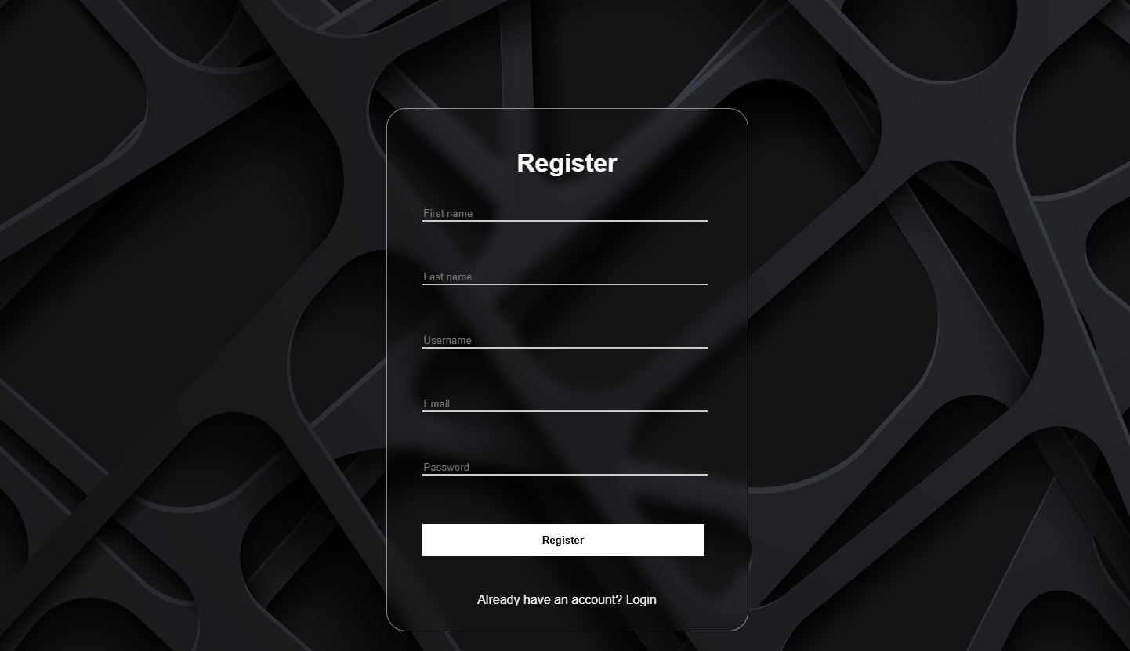
As said the register data are encrypted into the database

Slide 4
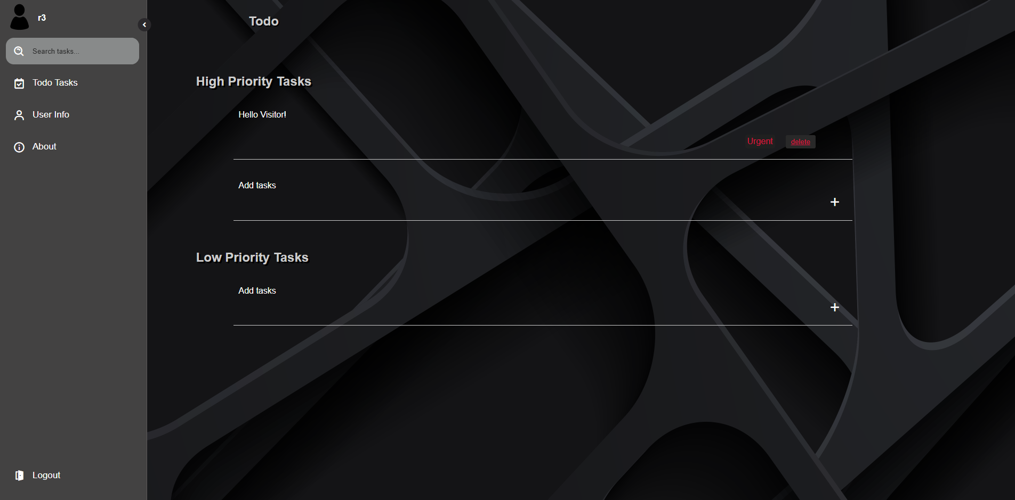
This is the main page which include the side bar and the todo list page

Slide 5
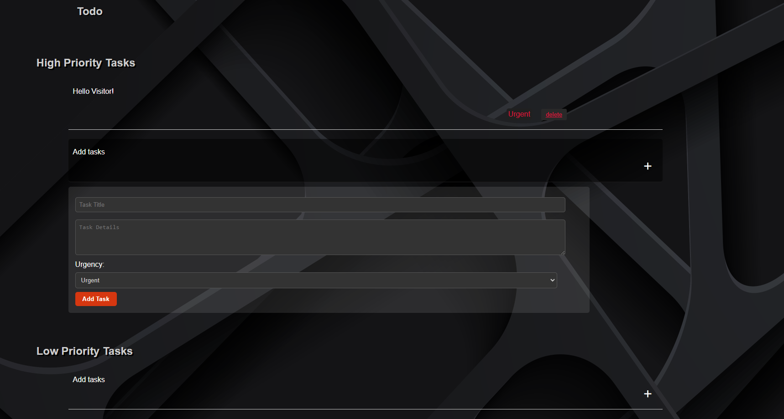
After clicking add tasks a form comes including task title, body and urgency

Slide 6
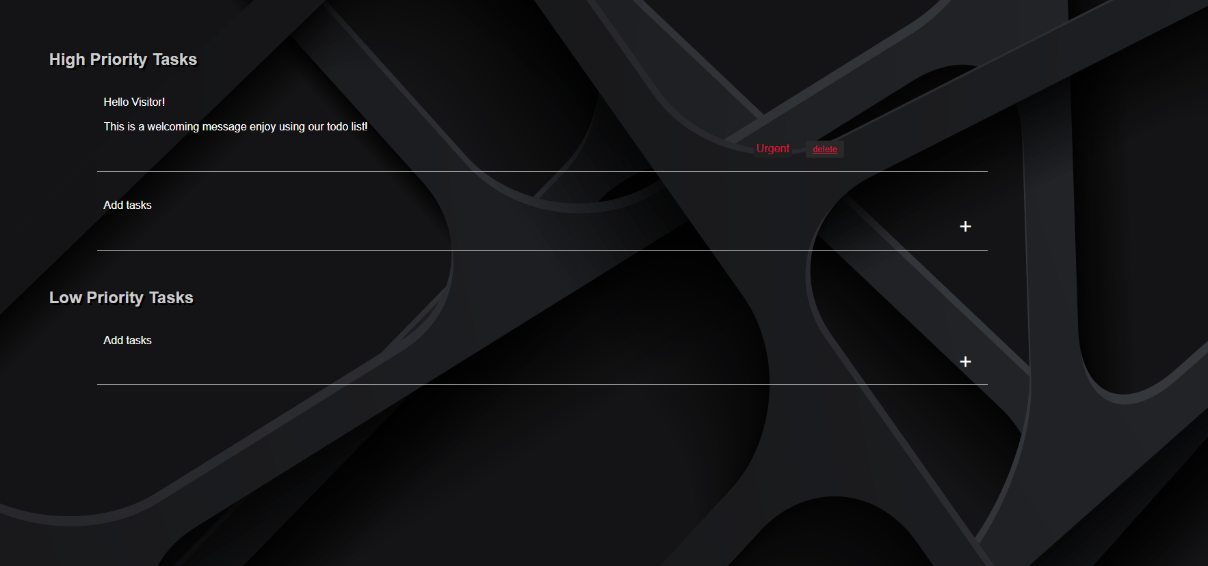
After pressing the title of the task it shows the body of it

Slide 7
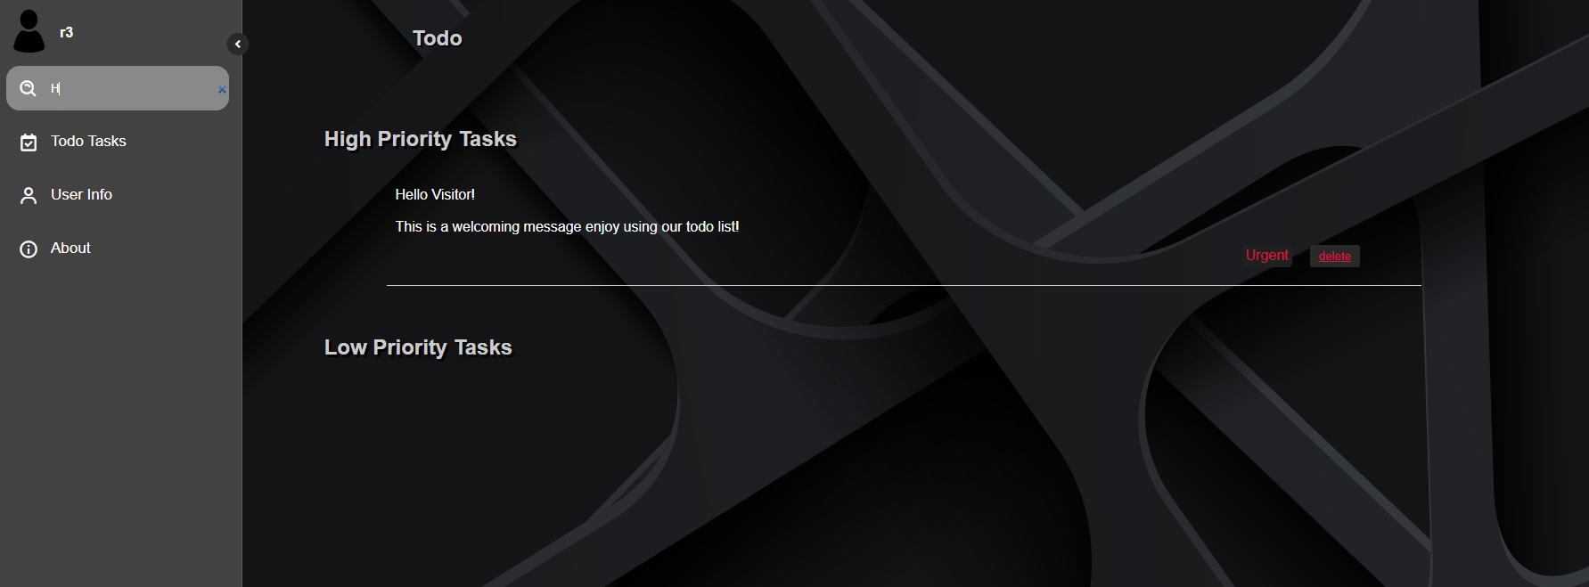
There is also a search mechanism

Slide 8
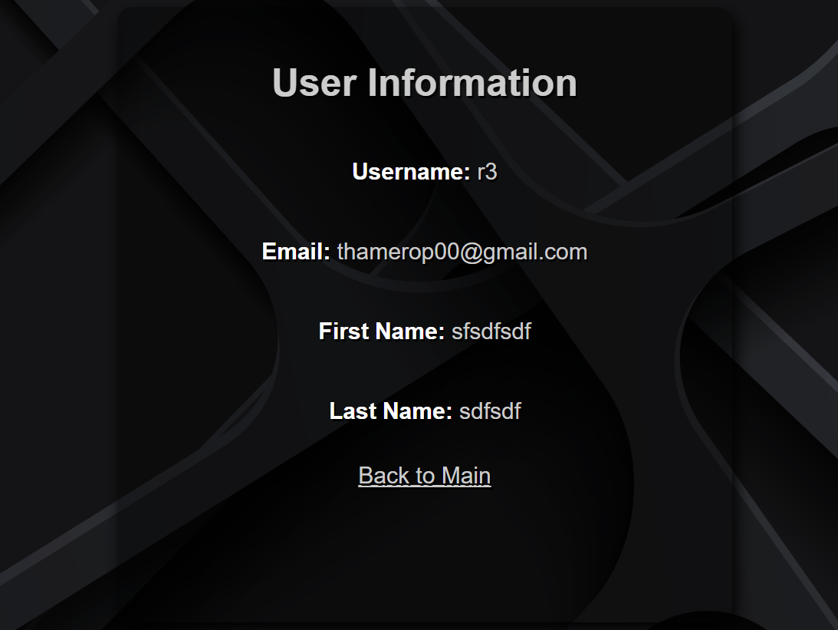
A section that shows user info this user is just for demonstration

Slide 9
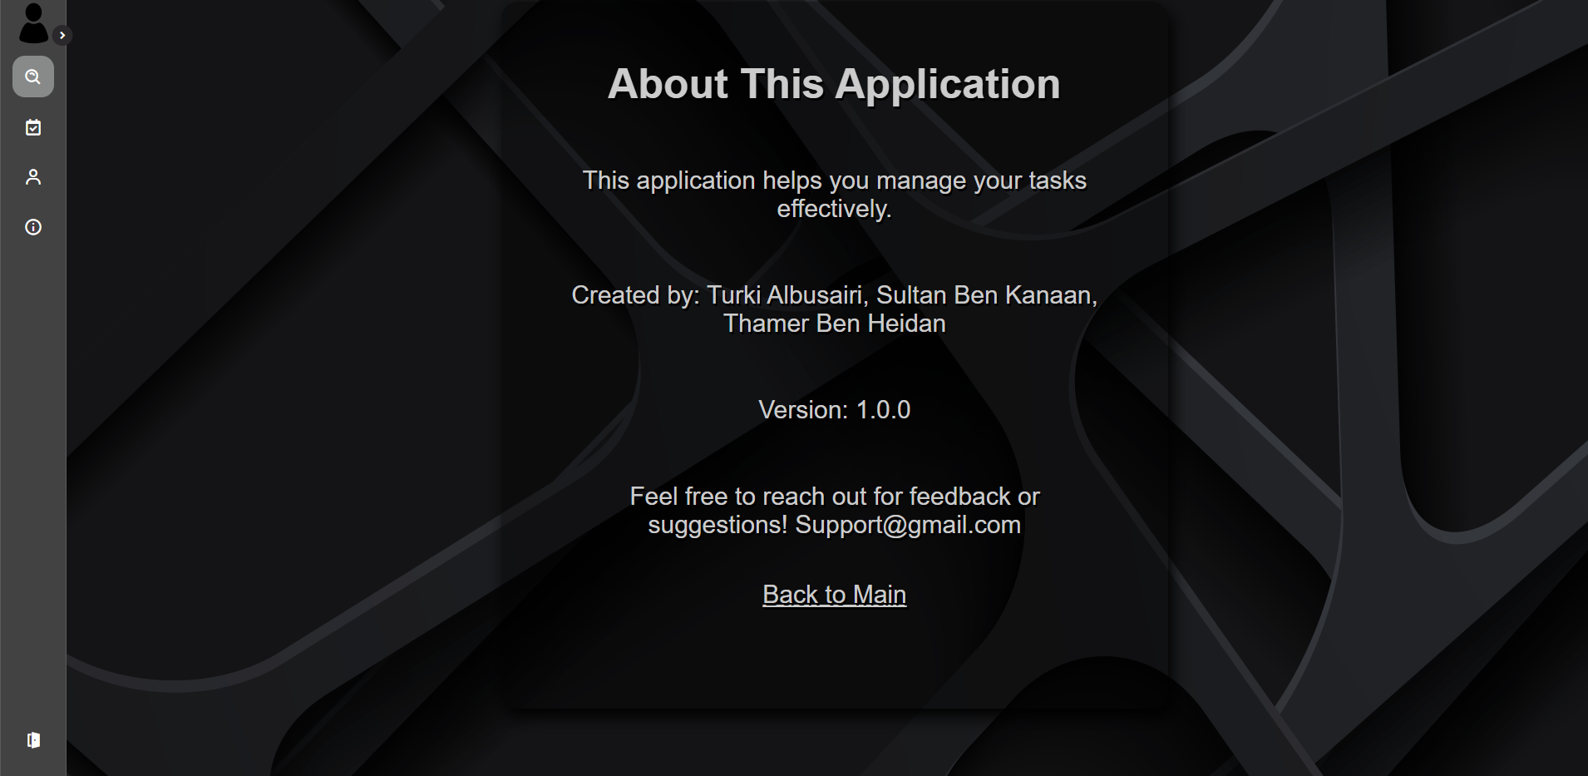
An about page listing the purpose and our group members

