Slide 1


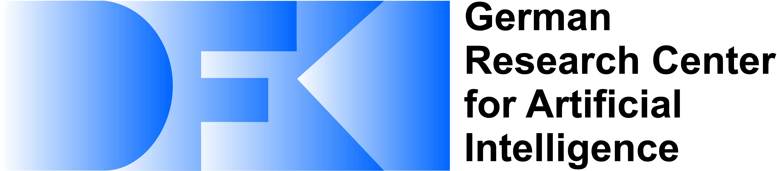
Optimized On-Demand Data Streaming from Sensor Nodes
Santa Clara, California,
September 25-27, 2017
Jonas Traub, Sebastian Breß, Asterios Katsifodimos, Tilmann Rabl, Volker Markl

Slide 2
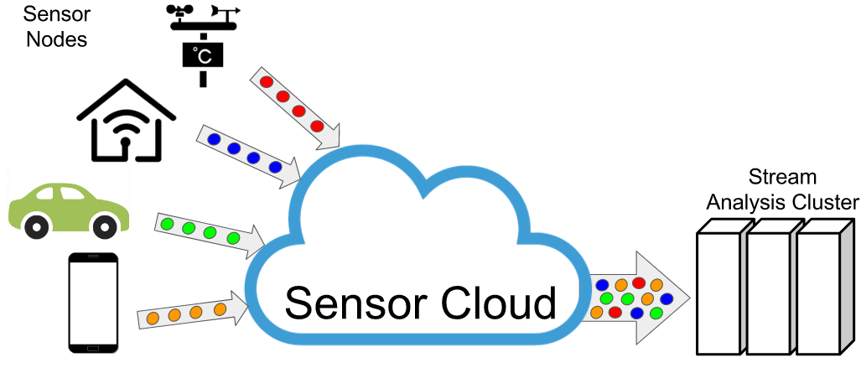
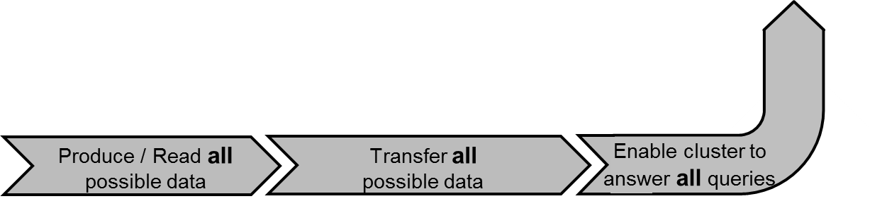
The Sensor Cloud – State of the Art
Billions of sensor nodes form a sensor cloud and offer data streams to analysis systems.
Real-time insights

Slide 3
The Sensor Cloud – Problems
Billions of sensor nodes form a sensor cloud and offer data streams to analysis systems.
Real-time insights
Streaming all data from billions of sensors to all applications with maximal frequencies is impossible
Increasing data rates require expensive system scale-out.

Slide 4
The Sensor Cloud – Solutions
Tailor Data Stream to the Demand of Applications
Provide an abstraction to define the data demand of applications.
Optimize communication costs while maintaining the result accuracy.
Share sensor reads and data transfer among users and queries.
User-Defined Sampling Functions (UDSFs)
Read-Time Optimization
Multi-Query / Multi-User Optimization

Slide 5
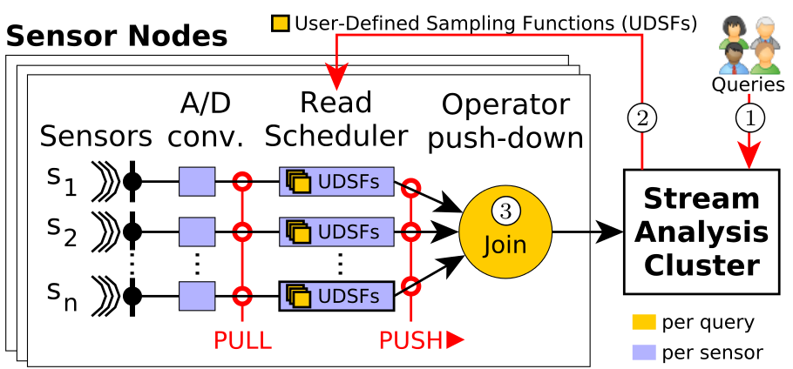
Architecture Overview

Slide 6
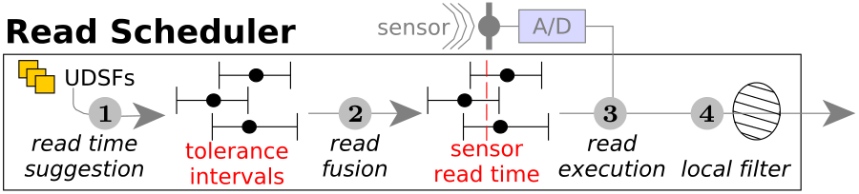
Sensor Read Scheduling

Slide 7
User-Defined Sampling Functions
Input: Sensor read time and value
Output: Next Sensor Read Request

Slide 8
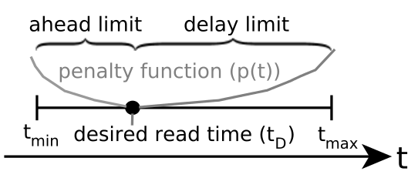
User-Defined Sampling Functions
Input: Sensor read time and value

Slide 9
User-Defined Sampling Functions
Enable adaptive sampling techniques to reduce data transmission e.g., Adam [Trihinas ‘15], FAST [Fan ‘14], L-SIP [Gaura ’13]

Slide 10
Sensor Read Fusion

Slide 11
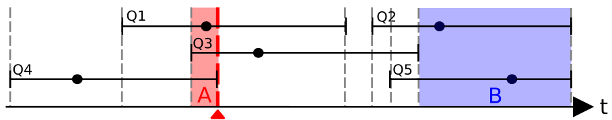
Sensor Read Fusion
1) Minimize Sensor Reads and Data Transfer:
Latest possible read time

Slide 12
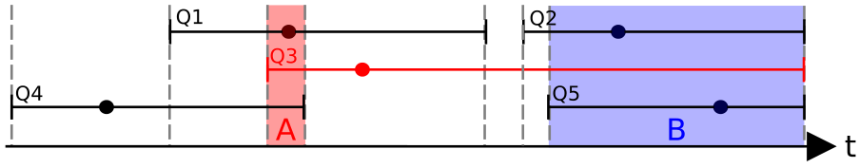
Read Time Optimization
2) Optimize Sensor Read Times:
Minimize penalty while executing the minimum number of sensor reads only
Smart assignment of read requests to sensor reads

Slide 14
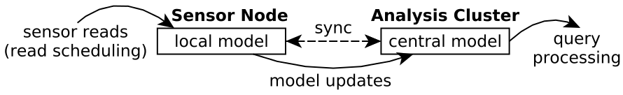
Local Filtering
Enable adaptive filtering in combination with adaptive sampling
Enable model-driven data acquisition

Slide 15
Evaluation
Replay sensor data from a football match [DEBS ’13]
Random UDSFs:
- Read in a poisson process (also simulate load peaks) - In average 1 read per query per second - Exponentially distributed read time tolerance - high probability for small tolerances - small probability for large tolerances - In average 0.04s read time tolerance

Slide 16
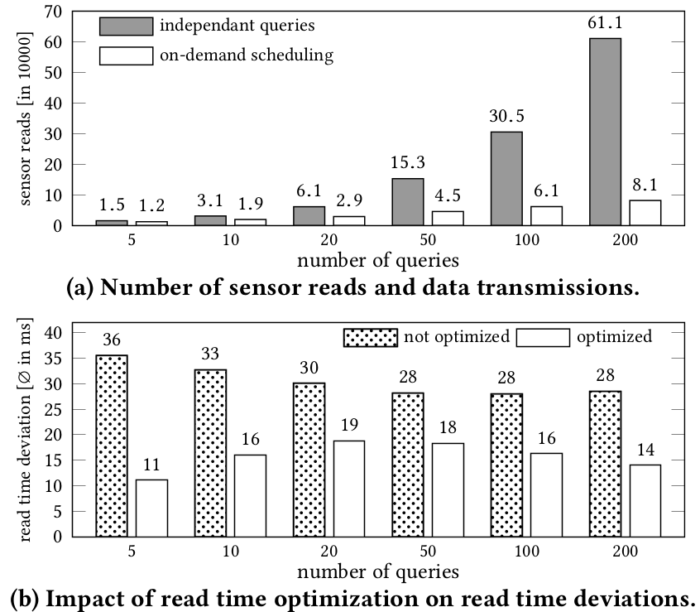
Increasing the number of concurrent queries
On-Demand scheduling reduces sensor reads and data transfer by up to 87%.
The # of reads and transfers increases sub-linearly with the # of queries.

Slide 17
Increasing the number of concurrent queries
Our read-time optimizer reduces the deviation from desired read times by up to 69% (preserving the min. # of reads and transfers).

Slide 18
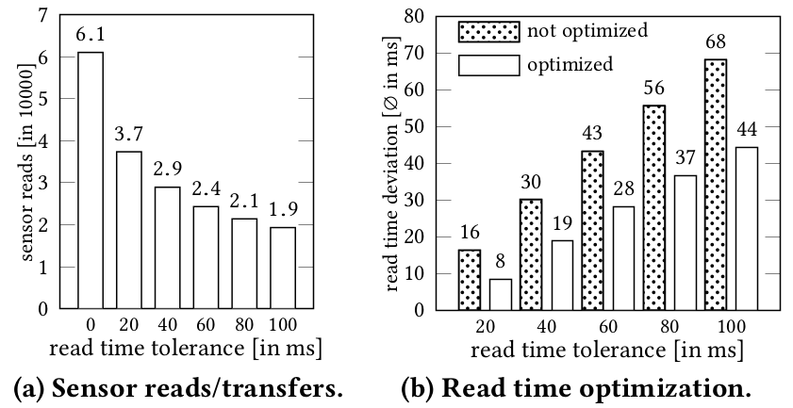
Increasing read time tolerances

Slide 19
Increasing read time tolerances

Slide 20
Optimized On-Demand Data Streaming from Sensor Nodes
Jonas Traub, Sebastian Breß, Asterios Katsifodimos, Tilmann Rabl, Volker Markl
Wrap-Up: Tailor Data Stream to the Demand of Applications
Define data demand: User-Defined Sampling Functions
Schedule Sensor Reads on-demand
Optimize Read Times globally - for all users and queries

