Slide 1
Faceted Values in Haskell
Andrew Kalenda
CS 252 - Advanced Programming Principles
Instructor: Dr. Thomas Austin
San Jose State University
Fall 2014

Slide 2
Outline
Motivation
General concept
Calculus (How facets change over time)
Algebra (How faceted operations work)
Programming context
References

Slide 3
Motivation
It can be difficult to keep track of where all of your security leaks are when writing a program.
This is especially true in browser-based Javascript.
Users can have who-knows-what programs loaded into the web browser on top of your own.

Slide 4
Motivation
b = user.getBalance() isRich = b > 999999 if (isRich) out = 'Youre a millionaire!' else out = 'Youre not a millionaire!' print out
Suppose a bank's website used this rather silly code.
It may be that only the intended customer would see the message, but maliciously inserted Javascript could see the customer's balance `b`.

Slide 5
Motivation
isRich = false scoped block { var b = user.getBalance() isRich = b > 999999
} if (isRich) out = 'Youre a millionaire!' else out = 'Youre not a millionaire!' print out
Even if we protect the balance, it may be easy to miss side effects. Here, malware can still see that the customer is rich.

Slide 6
Motivation
Information flow analysis studies this.
We've discussed secure multiexecution in class.
Faceted values are based on that, but you can probably grasp them on their own.
We want to outline what data are sensitive to whom, and let the calculus of faceted values keep track of side effects.

Slide 7
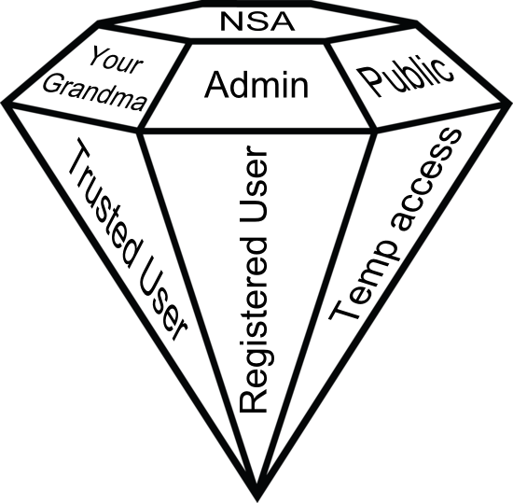
General concept

Slide 8
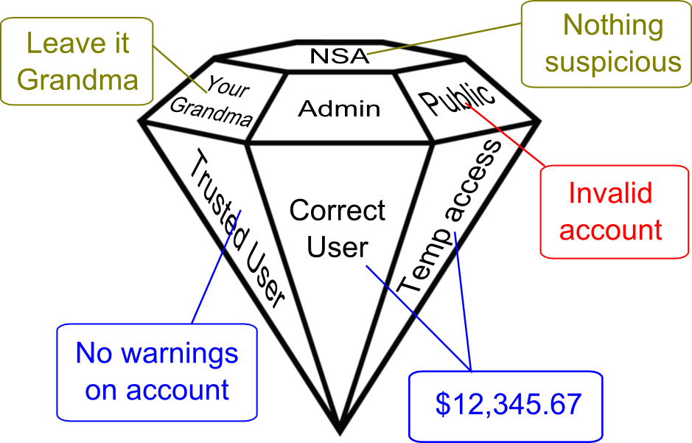
General concept

Slide 9
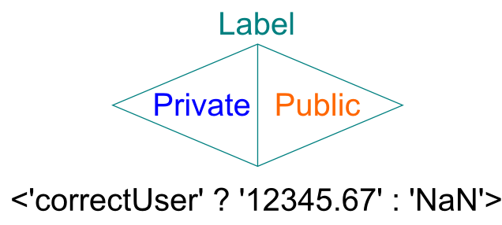
General concept
For computation's sake, use binary facets similar to ternary operators:

Slide 10
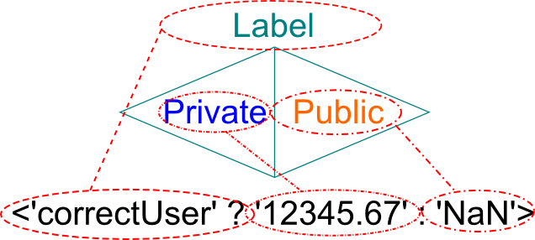
General concept
For computation's sake, use binary facets similar to ternary operators:

Slide 11
Calculus
(a.k.a. How the faceted values change over time)
As a program runs, it will need to create and modify faceted values.
It will also need to track what labels are currently in play.

Slide 12
Calculus
Currently active labels
b = user.getBalance() isRich = b > 999999 if (isRich) out = 'Youre a millionaire!' else out = 'Youre not a millionaire!' print out
[ ]
Current values
b = undefined isRich = undefined out = undefined

Slide 13
Calculus
Currently active labels
b = user.getBalance() isRich = b > 999999 if (isRich) out = 'Youre a millionaire!' else out = 'Youre not a millionaire!' print out
[ ]
Current values
b = <correctUser ? 1234567 : 42> isRich = undefined out = undefined

Slide 14
Calculus
Currently active labels
b = user.getBalance() isRich = b > 999999 if (isRich) out = 'Youre a millionaire!' else out = 'Youre not a millionaire!' print out
[ ]
Current values
b = <correctUser ? 1234567 : 42> isRich = <correctUser ? True : False> out = undefined

Slide 15
Calculus
Currently active labels
b = user.getBalance() isRich = b > 999999 if (isRich) out = 'Youre a millionaire!' else out = 'Youre not a millionaire!' print out
[]
Current values
b = <correctUser ? 1234567 : 42> isRich = <correctUser ? True : False> out = undefined

Slide 16
Calculus
Currently active labels
b = user.getBalance() isRich = b > 999999 if (isRich) out = 'Youre a millionaire!' else out = 'Youre not a millionaire!' print out
[!correctUser]
Current values
b = <correctUser ? 1234567 : 42> isRich = <correctUser ? True : False> out = <correctUser ? undefined : 'Youre not etc'>

Slide 17
Calculus
Currently active labels
b = user.getBalance() isRich = b > 999999 if (isRich) out = 'Youre a millionaire!' else out = 'Youre not a millionaire!' print out
[!correctUser]
Current values
b = <correctUser ? 1234567 : 42> isRich = <correctUser ? True : False> out = <correctUser ? undefined : 'Youre not etc'>

Slide 18
Calculus
Currently active labels
b = user.getBalance() isRich = b > 999999 if (isRich) out = 'Youre a millionaire!' else out = 'Youre not a millionaire!' print out
[ ]
Current values
b = <correctUser ? 1234567 : 42> isRich = <correctUser ? True : False> out = <correctUser ? undefined : 'Youre not etc'>

Slide 19
Calculus
Note that this example demonstrates how faceted values work nicely, but not how they should be used.
A public view shouldn't show that the user is not a millionaire anymore than it should show that she or he is.
Instead it should pretend that the user does not even exist.

Slide 20
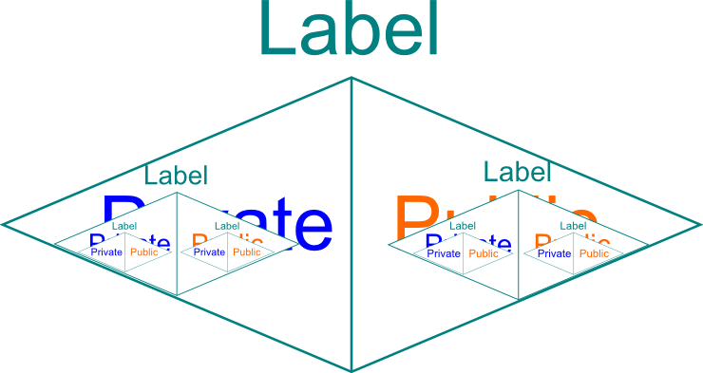
Algebra
(a.k.a. The niggly details of these operations)
Faceted values are an algebraic data type.
We can composite them in various ways.

Slide 21
Algebra
So we can describe it in Haskell, much like we would a tree structure:
data Faceted val
= Raw val
| Faceted Label (Faceted val) (Faceted val)
Which you might read like:
Describe a Faceted value as value or <Label ? Faceted value : Faceted value>

Slide 22
Algebra
So you can have a faceted value like this:
<A ? <B ? x1 : x2> : <C ? x3 : x4>>
They're like boxes, where you can take stuff out of the boxes and combine them together to create new boxes.
What else do we know of that's like boxes?

Slide 23


Slide 24
Algebra
Though not so much monads just yet, but applicative functors. Here's pseudocode from earlier:
b = <correctUser ? 1234567 : 42> isRich = b > 999999
And matching Haskell:
isRich = (>) <$> b <*> (Raw 999999) where b = Faceted 'correctUser'
(Raw 1234567) (Raw 42)

Slide 25
Algebra
b = <correctUser ? 1234567 : 42> isRich = b > 999999
isRich = (>) <$> b <*> (Raw 999999) where b = Faceted 'correctUser'
(Raw 1234567) (Raw 42)

Slide 26
Algebra
Faceted 'correctUser' (Raw True) (Raw False)
Faceted 'correctUser'
(Raw (1234567 >))
(Raw (42 >))
<*> (Raw 999999)
isRich = (>) <$> b <*> (Raw 999999) where b = Faceted 'correctUser'
(Raw 1234567) (Raw 42)
Which expands like so:

Slide 27
Programming Context
Faceted values aren't secure all by themselves.
They need to be used in a secure execution environment.
Let's revisit that code.

Slide 28
Programming Context
b = user.getBalance() isRich = b > 999999 if (isRich) out = 'Youre a millionaire!' else out = 'Youre not a millionaire!' print out evillyInsertedObject.extractPrivateValFrom(out)
This might print out the needed facet, but if code can see the faceted value (in scope or as a returned value), then it can just look inside to see the private value anyway.

Slide 29
Programming Context
function ruRich(){ b = user.getBalance() isRich = b > 999999 if (isRich) out = 'Youre a millionaire!' else out = 'Youre not a millionaire!' print out
} evillyInsertedObject.weepTearsOfDefeat()
By placing it inside a scope, the private facets within are protected.

Slide 30
Programming Context
function ruRich2(){ b = user.getBalance() isRich = b > 999999 if (isRich) out = 'Youre a millionaire!' else out = 'Youre not a millionaire!' return out.getVisible()
} evillyInsertedObject.giveUp()
And if returning a value in a public accessor, it should be whatever facet is visible, not the faceted value itself.

Slide 31
Programming Context
So when you have a faceted value like this:
<A ? <B ? x1 : x2> : <C ? x3 : x4>>
And return a public value, open the box.
If the currently active labels are
[A, !B]
Then x2 will be the value returned, and evillyInsertedObject will be none the wiser.

Slide 32
References
Austin, T. H., & Flanagan, C. (2009). Efficient purely-dynamic information flow analysis. ACM Sigplan Notices, 44(8), 20-31.
Austin, T. H., & Flanagan, C. (2012). Multiple facets for dynamic information flow. ACM SIGPLAN Notices, 47(1), 165-178.
Austin T.H., Knowles K. & Flanagan C. (2014). Typed Faceted Values for Secure Information Flow in Haskell. UCSC-SOE-14-07.
Denning, D. E., & Denning, P. J. (1977). Certification of programs for secure information flow. Communications of the ACM, 20(7), 504-513.
Devriese, D., & Piessens, F. (2010, May). Noninterference through secure multi-execution. In Security and Privacy (SP), 2010 IEEE Symposium on (pp. 109-124). IEEE.
Jaskelioff, M., & Russo, A. (2012). Secure multi-execution in haskell. In Perspectives of Systems Informatics (pp. 170-178). Springer Berlin Heidelberg.
Rafnsson, W., & Sabelfeld, A. (2013, June). Secure multi-execution: fine-grained, declassification-aware, and transparent. In Computer Security Foundations Symposium (CSF), 2013 IEEE 26th (pp. 33-48). IEEE.

Slide 33

It's not over 'til the fish jumps.
It's over.

