Slide 1
Floating point numbers
On GitHub: https://github.com/akalenuk/floating-point-experiments
On Medium (soon): https://medium.com/@okaleniuk

Slide 2
“One, two, many” counting system
Our only numbers are “1”, “2” and “many”.
There is no 0.
There is no negative numbers.
No rational and of course irrational numbers.
Isn’t it simple?
Addition is very simple indeed
 | +1 | +2 | +many
1 | 2 | many | many
2 | many | many | many
many | many | many | many

Slide 3
“One, two, many” counting system
Subtraction raises so many questions
 | -1 | -2 | -many
1 | ? | ? | ?
2 | 1 | ? | ?
many | ? | ? | ?
What do we do with “1-1”?.
What do we do with “1-2”?
What’s “many-many”?
What’s “many-1”?

Slide 4


“One, two, many” counting system
Since 0 isn’t part of our counting system, “1-1” is not a number.
So isn’t “1-2”.
“Many-many” could be anything. It may be a number, or not.
“Many-1” is polemic.
I take one sheep from
many, - and suddenly
there are only two left.
Never happens on practice.
Take one rice grain from
many, there are still many.
By tshrinivasan (Own work) [CC BY-SA 3.0], via Wikimedia Commons
By Balaram Mahalder (Own work) [CC BY-SA 3.0 or GFDL],
via Wikimedia Commons

Slide 5
Need for a standardization
We have to balance applicability, so it would work for most.
But different applications require different properties.
Therefore we have to agree on simplifications.
Subtraction after “standardization”
 | -1 | -2 | -many
1 | NaN | NaN | NaN
2 | 1 | NaN | NaN
many | many | Undef | Undef
Incorrect, but convenient.
(Also the guy on the right has a knife)

Slide 6
Floating point arithmetics
Standardized by IEEE 754. Not C++ specific, but universal.
Covers finite grids of rational numbers.
Treats overflows as “+infinity”, “-infinity”*.
Treats underflows as “+0” “-0”**.
Has a “not a number” special value***.
* - actually bear a semantic of “still a number,
we just can’t count it”.
+infinity + 1 = +infinity.
** - It also has subnormal numbers, which are
numbers with the least possible exponent
and trailing zeros in the significant. These
can be cast to zero automagically to avoid
performance overhead.
*** - Which can be quiet of signaling,
so there are technically two of them.

Slide 7
Examples
0 - 0 00000000 00000000000000000000000
-0 - 1 00000000 00000000000000000000000
1 - 0 01111111 00000000000000000000000
-1 - 1 01111111 00000000000000000000000
15 - 0 10000010 11100000000000000000000
15.9375 - 0 10000010 11111110000000000000000
0.9375 - 0 01111110 11100000000000000000000
inf - 0 11111111 00000000000000000000000
-inf - 1 11111111 00000000000000000000000
-nan - 1 11111111 10000000000000000000000 (1./0. * 0.)
-nan - 1 11111111 10000000000000000000000 (0./0.)
-nan - 1 11111111 10000000000000000000000 (std::sqrt(-1.))
Prepare for the big boring table!..

Slide 8
1 - 0 01111111 00000000000000000000000
2 - 0 10000000 00000000000000000000000
4 - 0 10000001 00000000000000000000000
8 - 0 10000010 00000000000000000000000
16 - 0 10000011 00000000000000000000000
32 - 0 10000100 00000000000000000000000
64 - 0 10000101 00000000000000000000000
128 - 0 10000110 00000000000000000000000
256 - 0 10000111 00000000000000000000000
512 - 0 10001000 00000000000000000000000
1024 - 0 10001001 00000000000000000000000
2048 - 0 10001010 00000000000000000000000
4096 - 0 10001011 00000000000000000000000
8192 - 0 10001100 00000000000000000000000
16384 - 0 10001101 00000000000000000000000
32768 - 0 10001110 00000000000000000000000
65536 - 0 10001111 00000000000000000000000
131072 - 0 10010000 00000000000000000000000
262144 - 0 10010001 00000000000000000000000
524288 - 0 10010010 00000000000000000000000
1.04858e+06 - 0 10010011 00000000000000000000000
2.09715e+06 - 0 10010100 00000000000000000000000
4.1943e+06 - 0 10010101 00000000000000000000000
8.38861e+06 - 0 10010110 00000000000000000000000
1.67772e+07 - 0 10010111 00000000000000000000000
3.35544e+07 - 0 10011000 00000000000000000000000
6.71089e+07 - 0 10011001 00000000000000000000000
1.34218e+08 - 0 10011010 00000000000000000000000
2.68435e+08 - 0 10011011 00000000000000000000000
5.36871e+08 - 0 10011100 00000000000000000000000
1.07374e+09 - 0 10011101 00000000000000000000000
2.14748e+09 - 0 10011110 00000000000000000000000
4.29497e+09 - 0 10011111 00000000000000000000000
8.58993e+09 - 0 10100000 00000000000000000000000
1.71799e+10 - 0 10100001 00000000000000000000000
3.43597e+10 - 0 10100010 00000000000000000000000
6.87195e+10 - 0 10100011 00000000000000000000000
1.37439e+11 - 0 10100100 00000000000000000000000
2.74878e+11 - 0 10100101 00000000000000000000000
5.49756e+11 - 0 10100110 00000000000000000000000
1.09951e+12 - 0 10100111 00000000000000000000000
2.19902e+12 - 0 10101000 00000000000000000000000
4.39805e+12 - 0 10101001 00000000000000000000000
8.79609e+12 - 0 10101010 00000000000000000000000
1.75922e+13 - 0 10101011 00000000000000000000000
3.51844e+13 - 0 10101100 00000000000000000000000
7.03687e+13 - 0 10101101 00000000000000000000000
1.40737e+14 - 0 10101110 00000000000000000000000
2.81475e+14 - 0 10101111 00000000000000000000000
5.6295e+14 - 0 10110000 00000000000000000000000
1.1259e+15 - 0 10110001 00000000000000000000000
2.2518e+15 - 0 10110010 00000000000000000000000
4.5036e+15 - 0 10110011 00000000000000000000000
9.0072e+15 - 0 10110100 00000000000000000000000
1.80144e+16 - 0 10110101 00000000000000000000000
3.60288e+16 - 0 10110110 00000000000000000000000
7.20576e+16 - 0 10110111 00000000000000000000000
1.44115e+17 - 0 10111000 00000000000000000000000
2.8823e+17 - 0 10111001 00000000000000000000000
5.76461e+17 - 0 10111010 00000000000000000000000
1.15292e+18 - 0 10111011 00000000000000000000000
2.30584e+18 - 0 10111100 00000000000000000000000
4.61169e+18 - 0 10111101 00000000000000000000000
9.22337e+18 - 0 10111110 00000000000000000000000
1.84467e+19 - 0 10111111 00000000000000000000000
3.68935e+19 - 0 11000000 00000000000000000000000
7.3787e+19 - 0 11000001 00000000000000000000000
1.47574e+20 - 0 11000010 00000000000000000000000
2.95148e+20 - 0 11000011 00000000000000000000000
5.90296e+20 - 0 11000100 00000000000000000000000
1.18059e+21 - 0 11000101 00000000000000000000000
2.36118e+21 - 0 11000110 00000000000000000000000
4.72237e+21 - 0 11000111 00000000000000000000000
9.44473e+21 - 0 11001000 00000000000000000000000
1.88895e+22 - 0 11001001 00000000000000000000000
3.77789e+22 - 0 11001010 00000000000000000000000
7.55579e+22 - 0 11001011 00000000000000000000000
1.51116e+23 - 0 11001100 00000000000000000000000
3.02231e+23 - 0 11001101 00000000000000000000000
6.04463e+23 - 0 11001110 00000000000000000000000
1.20893e+24 - 0 11001111 00000000000000000000000
2.41785e+24 - 0 11010000 00000000000000000000000
4.8357e+24 - 0 11010001 00000000000000000000000
9.67141e+24 - 0 11010010 00000000000000000000000
1.93428e+25 - 0 11010011 00000000000000000000000
3.86856e+25 - 0 11010100 00000000000000000000000
7.73713e+25 - 0 11010101 00000000000000000000000
1.54743e+26 - 0 11010110 00000000000000000000000
3.09485e+26 - 0 11010111 00000000000000000000000
6.1897e+26 - 0 11011000 00000000000000000000000
1.23794e+27 - 0 11011001 00000000000000000000000
2.47588e+27 - 0 11011010 00000000000000000000000
4.95176e+27 - 0 11011011 00000000000000000000000
9.90352e+27 - 0 11011100 00000000000000000000000
1.9807e+28 - 0 11011101 00000000000000000000000
3.96141e+28 - 0 11011110 00000000000000000000000
7.92282e+28 - 0 11011111 00000000000000000000000
1.58456e+29 - 0 11100000 00000000000000000000000
3.16913e+29 - 0 11100001 00000000000000000000000
6.33825e+29 - 0 11100010 00000000000000000000000
1.26765e+30 - 0 11100011 00000000000000000000000
2.5353e+30 - 0 11100100 00000000000000000000000
5.0706e+30 - 0 11100101 00000000000000000000000
1.01412e+31 - 0 11100110 00000000000000000000000
2.02824e+31 - 0 11100111 00000000000000000000000
4.05648e+31 - 0 11101000 00000000000000000000000
8.11296e+31 - 0 11101001 00000000000000000000000
1.62259e+32 - 0 11101010 00000000000000000000000
3.24519e+32 - 0 11101011 00000000000000000000000
6.49037e+32 - 0 11101100 00000000000000000000000
1.29807e+33 - 0 11101101 00000000000000000000000
2.59615e+33 - 0 11101110 00000000000000000000000
5.1923e+33 - 0 11101111 00000000000000000000000
1.03846e+34 - 0 11110000 00000000000000000000000
2.07692e+34 - 0 11110001 00000000000000000000000
4.15384e+34 - 0 11110010 00000000000000000000000
8.30767e+34 - 0 11110011 00000000000000000000000
1.66153e+35 - 0 11110100 00000000000000000000000
3.32307e+35 - 0 11110101 00000000000000000000000
6.64614e+35 - 0 11110110 00000000000000000000000
1.32923e+36 - 0 11110111 00000000000000000000000
2.65846e+36 - 0 11111000 00000000000000000000000
5.31691e+36 - 0 11111001 00000000000000000000000
1.06338e+37 - 0 11111010 00000000000000000000000
2.12676e+37 - 0 11111011 00000000000000000000000
4.25353e+37 - 0 11111100 00000000000000000000000
8.50706e+37 - 0 11111101 00000000000000000000000
1.70141e+38 - 0 11111110 00000000000000000000000
And now for even bigger!..

Slide 9
1 - 0 01111111 00000000000000000000000
0.5 - 0 01111110 00000000000000000000000
0.25 - 0 01111101 00000000000000000000000
0.125 - 0 01111100 00000000000000000000000
0.0625 - 0 01111011 00000000000000000000000
0.03125 - 0 01111010 00000000000000000000000
0.015625 - 0 01111001 00000000000000000000000
0.0078125 - 0 01111000 00000000000000000000000
0.00390625 - 0 01110111 00000000000000000000000
0.00195312 - 0 01110110 00000000000000000000000
0.000976562 - 0 01110101 00000000000000000000000
0.000488281 - 0 01110100 00000000000000000000000
0.000244141 - 0 01110011 00000000000000000000000
0.00012207 - 0 01110010 00000000000000000000000
6.10352e-05 - 0 01110001 00000000000000000000000
3.05176e-05 - 0 01110000 00000000000000000000000
1.52588e-05 - 0 01101111 00000000000000000000000
7.62939e-06 - 0 01101110 00000000000000000000000
3.8147e-06 - 0 01101101 00000000000000000000000
1.90735e-06 - 0 01101100 00000000000000000000000
9.53674e-07 - 0 01101011 00000000000000000000000
4.76837e-07 - 0 01101010 00000000000000000000000
2.38419e-07 - 0 01101001 00000000000000000000000
1.19209e-07 - 0 01101000 00000000000000000000000
5.96046e-08 - 0 01100111 00000000000000000000000
2.98023e-08 - 0 01100110 00000000000000000000000
1.49012e-08 - 0 01100101 00000000000000000000000
7.45058e-09 - 0 01100100 00000000000000000000000
3.72529e-09 - 0 01100011 00000000000000000000000
1.86265e-09 - 0 01100010 00000000000000000000000
9.31323e-10 - 0 01100001 00000000000000000000000
4.65661e-10 - 0 01100000 00000000000000000000000
2.32831e-10 - 0 01011111 00000000000000000000000
1.16415e-10 - 0 01011110 00000000000000000000000
5.82077e-11 - 0 01011101 00000000000000000000000
2.91038e-11 - 0 01011100 00000000000000000000000
1.45519e-11 - 0 01011011 00000000000000000000000
7.27596e-12 - 0 01011010 00000000000000000000000
3.63798e-12 - 0 01011001 00000000000000000000000
1.81899e-12 - 0 01011000 00000000000000000000000
9.09495e-13 - 0 01010111 00000000000000000000000
4.54747e-13 - 0 01010110 00000000000000000000000
2.27374e-13 - 0 01010101 00000000000000000000000
1.13687e-13 - 0 01010100 00000000000000000000000
5.68434e-14 - 0 01010011 00000000000000000000000
2.84217e-14 - 0 01010010 00000000000000000000000
1.42109e-14 - 0 01010001 00000000000000000000000
7.10543e-15 - 0 01010000 00000000000000000000000
3.55271e-15 - 0 01001111 00000000000000000000000
1.77636e-15 - 0 01001110 00000000000000000000000
8.88178e-16 - 0 01001101 00000000000000000000000
4.44089e-16 - 0 01001100 00000000000000000000000
2.22045e-16 - 0 01001011 00000000000000000000000
1.11022e-16 - 0 01001010 00000000000000000000000
5.55112e-17 - 0 01001001 00000000000000000000000
2.77556e-17 - 0 01001000 00000000000000000000000
1.38778e-17 - 0 01000111 00000000000000000000000
6.93889e-18 - 0 01000110 00000000000000000000000
3.46945e-18 - 0 01000101 00000000000000000000000
1.73472e-18 - 0 01000100 00000000000000000000000
8.67362e-19 - 0 01000011 00000000000000000000000
4.33681e-19 - 0 01000010 00000000000000000000000
2.1684e-19 - 0 01000001 00000000000000000000000
1.0842e-19 - 0 01000000 00000000000000000000000
5.42101e-20 - 0 00111111 00000000000000000000000
2.71051e-20 - 0 00111110 00000000000000000000000
1.35525e-20 - 0 00111101 00000000000000000000000
6.77626e-21 - 0 00111100 00000000000000000000000
3.38813e-21 - 0 00111011 00000000000000000000000
1.69407e-21 - 0 00111010 00000000000000000000000
8.47033e-22 - 0 00111001 00000000000000000000000
4.23516e-22 - 0 00111000 00000000000000000000000
2.11758e-22 - 0 00110111 00000000000000000000000
1.05879e-22 - 0 00110110 00000000000000000000000
5.29396e-23 - 0 00110101 00000000000000000000000
2.64698e-23 - 0 00110100 00000000000000000000000
1.32349e-23 - 0 00110011 00000000000000000000000
6.61744e-24 - 0 00110010 00000000000000000000000
3.30872e-24 - 0 00110001 00000000000000000000000
1.65436e-24 - 0 00110000 00000000000000000000000
8.27181e-25 - 0 00101111 00000000000000000000000
4.1359e-25 - 0 00101110 00000000000000000000000
2.06795e-25 - 0 00101101 00000000000000000000000
1.03398e-25 - 0 00101100 00000000000000000000000
5.16988e-26 - 0 00101011 00000000000000000000000
2.58494e-26 - 0 00101010 00000000000000000000000
1.29247e-26 - 0 00101001 00000000000000000000000
6.46235e-27 - 0 00101000 00000000000000000000000
3.23117e-27 - 0 00100111 00000000000000000000000
1.61559e-27 - 0 00100110 00000000000000000000000
8.07794e-28 - 0 00100101 00000000000000000000000
4.03897e-28 - 0 00100100 00000000000000000000000
2.01948e-28 - 0 00100011 00000000000000000000000
1.00974e-28 - 0 00100010 00000000000000000000000
5.04871e-29 - 0 00100001 00000000000000000000000
2.52435e-29 - 0 00100000 00000000000000000000000
1.26218e-29 - 0 00011111 00000000000000000000000
6.31089e-30 - 0 00011110 00000000000000000000000
3.15544e-30 - 0 00011101 00000000000000000000000
1.57772e-30 - 0 00011100 00000000000000000000000
7.88861e-31 - 0 00011011 00000000000000000000000
3.9443e-31 - 0 00011010 00000000000000000000000
1.97215e-31 - 0 00011001 00000000000000000000000
9.86076e-32 - 0 00011000 00000000000000000000000
4.93038e-32 - 0 00010111 00000000000000000000000
2.46519e-32 - 0 00010110 00000000000000000000000
1.2326e-32 - 0 00010101 00000000000000000000000
6.16298e-33 - 0 00010100 00000000000000000000000
3.08149e-33 - 0 00010011 00000000000000000000000
1.54074e-33 - 0 00010010 00000000000000000000000
7.70372e-34 - 0 00010001 00000000000000000000000
3.85186e-34 - 0 00010000 00000000000000000000000
1.92593e-34 - 0 00001111 00000000000000000000000
9.62965e-35 - 0 00001110 00000000000000000000000
4.81482e-35 - 0 00001101 00000000000000000000000
2.40741e-35 - 0 00001100 00000000000000000000000
1.20371e-35 - 0 00001011 00000000000000000000000
6.01853e-36 - 0 00001010 00000000000000000000000
3.00927e-36 - 0 00001001 00000000000000000000000
1.50463e-36 - 0 00001000 00000000000000000000000
7.52316e-37 - 0 00000111 00000000000000000000000
3.76158e-37 - 0 00000110 00000000000000000000000
1.88079e-37 - 0 00000101 00000000000000000000000
9.40395e-38 - 0 00000100 00000000000000000000000
4.70198e-38 - 0 00000011 00000000000000000000000
2.35099e-38 - 0 00000010 00000000000000000000000
1.17549e-38 - 0 00000001 00000000000000000000000
5.87747e-39 - 0 00000000 10000000000000000000000
2.93874e-39 - 0 00000000 01000000000000000000000
1.46937e-39 - 0 00000000 00100000000000000000000
7.34684e-40 - 0 00000000 00010000000000000000000
3.67342e-40 - 0 00000000 00001000000000000000000
1.83671e-40 - 0 00000000 00000100000000000000000
9.18355e-41 - 0 00000000 00000010000000000000000
4.59177e-41 - 0 00000000 00000001000000000000000
2.29589e-41 - 0 00000000 00000000100000000000000
1.14794e-41 - 0 00000000 00000000010000000000000
5.73972e-42 - 0 00000000 00000000001000000000000
2.86986e-42 - 0 00000000 00000000000100000000000
1.43493e-42 - 0 00000000 00000000000010000000000
7.17465e-43 - 0 00000000 00000000000001000000000
3.58732e-43 - 0 00000000 00000000000000100000000
1.79366e-43 - 0 00000000 00000000000000010000000
8.96831e-44 - 0 00000000 00000000000000001000000
4.48416e-44 - 0 00000000 00000000000000000100000
2.24208e-44 - 0 00000000 00000000000000000010000
1.12104e-44 - 0 00000000 00000000000000000001000
5.60519e-45 - 0 00000000 00000000000000000000100
2.8026e-45 - 0 00000000 00000000000000000000010
1.4013e-45 - 0 00000000 00000000000000000000001

Slide 13
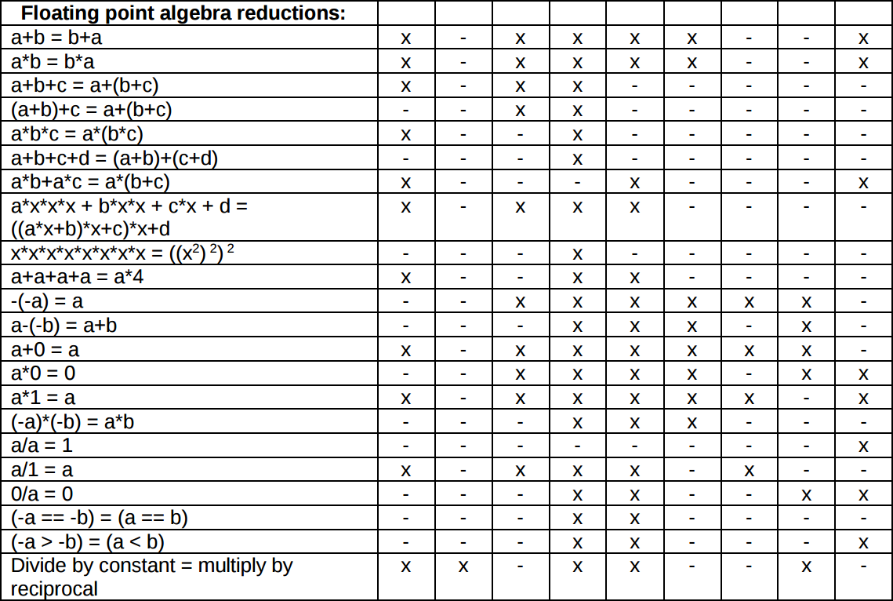
http://www.agner.org/optimize/optimizing_cpp.pdf

Slide 16
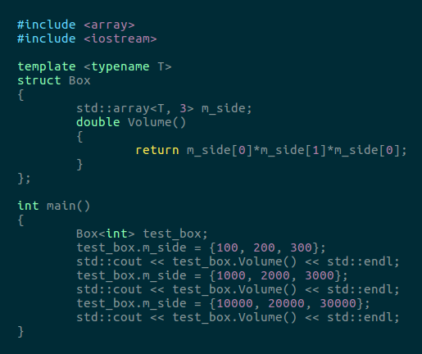
Integers
./integer_overflow
2e+06
2e+09
-1.45476e+09

